Slide 1
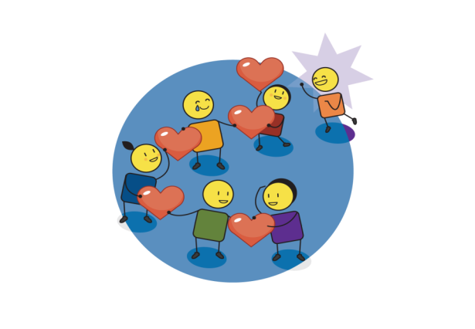
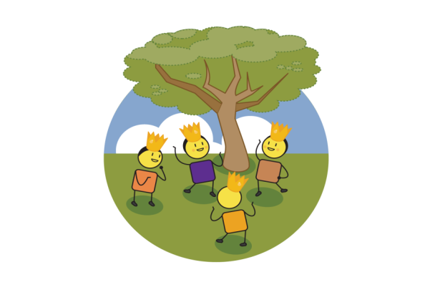
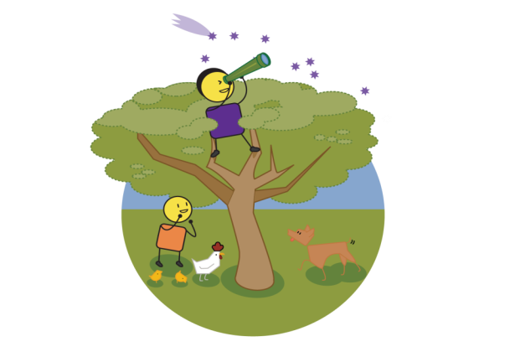
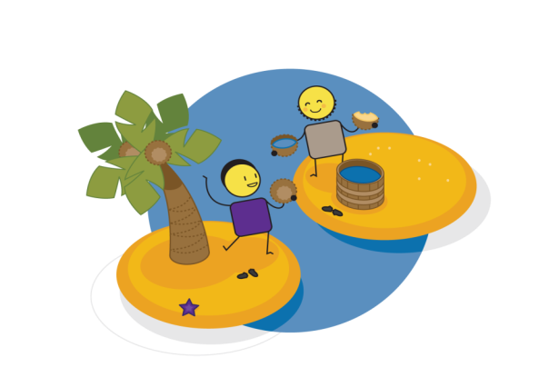
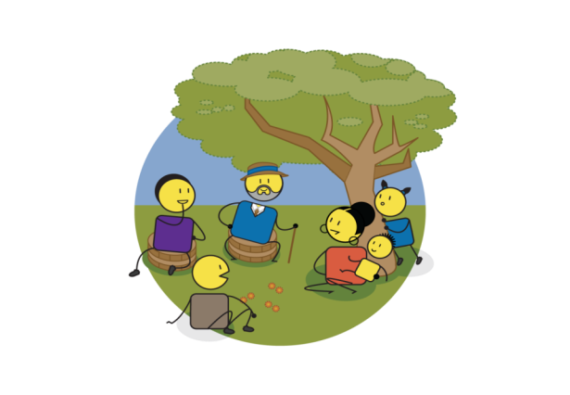
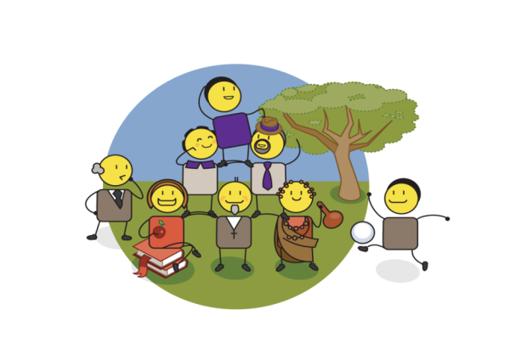
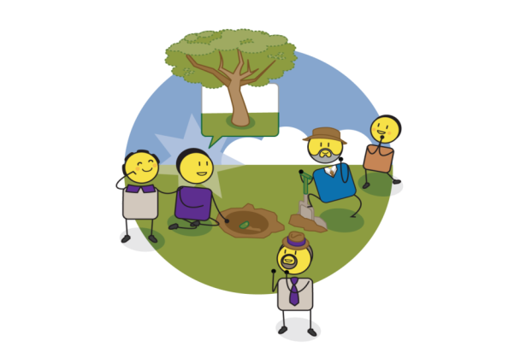

LOVE & HARMONY
SELF ESTEEM
& SELF WORTH
VISION & PURPOSE
MY PERSONAL EMPOWERMENT BOOK
PARTNERSHIP & COLLABORATION
KNOWLEDGE & LEARNING
VALUES & BELIEFS
PRESENCE
& ACTION
WWW.COURAGE-COMMUNITY.COM
Notes:
This book has been created as a personal workbook for children considered to have a-typical minds.
Its purpose is to explore their world from their perspective.

Slide 2

Creating Personal Empowerment
LOVE &
HARMONY
PRESENCE
& ACTION
HIGH
Unconsciously
Empowered
Consciously Empowered
abundance
KNOWLEDGE & INSIGHT
POSSIBILITY
Unconsciously Disempowered
Consciously Disempowered
scarcity
VISION & PURPOSE
LOW
SELF AWARENESS
HIGH
VALUES & BELIEFS
PARTNERSHIP & COLLABORATION
SELF ESTEEM
& SELF WORTH
WWW.COURAGE-COMMUNITY.COM

Slide 3
Personal Possibility Assessment
Complete the template below, referring specifically to your perceptions of yourself:
7. I strive to live my life in the present moment, ensuring action and personal accountability in all that I do?
0% | 10% | 20% | 30% | 40% | 50% | 60% | 70% | 80% | 90% | 100%
6. I am constantly seeking answers to the questions I encounter every day?
0% | 10% | 20% | 30% | 40% | 50% | 60% | 70% | 80% | 90% | 100%
5. I have defined my personal vision (life purpose) and live this daily with passion and commitment?
0% | 10% | 20% | 30% | 40% | 50% | 60% | 70% | 80% | 90% | 100%
4. I actively manage conflict resolution in my personal and professional life to ensure community and connection?
0% | 10% | 20% | 30% | 40% | 50% | 60% | 70% | 80% | 90% | 100%
3. I am confident that I am adding value to the world around me in a unique and meaningful way?
0% | 10% | 20% | 30% | 40% | 50% | 60% | 70% | 80% | 90% | 100%
2. I actively build win/win partnerships/relationships in my personal and professional life?
0% | 10% | 20% | 30% | 40% | 50% | 60% | 70% | 80% | 90% | 100%
1. I have defined my own personal value set and live these daily with passion and commitment?
0% | 10% | 20% | 30% | 40% | 50% | 60% | 70% | 80% | 90% | 100%
Start at the bottom and work your way up from 1 to 7.
Circle the % number that you think you have achieved, at this stage in your life, in response to the question asked.
WWW.COURAGE-COMMUNITY.COM

Slide 4
Understanding Mental Health & Harmony
=
+
+
+
+
MENTAL HEALTH
PHYSICAL
MENTAL
EMOTIONAL
SOCIAL
HARMONY
WELLBEING
SOMETIMES WE FEEL
WHICH IMPACTS ON OUR LIVES
& OUR SENSE OF WELLBEING
LEARNING
WORK
HEALTH
EXERCISE
COMMUNITY
RELATIONSHIPS
WWW.COURAGE-COMMUNITY.COM
Notes:
The workshop starts with a discussion around mental health and harmony, how it relates not just to our mental wellbeing, but to our physical, emotional and social wellbeing as well.
It talks about how we can feel lots of different things, and that this impacts on our everyday wellbeing, learning, work, health, exercise, community and relationships.

Slide 5
Understanding Mental Health Challenges & Frequency
WHICH MAKES US FEEL & BE
DISBLED OR DIFFERENT
DISTRESSED AND DISCONNECTED
SOMETIMES THINGS HAPPEN TO US
EVERY DAY?
EVERY WEEK?
WHICH IMPACTS ON US OVER TIME OR IN DIFFERENT SPACES OR PLACES
IMPAIRED
DISTRAUGHT
EVERY MONTH?
WHEN DOING
CERTAIN THINGS?
DYSFUNCTIONAL
HARMFUL TO OURSELVES
AT DIFFERENT TIMES OF THE YEAR?
TRAUMA
WWW.COURAGE-COMMUNITY.COM
Notes:
However, as noted by the World Health Mental Health Report of 2022, sometimes things happen which can make us feel and be disabled and different, or distressed and disconnected. We could also feel or be impaired, distraught, dysfunctional or harmful to ourselves.
This can happen over time and in different spaces such as every day, every week, every month, when you do certain things or at different times of the year (there is a high degree of seasonality to some mental health challenges).

Slide 6






Understanding TRAUMA
TRAUMA
ACCUTE TRAUMA
CHRONIC TRAUMA
COMPLEX TRAUMA
ACCIDENT
DOMESTIC
VIOLENCE & ABUSE
CHRONIC MEDICAL
ILLNESS OR SURGERY
CHILDHOOD
ABUSE
NEGLECT & ABANDONMENT
CRIME
TERRORISM
RAPE
DISABILITY &
MENTAL HEALTH
BULLYING
GROOMING &
EXPLOITATION
HARMFUL CULTURAL PRACTICES
ONGOING WAR
& CONFLICT
DEPRAVATION
GENERATIONAL
TRAUMA
RELENTLESS REMEDIATION
ASSAULT
NATURAL DISASTER
WWW.COURAGE-COMMUNITY.COM
Notes:
However, as noted by the World Health Mental Health Report of 2022, sometimes things happen which can make us feel and be disabled and different, or distressed and disconnected. We could also feel or be impaired, distraught, dysfunctional or harmful to ourselves.
This can happen over time and in different spaces such as every day, every week, every month, when you do certain things or at different times of the year (there is a high degree of seasonality to some mental health challenges).

Slide 7
This can move us from connection to disconnection
WWW.COURAGE-COMMUNITY.COM
Notes:
Having explored trauma and its very real impact on our lives, we then return to the idea of connection and disconnection due to trauma and how each of us find ourselves on a spectrum somewhere between these drivers of personal and community empowerment or disempowerment.

Slide 8
Mental Health Check In
WHAT I AM CONNECTED TO
SPECTRUM
SPECTRUM
“WE”
COMMUNITY
“ME”
PERSONAL
SPECTRUM
SPECTRUM
WHAT I AM DISCONNECTED FROM

Slide 9
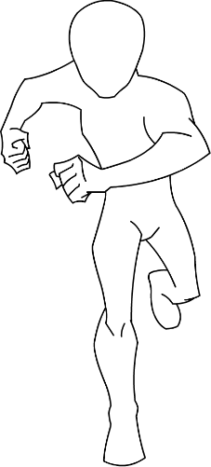
Me as a Superhero
My talents:
My tools:
Superhero Name:____________________________
Notes:
Use the template to draw yourself as a superhero.
Give yourself a superhero name.
Use the blocks provided to describe your superhero talents and tools (you can draw or write these).

Slide 10
Exploring Knowledge & Learning
GROWTH & DEVELOPMENT
OPEN TO NEW IDEAS
SUPPORT/APPRECIATE DIVERSITY
MONITORING & MEASUREMENT
TRUTH
TRANSPARENCY
KNOWLEDGE
SHARING
INSIGHT
WWW.COURAGE-COMMUNITY.COM
Notes:
The area of knowledge and learning systems and processes relates to how we learn and grow as individuals within the context of our communities, as well as some important tenants to this, such as having an open mind, appreciating diverse thinking, transparency, truth and identifying meaningful insights.

Slide 11
Personal Insight
What are the things I am good at? | What are the things I need help with?
What are the things I like to do most? | What are the things I don’t like to do?
Notes:
Fill in this template as honestly as possible. If the child cannot write, this can be a discussion with the facilitator or a creative drawing exercise.

Slide 12



My journey so far?
Notes:
Draw or write the highlights and lowlights in your life so far. You don’t have to remember everything just that things that were important or had an impact on you.

Slide 13
Mental Health Check In
CONNECTED TO KNOWLEDGE & LEARNING SYSTEMS & PRACTICES
abc
123
LEARNING
ENGAGEMENT
FOCUSSED &
ATTENTIVE
COGNITIVE SOCIAL
CONNECTION
COLLECTIVE
MEMORY
LEARNING
ABILITY
INTELLECTUAL
ABILITY
FOCUSSED
ATTENTION
LEARNING
MEMORY
MENTAL
FLEXIBILITY
COMMUNICATION
ENGAGMENT
SENSORY
CO-REGULATION
SOCIALLY
ADAPTABLE
SELF
MANAGEMENT
COMMUNICATION
ABILITY
SENSORY
REGULATION
FLEXIBILITY &
ADAPTABILTY
“WE”
COMMUNITY
“ME”
PERSONAL
abc
123
LEARNING
DISENGAGEMENT
DREAMY OR
DISRUPTIVE
NO COGNITIVE SOCIAL CONNECTION
DISTRACTED
& FORGETFUL
LEARNING
CHALLENGES
INTELLECTUAL
CHALLENGES
INATTENTION/
HYPERACTIVITY
MEMORY CHALLENGES
MENTAL
RIGIDITY
COMMUNICATION
INHIBITION
SENSORY
DYSREGULATION
REPETITIVE BEHAVIOUR
SELF MANAGEMENT CHALLENGES
COMMUNICATION
CHALLENGES
SENSORY
CHALLENGES
INFLEXIBILITY RESTRICT/REPEAT
DISCONNECTED FROM KNOWLEDGE & LEARNING SYSTEMS & PRACTICES
WWW.COURAGE-COMMUNITY.COM
Notes:
In the space of being connected to or disconnected from knowledge and learning systems and practices, this relates to the many neurocognitive disorders, learning disabilities, ADHD, communication and sensory challenges that we see in more and more children today. It is important to note that this is not implying that children in this space cannon learn, it is rather that their learning systems and environments do not support their specific learning needs.
DIAGNOSES EXPLORED:
Neurocognitive disorders
Specific learning disorders
Autism spectrum disorder
ADHD
Communication disorders
Intellectual disorders (perception & cognition)
Developmental disorders
Motor disorders
Sensory disorders
Adaptive social dysfunction (vs adaptive social functioning)

Slide 14
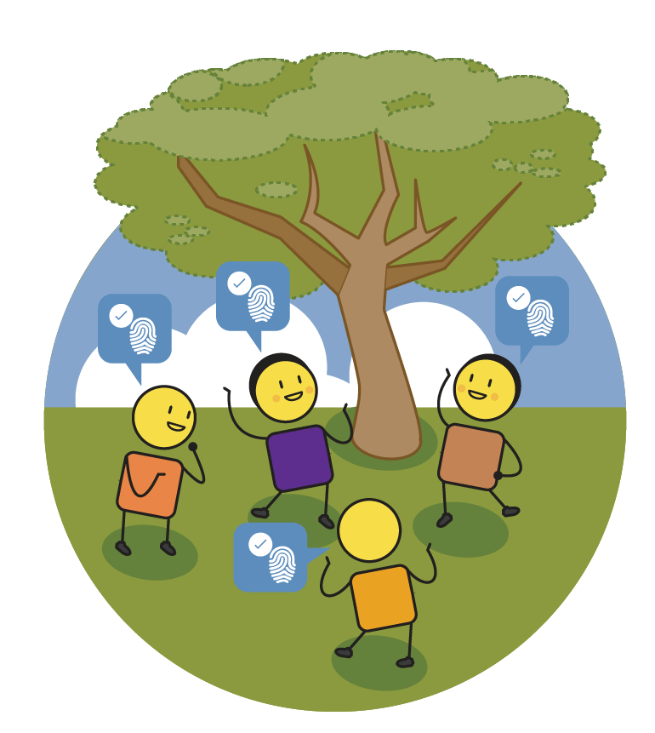
Exploring Self-Identity & Esteem
WHAT MAKES
YOU UNIQUE
WHAT MAKES
YOU SPECIAL
BUILDS YOUR SELF-ESTEEM
BUILDS YOUR SELF-WORTH
AUTHENTIC
SELF LOVE
& CARE
PERSONAL
ACHIEVEMENT
SELF EXPRESSION
WWW.COURAGE-COMMUNITY.COM
Notes:
The next area is about connecting to our authentic self-identity which then relates to our self esteem and self worth.

Slide 15

What makes me special?
MY SELF-ESTEEM
BOWL
WWW.COURAGE-COMMUNITY.COM
Notes:
Think about this bowl as representing your own self esteem, or how you feel about yourself. Think about all of the things that people say to you that makes you feel special about yourself. Now think about all of the things that people say you that make you feel sad or unhappy about yourself. Remember, if you allow other people to fill your self esteem bowl, you also allow them to empty the bowl! Try to think about all of the things that you think make you special and unique. The things that no-one can take out of your self esteem bowl. Now write these things into the circles above the bowl.

Slide 16

Mental Health Check In
CONNECTED TO AUTHENTIC SELF IDENTITY & ESTEEM
POSITIVE BODY
DIVERSITY
SELF-EXPRESSION
& CONFIDENCE
GENDER ID
ACCEPTANCE
DIVERSITY & TOLLERANCE
POSITIVE
BODY IMAGE
POSITIVE
SELF IMAGE
FEEL CONFIDENT
& ENOUGH
AUTHENTIC
GENDER ID
HEALTHY FOOD RELATIONSHIPS
COMMUNITY BELONGING
CREATIVITY & EXPLORATION
COHESION & EMPATHY
HEALTHY
DIET
HIGH
SELF ESTEEM
PERSONAL
RISK TAKING
SELF
LOVE
“WE”
COMMUNITY
“ME”
PERSONAL
NEGATIVE SOCIAL PRESSURE
SOCIAL INHIBITION
GENDER ID
INTOLLERANCE
CONFORMITY & COMPLIANCE
NEGATIVE
BODY IMAGE
NEGATIVE
SELF IMAGE
HYPER-SENSITIVE
& INADEQUATE
INCONGRUENT
GENDER ID
UNHEALTHY FOOD RELATIONSHIPS
ISOLATED
& EXPLOITED
UNINSPIRED & FEARFUL
DISCONNECTION
GUILT & SHAME
EATING
DISORDERS
LOW SELF ESTEEM /WORTH
NO PERSONAL RISK TAKING
SELF HARM
& SUICIDE
DISCONNECTED FROM AUTHENTIC SELF IDENTITY & ESTEEM
WWW.COURAGE-COMMUNITY.COM
Notes:
In terms of identity, this relates to many of childhood eating disorders, identity challenges, body and gender challenges, self-harming and even suicide.
DIAGNOSES EXPLORED:
Feeding and eating disorders
Anorexia nervosa
Bulimia nervosa
Overeating
Pica
Rumination disorders
Binge eating disorder
Avoid/Restrictive eating
Body dysmorphic disorder
Gender dysphoria
Avoidant personality disorder
Self harming
Suicide

Slide 17
Exploring Vision & Purpose
FOCUS & DIRECTION
SELF EXPRESSION
STABILITY
FREEDOM
LEADERSHIP
INNOVATION
& IDEAS
CREATIVITY
GROWTH & DEVELOPMENT
WWW.COURAGE-COMMUNITY.COM
Notes:
The next area is about being connected to your future vision and purpose, and what this enables you to achieve.

Slide 18
My personal vision?
The world would be a better place if…
I am going to help make this happen by…
When people see me they will think…
Notes:
Finish each of these sentences to create your own personal vision.

Slide 19
My future dream world?
Notes:
Draw a picture or create a collage of your future dream world. This is the world that you would like to create for yourself to live in when you grow up.

Slide 20





My personal crest?
Animal/Plant?
Shield?
Colour?
Motto or Tagline?
Notes:
Design your own personal crest, like your school crest (explore this if there is confusion). You will need to choose an animal that you think represents who you are and/or who you would like to become. A shield shape, your favourite colour (you can choose more than one) and a motto or tagline that inspires you and who you want to become.

Slide 21
Mental Health Check In
CONNECTED TO A FUTURE VISION & PURPOSE
COMMUNITY
VISION
COMMUNITY
PURPOSE
SOCIAL CONTRIBUTION
SOCIETAL
LEADERSHIP
PERSONAL
VISION
MEANING
& PURPOSE
PERSONAL
CHOICE
PERSONAL
RESPONSIBILITY
COMMUNITY
ENGAGEMENT
COMMUNITY INNOVATION
COMMUNITY
HEALTH
COMMUNITY
CARE & SUPPORT
HEALTH
BODY
HEALTHY
MIND
HEALTHY
BEHAVIOUR
CARE &
CONCERN
“WE”
COMMUNITY
“ME”
PERSONAL
BROKEN FAMILIES
& COMMUNITIES
CONFORMITY
& CONTROL
NO CONTRIBUTION
NO SOCIAL
RESPONSIBILITY
NO FOCUS OR DIRECTION
NO MEANING
& AIMLESS
NO PERSONAL
CHOICE
NO PERSONAL
RESPONSIBILITY
INTOXICATION
& WITHDRAWEL
STIMULATION &
HALLUCINATION
RISKY SOCIAL
BEHAVIOUR
SOCIAL
COLLAPSE
PHYSICAL
ADDICTION
PSYCHOLOGICAL
ADDICTION
BEHAVIOURAL
ADDICTION
APATHY
DON’T CARE
DISCONNECTED FROM A FUTURE VISION OR PURPOSE
WWW.COURAGE-COMMUNITY.COM
Notes:
In the space of being connected to or disconnected form a future vision or purpose, it relates to a sense of apathy and hopelessness. It also relates to the many challenges around substance abuse, the range of addictions and the impact this has on families and communities.
DIAGNOSES EXPLORED:
Substance and related addictive disorders
Substance medication induced psychotic disorder
Substance medication induced bipolar disorder
Physical addiction – alcohol, caffeine, Methamphetamines, Opiates (heroin, morphine, etc.), Barbiturates (phenobarbital, Seconal) and Benzodiazepines (Valium, Xanax, etc.)
Psychological addiction – Hypnotics, stimulants, inhalants, cannabis, hallucinogens.
Behavioural addiction – Gambling, sex, exercise, gaming, shopping etc.

Slide 22
Exploring Values & Beliefs
WHAT WE BELIEVE IN
WHAT WE CARE ABOUT MOST
GUIDES OUR
DAILY BEHAVIOUR
GUIDES OUR DECISIONS
DEFINES RIGHT FROM WRONG
ENSURES EQUALITY
& EQUITY
FAMILIES & COMMUNITY BELONGING
WHAT WE STAND UP FOR
WWW.COURAGE-COMMUNITY.COM
Notes:
So the first area to explore is that of being connected to or disconnected from the values of our community and society.
We start by understanding what values are…

Slide 23
My personal values?
Teamwork
Happiness
Creativity
Equality
Integrity
Respect
Family
Community
Reliability
Honesty
Love
Commitment
Punctuality
Delivery
Partnership
Possibility
Caring
Notes:
Think about what is most important to you in your life, your values. Values are the things that are most important to you and often guide how you act or behave on a day to day basis. There are a few examples on the page that you can circle, or you can write your own in your own language. Try to pick the 4 or 5 most important values that represent what is most important to you.

Slide 24
Mental Health Check In
CONNECTED TO VALUES OF COMMUNITY & SOCIETY
RESPECT RIGHTS OF OTHERS
CARE &
SUPPORT
LOVE &
EMPATHY
ACCEPTANCE
& COMPLIANCE
ALTRUISTIC
& SELFLESS
EMOTIONALLY
BALANCED
FORGIVENESS
SELF REFLECTION
& CARE
SUPPORT FOR COMMUNITY
FOLLOWS
THE RULES
GOOD
CITIZENSHIP
APPRECIATES
DIVERSITY
EQUALITY
PERSONAL
RESPONSIBILITY
PERSONAL
VALUES & BELIEFS
SELF CONTROL
“WE”
COMMUNITY
“ME”
PERSONAL
VIOLATE RIGHTS OF OTHERS
ANTI-SOCIAL
FIGHT/BULLY/ABUSE
NO EMPATHY
HOLDS GRUDGES
OPPOSITIONAL
& DEFIANT
SELF
CENTRED
EMOTIONALLY
EXPLOSIVE
VINDICTIVE
& SPITEFUL
NO REMORSE
INDIFFERENCE
MANIPULATIVE & DECEITFUL
BREAKS
RULES
BURNS, BREAKS,
STEALS, DESTROYS
GRANDIOSE
HISTRIONIC
BETTER THAN OTHERS
NO PERSONAL
RESPONSIBILITY
PARANOID &
DELUSIONAL
IMPULSIVE & UNSTABLE
DISCONNECTED FROM VALUES OF COMMUNITY & SOCIETY
WWW.COURAGE-COMMUNITY.COM
Notes:
We then explore what happens when we disconnect from the values of our community or society at a personal and community and the behaviours that show up versus the behaviours that imply connection.
(Explore behaviours)
There are no diagnoses here, just behaviours, but these behaviours can be found in children struggling with impulse control challenges, conduct disorders, anti-social and oppositional defiant behaviours and even more serious challenges, such as some of your personality disorders.
This conversation is just the first step when these challenges start to appear in the context of a community, such as a school. It gives the children’s teachers, parents and school social workers a language to talk to the children about these issues. as well as practical exercises around values, at both an individual and community level and why they are so important in guiding our day-to-day behaviour.
Obviously, if a child consistently acts out in this way, it is also a sign to move the child up ‘therapeutic ladder to a counsellor, a psychologist and ultimately a psychiatrist.
DIAGNOSES EXPLORED:
Disruptive impulse-control disorder
Oppositional defiance disorder
Intermittent explosive disorder
Conduct disorder
Anti-social personality disorder
Narcissistic personality disorder
Histrionic personality disorder
Paraphilic disorders
Borderline personality disorder
(Sociopathy/Psychopathy – not formal mental health diagnoses)

Slide 25
Exploring Love & Connection
USE LOVE TO SOLVE CONFLICT
EMPATHY
PEACE IN SELF,
FAMILY & COMMUNITY
FORGINVENESS
CONNECTION TO FAMILY & COMMUNITY
HARMONY & BALANCE
CARE & COMPASSION
GRATITUDE
WWW.COURAGE-COMMUNITY.COM
Notes:
When we talk about being connected to Humanity and social reality through the concept of love, we are talking about the ancient Greek concept of Agape. Greek philosophers noted several different kinds of love, from eros, which was romantic, to philia, which as about being part of a team, to storge, which was about familial relationships. Agape is about a love of humanity and a connection to that humanity through contribution. So, it is about abundant love, which connects us to the world around us…

Slide 26
Exploring love and empathy
Notes:
This practical exercise is a powerful meditation around sunshine, light and love. We use this exercise often with children in our Be Kind anti-bullying programme.
The children have to metaphorically breathe in all the love and light of the universe into their bodies and then once they are completely full, they have to push this love out to the bullys, bullied and bystanders in their world equality.
This act of unconditional empathy forces them to to connect with people they love and hate equally, and through this connection to heal.

Slide 27
Mental Health Check In
CONNECTED TO HUMANITY & SOCIAL REALITY
CARE FOR SELF & OTHERS
ENGAGED IN ENVIRONMENT
LOVE &
EMPATHY
RESPONSIVE & PROACTIVE
GROUNDED
IN BODY
AWARE OF ENVIRONMENT
EMOTIONALLY ENGAGED
EMOTIONAL
WELLBEING
COMMUNITY
ENGAGEMENT
COMMUNITY BELONGING
SOCIALLY
CONNECTED
COMMUNITY/SOCIAL
PARTICIPAITON
SELF
AWARE
ORGANISED &
IN CONTROL
COMMUNITY
AWARE
PRESENT IN
TIME & SPACE
“WE”
COMMUNITY
“ME”
PERSONAL
NO CARE FOR SELF OR OTHERS
UNAWARE OF
ENVIRONMENT
EMOTIONALLY
INACCESSIBLE
DEMAND AVOIDANT
PHYSICAL
DISSOCIATION
ENVIRONMENTAL
DISSOCIATION
EMOTIONAL
DETACHMENT
TRAUMATIC
MELTDOWN
CONSPIRACIES
& PERSECUTION
EXCENTRIC
& STRANGE
SOCIALLY
DETACHED
DISCONNECTED
NON-RESPONSIVE
PARANOID & DELUSIONAL
AGGITATED &
DISORGANISED
SOLITARY
& ALONE
SHUT DOWN
CATATONIC
DISCONNECTED FROM HUMANITY & SOCIAL REALITY
WWW.COURAGE-COMMUNITY.COM
Notes:
In the space of being connected to or disconnected from humanity and social reality, this relates to challenges of trauma, PTSD and dissociation, sometimes to the extreme, as we see with the extreme disconnection associated with Schizoid behaviours, where a person experiences a complete breakdown or split from reality.
DIAGNOSES EXPLORED:
Trauma and stressor related disorders
PTSD/cPTSD
Autism spectrum disorder
Delusional disorder
Dissociative disorder
Physical dissociation
Environmental derealisation
Dissociative identity
Somatic symptoms and related disorders
Conversion disorder
Elimination disorders
Paranoid personality disorder
Schizophrenia spectrum psychotic disorder
Schizoid personality disorder
PTSD
Adjustment disorder
Pathological demand avoidance

Slide 28
Exploring Partnership & Collaboration
SHARED VISION & GOALS
SHARED VALUES & BELIEFS
MUTUAL TRUST
MUTUAL RESPECT
GOOD COMMUICATION
HONESTY
& INTEGRITY
COLLABORATION
WORK TOGETHER
RESIPROCITY
WIN/WIN
WWW.COURAGE-COMMUNITY.COM
Notes:
The next area is that of partnership, which relates not just to how we connect to other people, but also how we connect to ourselves in the tradition of attachment and co-regulation.
Simply put, what makes a good partnership…

Slide 29
My partners who will help me achieve my vision
ME
Notes:
Who are the people that you think will help you achieve your dream world. These may not be the same people that you are close to, but rather the people who can help you achieve your vision for yourself.

Slide 30
Building win/win relationships
What do I get from them? |  |  | What do I Get from them?
1. |  | 3. | 1. |  | 3.
2. |  | 2. | 2. |  | 2.
3. |  | 1. | 3. |  | 1.
 |  | What do I give them? |  |  | What do I Give to them?
Me
Me
What do I get from them? |  |  | What do I get from them?
1. |  | 3. | 1. |  | 3.
2. |  | 2. | 2. |  | 2.
3. |  | 1. | 3. |  | 1.
 |  | What do I give to them? |  |  | What do I give to them?
Me
Me
Notes:
Explore your relationship with all of the important people in your life. Think about what you get from them (physically, emotionally, socially) and what you give them (physically, emotionally, socially).

Slide 31
Building win/win relationships
What do I get from them? |  |  | What do I Get from them?
1. |  | 3. | 1. |  | 3.
2. |  | 2. | 2. |  | 2.
3. |  | 1. | 3. |  | 1.
 |  | What do I give them? |  |  | What do I Give to them?
Me
Me
What do I get from them? |  |  | What do I get from them?
1. |  | 3. | 1. |  | 3.
2. |  | 2. | 2. |  | 2.
3. |  | 1. | 3. |  | 1.
 |  | What do I give to them? |  |  | What do I give to them?
Me
Me
Notes:
Explore your relationship with all of the important people in your life. Think about what you get from them (physically, emotionally, socially) and what you give them (physically, emotionally, socially).

Slide 32
Mental Health Check In
CONNECTED TO SELF & PARTNERING OTHERS
SELF & SOCIAL CONTROL
SOCIAL FLOW &
ADAPTABILITY
HEALTHY SOCIAL
ENGAGEMENT
COREGULATION
SOC. RESIPROSITY
BODY
SELF CONROL
EMOTIONAL SELF REGULATION
EXERCISE FREE WILL & CHOICE
FOCUSSED
ATTENTION
POSTIVE
ENGAGEMENT
SOCIALLY
AWARE
HEALTHY SEXUAL RELATIONSHIPS
SOCIALLY
INTERDEPENDENT
ENERGY
REGULATION
CALM &
THOUGHTFUL
SEXUAL
FUNCTION
SELF
RELIANCE
“WE”
COMMUNITY
“ME”
PERSONAL
TICS, ECHOS
& DYSPRAXIA
RULES, RITUALS
& HOARDING
DIS/INHIBITED
SOCIALLY
IMPULSIVE &
DISRUPTIVE
PHYSICAL SELF
DYSREGUALATION
EMOTIONAL SELF
DYSREGULATION
OBSESSIONS
& COMPULSIONS
UNFORCUSSED
& INATTENTION
DREAMY & DISENGAGED
SOCIALLY UNAWARE
PROBLEM SEXUAL RELATIONSHIPS
OVER
DEPENDENT
ENERGY
DYSREGUALTION
HYPERACTIVITY & IMPULSIVITY
SEXUAL
DYSFUNCTION
NO SELF RELIANCE
DISCONNECTED FROM SELF & PARTNERING OTHERS
WWW.COURAGE-COMMUNITY.COM
Notes:
In the space being connected to or disconnected from our-selves and partnering with others. It relates to children who have challenges with impulsivity, hyperactivity, or being dreamy or disconnected, as we see with children who have ADHD, ASD, trauma related stressors and attachment challenges. It also relates to problematic social relations, sexual relationships and the inability to self-regulate and co-regulate.
DIAGNOSES EXPLORED:
ADHD (Impulsivity & Hyperactivity vs dreamy and disconnected)
Autism spectrum disorder
Trauma and stressor related disorders
Disinhibited social relations
Lack of/insecure attachment
Reactive attachment disorder
Obsessive compulsive & related disorders
Hoarding disorders
Dependent personality disorder

Slide 33

Exploring Presence & Action
FUTURE
FOCUS
POSSIBILITY
ACCESS
PLANNING
PESONAL
RESPONSIBILITY
DELIVERY
ACCOUNTABILITY
SUSTAINABILITY
WWW.COURAGE-COMMUNITY.COM
Notes:
Finally, we move to connecting to the present and taking action. As the picture illustrates, what are the things that we need to do today to create our futures, so if we want to grow a tree tomorrow, today we need to plant a seed. Itt speaks to how we can make ideas happen and be accountable for our actions.

Slide 34
My personal action plan & pledge?
From today I will START | From today I will STOP | From today I will CONTINUE
Signed:____________________________
Date:____________________________
Notes:
Its time to make an action plan. Thinking about all of the things that you have written in this book, what will your action plan be from today. Think about all of the things that you need to start doing to achieve your vision. Now think about all of the things that you are doing at the moment that don’t support your vision or dream for yourself, these are the things that you need to stop doing. Finally, think about the things that you are already doing that support your vision or dream for yourself, these are the things that you need to continue doing. Sign this action plan and put a date on it, to make sure that you follow through on building your own personal vision.

Slide 35
Mental Health Check In
CONNECTED TO THE PRESENT & TAKING ACTION
SOCIAL
ENGAGEMENT
SOCIAL
CONFIDENCE
EMOTIONAL
RECIPROCITY
HEALING
HAPPY
& PRESENT
CALM
& RELAXED
BALANCED
MOODS
STRONG &
CONFIDENT
=
STRONG BODY & SOCIAL BOUNDARIES
EQUAITY &
BELONGING
GOOD
TEAMWORK
SOCIAL
CONNECTION
GOOD RESTFUL
SLEEP
WORTHY &
SUPPORTED
PRODUCTIVE
& EFFICIENT
ADDRESS
FEARS & PHOBIAS
“WE”
COMMUNITY
“ME”
PERSONAL
SOCIALLY
ISOLATED
SOCIAL
ANXIETY
FRACTIOUS
RELATIONSHIPS
TRAUMA
DEPRESSED
& SAD (PAST)
ANXIOUS &
STRESSED (FUTURE)
DISRUPTIVE
MOODS
EXHAUSTED & OVERWHELMED
PROBLEM BODY & SOCIAL BOUNDARIES
FEEL INFERIOUR
& UNWORTHY
FRACTURED
TEAMWORK
SOCIAL
AVOIDANCE
SLEEP/WAKE
PROBLEMS
FEEL WORTHLESS
& GUILTY
MANIC
HYPERFOCUS
AVOIDANCE
FEAR & PHOBIAS
DISCONNECTED FROM PRESENT & TAKING ACTION
WWW.COURAGE-COMMUNITY.COM
Notes:
In the space of being connected to the present and taking action, this relates to the many challenges we see in children today around depression (being too much in the past) and anxiety (being too much in the future) or the combination of these challenges as seen with sleep/wake and bipolar disorders.
DIAGNOSES EXPLORED:
Depressive disorders
Anxiety disorders
Bipolar and related disorders
Sleep/Wake disorders

Slide 36
Mental Health Check In:
Connecting to humanity and the world we live in
Connecting to out authentic identity and self esteem
Connecting to our future vision and purpose
Connecting to ourselves and partnering with other people
Connecting to knowledge and learning practices
Connecting to the values of our community & society
Connecting to the present moment and taking action
Neuro
Diversity
Health
Sight
Hearing
Mobility
Speech
Notes:
The programme takes the behaviours of the multiple disorders and diagnoses that you will find in the likes of DSM 5 (20 disorder chapters and 300 diagnoses) and simplifies them into several areas that children can either connect to, or disconnect from, and the behaviours that result from this.

