Slide 1

the Courage Positive Parenting Workshop
www.courage-community.com
Notes:
This presentation will help you to run a Courage Positive Parenting Workshop, with parents, guardians and care-givers in your community.

Slide 2
This workshop will help you to:
Develop a vision for the kind of world you would like to create for your children.
Understand the human rights and developmental needs of children and how you can support them.
Understand what causes and what can prevent child protection challenges in your community.
Understand the child protection and safeguarding process.
Understand the role of parents or caregivers and how to build your children’s self-esteem and self-worth.
Develop an action plan to ensure positive parenting in your home and community.
Notes:
This workshop will help your participants to…
Develop a vision for the kind of world they would like to create for their children.
Understand the human rights and developmental needs of children and how you can support them.
Understand what causes and what can prevent child protection challenges in their community.
Understand the child protection and safeguarding process.
Understand their role as parents or caregivers and how to build their children’s self esteem and self worth.
Develop an action plan to ensure positive parenting in your home and community.

Slide 3












2.5 HOUR POSITIVE PARENTING WORKSHOP
1 HOUR CHLD RIGHTS & DEVELIOMENTAL NEEDS WORKSHOP
1 HOUR CHLD PROTECTION & SAFEGUARDING WORKSHOP
WELCOME &
INTRODUCTIONS 10 MINS
WELCOME/INTRO10 MINS
FUTURE VISION
EXERCISE
20 MINS
WELCOME/INTRO10 MINS
COMMUNITY MAPPING
20 MINS
FUTURE VISION
EXERCISE
20 MINS
RIGHTS & NEEDS
20 MINS
CHILD PROTECTION PROCESS
20 MINS
ACTION PLAN
10 MINS
ACTION PLAN
10 MINS
RIGHTS & NEEDS
20 MINS
1 HOUR POSITIVE PARENTING & SELF ESTEEM BUILDING WORKSHOP
1 HOUR DISABILITY AND INCLUSION WORKSHOP (IN DEVELOPMENT)
COMMUNITY MAPPING
20 MINS
CHILD PROTECTION PROCESS
20 MINS
TAKE
10
WELCOME/INTRO10 MINS
POSITIVE
PARENTING
20 MINS
WELCOME/INTRO10 MINS
ABANDONED CHILD PROTECTION
20 MINS
POSITIVE PARENTING
20 MINS
BUILDING SELF ESTEEM
20 MINS
ACTION PLAN
10 MINS
ADOPTION
20 MINS
ACTION PLAN
10 MINS
BUILDINS SELF ESTEEM
20 MINS
THE COURAGE POSITIVE PARENTING MATERIAL CAN BE USED IN A NUMBER OF DIFFERENT WORKSHOP FORMATS DEPENDING ON THE TIME YOU HAVE AVAILABLE AND WHICH MODULES YOU WOULD LIKE TO INCLUDE IN YOUR PROCESS
SEE WWW.COURAGECHILDPROTECTION.COM FOR MORE
ACTION PLAN
10 MINS
Notes:
The process and timing illustrated here shows how you can run:
1) A 2.5 hour positive parenting workshop, or…
2) A 1 hour child rights and developmental needs workshop
3) A 1 hour child protection and safeguarding workshop.
4) A 1 hour positive parenting and self esteem building workshop.
5) A 1 hour abandoned child protection and the process of adoption workshop.

Slide 4

Notes:
Children are the sum total of all that has come before them in terms of their family and ancestors, but they are also shaped by their environment and how they are brought up. Every person, place and experience influences the people they become, from their parents or caregivers, to their extended family, their friends, teachers, spiritual and cultural advisors, and the people they work with.

Slide 5


Discuss
How do we define what a family is?
What do we think makes a good parent?
?
Notes:
As a warm up and before we start discussing positive parenting, ask participants, how do they define family? and what do they think makes a good parent? And Then discuss their responses.

Slide 6
How should we answer?
How do I define a family?
What makes a good parent?
1.
2.
3.
4.
5.
1.
2.
3.
4.
5.
Notes:
This is a useful template to help you and your team or community to capture your answers.
On the one side list how you would define what a family is, and on the other, all of the attributes that your participants think make a good parent.

Slide 7
Creating a vision for our children and the world we would like them to live in
www.couragechildprotection.com
Notes:
Our first exercise is to create a vision for our children and the world we would like them to live in.

Slide 8


What is a vision?
Notes:
So, what is a vision? To have a vision or purpose is to have direction and focus.
It is about making choices and leadership at every level, from individuals to society at large.
A vision allows you to express who you are and what is important to you at a personal and community level.
Once you have defined your vision or purpose, you will feel a great sense of freedom that comes with turning your dreams and ideas for the future into reality.
The best visions are those based on new ideas and innovation, thinking differently about the world, and how you can make it better.

Slide 9
Great visions?
leader initiated
positive & inspiring
shared & supported
comprehensive & detailed
Notes:
A great vision is leader initiated, meaning that you are the master of your destiny.
It should be shared and supported by your family, friends and community.
It should be comprehensive and detailed, so that you know exactly what you need to do to achieve it.
And it should be positive and inspiring, to make sure that you push yourself to new heights.

Slide 10
What should we ask?
Notes:
When thinking about creating a vision for the children in our communities, it is useful to ask ourselves two questions.
Firstly, why do we have children and what is their role in our lives?
And secondly, what kind of world should we be creating for them?

Slide 11
How should we answer?
The role of children is…
We should create a world that…
1.
2.
3.
4.
5.
1.
2.
3.
4.
5.
Notes:
This is a useful template to help you and your participants to capture your answers.
On the one side list the role of children in your family and community, and on the other, the kind of world you would like to create for them.

Slide 12
Understanding the rights and needs of our children
www.courage-community.com
Notes:
As parents or caregivers it’s important to understand what our children’s rights are, how they will develop over the years, and how we can support them in the realisation of their rights and the fulfilment of their needs.

Slide 13
How should our children grow up?
Children have different developmental stages that we should understand and prepare for as parents
Children have a number of rights that we need to respect and protect as parents
Notes:
We need to spend some timing thinking about how children should be growing up in our communities. Children have a number of developmental stages that we should understand and prepare for as their parents. Children also have a number of rights that we need to respect and protect as parents and community members.

Slide 14
What are children’s rights?
Notes:
So, what are children’s rights?

Slide 15






vs
Notes:
A right is a freedom to do, or not do, certain things, or to be entitled to certain things because you belong to a particular community or country that hold these things dear . Children’s rights were first identified at the United Nations Convention on the Rights of the Child in 1990.
They have been defined at a global level by UNICEF,
At a continental level, such as by the African or European Unions,
And by individual countries in their own Bill of Rights and Children’s Acts.
These ‘Rights Documents’ detail what should, or should not be happening to children in families, communities or societies at large..

Slide 16









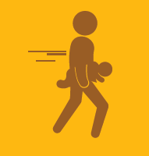



They have rights to live
vs
Notes:
All children have a right to live…
These rights include a right to life,
Safety and security.
To be registered and have a name, an identity and a nationality.
A right to health care.
A right to legal protection.
And a right to support if they have any special needs.
This is in contrast to a world of no rights…
Where children are rejected or neglected.
Subjected to abuse, whether physical, emotional or sexual.
To substance abuse, sometimes even in utero.
To have no access to justice
Or to be trafficked as a commodity to be bought or sold.

Slide 17









They have rights to love
vs
Notes:
They have rights to love…
Which include a right to a family.
And parental love and care.
To honour, respect and dignity.
And to privacy.
Versus a world where they are subjected to.
Harmful cultural practices
Armed conflict.
Race, gender, age or sexual discrimination.
Where they are refugees..
And have no care or protection.

Slide 18








They have rights to learn
vs
Notes:
They have rights to learn…
Through community participation and belonging
Through education.
Leisure and recreation.
Where they have freedom of thought, expression, association and religion.
And knowledge of their cultural roots.
Versus a world where they have no access…
To play.
To education.
To personal development.
And are subjected to harmful cultural practices

Slide 19











They have rights to leave a legacy
vs
Notes:
And finally they have a right to leave a legacy…
To have a unique identity.
To have physical, mental and emotional development.
To have moral development.
To live a full and happy life.
On a healthy planet
Versus a world where they …
Have no belonging or identity.
They are not developed or nurtured
They are Isolated and ignored.
And live an unhappy life
On an unhealthy planet.

Slide 20
Children also have developmental needs
Notes:
In addition to their rights, children also have different needs as they grow up and develop, the next few pictures illustrate how children develop physically, emotionally and socially and some tips for parents to support them along the way.

Slide 21
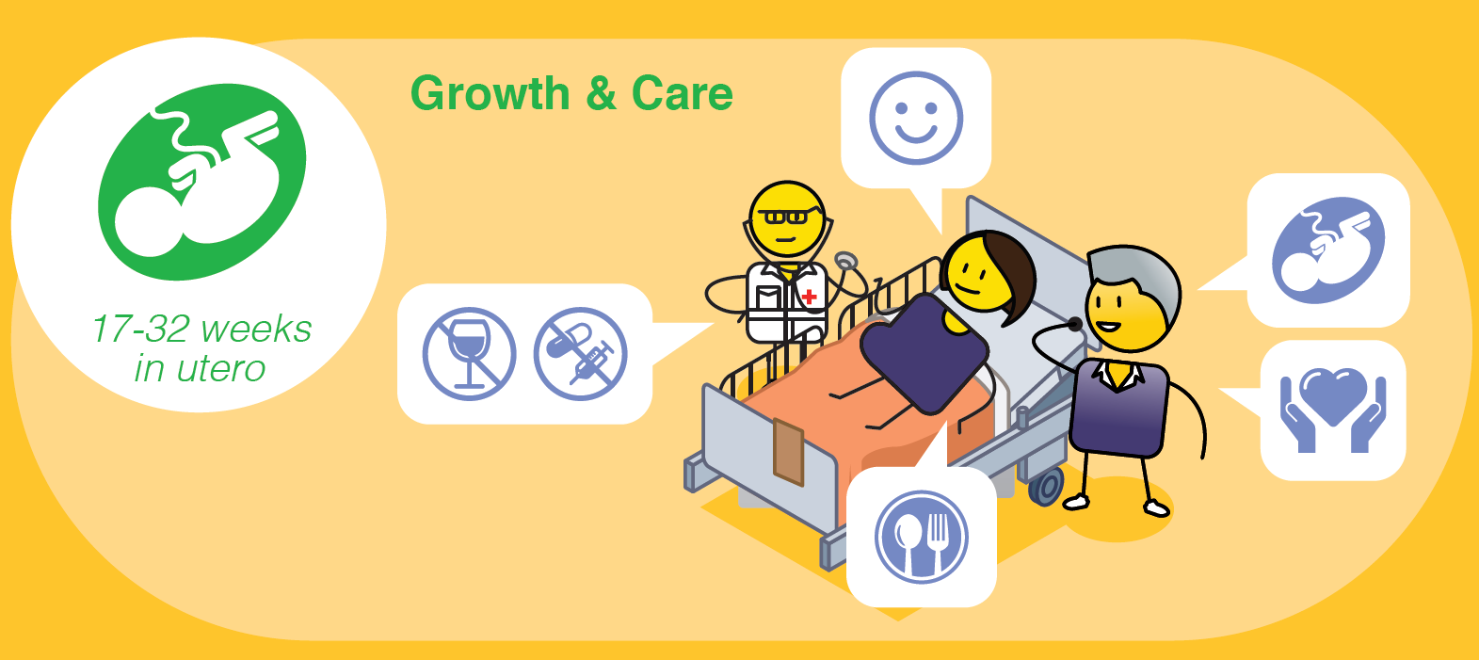
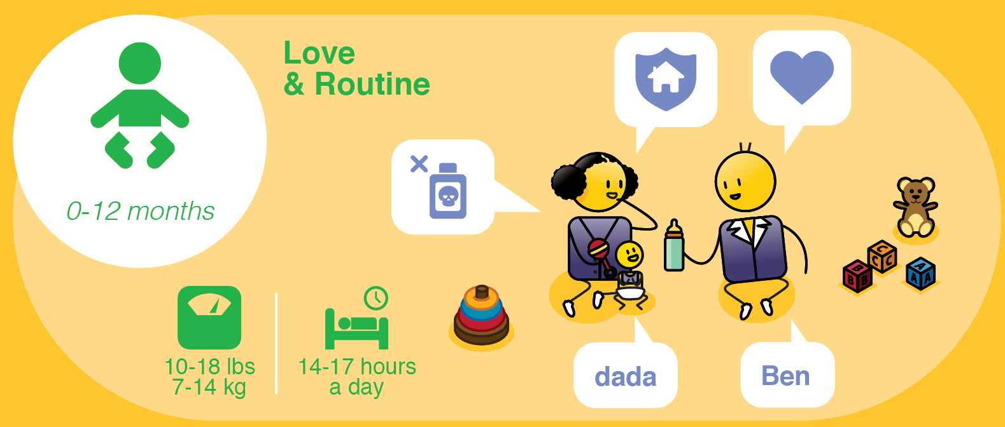
0 – 40 weeks
Healthy weight for Mother
8 Hours Sleep at Night
Notes:
From conception to around 38 to 40 weeks your baby develops completely in your womb. This is a time of growth for your child and care and preparation for you as a parent.

Slide 22

0 – 40 weeks
Healthy weight for Mother
8 Hours Sleep at Night
Notes:
From a physical perspective, development starts with your baby’s central nervous system; spine; heart; ears; eyes; arms; legs; teeth; palate; sex; vocal cords and finally their lungs. Your baby can grasp with their hands, move, kick and hiccup. Your nutrition is their nutrition, so be sure to eat a healthy diet with lots of vitamins and minerals, a healthy mother creates a healthy child.

Slide 23

0 – 40 weeks
Healthy weight for Mother
8 Hours Sleep at Night
Notes:
Mentally, your baby can feel pain, suck its thumb and dream. Your nutrition is also important for their mental development, so a balanced diet is crucial.

Slide 24

0 – 40 weeks
Healthy weight for Mother
8 Hours Sleep at Night
Notes:
From an emotional perspective, your baby can recognise your voice in utero. They will react to your moods, so be sure to stay calm and relaxed as much as possible. At this stage, your baby uses sight, sound, taste and touch to experience and explore their world, this is the start of their sensory development. Positive-in-utero experiences affect your unborn child, just as negative-in-utero experiences. A calm, anxiety free mother creates a calm anxiety free child.

Slide 25

0 – 40 weeks
Healthy weight for Mother
8 Hours Sleep at Night
Notes:
As a mother you should get lots of rest, at least 8 hours at sleep a night. You must eat a healthy balanced diet and you must not take any drugs, drink alcohol or smoke cigarettes throughout your pregnancy. Visit your doctor or local clinic regularly for check ups and ensure that you are being emotionally supported by your partner, family and community at this time, as this ensures the best possible future for our child.

Slide 26
17-27 lbs
7-14 kg
(Day/Night)
Notes:
From birth to 12 months, is a time of love and developing routines for your baby and yourself.

Slide 27
17-27 lbs
7-14 kg
(Day/Night)
Notes:
Physically, your baby's will do lots of growing in this time and should weigh between 7 and 14kgs or 17 to 27 pounds in this first year, this should be monitored by your health care provider or local clinic. Your baby will sleep a lot, from 14 to 17 hours at night with frequent naps during the day. They will start to lift their head and chest when lying on their stomach. Their eyes will start to focus on and follow a moving object around a room. Their fingers can grasp a rattle or finger, and by 12 months, they should be able to roll over, sit, crawl, pull themselves into a standing position and walk holding onto furniture. You can stimulate your baby through massage and be sure to keep an eye open for any ear or eye infections.

Slide 28
17-27 lbs
7-14 kg
(Day/Night)
Notes:
From an intellectual perspective, your baby will explore objects with their mouth. They will play with fingers, hands and toes, and will turn their head towards bright colours and lights. They should be able to clap their hands and wave goodbye. They will react to the sound of voices, rattles or bells, and they will say their first words, such as da-da and ma-ma. They will start to dance to music. They will be Interested in pictures, colors and textures, and early sensory challenges should be detected at this stage, such as with their hearing or sight. They will need a healthy balanced diet ideally of breast milk, or formula if breastfeeding is not possible, and will start eating basic solid foods from 6 to 12 months.

Slide 29
17-27 lbs
7-14 kg
(Day/Night)
Notes:
Emotionally, your baby will babble, smile and squeal with laughter. They will cry to communicate pain, fear or discomfort, and will love to be touched and cuddled. They will return smiles and respond to their name and recognise close family members. They will also know if someone is a stranger. They will copy your actions, attach to a special toy and start to express their emotions. Their language development will start through talking to you, repetition and making connections.

Slide 30
17-27 lbs
7-14 kg
(Day/Night)
Notes:
As a parent, you must make sure that you baby-proof your home by locking up poisonous substances, covering electrical outlets and removing sharp corners and edges where possible. Give your baby interesting objects of different colours and textures to play with but be aware of smaller objects that they can choke on. Cuddle and touch your baby as much as possible. Let them explore and move around. Create a routine but be flexible about this. Talk to, communicate, read to and play with your baby. Play hide & seek (or peek a boo) with hands. Most importantly, respond to you babies cries so that they learn trust and build strong emotional connections.

Slide 31
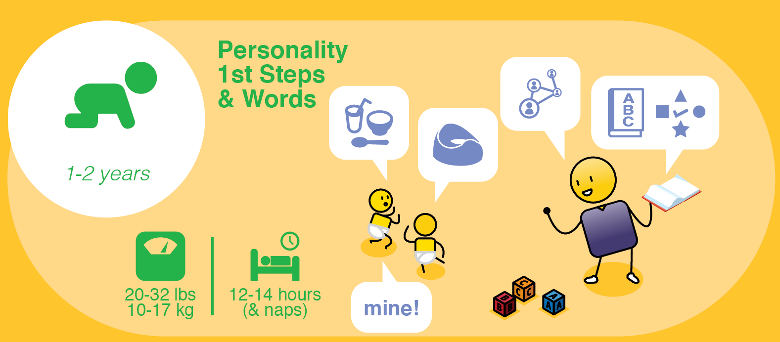
Notes:
From 1 to 2 years, is a time of building their personality, taking their first steps and saying their first words.

Slide 32
Notes:
By 2 years your baby will weigh between 10 and 17kg’s or 20 to 32 pounds, again this should be monitored by your health care provider or local clinic. They should still be sleeping between 12 to 14 hours at night with naps during the day. They will start walking without help, and be able to stoop, bend over and walk backwards without falling over. They should be able to drink from a straw and feeds themselves with a spoon. They will start to gesture, push, pull and grasps items. They should be able to turn the pages of a book (make sure you read to them every night). They will be able to stack 2 to 4 objects by 2 years. They can open drawers and cupboards, so be sure to put all dangerous items out of reach. They will begin to have control over their bowels, so you can start potty training, which should be completed by around 3 ½ years (but this is not a strict time limit).

Slide 33
Notes:
Mentally, by age 2, your baby should be able to say 2 to 3-word sentences. They will talk to themselves and ‘jabber’ expressively. They will look at the person they are speaking to and can identify toys with words. They can scribble with crayons on paper, identify objects in books, search for objects out of sight and take things apart. They will also start humming and try to sing. It is at this stage that you may pick up developmental challenges if they are struggling to reach any of these milestones.

Slide 34
Notes:
Emotionally, your baby will start to develop their personality and independence in this second year. This is an important stage to start teaching your child a sense of safety, and that their home is a place of care and love. They will refer to themselves by their name and will start to play with other children. They can be very possessive with their toys, and will imitate their parents or siblings all the time. They will insist on doing tasks on their own, and will get frustrated and have tantrums. They will start to engage in simple make-believe play.

Slide 35
Notes:
Play with your child on the floor every day. Make sure your home is toddler proof and safe, everything will have to move up a level. Put a box of interesting objects together for your baby to play with, including tubs, cups, paper or fabric of different colours and textures. Talk to your child and encourage them to copy you. Read simple books to them and look for teachable moments in your everyday lives. Play music to them to stimulate their brains and play dress up and make-believe games to help develop their imaginations.

Slide 36
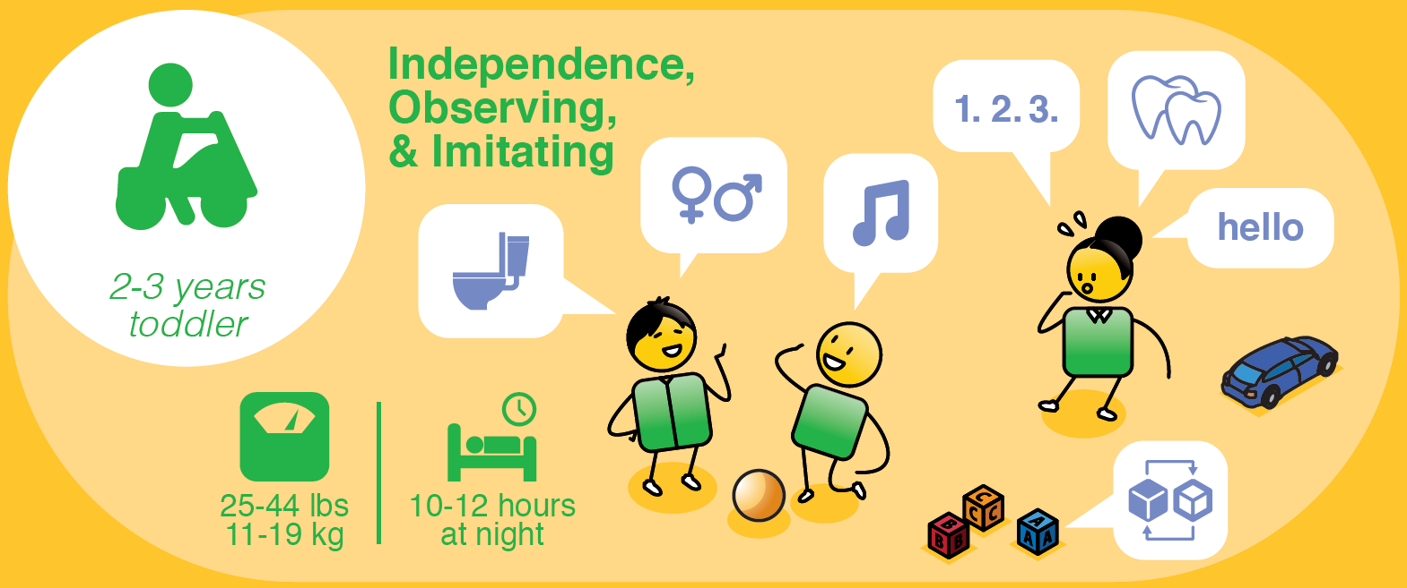
Notes:
From 2 to 3 years, your child becomes a toddler, this is a time of growing independence, observation and imitation to learn and grow.

Slide 37
Notes:
By 3 years your child should weigh between 11 and 19kgs or 25 to 44 pounds and should be sleeping 10 to 12 hours at night. They may also still need naps during the day. They will become taller and thinner framed, and slightly more adult looking. They will grow their full set of baby teeth, so you will need to teach them about dental care. They will start to sleeps through most nights without wetting their bed, and will start to use the toilet with some help from you. They will put on their shoes, but will still need help lacing them up. They should be able to dress themselves with some help from you and they can feed themselves. They can hop on one foot, climb on small playground equipment, kick and throw balls and peddle a bicycle.

Slide 38
Notes:
Intellectually, most of their speech will be understandable, and they will continue to repeat words and sounds that they hear around them. They will be able to listen to and tell simple stories, and stack 5 - 7 blocks. They will enjoy playing with clay and play dough and should be able to complete a 6-piece puzzle. They will be able to match objects and pictures and be able to count up to 3 objects. Make brushing their teeth part of their daily routine.
Encourage lots of tactile play in sand and water and start to build your child's vocabulary by adding descriptive words to their sentences. Sing simple songs and dance with them. Talk about colors, numbers and shapes everyday.

Slide 39
Notes:
Help them to build their physical confidence.

Slide 40
Notes:
Teach your child their surname. Children mirror adult behaviours, so make sure you behave as you want your child to behave.

Slide 41
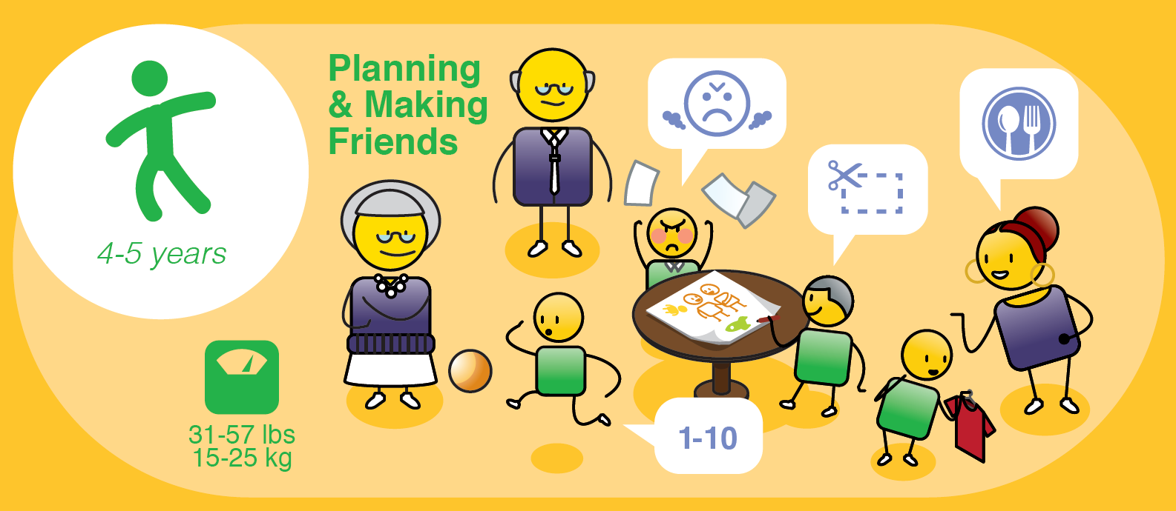
Notes:
From 4 to 5 years, your child will start learning how to plan and will start to make friends.

Slide 42
Notes:
By 5 years your child should weigh between 15 and 25kgs or 31 to 57 pounds and should sleep for 10 to 12 hours at night. They may begin to loose their baby teeth, and should be able to dress themselves with a little assistance. They will learn how to skip, and be able to throw a ball over head, catch a ball after it bounces and jump over low objects. They will be able to use a knife and fork, with some practice, and should begin to eat three meals a day with a snack. They can use scissors and cut a straight line, and their right or left hand or foot dominance will be decided at this stage.

Slide 43
Notes:
Intellectually, they should know the names of basic colours and be able to memorise their home address and telephone number, which is important for their safety. Their play will include being upside down (on swings or monkey bars), tumbling and rolling, which all helps to improve their mental concentration and focus. They can tell their own stories and will understand that books are read from left to right. They can draw pictures that represent people, objects and animals, and can sort objects by size, colour and other aspects. They can count up to 10 and will begin to identify letters and to write. They will start planning or becoming ‘project minded’ and understand cause and effect.

Slide 44
Notes:
Emotionally your 4 to 5-year-old will be cheerful, energetic and enthusiastic about life. They will enjoy planning and discussing what to do and will start to identify ‘best friends’ who will be very important to them. They will invent games and organises other children and will start to learn to share. They can make their own decisions and will become more sensitive to other’s feelings, and notice when another child is happy or sad. They will enjoy collecting things, role playing and will start to understand right from wrong.

Slide 45
Notes:
As their parent, encourage your child’s physical development through skipping, galloping, hopping, and follow the leader. Play with cutting, drawing and writing and help your child to identify and name their feelings. Praise and encourage your child for specific achievements (rather than generally). And give your child a space to be alone (such as their own tent, or special place). Encourage your children to be thankful and show empathy in everyday interactions. Ideally start early childhood education at this stage either at home or at an early childhood development or play school.

Slide 46

Notes:
From 6 to 8 years, your child will get involved in school projects and will develop their problem-solving skills.

Slide 47
Notes:
As your child gets older, you must ensure that they develop a healthy weight to height ratio, through eating a balanced diet. They should also still be getting 10 to 12 hours of sleep at night. Your child will become skilled at using scissors, cutting along lines and basic threading as their fine motor coordination strengthens. Their permanent teeth will start to develop, and they will start to test their muscle strength through physical activities such as cartwheeling, running and climbing. They should have a good sense of balance by now and be able to tie their own shoelaces. They will enjoy copying designs, shapes, letters and numbers, and as they grow, they will need a larger space to exercise.

Slide 48
Notes:
Intellectually they will start to build their skills in reading and writing, but they may still switch letters (such as b and d) when learning to spell. They will enjoy planning and building and may start to show a stronger interest in reading. Their problem-solving abilities will increase, and they will start to develop a longer attention span. They will know the difference between right and left and will begin to understand times of day and days of week.

Slide 49
Notes:
Emotionally, friendships and spending time with their friends will become increasingly important to them. They will start to show an interest in rules and rituals and may want to play with similar friends, such as girls with girls and boys with boys. They will start identifying ‘best friends’ and possibly an ‘enemy’, or someone they don’t get on well with. They will struggle with criticism and failure and will want to perform well and do the right thing. They will start to see things from another child’s viewpoint. This is a good time to teach them about their family history so that they understands the value of the family and belonging.

Slide 50
Notes:
As parents, Provide lots of opportunity for active play, such as throwing at targets, running, jumping rope, tumbling, swinging and balancing. Provide simple opportunities to understand rules of play such as card or board games. Encourage your child to collect, sort and store interesting things, and most importantly, encourage them to read and write by taking them to the library, writing about their day or making a picture story book. Help your child to explore their world more broadly, such as through visiting your place of work, a play or musical performance and museums. Start to teach your child effective stress management skills such as quiet time, reading, deep breathing, anger management and thinking skills.

Slide 51
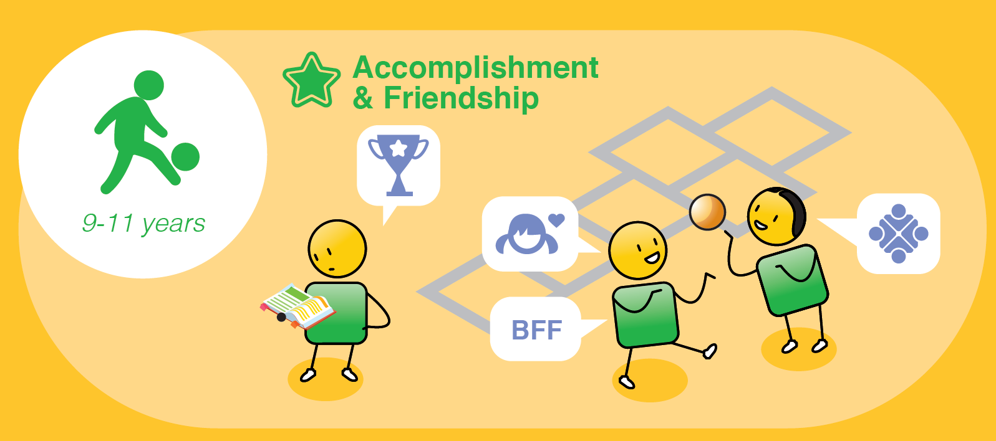
Notes:
9 to 11 years is a time of achieving things, accomplishment and building strong friendships.

Slide 52
Notes:
At this stage, girls can be as much as 2 years ahead of boys in development and can start to menstruate from the age of 11. Your child will start to get much stronger and more confident in their physicality and will have improved coordination and reaction time, as their reflexes improve and develop. You may notice a rapid growth phase at this stage, and you will need to make sure that they have access to lots of healthy food to help them manage their energy levels.

Slide 53
Notes:
Intellectually, your child should be able to read and write well at this stage, so they may need some support if they have any learning challenges. They will start to develop an interest in fictional stories and ‘how to’ books. They will develop special interests and hobbies and will fantasize and daydream about their future. They will enjoy planning and organising tasks and will be more product and goal orientated. They will have great ideas and intentions, but not be good at following through on them. They will enjoy games with more complex rules and should still be encouraged to participate in imaginative play. Develop their skills in building, cooking, sewing, designing, technology and executing on plans.

Slide 54
Notes:
Provide time and a place for them to be alone to read or daydream (not just schoolwork). Encourage them to set up play dates with friends, and to take part in an clubs or sport. Play games that improve their strategic ability such as chess, checkers and Monopoly.

Slide 55
Notes:
As a parent, make sure you are providing lots of balanced meals and snacks as this is a time of significant growth. Discuss your children’s sexuality with them, the differences between boys and girls' bodies, attraction, relationships, sex, conception and how their body will develop through puberty into adulthood.

Slide 56

Notes:
From 12 to 18 years, your child becomes a teenager, this is a time of puberty, hormones and early adulthood.

Slide 57
Notes:
From a physical perspective, your child will experience dramatic changes in their bodies. Girls start to menstruate, and boys reach puberty. Both become sexually aware and may act on their new physical status. Becoming a teenager can be an emotional rollercoaster, there are several hormonal changes. Increased testosterone in boys can lead to more aggression. It is an awkward growth stage, as they get used to their changing bodies. It can be a time of stress and tension, often driven by school pressure, and your child will need love and understanding as they become young adults.

Slide 58
Notes:
Intellectually, teenagers can be quite egocentric and view the world very much from their perspective. They will become very concerned that everyone is watching them and will be very preoccupied with themselves, how they are feeling and how they are perceived. They can become critical of others, especially their parents or caregivers, and often want to ‘fit in’ and gain approval from their friends. They will question your and other people’s views, on religion, political beliefs, values and more and they will often feel misunderstood. They will be very experimental and take risks. Teens believe they have a personal magic that will protect them even with risky behaviour, remember their brains are only fully developed at the age of 24 years.

Slide 59
Notes:
From an emotional perspective the changes in their hormones can lead to sudden unexpected changes in moods which can be frustrating for parents. They can be very critical of their family and will have some emotional outbursts. From 12 to 14 years they will seem irritable and excitable; at 15 years they may become moody and withdrawn; and from 16 to 18 years they will start to settle down and become calmer and less volatile. We expect teens to behave as adults, but they are not always ready for this. They will, however, want to be socially acceptable and seem mature for their age. Most importantly, be aware of depression, anxiety and self harming, teens are at high risk of these challenges and will need your support if they emerge.

Slide 60
Notes:
As parents, make sure you start to guide and prepare your child for puberty, sex education, and the physical and hormonal changes to expect from as young as 9 years of age. Help your child to find an adult mentor, outside of your immediate family if necessary, at these individuals can sometimes help to guide and provide a safe place to talk about changes in bodies and emotions if they feel uncomfortable doing this with you. Your teens will have high levels of anxiety at potential failure, so allow minor ‘victories’ by acknowledging their newfound thinking abilities and independence. Develop their creativity in all fields to help them to understand how to solve problems creatively and ensure lots of space for sharing and understanding.

Slide 61
Discuss
Do you have any questions about the rights and needs of children?
Would you like any further information about this?
?
Did you find this presentation useful as a parent?
How will this information about the rights and needs of children change your behaviour as a parent?
Notes:
Discuss
Do you have any questions about the rights and needs of children?
Would you like any further information about this?
Did you find this presentation useful as a parent?
How will this information about the rights and needs of children change your behaviour as a parent?

Slide 62
Identifying the child protection challenges happening in our community
www.courage-community.com
Notes:
As parents or caregivers, we need to be aware of the different child protection challenges happening in our community, that our children are dealing with. We also need to start thinking about what is driving these challenges and what can do to help to prevent them at a community level.

Slide 63
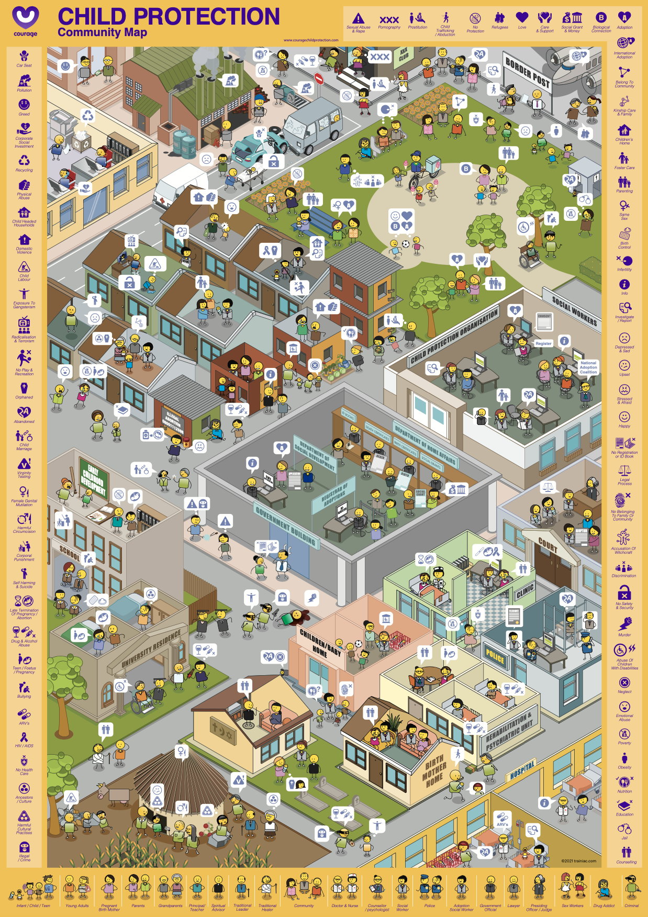
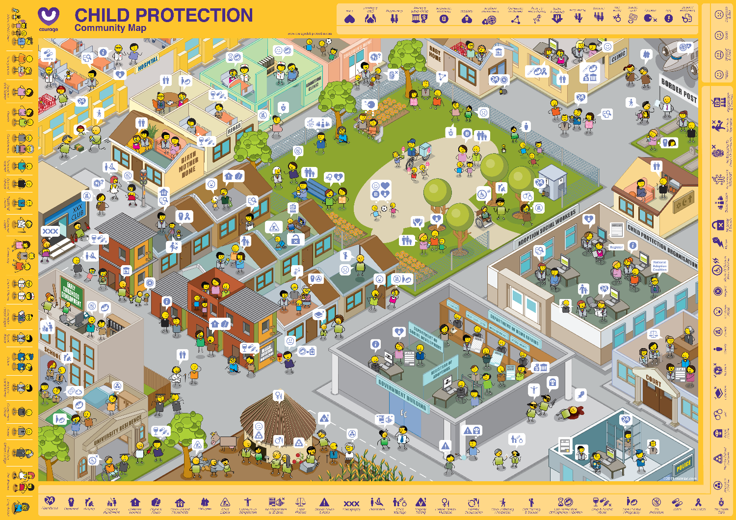

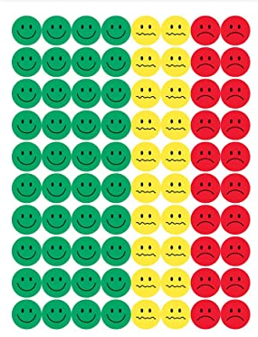

Useful courage tools
courage community map and stickers/buttons
Projection of map and white board markers
or
Notes:
As stimulus for your child protection identification exercise you can either use:
An A1 Courage Community Map which is available in portrait or landscape format and some coloured buttons or stickers.
Or you can play this video and ask participants to list child protection challenges that they have seen in their community.
Or you can download and project the Courage Community Map from the presentation format off our website, and use coloured marker pens to identify your community’s child protection challenges.

Slide 64
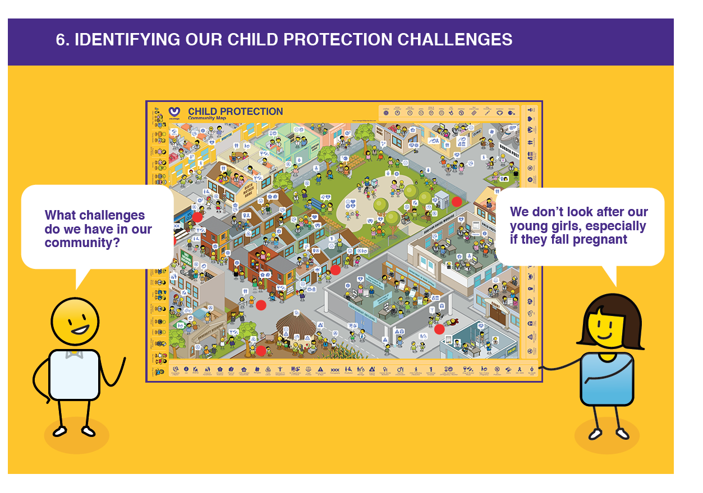
What we should ask?
What are some of the child protection challenges happening in our community?
What is causing and what could prevent these challenges from taking place?
Notes:
For this exercise, you will want to ask your participants to identify all of the child protection challenges that they have seen or observed in their community.
They can identify these using stickers or buttons on the community map, or just by listing them on a piece of paper. You then want them to think about what they think may be causing these challenges and what they think could prevent them in the their community.
If your participants are working in a group, suggest that they spend some time describing their community to the rest of the team, so that they understand the context of the challenges that they identify.

Slide 65
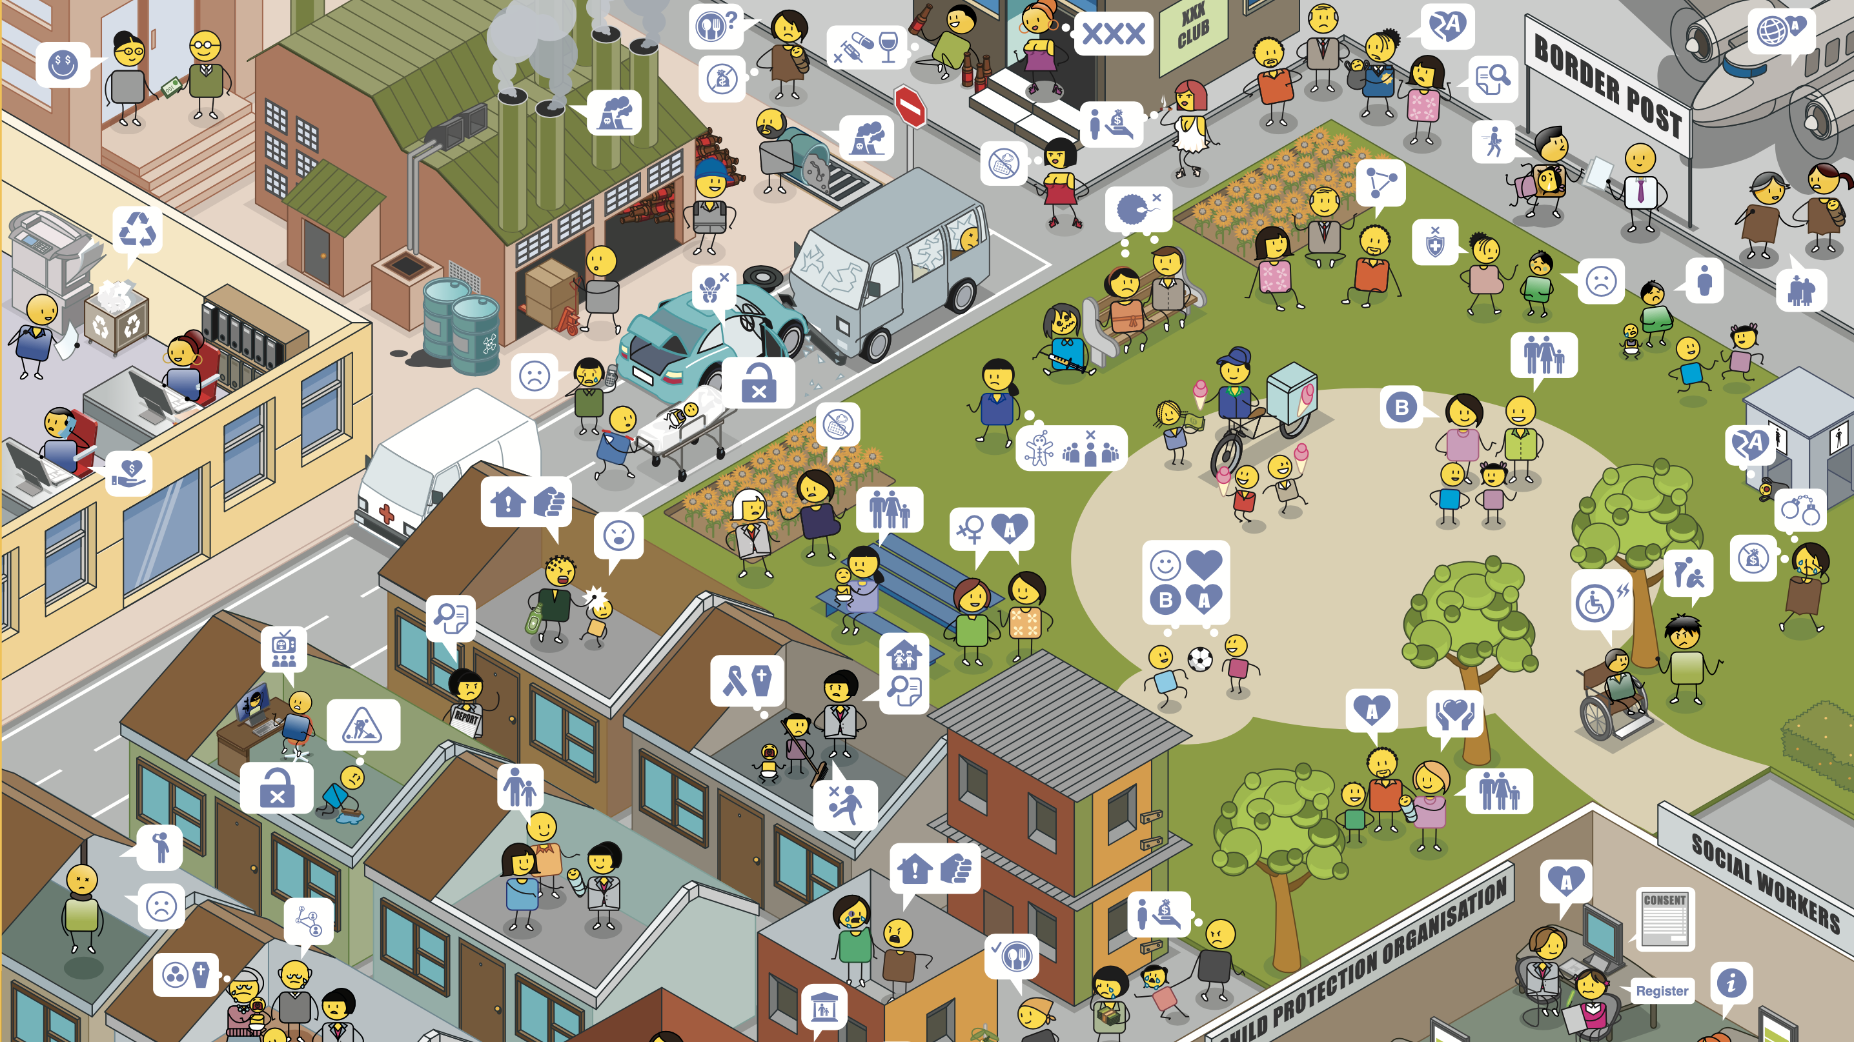
Notes:
Introduce the community map to your participants…
Starting in the top left-hand corner and moving right, you will see different kinds of companies, main roads, night clubs, bars and border posts.
Moving down, you will see public spaces such as parks where people can relax and meet friends outside, and then there are different kinds of residential areas.

Slide 66
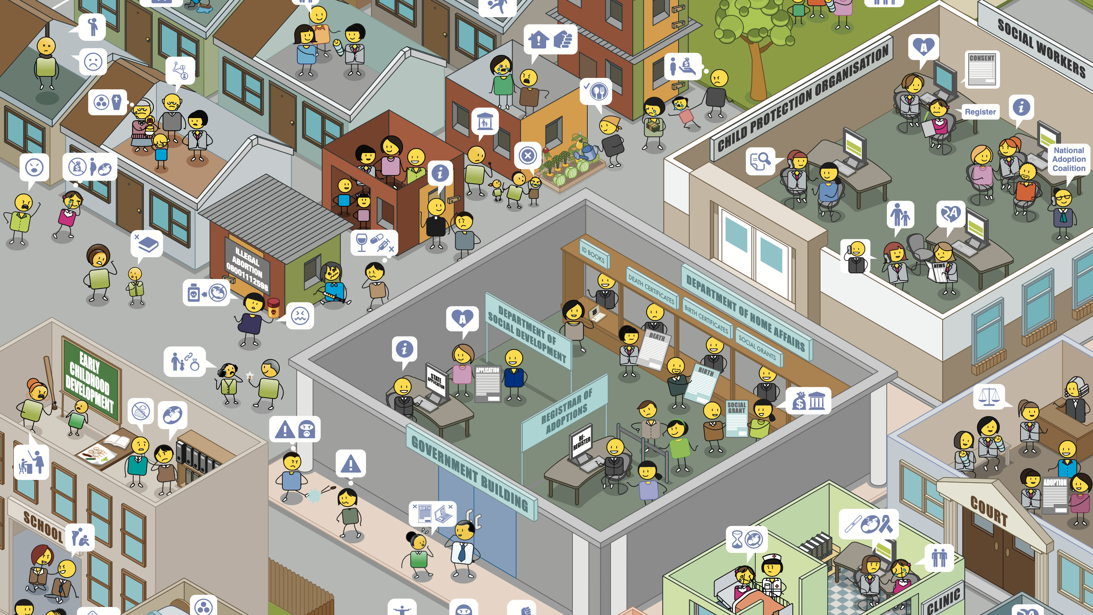
Notes:
Some residential areas have formal houses, and some have informal houses as you can see in the middle of this community map.
There are also child protection organizations, social workers, courts, clinics and government departments that span a number of different areas such as home affairs and social development.
Moving back to the left of the map, you will see early childhood development centres or creches and schools.

Slide 67
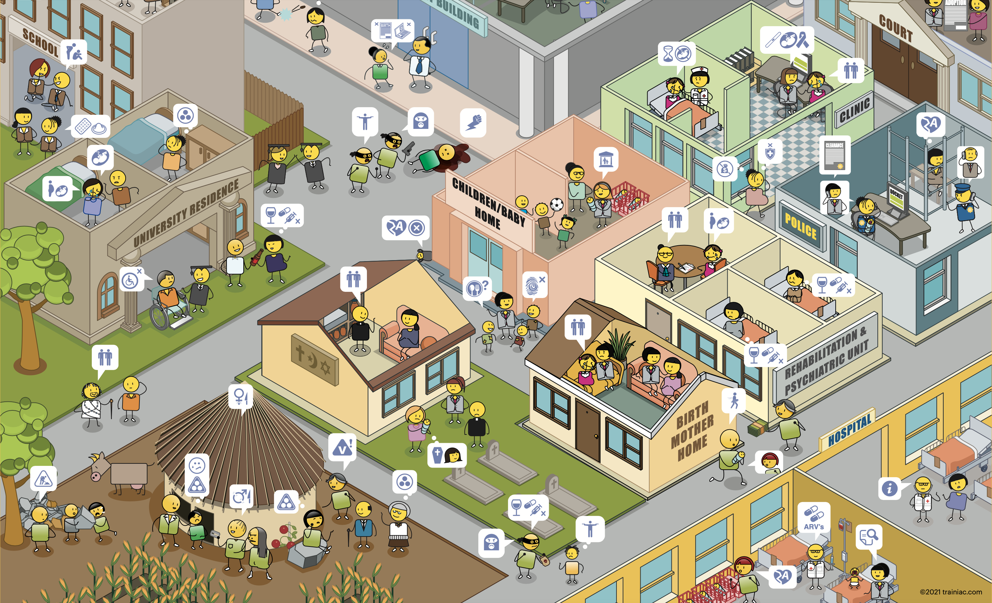
Notes:
In addition to schools there are universities and places of post graduate study.
You will also find religious intuitions, baby and children’s homes, a range of different health clinics, police stations, rehabilitation and psychiatric units, birth mother homes and hospitals.
Finally in the bottom left-hand corner you can see a home that is situated in a rural area, where people may go to visit their family and where they have come from.

Slide 68
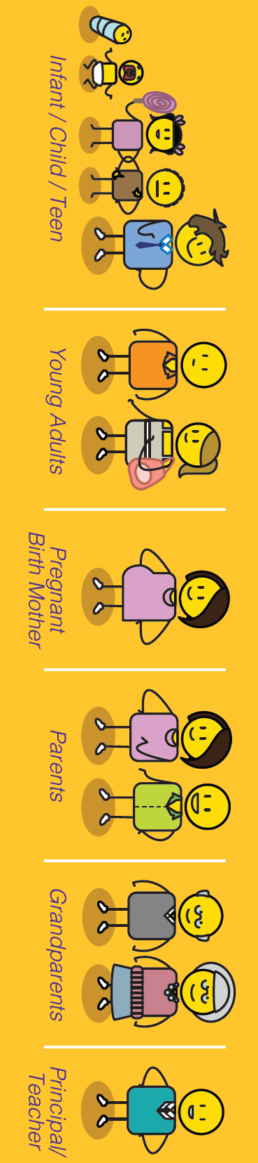
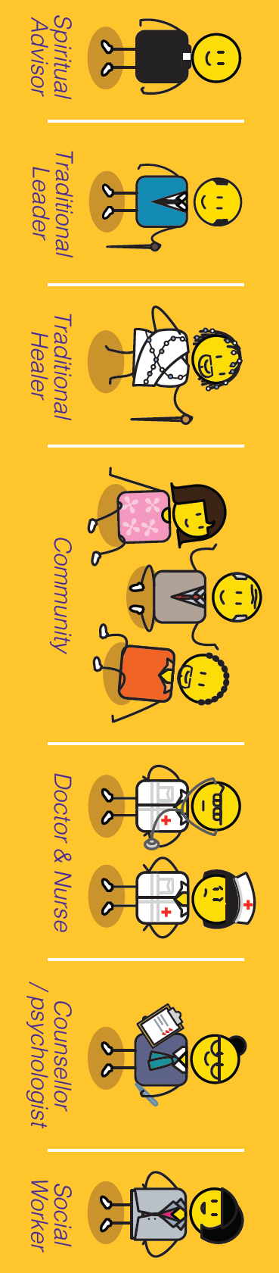
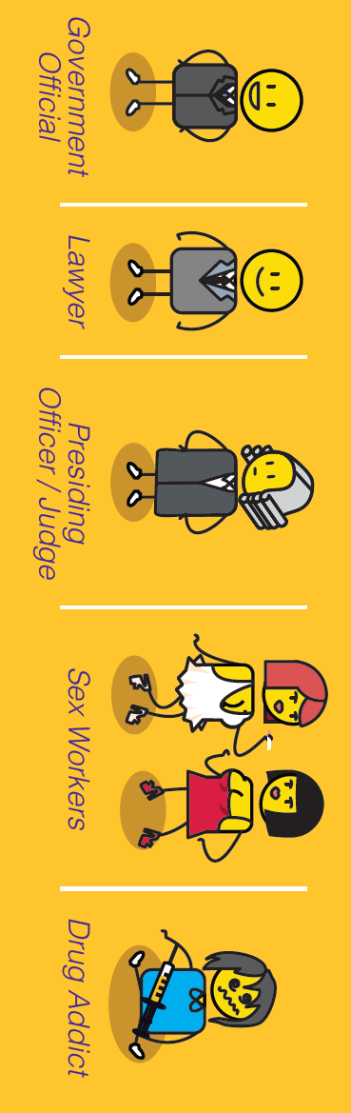


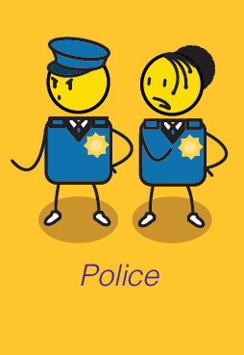
Community members
Criminal
Notes:
There are different kinds of people in this community from children to families, spiritual, traditional and community leaders, doctors, nurses, social workers, police officers and government officials. There are also people who struggle to fit into communities such as drug addicts or those with criminal intent.

Slide 69

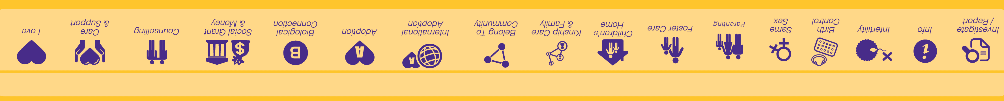






Child protection conversations
Notes:
The people in the community are having lots of different conversations about the child protection challenges happening in their community. We have used a child protection emoji language to illustrate these conversations.

Slide 70

Notes:
If you are using this presentation as the workshop stimulus, you may want to stop on this slide, so that participants can spend some time exploring the community map.

Slide 71


How we should answer?
What do we think is causing these child protection challenges in our community?
What do we think could prevent these child protection challenges in our community?
Notes:
Once your participants have identified all of the child protection challenges in their community, ask them to make a list of all of the things that they think are causing these challenges in their community, and another list of all of the things that they think can prevent these challenges from taking place.

Slide 72
Understanding the child protection and safeguarding process
www.courage-community.com
Notes:
As parents and caregivers it is important to understand the process that should be followed if the event of a child experiencing abandonment, neglect, abuse or exploitation.

Slide 73
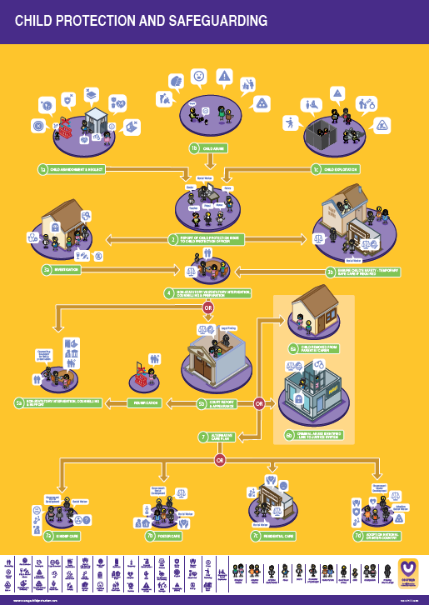
Useful courage tools
Courage child protection and safeguarding poster & Community Map
or
The Courage child protection and safeguarding video or presentation
Notes:
Some useful tools to help you to understand and follow the child protection and safeguarding process in your community include:
The Courage Child Protection and Safeguarding A1 Poster and the Courage Community Map, watching the Courage movie or this presentation.

Slide 74
Why it is important
to stand up for children?
Notes:
Firstly, we need to understand why is it so important to stand up for children and safeguard them?

Slide 75



Building self-esteem & self-worth
Notes:
When we stand up for children, we are not only ensuring their protection and wellbeing we are also teaching them that we think they are important, how to stand up for themselves, how to be assertive and to advocate for their own rights as human beings. Most importantly, when we stand up for children, we help to build their self-esteem and self-worth. Building a strong sense of self-worth and self-esteem is about developing a strong personal identity. It’s about teaching children to care for themselves and for others. Self-esteem can be about personal achievement, but it is also about simply making good choices or decisions that are in your, your family or your communities' best interest. Its about having a focus and direction and taking personal responsibility for your life and how you live it.

Slide 76
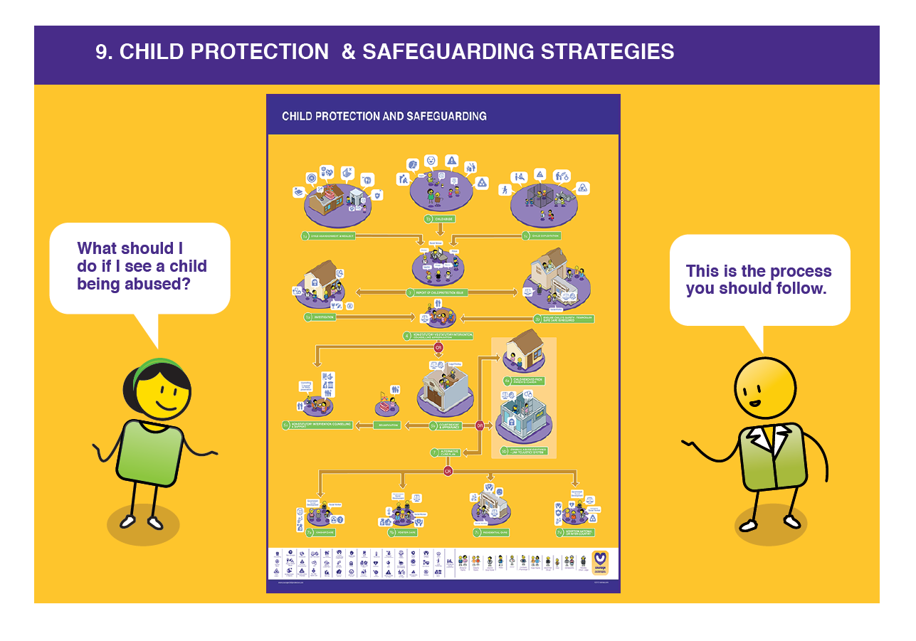
The Child Protection Process
What should you do if you see child protection challenges in your community, follow the Courage Child Protection & Safeguarding process.
Link this process to the Courage Child Protection Community Map to understand which stakeholders are involved.
Notes:
Your child protection and safeguarding process will be set out by your country’s Children’s Act and should detail the different steps you should take if you have seen or have knowledge of a child or children who are being abused, neglected or exploited. Whilst following the process, try to identify the different stakeholders on the Courage Community map so that you can connect the formal process to real people and places in your community.

Slide 77
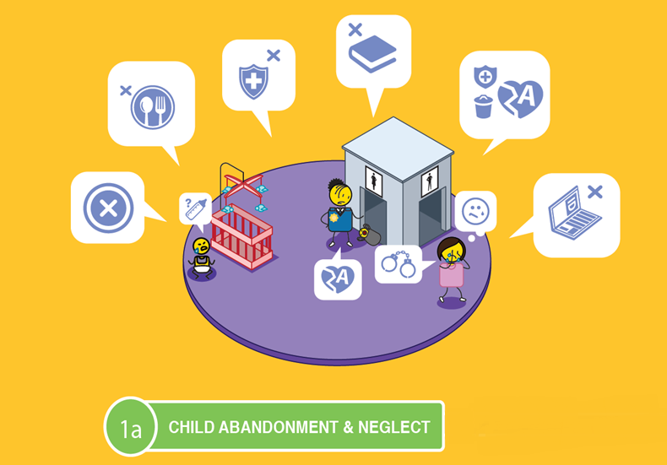
Notes:
If a child has been abandoned or neglected, which includes not being fed, given access to healthcare, schooling or adequate personal identity documentation.

Slide 78
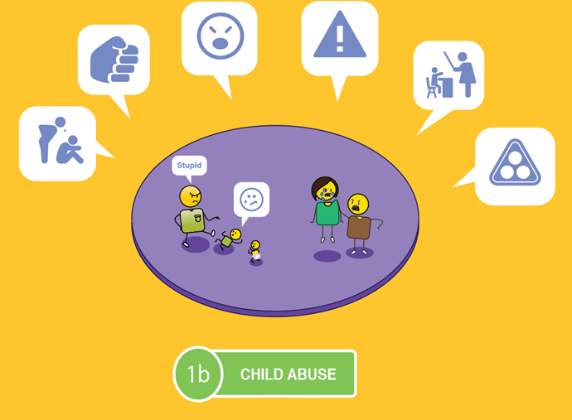
Notes:
Abused, which includes physical, mental, emotional and sexual abuse, bullying, corporal punishment or subjected to harmful cultural practices.

Slide 79
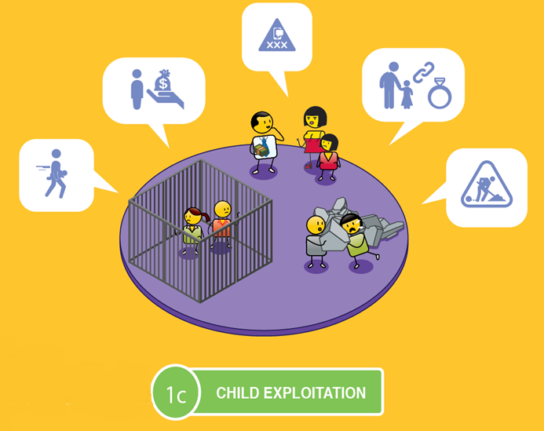
Notes:
Or exploited, which includes child trafficking, prostitution, pornography, child marriage or child labour.

Slide 80
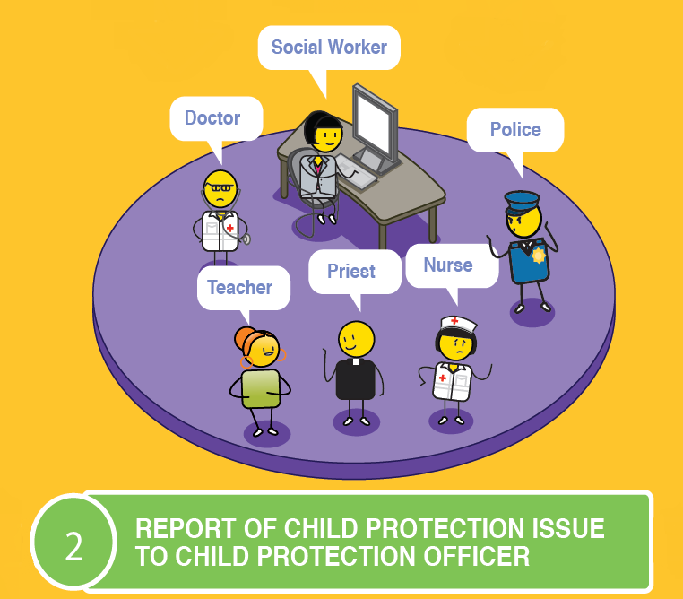
Notes:
The first step is to report this problem to a child protection officer, who could be a social worker, the police, a doctor or nurse, a teacher, a sports coach, a counsellor, or a community or religious leader.

Slide 81
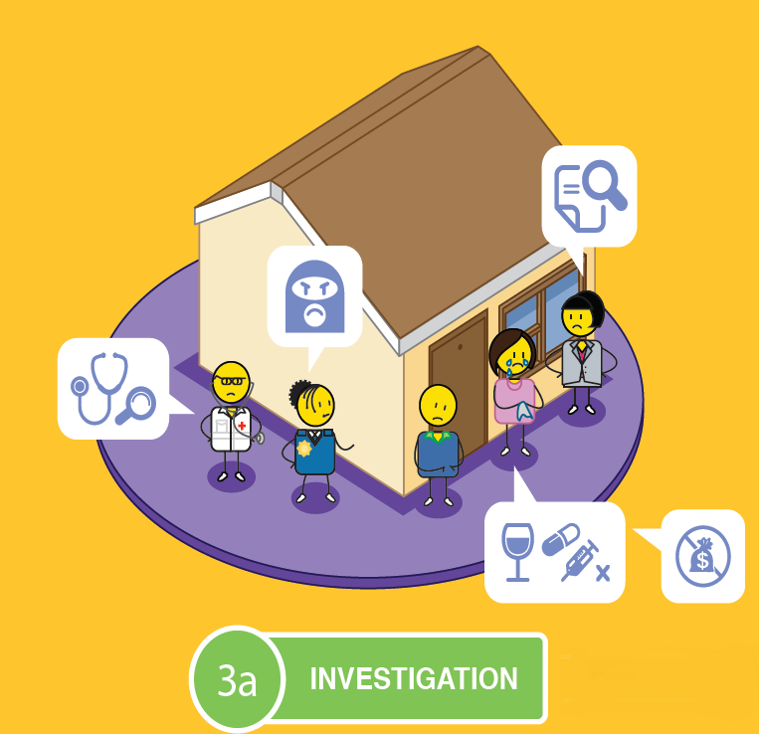
&
Notes:
The child protection officer must report the neglect, abuse or exploitation to the police and a social worker, who must then conduct a full investigation, which includes visiting the child’s home, school or where the abuse is reported to be taking place.

Slide 82
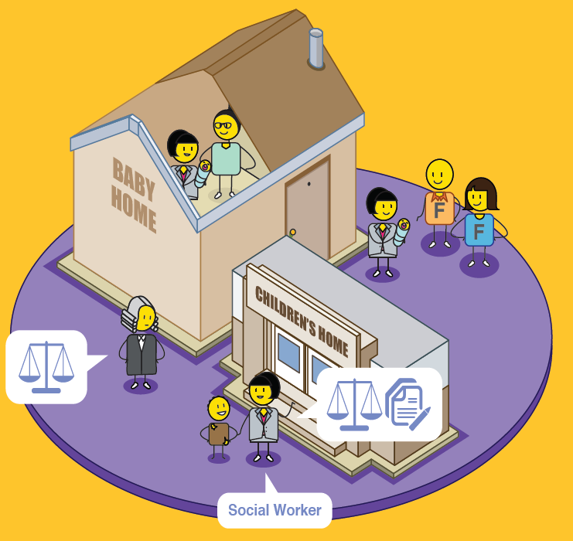
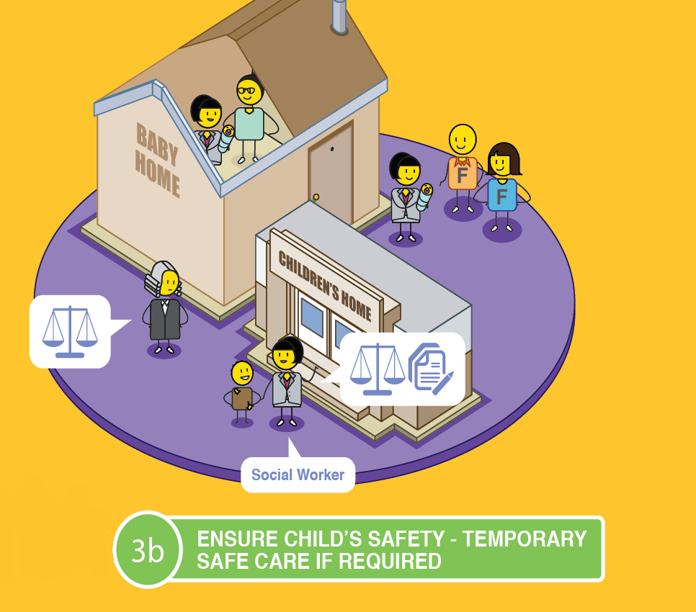
Notes:
The safety of the child must be ensured.
If there is any risk to the child, they must be removed from their home, place of residence, or risky environment, and placed in temporary care such as a baby or children’s home, in foster care or a registered place of safety. This removal will require formal legal intervention.

Slide 83
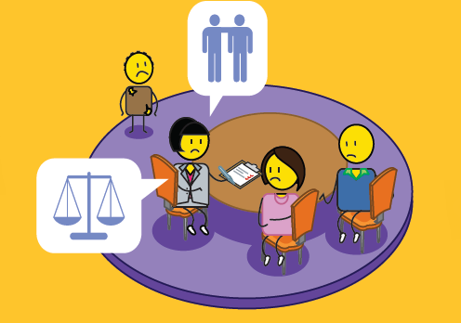

Notes:
The social worker will then need to assess if the issue reported can be dealt with through counselling and family support, or if statutory intervention is required through the Children’s Court, in which case, the parents, child and relevant perpetrators must be prepared. If the abuse, neglect or exploitation took place in a formal school, cultural or sporting environment or event, it must be reported to the relevant oversight or professional body for investigation as well.

Slide 84
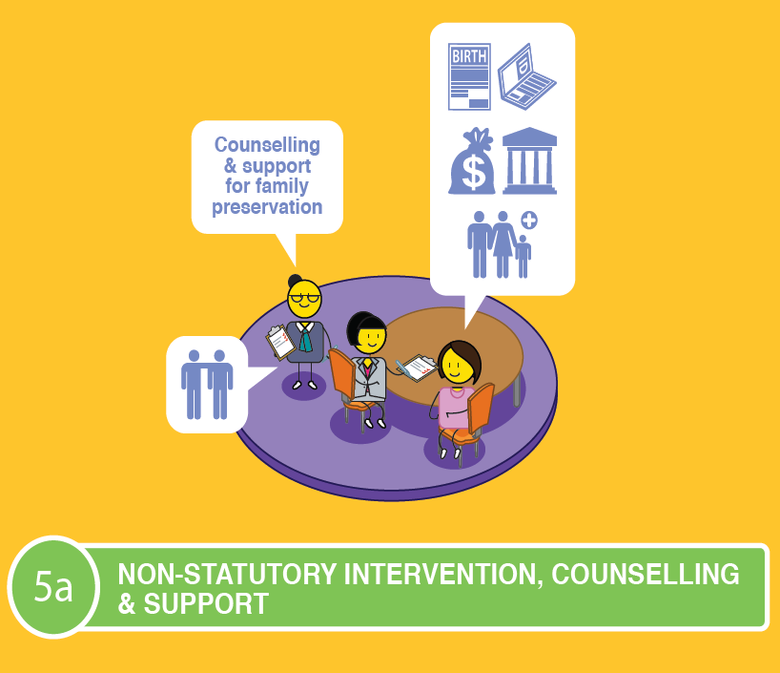
OR
Notes:
If the formal decision is that counselling and support is sufficient to solve the problem, this can be undertaken by a social worker or family support organisation, who can also assist parents in getting the correct documentation for their child, and financial or social support if needed.

Slide 85
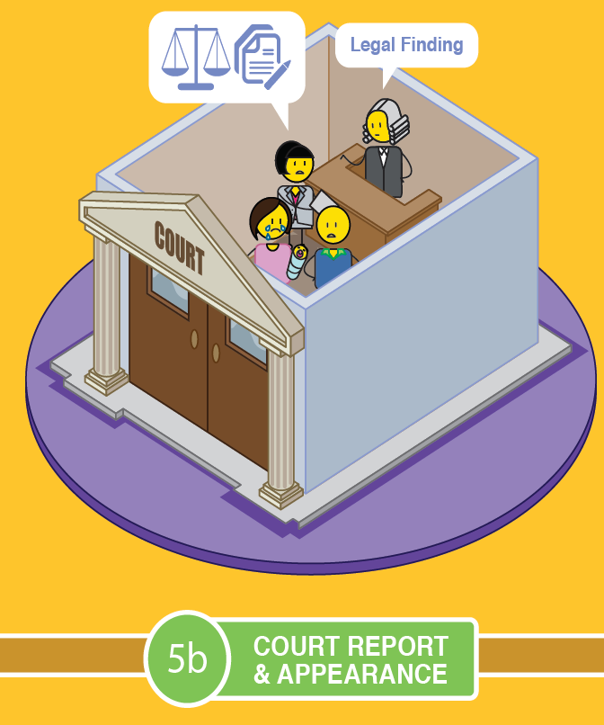
Notes:
If a statutory intervention is required, the child, parents or relevant perpetrator will be taken to court and a legal finding will be made.

Slide 86
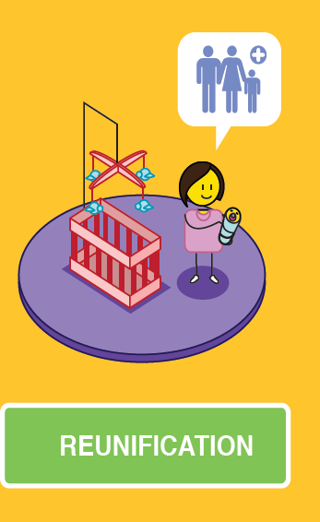
OR
Notes:
In this legal finding, the court may rule that the child be reunified with their parents, with appropriate support, or they could decide to remove the child form their parents’ or guardian’s care.

Slide 87

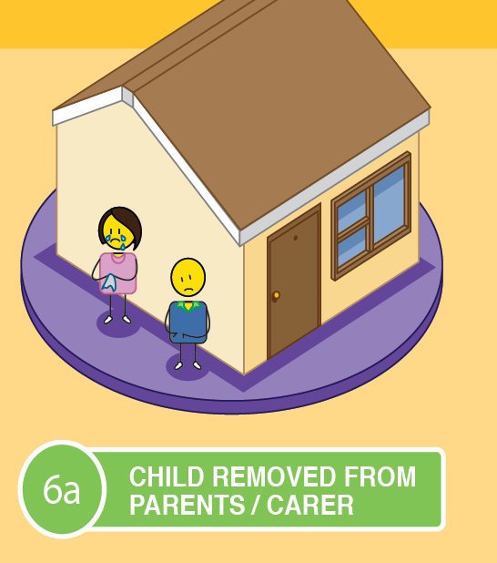
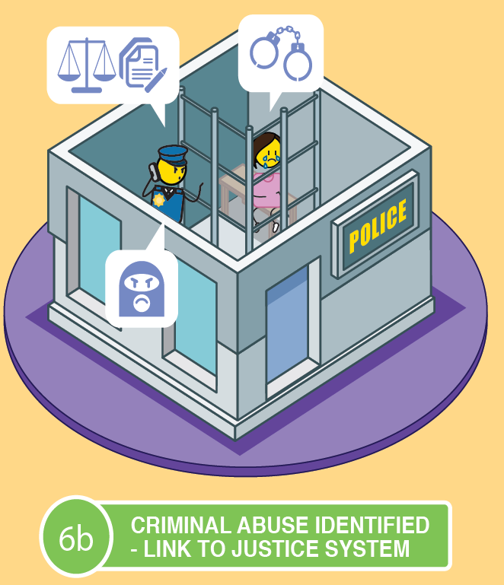
OR
Notes:
If there was no criminal intent, the child will be removed from the parent's care, however, if the parents or other relevant perpetrator INTENTIONALLY abused, neglected or exploited the child, they will be referred to the criminal justice system for prosecution.

Slide 88
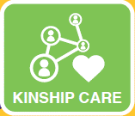



ALTERNATIVE CARE PLAN
Notes:
If a child is removed from their parent’s care, an alternative care plan will be needed. These can include placing the child with other family members in a kinship care arrangement, placing the child into foster care, institutional care or placing the child up for adoption.

Slide 89

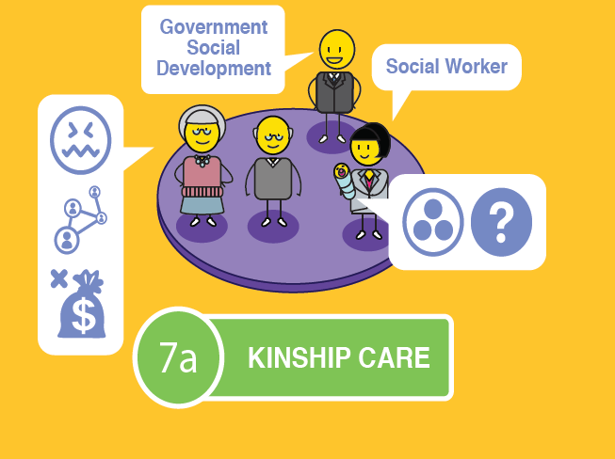
Notes:
Kinship care refers to placing a child into the care of another family member, such as the child’s grandparents or a close relative.
The courts and child protection officers must ensure that these family members are fit to care for the child in question.
This can be done through a formal foster care placement or adoption, or through an informal arrangement between family members.
It is important to note that Kinship care can have a negative impact on older family members as they are expected to take care of young children, well into old age, which can lead to high levels of stress and anxiety.
Financial considerations also need to be taken into account and whether the family member is in a financial position to take on another dependent.
This option does ensure that the child is still connected to their biological family which can support the cultural needs of the child.

Slide 90
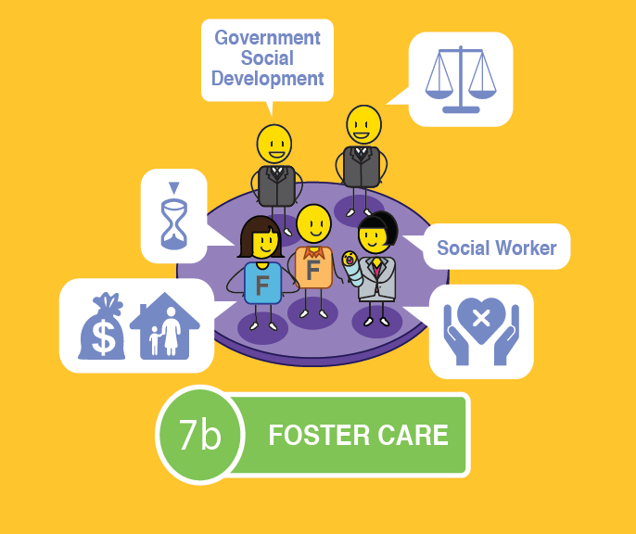
Notes:
Foster care is a temporary child protection solution to give parents or guardians an opportunity to remediate the challenges that led to their child’s removal in the first place.
Foster care is legal, when conducted in accordance with the Children’s Act, and is a good temporary solution for keeping a child safe and secure.
The child can remain in contact with their parents if they desire this, usually under supervision.
Foster parents are entitled to a foster care grant which they can apply for at their local Department of Social Development.
As it is a temporary solution, however, there are some concerns that need to be raised.
Foster care can never replace a family environment where a child has a sense of permanence and feels like they belong.
The child may struggle with the issue of having an inconsistent carer, they may not be able to bond with a primary care giver and as a result they could feel insecure and struggle with their sense of identity as they grow up.

Slide 91
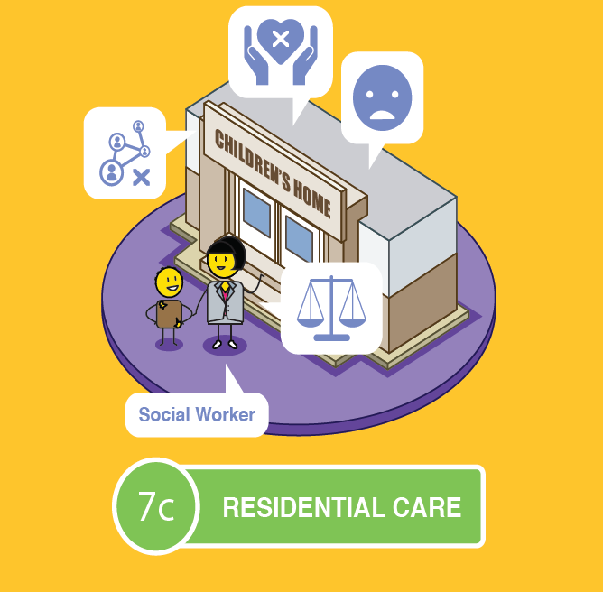
Notes:
Institutional or residential care is when a child is placed in a children’s home, or a group foster care home after going through the necessary process in court.
As with foster care, this option is a temporary child protection solution to give parents or guardians an opportunity to remediate the challenges that led to their child’s removal in the first place.
The child can remain in contact with their parents if they desire this, usually under supervision.
The home will take full responsibility for the care and education of the child whilst he or she is in their care.
As it is a temporary solution, however, there are some concerns that need to be raised.
As with Foster Care, a children’s home can never replace a family environment where a child has a sense of permanence and feels like they belong.
The child may struggle with the issue of having an inconsistent carer as children’s homes rely on shift workers.
They may not be able to bond with a primary care giver and as a result they could feel insecure and once again struggle with their sense of identity as they grow up.

Slide 92
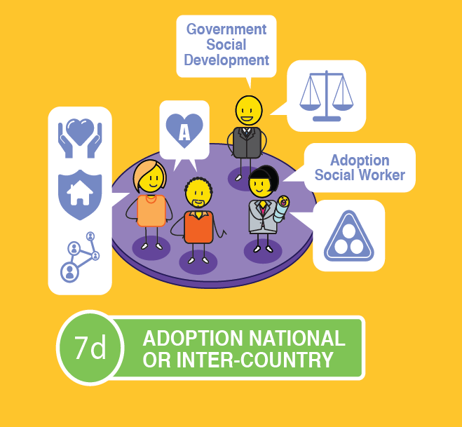
Notes:
Adoption is believed to be the best long-term solution for a child outside of being cared for by their own family.
It is a legal process that is conducted in accordance with the Children’s Act.
The child would get a new family that has been carefully selected to meet their needs in a stable, permanent and loving home.
Some adoptees struggle with their identity formation due to living with an adopted family, rather than their biological family.
The child may choose to meet their biological parents when they become an adult, but this is at their discretion.

Slide 93
Take action
The most important thing you can do to prevent or stop child neglect, abuse or exploitation is to take action by speaking up!
Notes:
The most important thing you can do to prevent or stop child neglect, abuse or exploitation is to take action by speaking up! If you are a child protection officer, such as a social worker, a police officers, a doctor or nurse, a teacher, a sports coach, a counsellor, or a community or religious leader, you have a legal duty to report any suspicions of child neglect, abuse or exploitation to the relevant authorities. If you do not report your suspicions, you can be prosecuted for your lack of action.

Slide 94
Understanding the role of parents and caregivers
www.courage-community.com
Notes:
The role of parents is often defined in a country’s Children’s Act or in their declarations on the rights and needs of children. We define the roles of parents and caregivers as follows…

Slide 95



Parent’s role?
To provide financial support to your child.
$
To ensure the health, wellbeing and development of your child.
To safeguard & promote the wellbeing of your child.
Notes:
As a parent, you must ensure the health, wellbeing and development of your child. You must provide them with financial support, and safeguard them at all times.

Slide 96


Parent’s role?
To protect your child from maltreatment, abuse, neglect, degradation, discrimination, exploitation and any physical, emotional or moral harm.
To respect, protect and promote the rights and dignity of your child.
To guide, advise and assist your child in making decisions for themselves.
Notes:
You must respect, protect and promote the rights and dignity of your child. You must protect them from maltreatment, abuse, neglect, degradation, discrimination and any physical, emotional or moral harm. You must guide, advise and assist them in making good decisions for themselves.

Slide 97



Parent’s role?
To guide, direct and secure your child’s education and upliftment through intellectual, emotional, physical, moral and cultural development that is appropriate to their age.
To apply consistent and fair discipline to your child.
To build sound and loving relationships with your child.
Notes:
You must always apply consistent and fair discipline to your child. You must guide, direct and secure your child’s education and upliftment through intellectual, emotional, physical, moral and cultural development that is appropriate for their age. And most importantly, you must build a sound and loving relationship with your child.

Slide 98


Parent’s role?
To inform, involve & encourage your child’s participation in their care & protection
To accommodate any special needs your child may have.
To find a suitable place for your child to live.
Notes:
As a parent, you will need to accommodate any special needs your child may have. You should inform, involve and encourage their participation in their care and protection, and you must ensure that they have a suitable place to live where they feel secure and protected.

Slide 99
We must always focus on what is in the best interests of the children in our care
Notes:
As parents, caregivers and child protection officers we must always focus on what is in the best interests of the children in our care.

Slide 100

YOU MUST ALWAYS: | CHECK
Respect a child’s dignity.
Be fair and equitable.
Protect them from discrimination.
Inform, involve and encourage their participation throughout any protection process.
Support their disabilities, special needs or chronic illness.
Protect a child from harm which includes neglect, abuse or exploitation.
Solve a child’s problem as quickly as possible.
Respect, promote and fulfil their rights at all times.
Notes:
This means that we must always… (read off slide)

Slide 101
YOU MUST CONSIDER: | CHECK
The relationship between a child and their parent or caregiver?
The child’s need to grow up in a stable family environment?
The child’s physical and emotional security and development?
The child’s age, maturity, gender and stage of development?
The child’s background and current family and social context?
The attitude of the parents or caregiver to their child?
The impact any change will have on a child e.g. if separated from parents or siblings?
The child’s need for education and recreation?
Notes:
When making decisions about what is in the best interests of a child, we must consider… (read off slide)

Slide 102
The difference between positive parenting and negative punishment…
Notes:
Throughout your child’s growing up experience, you will need to help them to become responsible young adults. It is important that this guidance is given in the form of positive parenting rather than harsh punishment. This will ensure that you maintain a strong relationship with your child.

Slide 103


As parents we must choose
Don’t worry, we all make mistakes
How could you be so stupid!
over
positive parenting
negative punishment
Notes:
As parents, we must choose positive approaches to this guidance that empowers your child, rather than negative punishment that demeans and disempowers them.

Slide 104
Positive Parenting
I made a very bad choice and did something wrong
I still love you even when you make bad choices or do the wrong thing
reassurance of love
Notes:
Positive parenting is about reassuring your child that they will always be loved, even when they make mistakes or poor choices.

Slide 105
Negative Punishment
You are such a bad child
I don’t trust you anymore!
I made a very bad choice and did something wrong
love is conditional
Notes:
Negative punishment focusses on your child’s ‘bad’ behaviour, and makes them feel like your love is conditional. This will not help them understand their mistakes or prevent them in the future.

Slide 106
Positive Parenting
This is how you can make better choices
understand consequences of behaviour
Notes:
Positive parenting is about teaching your child by providing them with examples of good choices and explaining the consequences of their behaviour.

Slide 107
Negative Punishment
If you don’t do what I tell you to do, you will be sorry!
threats and fear to force compliance
Notes:
Negative punishment involves threatening your child, forcing compliance or trying to teach them through fear, which is very ineffective in creating behaviour change.

Slide 108
Positive Parenting
You have control over your choices and how you behave
child in control
Notes:
Positive parenting is about focussing on how your child is in control of their behaviour and as a result, the outcomes of their decisions.

Slide 109
Negative Punishment
If you don’t do what I tell you to do, I will punish you and you will be sorry!
try to control child
Notes:
Rather than trying to control your child’s behaviour through threatening them with punishment.

Slide 110
Positive Parenting
How are you feeling?
How can I help you solve this problem?
parent-child connection
Notes:
Positive parenting is about focussing on your child’s feelings and encouraging them to solve their problems by discussing them with you. This creates a strong parent-child connection.

Slide 111
Negative Punishment
Next time,
I just won’t tell
you what I did!
You always get things wrong!
You are so stupid!
parent-child disconnection
Notes:
Negative punishment focusses on negative behaviour and often fosters dishonesty to avoid negative consequences. This encourages more rebellion and will create a disconnection between you and your child.

Slide 112
How we should answer?
What is working well at the moment in terms of your parenting style?
What do you think could work better in terms of your parenting style?
Notes:
Once you have taken your participants through the positive parenting presentation, discuss what they think about it.
What do they think is working well in terms of their current parenting style?
What do they think could work better in terms of their current parenting style?

Slide 113
How should we answer?
What is working well?
What could work better?
1.
2.
3.
4.
5.
1.
2.
3.
4.
5.
Notes:
This template should help you and your participants to define your answers. On the one side list what is working well in terms of your parenting style on the other list what you think could work better?

Slide 114
Building our children’s self- esteem and self-worth
www.courage-community.com
Notes:
One of the most important roles of a parent or caregiver is to build your child’s self-esteem and self-worth.

Slide 115
Self-esteem & self-worth
Notes:
Self-esteem and self-worth is about having confidence in your own worth and abilities. It is about having a strong personal identity, making good personal decisions, caring for oneself and others around you, having a clear focus and direction for your life, achieving your personal goals and taking responsibility for your life.

Slide 116
Fun things you can do to build your child’s self-esteem
Notes:
These are some fun things you can do with your child to build their self-esteem.

Slide 117

The gratitude chair
Each member of your family should take turns to tell your child what they are grateful to them for.
Ask your child to sit in a chair in the middle of the room.
Notes:
The first is called the gratitude chair. Ask your child to sit in a chair in the middle of your family circle. Each member of your family should then tell your child what they are grateful to them for. You may want to do this on special occasions such as their birthday, if they have achieved something noteworthy, or just if they are feeling down and need to some positive reinforcement from their family or close friends.

Slide 118

The self-esteem bowl
I am
loving
I work
hard
I am
kind
I am
creative
I love
animals
I am
helpful
I am
sporty
MY SELF ESTEEM
Notes:
The second exercise is called the self-esteem bowl. Show your child a bowl and tell them to think about this bowl as representing their self-esteem, or how they feel about themselves. Ask them to think about all of the things that people say to them that makes them feel special about themselves. Then ask them to think about all of the things that people say to them, that makes them feel sad or unhappy about themselves. Explain to them that, if they allow other people to fill their self-esteem bowl, they will also allow them to empty their bowl! Finally, get them to think about all of the things they think make them special and unique. The things that no-one can take out of their self-esteem bowl. Get them to write these things onto little pieces of paper and put them in their bowl to remind themselves of what makes them special.

Slide 119







MY PERSONAL CREST
Animal/Plant?
Shield?
Colour?
Motto or Tagline?
HEAR ME ROAR!
Notes:
The final exercise is about helping your child to develop their own personal brand or crest. They do this by drawing an animal or plant that they think represents who they are or want to be, inside a shield or crest shape that speaks to them. They should use their favourite colours to draw their crest, and finally they should create a motto or tagline that defines what is important to them. You can find out more about developing a personal brand through the Courage Personal Empowerment Booklet or Video.

Slide 120
Practice & Discuss
Were these self esteem exercises useful?
Do you think you can apply them in your home and with your children?
?
How do you think you will do this?
Notes:
Give your participants a chance to engage in each of these self-esteem building exercises in your workshop, the gratitude chair, the self-esteem bowl and creating their own personal crest.
Discuss with them:
What did you find useful about the exercises?
Do you think you can apply them in your home/family?
How will you do this?

Slide 121
Action planning to achieve our vision
for ourselves
www.courage-community.com
Notes:
The final step in the Courage positive parenting workshop is to develop an action plan to ensure that the lessons learnt are taken forward.

Slide 122


Presence & action
Notes:
Presence and action are the final drivers of personal and community empowerment and should always be the final exercise you run in a Courage process. As this picture illustrates, presence and action are about focusing on what you need to do today to achieve your vision for tomorrow. If you want to grow a tree in the future, you need to plant a seed today. Presence and action are about planning, delivering on what you promise, believing in possibility, and ensuring that everyone has access to the services they need to make their dreams come true. They are also about ensuring that the difference you create is sustainable for future generations.

Slide 123

What should we ask?
Notes:
To understand what actions we need to take, we can ask three simple questions. To achieve our vision for our children, what do we need to stop doing? What do we need to start doing? And what do we need to continue doing, which are things we are already doing that support our vision?

Slide 124
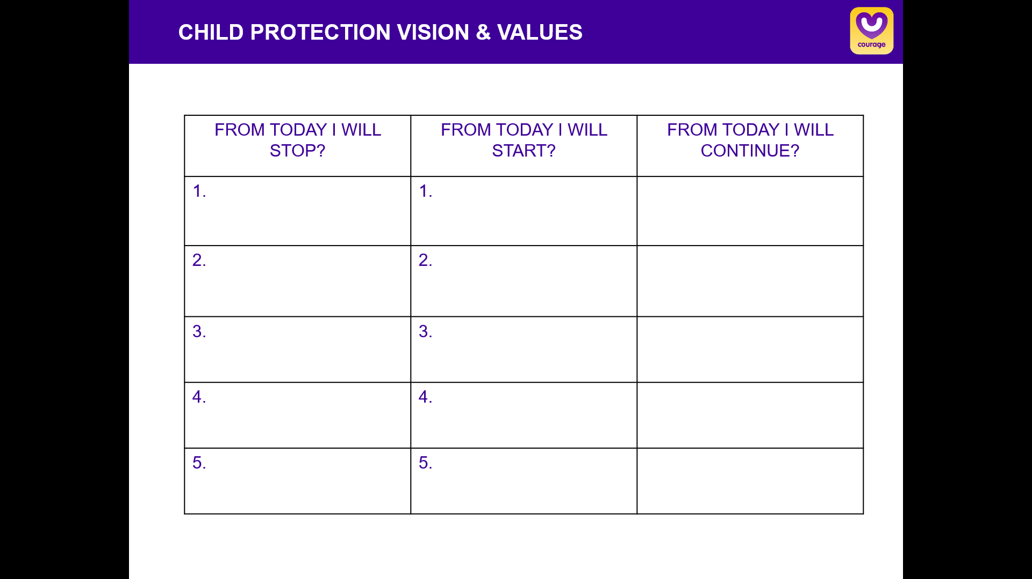
How should we answer?
From today what will we stop doing? What will we start doing? What will we continue doing? To achieve our vision for our children and the world we would like them to live in?
ACTION PLANNING
Notes:
As individuals or a group you can capture all of the things you plan to stop doing, all of the things you plan to start doing and all of the things you plan to continue doing. You can then commit either individually or as a group to these actions by signing and dating your action plan.

Slide 125

stay strong
take
www.courage-community.com
Notes:
Thanks for watching.
For more information visit Courage dash Community dot com
Be sure to like this video and subscribe to our Courage Channel.
Stay strong and take courage.

