Slide 1

The child protection & empowerment
community workshop
www.courage-community.com
Notes:
This presentation takes you in detail through how to run a Courage workshop, the child protection and empowerment programme for communities around the world.

Slide 2
This workshop will help you to:
Develop a vision for yourself, your family, your community or organisation based on children’s rights and developmental needs.
Identify what drives and what prevents all or particular child protection challenges in your community.
Understand and prioritise your child protection challenges and how they show up.
Develop empowered strategies to drive change.
Understand child protection and safe-guarding processes.
Identify and develop win/win community child protection partnerships.
Develop guiding values and principles to ensure the delivery of your child protection vision.
Develop a detailed action and implementation plan to ensure meaningful and sustainable change.
Notes:
This workshop will help you and your participants to…
Develop a vision for yourself, your family, your community or organisation based on children’s rights and developmental needs.
Identify what drives and what prevents all or particular child protection challenges in your community.
Understand and prioritise your child protection challenges and how they show up.
Develop empowered strategies to drive change.
Understand child protection and safe-guarding processes.
Identify and develop win/win community child protection partnerships.
Develop guiding values and principles to ensure the delivery of your child protection vision.
Develop a detailed action and implementation plan to ensure meaningful and sustainable change.

Slide 3












4 HOURS
WORKSHOP
4 X 1 HOUR
WORKSHOPS
WELCOME &
INTRODUCTIONS 20 MINS
WELCOME/INTRO10 MINS
FUTURE VISION
EXERCISE
20 MINS
WELCOME/INTRO10 MINS
PRIORITISE CHALLENGES
20 MINS
FUTURE VISION
EXERCISE
30 MINS
TAKE
10
COMMUNITY MAPPING
20 MINS
EMPOWERED SOLUCITONS
20 MINS
COMMUNITY MAPPING
30 MINS
WRAP & THANKS
10 MINS
WRAP & THANKS
10 MINS
PRIORITISE CHALLENGES
30 MINS
EMPOWERED SOLUCITONS
30 MINS
WELCOME/INTRO10 MINS
WELCOME/INTRO10 MINS
VALUES, RIGHTS
RESPONSIBILITIES
20 MINS
CHILD PROTECTION & SAFTY PROCESS
20 MINS
TAKE
10
CHILD PROTECTION & SAFTY PROCESS
20 MINS
WIN.WIN PARTNERSHIPS
20 MINS
ACTION PLANNING
20 MINS
WRAP & THANKS
10 MINS
WIN.WIN PARTNERSHIPS
20 MINS
WRAP & THANKS
10 MINS
THE COURAGE MATERIAL CAN BE USED IN A NUMBER OF DIFFERENT WORKSHOP FORMATS DEPENDING ON THE TIME YOU HAVE AVAILABLE AND WHICH MODULES YOU WOULD LIKE TO INCLUDE IN YOUR PROCESS
SEE WWW.COURAGECHILDPROTECTION.COM FOR MORE
VALUES, RIGHTS
RESPONSIBILITIES
20 MINS
ACTION PLANNING
20 MINS
Notes:
The Courage Child Protection Process can be run in a morning over 4 hours, or broken up into 4 hour workshops. If you would like to spend more time on each exercise, you are welcome to take as long as you want on each of them, as this timing plan is just a guide.

Slide 4
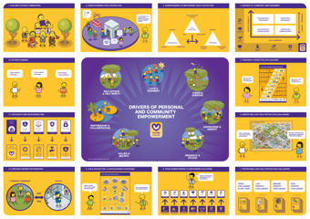
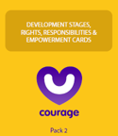
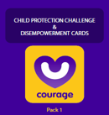
The Courage Toolkit
Notes:
This is the Courage Child Protection Toolkit, whish is made up of 4 picture based posters.The first illustrating a typical community anywhere in the world, complete with people, spaces and the child protection challenges they are dealing with. The second illustrates children’s rights and needs based on developmental stages, essentially how a child should grow up. The third illustrates the shift from disempowered to empowered drivers of change. And the final poster illustrates the step by step approach to child protection and safeguarding. There are also two packs of cards, a disempowerment pack, that details every single child protection challenge that exists in the world today and the seven disempowerment drivers that cause them. And an empowerment pack that details the empowerment drivers, child developmental stages, children’s rights and importantly the responsibilities that come with those rights. Finally there is an easy to use ‘quick start’ poster to for workshop trainers.
You can run a workshop with the printed toolkit, or you can download the posters from the website and print them yourself, or you can watch the various Courage videos on our website at www.courage-community.com in conjunction with the relevant exercises detailed in this presentation.

Slide 5
Notes:
This is the Courage quick start guide, that helps you to navigate your way around the workshop process which you can download from our website. The top 4 blocks explain the Courage purpose and philosophy, the middle picture illustrates our various drivers of individual and community empowerment, and the rest of the blocks from 5 to 12 explain each exercise visually, working clockwise around the poster.

Slide 6

Useful Courage Tools
Introduction to Courage Presentation
Introduction to Courage Movie
https://youtu.be/dOz6Vj4sm0I
Notes:
As a facilitator of this workshop, you can either present the introduction to the workshop by using the slides in this presentation and reading the speaker notes, or you can play the introductory video which you can find at this YouTube link.

Slide 7
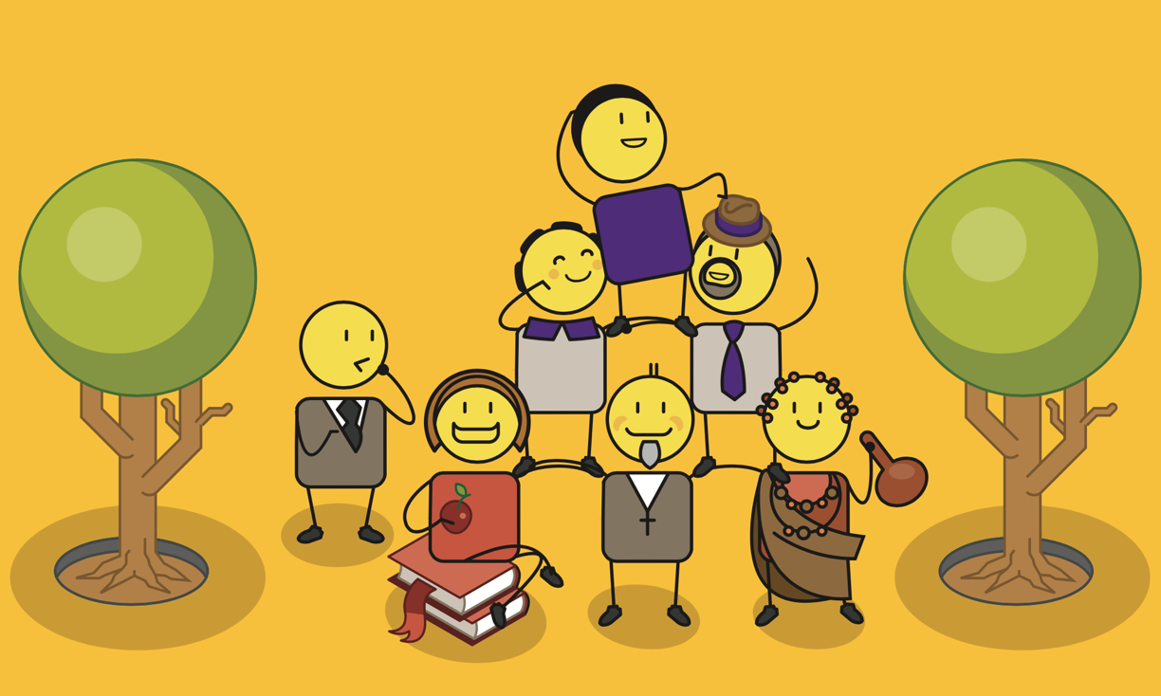
A community based programme
Notes:
The value of the Courage Child Protection & Empowerment programme is that it is community based. This means that we will explore the child protection challenges taking place in your community, and find solutions that are relevant and deliverable within your community context.
You may want to explore what a community is with your participants:
Ask everyone what community means to them and list these attributes on a flip chart.
Then ask them to list all of the communities that they are involved in e.g. school, sport, friendship, neighbourhood, work, church, youth etc.

Slide 8
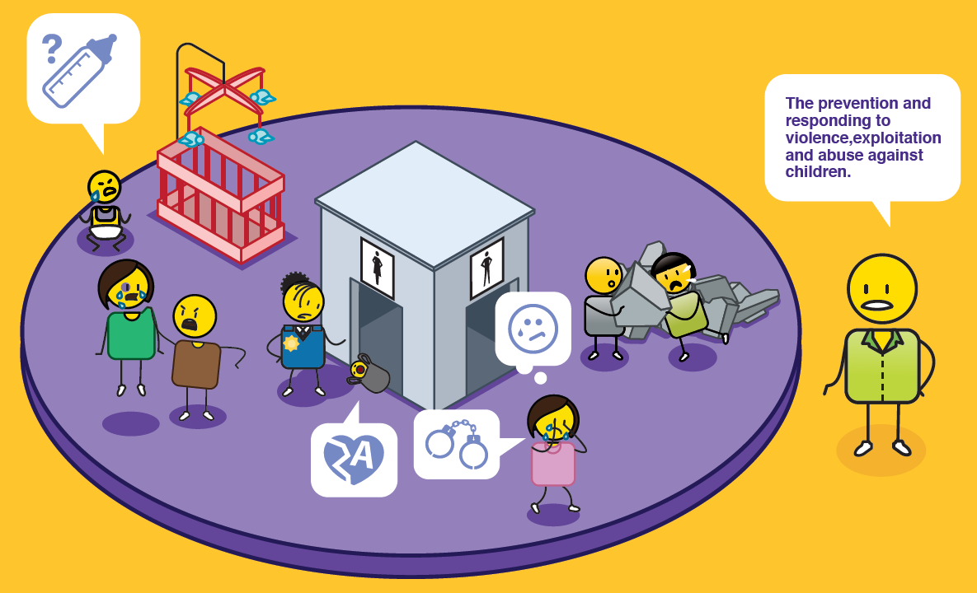
What is child protection?
Notes:
Lets understand what child protection is. The legal definition of child protection is the prevention and responding to violence, exploitation and abuse against children. There are three main themes to child protection, which are illustrated in this picture, neglect, where a child is either not cared for or has been abandoned by their caregivers, abuse where a child is subjected to a range of different forms of abuse such as physical, emotional and sexual abuse, and finally exploitation, where a child is used or exploited for monetary or other gain.

Slide 9

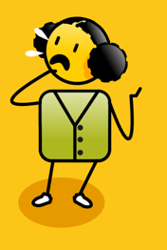
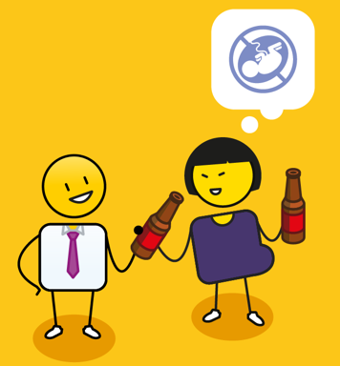
Why is it important?
depression
anxiety
post traumatic stress
learning disorders
suicide
toxic stress
substance abuse
developmental challenges
violence
poor self regulation
risky sexual behaviour
Notes:
Child protection is very important, as issues such as child abuse, neglect and exploitation can lead to anxiety, depression, suicide, learning disorders, post traumatic stress and developmental challenges. In the long term, a life of violence, can result in substance abuse, poor self regulation, risky sexual behaviour and toxic stress that impacts negatively on a person's health and wellbeing.

Slide 10
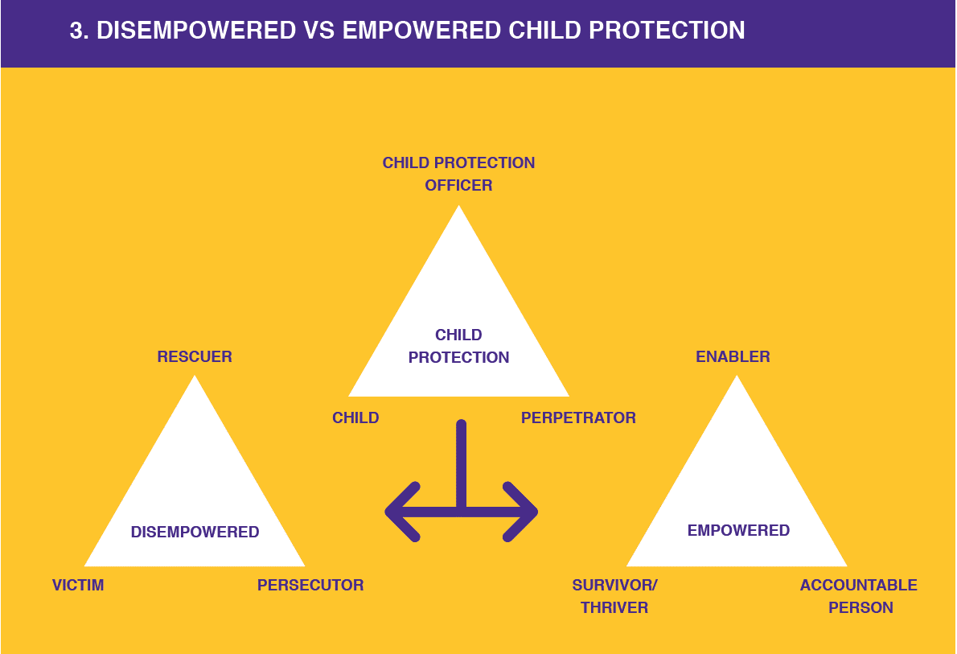
Notes:
When we started on our child protection journey at Courage, the first thing we noticed was how often people took a disempowered approach to solving their child protection challenges!

Slide 11

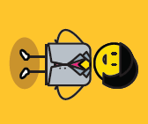

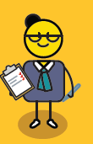


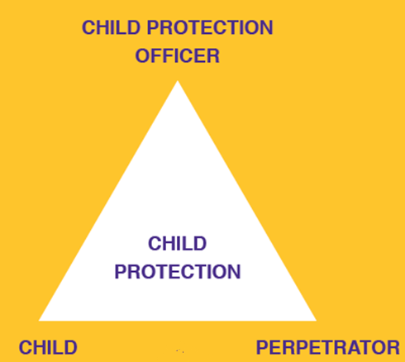
Who is involved?
Notes:
In child protection there are three different groups of people involved. The first are the child protection officers who can be teachers, police officers, social workers, doctors and nurses. In fact all adults have a responsibility to look after the children in their family and community.

Slide 12
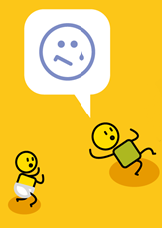

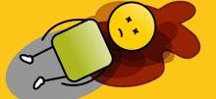
Who is involved?
Notes:
The second group are children. This starts at the point of conception, when a child is still growing in their mother’s womb and continues from their birth all the way up until they turn 18 years of age.

Slide 13
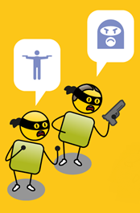



Who is involved?
Notes:
The last group of people are the perpetrators. These are people who have done something wrong to a child and can be strangers, members of their community, other children or a child’s parents.

Slide 14
The problem?
Notes:
The biggest problem, however, is that all these people often make disempowered choices.

Slide 15
Notes:
What happens is that in the process of tyring to protect the child, this group of people often descend into what Dr Stephen Karpman refers to as a ‘Drama Triangle’. In this drama, the child protection officer becomes a rescuer who tries to save the child. The child becomes a victim, and the perpetrator becomes a persecutor. Because everyone is disempowered, the drama tends to go round and round in a circle, where victim becomes persecutor, persecutor becomes rescuer and rescuer becomes victim, and so on.

Slide 16
Notes:
The key is to move out of this drama, and into a space of empowerment, where the child protection officer become an enabler, they are not rescuing the child, they are providing the child or parents with choices, and then empowering them to make the right choices. The victim becomes a survivor or thriver, and the persecutor becomes an accountable person who knows the difference between right and wrong.

Slide 17
Mind-shift!
Notes:
A mind shift is needed in the child protection community, and this is what it looks like?

Slide 18
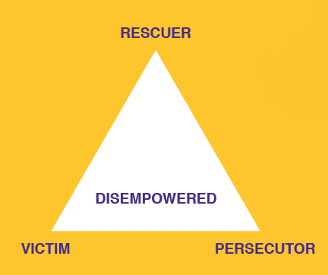
Disempowered
I feel so sorry for this child!
This child needs me.
I feel so guilty I should have done more!
I’m going to solve this problem for the child.
Notes:
The disempowered rescuer feels sorry for the child. Their desire to help is often driven by a sense of guilt. They believe the child needs them and they try to solve all the children’s problems for them.

Slide 19
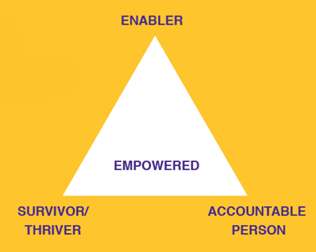
Empowered
This is not acceptable!
What are our choices?
We need to change this!
How can I empower action?
Notes:
The empowered child protection officer is an enabler. They are concerned for the vulnerable, but their focus is on identifying what needs to change, what choices are available, and how they can empower the child, parents or community members to act to prevent or stop the abuse from continuing.

Slide 20
Disempowered
I’m trapped and I’m suffering!
I don’t know what to do?
There is nothing I can do!
I have no choices!
Notes:
The disempowered child becomes a victim. They are suffering and feel trapped and helpless. They believe they have no choices and that they can’t solve their problems.

Slide 21
Empowered
What is happening to me is not right!
I need to do something about this!
What choices do I have?
Who can help me and what can I do?
Notes:
The empowered child becomes a survivor and hopefully thrives in the long term. They identify that the abuse, neglect or exploitation they are experiencing is wrong, and that they must act to change their situation. This could be a simple act of telling someone about what they are experiencing, or for older children, confronting their abuser. For babies, action is difficult, but their carers can be empowered to make different choices, that are in their child’s best interest,

Slide 22
Disempowered
This child doesn’t matter!
This child is not a person!
What about my struggles!
It's not my fault it’s the child’s fault!
Notes:
The disempowered perpetrator of child abuse, neglect or exploitation becomes a persecutor. The child does not matter to them, they have no empathy for the child and in some instances even blame them for what happened. They are very self centred and take no responsibility for their actions.

Slide 23
Disempowered
What I have done is wrong!
This could be my child, sister or brother!
What can I do to make up for my actions?
I must take responsibility for my actions.
Notes:
The empowered perpetrator becomes an accountability person, who acknowledges that what they have done is wrong. They empathise with the child, and realise that the child could be their sister or brother, their own child, or even themselves. They take responsibility for their actions and work hard to make amends.

Slide 24
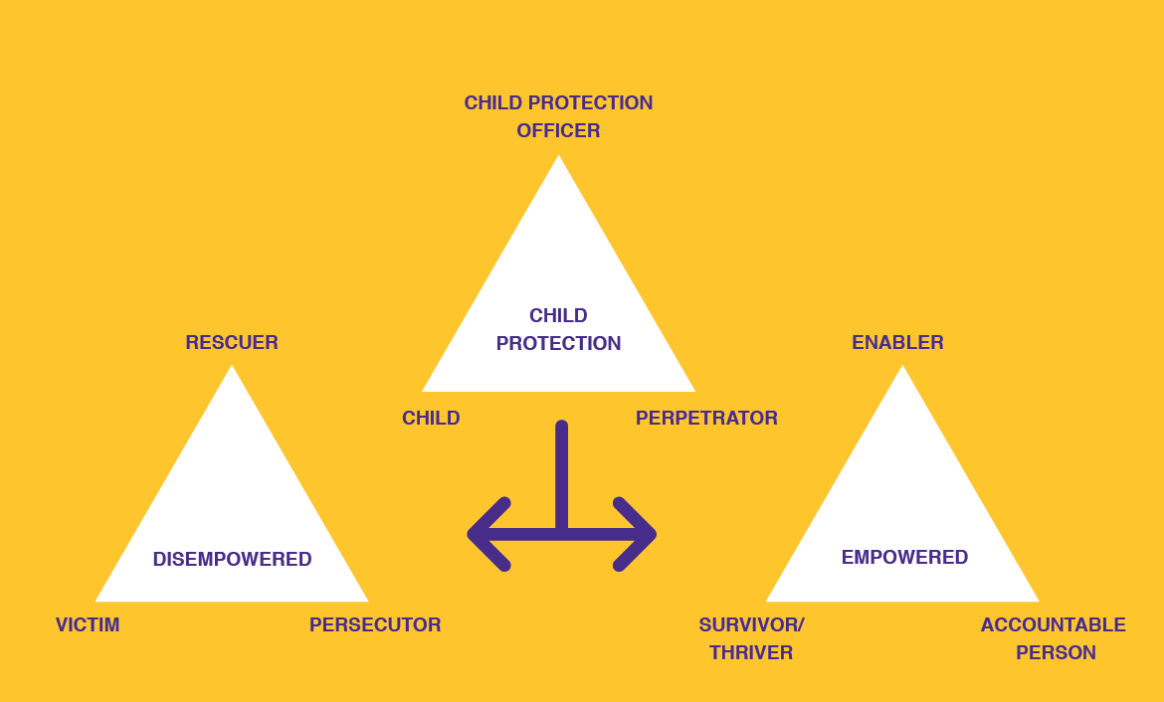
Empowered choices
Notes:
When we get stuck in the cycle of disempowerment, we never truly solve child protection challenges. It is only through making empowered choices that we can really bring about real and meaningful change.

Slide 25
What is empowerment?
Dictionary
noun
authority or power given to someone to do something.
the process of becoming stronger and more confident, especially in controlling one's life and claiming one's rights.
Notes:
So what does it mean to be empowered? The dictionary says it is when a person is given authority or power to do something. If we are empowered, we become stronger and more confident. We become the masters of our destiny and able to claim our rights as members of the human race.

Slide 26
How to build
personal & community empowerment?
Notes:
So how do we build personal and community empowerment?

Slide 27
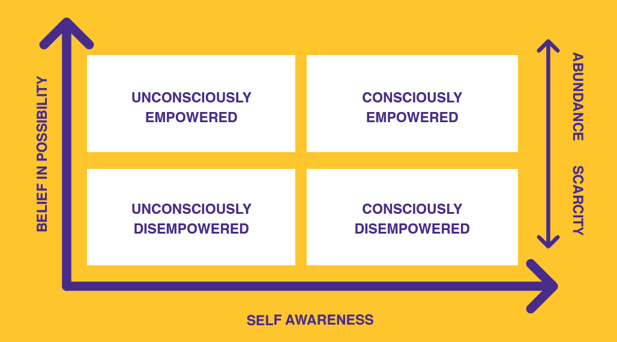
To build personal & community empowerment
3 simple steps:
1. Believe in possibility
2. Build self awareness
3. Focus on abundance
Notes:
At Courage we believe this can be built in 3 steps:
Firstly, you need to believe in possibility,
Secondly, you need to have some level of self awareness, and
Finally you need to do these two things in the context of abundance.

Slide 28
To build personal & community empowerment
Notes:
If you think about it, when we are young, we all have a relatively high level of belief in possibility, but we are not particularly self aware. We are ‘unconsciously empowered’, we believe we can be anything and do anything, we are just not sure how at this point.

Slide 29
To build personal & community empowerment
Notes:
And then different people arrive in our lives and tell us, well you can’t actually be what you want to be, because of your age, or the colour of your skin, or the fact that you are a girl, or a boy, or you are too old, you get the picture. Suddenly we find ourselves in the space of being ‘unconsciously disempowered’, we no longer believe anything is possible and we don’t know why we are in such a dark hole.

Slide 30
To build personal & community empowerment
Notes:
Interestingly, the people that put us in these dark holes are often the ‘consciously disempowered’, and this is the third dimension we need to be aware of. These people have a high degree of self awareness, they are often very clever, but their vision is based on scarcity rather than abundance. They believe that there will never be enough for everyone in the world, and so the only way to get what they want, is to take it away from other people.

Slide 31
To build personal & community empowerment
Notes:
Where we want to be is consciously empowered, so how do we do this?

Slide 32
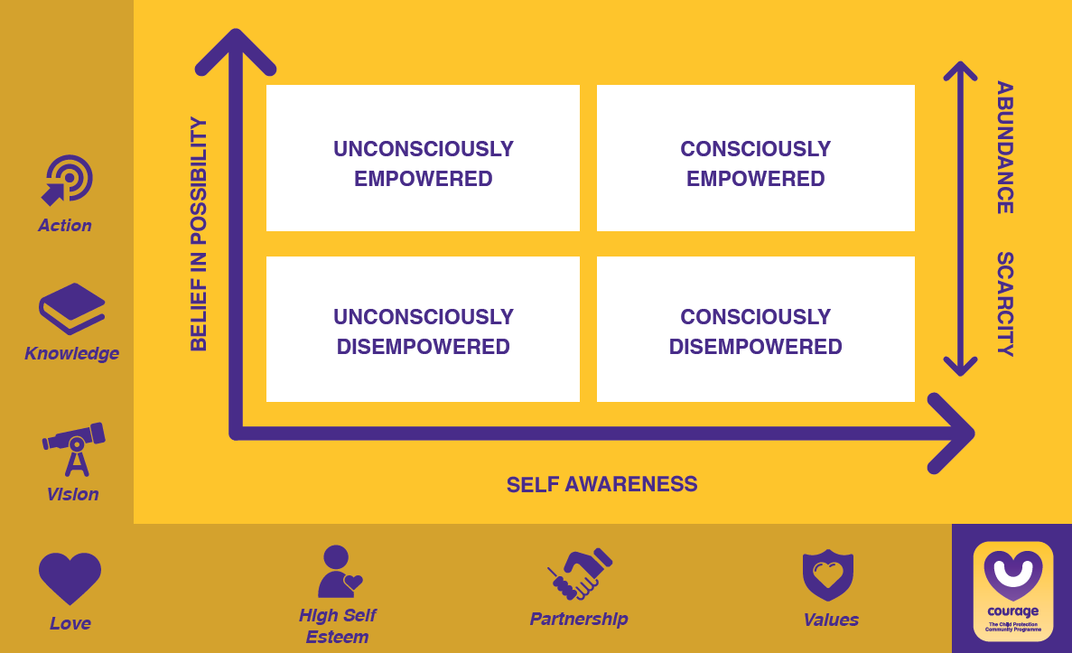
To build personal & community empowerment
Notes:
To build self awareness, we need to know what our values and beliefs are, we need to partner with other people to test these values and beliefs, and we need to ensure that we have a healthy sense of self esteem and self worth and that we are adding value to the world around us.

Slide 33
To build personal & community empowerment
Notes:
To build our belief in possibility, we need to have a vision for ourselves, a purpose for our lives. We need to build on this constantly through gaining knowledge and insight, and finally, we need to turn this vision, knowledge and insight into action, preferably on a daily basis.

Slide 34
To build personal & community empowerment
Notes:
The last point, is that we must build our self awareness and belief in possibility in the context of love and abundance, with the knowledge that there is more than enough for everyone to live their best life in this world.

Slide 35
To build personal & community empowerment
Notes:
At Courage, personal and community empowerment is both a philosophy and a tangible step by step programme to address the many child protection challenges we see in our communities every day.

Slide 36
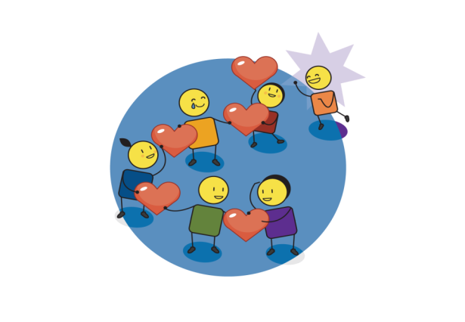


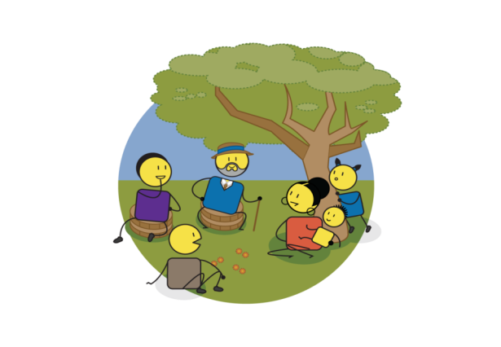
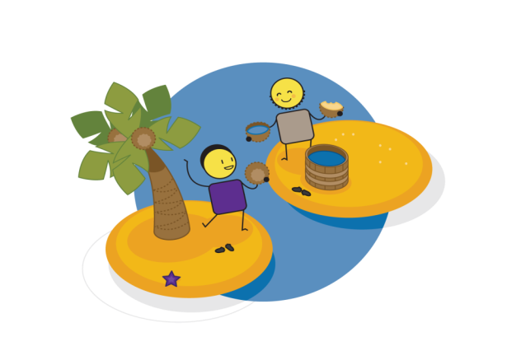
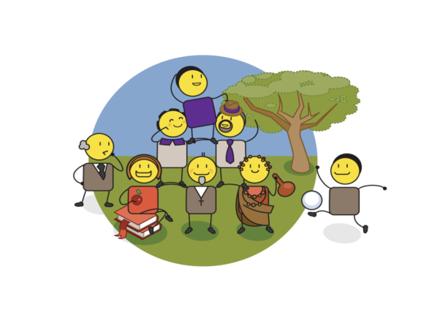

LOVE & HARMONY
SELF ESTEEM & SELF WORTH
VISION & PURPOSE
Are you empowered?
PARTNERSHIP & COLLABORATION
KNOWLEDGE & INSIGHT
VALUES & BELIEFS
PRESENCE
& ACTION
Notes:
We will now go through each of the seven different drivers of personal and community empowerment, to make sure we understand their relevance in our world and to child protection.

Slide 37










Values & beliefs
Notes:
The first source of empowerment is a person’s values and beliefs. These are the cornerstones of your identity, and should drive all of your day to day actions, behaviours and choices. Values and beliefs in the context of child protection are about ensuring that we provide for the basic needs of all people in our community. Values are about creating a sense of law and order in our world, knowing right from wrong, and agreeing what is most important, not just to you, but to your family and your community. One of the most important values is believing in the equality of all people, this is fundamental to personal, community and societal leadership.

Slide 38






Partnership & collaboration
Notes:
The second source defining who your community partners are and agreeing how you will work with them. Real partnership and collaboration cannot happen without shared values, mutual trust and respect, and good communication. Good partnership and collaboration, should happen at a family, extended family, community and societal level through government and social partnerships.

Slide 39







Self esteem & self worth
Notes:
The third source, is ensuring a positive sense of self-worth and self-esteem, which starts with creating a strong personal identity. Self-esteem and self-worth ensures that we care for ourselves and others around us. It can be about personal achievement, but it is also about simply making good choices or decisions that are in your, your family or community’s' best interest. It is about having a focus and direction and taking personal responsibility for your life and how you live it.

Slide 40


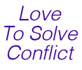




Love & harmony
Notes:
The glue that holds all of our personal and community empowerment drivers together is that of love and harmony. To ensure that we act with abundance rather than scarcity, we need to use love to solve conflict in our families and our communities. We need to practice empathy, and strive to build peace in our homes, which will ultimately lead to peace in the world around us. In abundant communities, all actions are driven by a desire to support and care for each other, rather than pushing each other apart.

Slide 41






Vision & purpose
Notes:
The fifth source is to define our vision or purpose. This is about having focus and direction in our lives. It is about making good choices and ensuring personal, community and societal leadership. A personal vision allows you to express who you are and what is important to you. Once you have defined your vision and purpose, you will feel the great sense of freedom that comes with turning hopes, dreams and imagination into the realisation of innovation and new ideas.

Slide 42







Knowledge & insight
Notes:
The sixth source is about constantly building our knowledge and insight into our world. Its about learning and education, supporting everyone’s right to an opinion and seeking the truth in all that we do. Its about openness and transparency, monitoring, measuring and evaluating what has come before, but most importantly, it is about being open to new ideas, and new ways of seeing the world.

Slide 43







Presence & action
Notes:
The final source of personal and community empowerment, is that of presence and action. This is about focussing on the future and understanding how to plan for this today. Its about delivering on what you promise. Its about believing in possibility, ensuring that everyone has access to making their dreams come true, and that the difference you create is sustainable for future generations.

Slide 44
Notes:
Now that we understand the Courage philosophy, its time to explore our community and develop our own child protection strategy, which we will do by following exercises 5 to 12 on the Quick Start Guide.

Slide 45
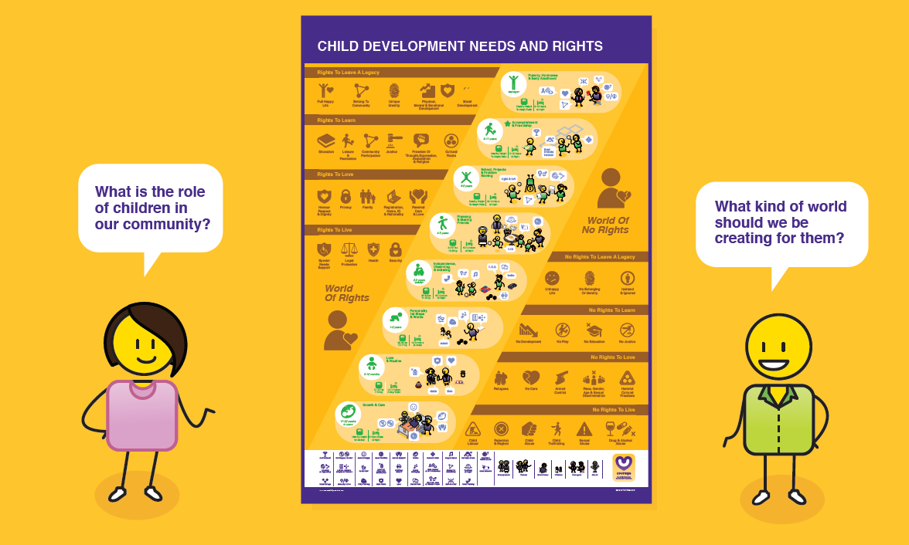
Defining your vision
Notes:
All Courage workshops start with a visioning exercise, where we ask participants what kind of world they would like children to grow up in.

Slide 46
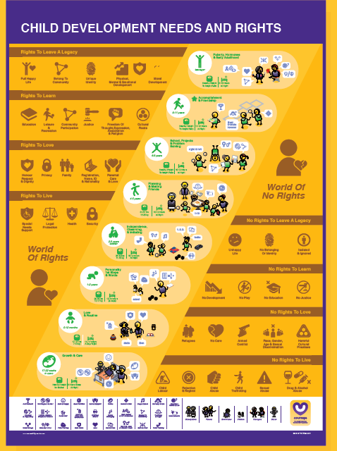
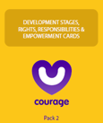








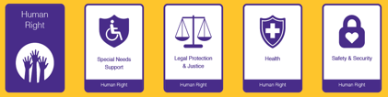
Useful Courage Tools
Child needs & rights presentation
Child needs & rights cards
Child needs & rights poster
Child needs & rights movie
https://youtu.be/3FP3dJZAQZo
or
or
Notes:
As stimulus for your vision exercise you can either use a pack of Courage Empowerment cards, which include cards describing children’s rights and developmental needs.
Or you can use the Courage Child Development Needs and Rights A1 Poster.
Or you can present the slides on this presentation using the speaker notes.
Or you can play the vision exercise video which you will find at this YouTube link.

Slide 47
What is a vision?
Notes:
As discussed before, to have a vision or purpose is to have direction and focus. It is about making choices and leadership at every level, from individuals to society at large. A vision allows you to express who you are and what is important to you at a personal and community level. Once you have defined your vision or purpose, you will feel a great sense of freedom that comes with turning your dreams and ideas for the future into reality. The best visions are those based on new ideas and innovation, thinking differently about the world, and how you can make it better.

Slide 48
Great visions?
leader initiated
positive & inspiring
shared & supported
comprehensive & detailed
Notes:
A great vision is leader initiated, meaning that you are the master of your destiny. It should be shared and supported by your family, friends and community. It should be comprehensive and detailed, so that you know exactly what you need to do to achieve it. And it should be positive and inspiring, to make sure that you push yourself to new heights.

Slide 49

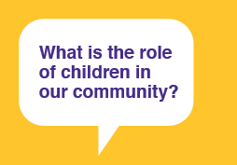
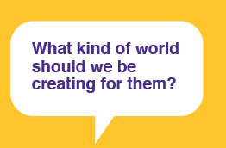
What should we ask?
Notes:
When thinking about creating a vision for the children in our communities, it is useful to ask ourselves two questions.
Firstly, why do we have children and what is their role in our family or community?
And secondly, what kind of world should we be creating for them?

Slide 50
How should we answer?
The role of children is…
We should create a world that…
1.
2.
3.
4.
5.
1.
2.
3.
4.
5.
Notes:
This is a useful template to help you and your team or community to capture your answers. On the one side list the role of children in your family and community, and on the other, the kind of world you would like to create for them.

Slide 51
Why is a vision important?
Notes:
Why is a vision important?

Slide 52




Positive Role = Empowered Child
The role of children is…
care, love & empathy
To be an expression of our love as a couple/family.
To build and grow our families and communities.
To build our future generations.
To create new ideas and possibilities.
family & community
learning & education
innovation & growth
Notes:
If children have a positive role in their family and community, they will be empowered and have a high degree of stability in their lives. This role could be as an expression of a family's love, to grow that family and community, to build future generations and to create future possibilities. A positive role creates empowered children who are empathetic and value love, family, community, education, innovation and growth.

Slide 53




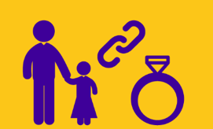
Negative Role = Disempowered Child
The role of children is…
abuse & neglect
They were a mistake we did not plan for them.
I had them because my culture expects it of me.
They are a good source of labour.
They are a good retirement plan.
harmful cultural practices
child labour & exploitation
child marriage
Notes:
However, many people do not think about the role of children in their world. Parents often talk about unplanned children as a mistake. They note how their culture expects them to have children rather than wanting a child themselves. Children are sometimes referred to as ‘a good source of labour’ or ‘a good retirement plan.’ It is not surprising that some of the biggest child protection challenges in the world include abuse and neglect, harmful cultural practices, child labour and exploitation, and child marriage. Just as children with positive roles are empowered and have stability in their lives, children with negative or no defined role are often disempowered and have an enormous amount of instability in their world.

Slide 54
How should children grow up?
Notes:
To think about the kind of world we would like our children to grow up in, its useful to understand how our children should grow up.

Slide 55
They have rights…
Notes:
Firstly, all children are entitled to a number of rights.

Slide 56






vs
Notes:
These rights were first identified at the United Nations Convention on the Rights of the Child in 1990. Children’s Rights have been defined at a global level by UNICEF. At a continental level, such as by the African or European Unions, and by individual countries in their own Bill of Rights and Children’s Acts. These ‘Rights Documents’ detail what should, or should not be happening to children in families, communities or societies at large..

Slide 57




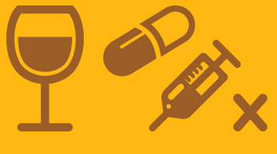
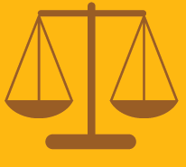




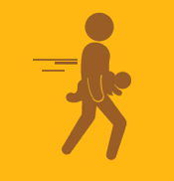




They have rights to live
vs
Notes:
All children have a right to live…
These rights include a right to life,
Safety and security.
To be registered and have a name, an identity and a nationality.
A right to health care.
A right to legal protection and justice.
And a right to support if they have any special needs.
This is in contrast to a world of no rights…
Where children are rejected or neglected.
Subjected to abuse, whether physical, emotional or sexual.
To substance abuse, sometimes even in utero.
Have no access to justice
Or are trafficked as a commodity to be bought or sold.

Slide 58





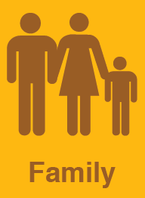

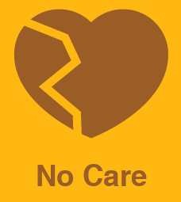

They have rights to love
vs
Notes:
They have rights to love…
Which include a right to a family.
And parental love and care.
To honour, respect and dignity.
And to privacy.
Versus a world where they are subjected to.
Harmful cultural practices
Armed conflict.
Race, gender, age or sexual discrimination.
Where they are refugees..
And have no care or protection.

Slide 59








They have rights to learn
vs
Notes:
They have rights to learn…
Through community participation and belonging
Through education.
Leisure and recreation.
Where they have freedom of thought, expression, association and religion.
And knowledge of their cultural roots.
Versus a world where they have no access…
To play.
To education.
To personal development.
And are subjected to harmful cultural practices

Slide 60
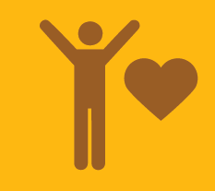


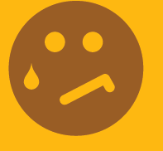




They have rights to leave a legacy
vs
Notes:
And finally they have a right to leave a legacy…
To have a unique identity.
To have physical, mental and emotional development.
To have moral development.
To live a full and happy life.
On a healthy planet
Versus a world where they …
Have no belonging or identity.
They are not developed or nurtured
They are Isolated and ignored.
And live an unhappy life
On an unhealthy planet.

Slide 61
They have needs…
Notes:
In addition to their rights, children also have different needs as they grow up and develop…

Slide 62
0 – 40 weeks
Healthy weight for Mother
8 Hours Sleep at Night
Notes:
Even in-utero, a foetus has rights from around 24 weeks, to when they are born between 38 and 40 weeks. This is a time of growth for the baby and care of the mother. Pregnant mothers must get lots of rest, visit their doctor or clinic regularly and eat healthy food. They must avoid all drugs and alcohol and try to stay calm and happy during this exciting time. Ideally they should be supported by their family and partner.

Slide 63
17-27 lbs
7-14 kg
(Day/Night)
Notes:
From zero to 12 months is a time of love and creating routine in your babies life. In this first year they will learn their name, start to play with basic toys and build strong attachments to their parents or caregivers. Parents should make sure they have ‘baby proofed’ their home by locking away any dangerous substances, covering electrical outlets or open sources of water.

Slide 64
Notes:
From their first to second birthday, a baby will develop their personality, take their first steps and say their fist words. They will start to be possessive of their toys, understand that they belong to a family and be interested in early learning concepts such as letters, colours, shapes and texture. They should start potty training at this stage and learn to drink from a cup and feed themselves.

Slide 65
Notes:
From two to three years, a baby becomes a toddler, it is a time of learning independence from their primary care givers and observing and imitating the people around them. They will start to notice biological differences between boys and girls, and engage in singing, simple counting and playing with more complex toys such as stacking items and kicking a ball. They should move from a potty onto a toilet and as their teeth start to grow they will need to be taught about good dental care. At this stage they will also need to engage in an early childhood development programme or play school. This is also the stage when parents may notice some developmental delays in a child with neurodevelopmental challenges, and should seek help if this is the case.

Slide 66
Notes:
From four to five years children will start to make friends and learn simple planning. They may become frustrated and express anger through tantrums, so positive discipline is encouraged. They become more active in sport, developing their gross and fine motor coordination, which is important for writing and cutting. They should be able to count to 10, remember basic letters and words, and dress themselves. As they are growing fast, good nutrition is very important, as is giving them opportunities to connect with extended family and friends to build their sense of belonging to a community.

Slide 67
Notes:
From 6 to 8 years, children start school, and learn about projects and problem solving. Their right or left hand and foot dominance becomes evident and their confidence in their physical body grows. Gender awareness becomes more pronounced, and their need to belong to broader communities such as friendship circles.

Slide 68
Notes:
From 9 to 11 years, children become more focussed on achievement and building their personal friendships. They will start to identify ‘best friends’ and even enemies and will want to belong to clubs and social groups. They will also become sexually aware at this stage and it is important to start to engage with them openly about their bodies and sexuality.

Slide 69
Notes:
From 12 to 18 years, children enter their teenage years, which is typified by puberty, hormones and development into young adults. They may become sexually active, so it is important to talk to them about sex education, birth control and how to protect themselves from sexually transmitted diseases. They will start to fall in love, become quite self centred, questions norms and values (especially of their parents or caregivers), and sometimes have dramatic mood swings, this is all completely normal. They will start to test boundaries and sometimes engage in risky behaviour such as smoking, drinking or taking drugs, often due to peer pressure. It is important that they know that they can confide in their parents or another family member should they need to throughout their teenage years.

Slide 70

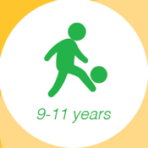


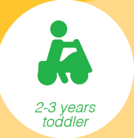
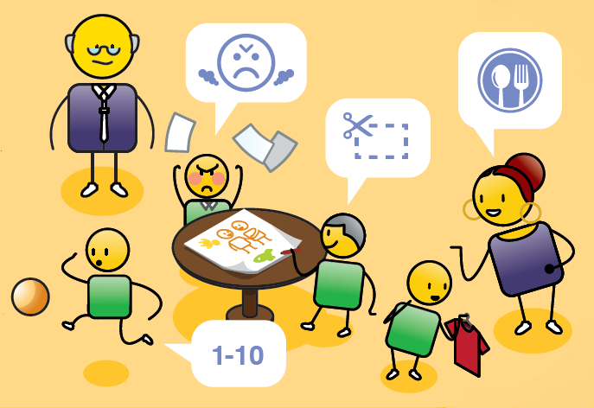
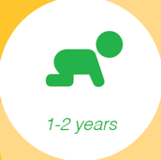
Courageous Parenting
https://youtu.be/1gKT_t4L_oA
Notes:
For more detailed information about how a child develops physically, mentally, emotionally and socially, see our ‘Courageous Parenting’ presentation which details this and tips for parenting at each stage.

Slide 71
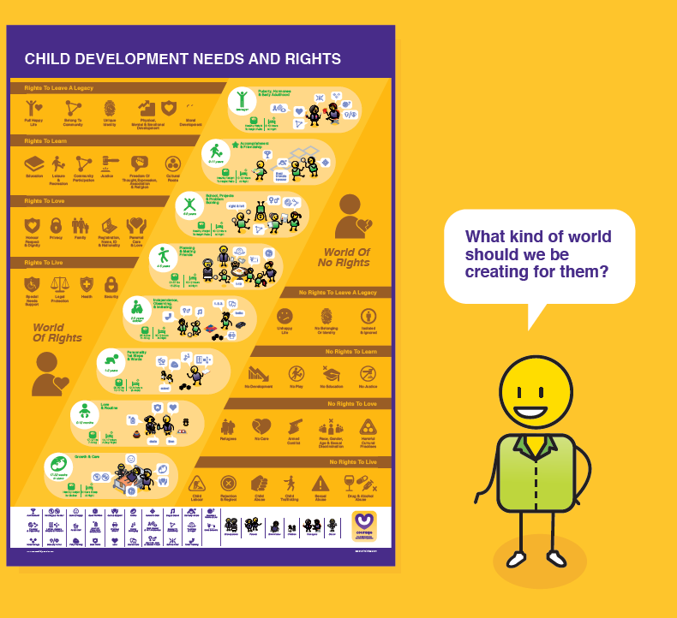
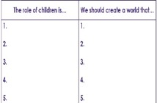
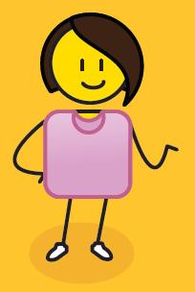
Agree your vision
Let’s agree on what kind of world we would like our children to live in so that we can build this for them?
Notes:
Now that we understand the rights and needs of children, spend some time discussing and agree a positive role for children in your community and the kind of world that you would like to create for them. Then summarise this into a simple vision statement that you can share with your family, community, school or child protection organisation.

Slide 72
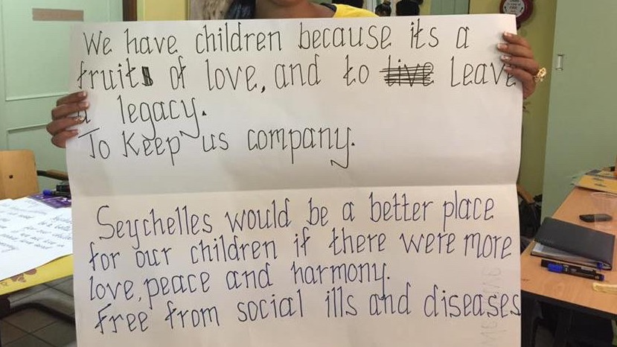
Notes:
This is an example of a community vision that a team developed in one of our workshops.

Slide 73
Notes:
In this vision, developed by a group of children, they have drawn and named their ideal community, which is another approach to creating a vision.

Slide 74
No right or wrong visions
leader initiated
positive & inspiring
shared & supported
comprehensive & detailed
Notes:
There are no right or wrong vision statements, but remember, if you are part of creating the vision, you are also responsible for leading it. You will need to share it with your community and make sure that they support you. It needs to be comprehensive and detailed enough that everyone can help in delivering it, and it must be positive and inspiring to be worth the effort of creating it in the first place.

Slide 75
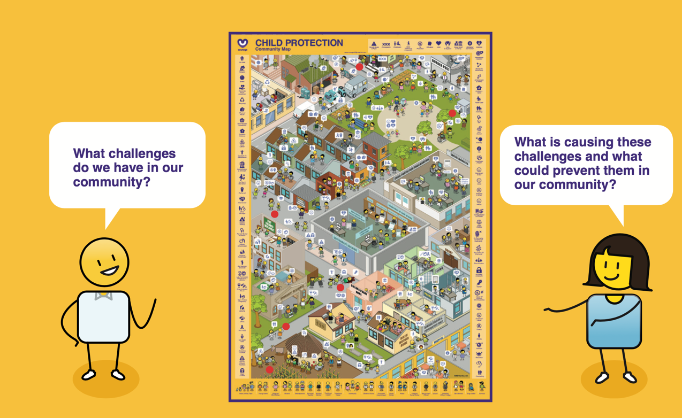
Identifying our child protection challenges
Notes:
The next exercise is about understanding what participants think drives child protection challenges, versus what prevents them, in their communities. We use the community map for this exercise and ask participants to identify all of the child protection challenges they have observed in their community on the map. They then need to discuss what they think are the key causes of these challenges and what they think could prevent them. This is a powerful exercise that creates a foundation for the rest of the workshop, as it creates an overview of what the participants are dealing with in each of their unique communities.

Slide 76

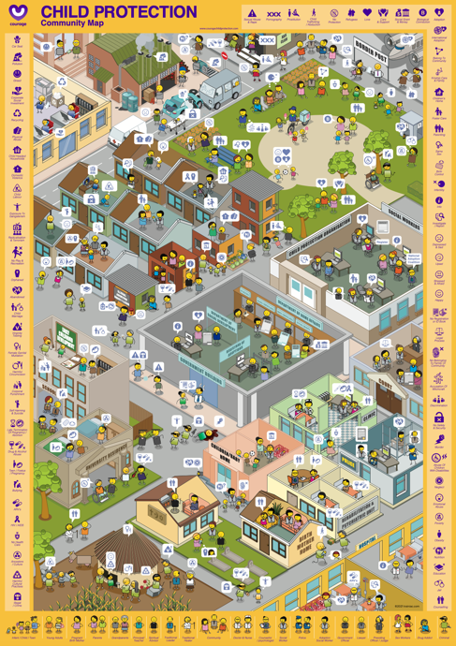
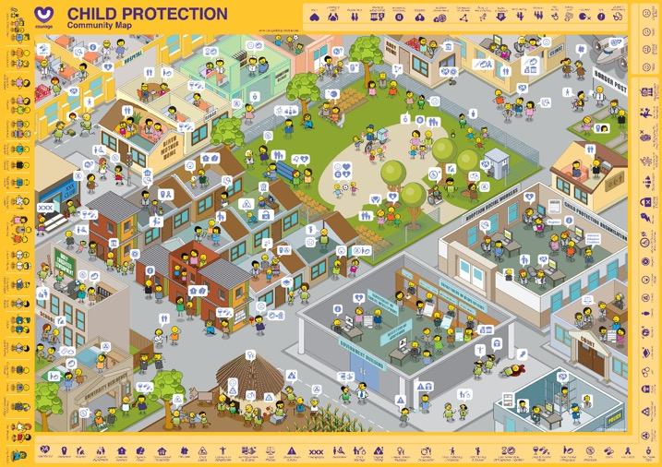

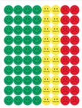
Useful courage tools
Community map presentation
Courage community map and stickers/buttons
Community map video
https://youtu.be/s-NU_75ba6o
or
Notes:
As stimulus for your child protection identification exercise you can either use:
An A1 Courage Community Map which is available in portrait or landscape format and some coloured buttons or stickers.
Or you can present the slides in this presentation and use coloured marker pens to identify your community’s child protection challenges on the projected map.
Or you can play the YouTube video that you will find at this link., and ask participants to list child protection challenges that they have seen in their community on a piece of paper.

Slide 77


Notes:
This is the Courage Community Map, and represents a community anywhere in the world.

Slide 78

Notes:
Starting in the top left-hand corner and moving right, you will see different kinds of companies, main roads, night clubs, bars and border posts. Moving down, you will see public spaces such as parks where people can relax and meet friends outside, and then there are different kinds of residential areas.

Slide 79

Notes:
Some residential areas have formal houses, and some have informal houses as you can see in the middle of this community map. There are also child protection organizations, social workers, courts, clinics and government departments that span a number of different areas such as home affairs and social development. Moving back to the left of the map, you will see early childhood development centres or creches and schools.

Slide 80

Notes:
In addition to schools there are universities and places of post graduate study. You will also find religious intuitions, baby and children’s homes, a range of different health clinics, police stations, rehabilitation and psychiatric units, birth mother homes and hospitals. Finally in the bottom left-hand corner you can see a home that is situated in a rural area, where people may go to visit their family and where they have come from.

Slide 81







Community members
Criminal
Notes:
There are different kinds of people in this community from children to families, spiritual, traditional and community leaders, doctors, nurses, social workers, police officers and government officials. There are also people who struggle to fit into communities such as drug addicts or those with criminal intent.

Slide 82
























Child protection conversations
Notes:
The people in the community are having lots of different conversations about the child protection challenges happening in their community. We have used a child protection emoji language to illustrate these conversations.

Slide 83

What challenge have we seen?
What are some of the child protection challenges that you have seen in your community?
Using the red stickers or buttons identify what these challenges are on the community map
Notes:
For this exercise, you will want to ask your participants to identify all of the child protection challenges that they have seen or observed in their community. They can identify these using stickers, buttons, markers on a printed or projected community map, or just by listing them on a piece of paper. If your participants are working in a group, suggest that they spend some time describing their community to the rest of the team, so that they understand the context of the challenges that they identify.

Slide 84


What promotes or prevents these challenges?
What do we think is causing these problems in our community?
What do we think could prevent these problems in our community?
Notes:
Once they have identified all of their challenges, ask them to make a list of all of the things that they think are causing the challenges in their community and another list of all of the things that they think can prevent these challenges from taking place.

Slide 85

Notes:
If you are using this presentation as the workshop stimulus, you may want to press leave this picture up, so that participants can spend some time exploring the community map.

Slide 86

Notes:
This was a group of child protection officers identifying the child protection challenges in their community. Once they had acknowledged that the challenges existed, they could start to work towards solutions to solve them.

Slide 87










The process of change*
HOLDING ON
LETTING GO
MOVING ON
MOVING FORWARD
DENIAL
TESTING
SHOCK
* Inspired by Elisabeth Kubler Ross Stages of Grief
CONFIDENCE LEVELS
AWARENESS
UNDERSTANDING
ACCEPTANCE
TIME
Notes:
This exercise, of identifying child protection challenges and what promotes or prevents them, is very important if we want to solve these problems. When something bad happens in a community such as the rape or abuse of a child. People will go through a number of stages in trying to make sense of this terrible event. They will go through shock, “I can’t believe this has happened”. They may even go through denial, “perhaps this didn’t happen and the child is lying?” But often more evidence will emerge and the community will become aware and finally accept that there is a problem in their community and amongst their families. Although child protection challenges such as abandonment, neglect, abuse and exploitation rock the very foundations of our communities, we cannot solve these problems until we accept that they are, in fact, taking place. As quickly as possible, we need to move our communities into understanding and testing new ways of doing things to make sure that these kinds of challenges don’t happen again. This exercise is critical, as it moves people on from holding onto the past, to letting go and finally moving forward as a stronger community intent on the care and protection of their children.

Slide 88

Understanding & prioritising
Notes:
After defining a vision for our community and then acknowledging that challenges exist its important to start thinking strategically about how to solve them.
Courage has identified nearly 50 unique child protection challenges that children are experiencing around the world. Each is represented by a card that details what the challenge is and what needs to be considered in terms of its impact on the children and the community they live in.
At this point in the workshop, participants are encouraged to go through all the Courage child protection cards, to understand what the challenges are, if they are happening in their community, and if yes, to prioritise the challenge as a low, medium or high problems.

Slide 89









Useful courage tools
Courage child protection challenges presentation
Courage Disempowerment Cards (purple pack)
or
Courage child protection challenges video
https://youtu.be/_QdBJDiIx68
Notes:
For this exercise you can either use:
The Courage disempowerment cards (which is the purple pack), or
Or you can present the child protection challenges using this presentation and the speaker notes.
Or you can watching the Courage child protection challenges movie which you will find at this YouTube link.

Slide 90
Knowledge & insight
Notes:
The purpose of this exercise is to empower your participants and community with knowledge and insight about the child protection challenges happening around you. Knowledge and insight are critical to solving any problem, and are an important driver of personal and community empowerment. They are about learning and education, about openness and transparency,. Knowledge and insight helps us to support concepts such as human diversity and rights. In the world of child protection, they often come from the monitoring, measurement and evaluating what is happening around us. Knowledge and insight are about searching for the truth every day and being open to new ideas and new ways of thinking about the world.

Slide 91


What should we ask?
Look at each child protection challenges card to understand what it is about
Place your cards in 4 piles, high, for the biggest problems, medium and low. And a pile for challenges that don’t exist in your community
Notes:
For this exercise, you will want to ask your participants to go through each child protection challenge card, of as they are presented, to understand what the challenge is all about. The first question they should ask themselves is whether this child protection challenge is happening in their community or not. If it is not happening, they should place the card in a “does not exist” pile. If the challenge does exist, they should ask themselves if this is a high, medium or low priority challenge in their community, and then place the card in the appropriate pile. If your participants are just listening to your presentation or the child protection challenges video, they should list each challenge that does exist in a high, medium, or low column and then discuss and agree this with their team. This is a very subjective exercise, as community members are being asked for their opinion, on the impact or severity of the child protection challenge, so if there is disagreement they should discuss why they think the way they do as a group. At the end of the day, each participant is an expert on their own community and their views matter.

Slide 92
How should you answer?
HIGH
PRIORITY
MEDIUM PRIORITY
LOW
PRIORITY
DOES NOT EXIST
1.
2.
3.
4.
5.
6.
7.
8.
9.
10.
1.
2.
3.
4.
5.
6.
7.
8.
9.
10.
1.
2.
3.
4.
5.
6.
7.
8.
9.
10.
1.
2.
3.
4.
5.
6.
7.
8.
9.
10.
Notes:
If you have cards, you can just make 4 different piles, however, if you are writing your answers down, write them into 4 separate columns as illustrated. At the end of the exercise you can then try to prioritise them from highest to lowest in each of your high medium and low columns.

Slide 93









A cycle of disempowerment
20
21
- 2
19
- 1
18
YOUNG ADULT
IN-UTERO
0
17
1
OLDER TEEN
BABY
16
2
15
3
14
4
YOUNGER TEEN
TODDLER
13
5
12
6
TWEEN
CHILD
11
7
10
9
8
Notes:
Different child protection challenges happen at different stages in a child’s life, from in-utero, to when they are born, become a toddler, a child, a tween, a young teen, an older teen or a young adult.

Slide 94






A cycle of disempowerment
20
21
- 2
19
- 1
18
YOUNG ADULT
IN-UTERO
0
17
1
OLDER TEEN
BABY
16
2
15
3
14
4
YOUNGER TEEN
TODDLER
13
5
12
6
TWEEN
CHILD
11
7
10
9
8
Notes:
Before children are born they are exposed to challenges such as drug and alcohol abuse by their mother in utero, which impacts on a baby’s mental and physical development in what is termed foetal alcohol spectrum disorder, there is also the challenge of 3rd trimester late abortion. At birth children are at risk of being exposed to the HIV virus and to poor health services that place their life and wellbeing at risk. They are also at risk of being orphaned given the high rate of maternal death for HIV positive mothers. Small babies are also at risk of neglect,

Slide 95



A cycle of disempowerment
20
21
- 2
19
- 1
18
YOUNG ADULT
IN-UTERO
0
17
1
OLDER TEEN
BABY
16
2
15
3
14
4
YOUNGER TEEN
TODDLER
13
5
12
6
TWEEN
CHILD
11
7
10
9
8
Notes:
In the first weeks and months following birth, children are at their highest risk of being abandoned by their mothers in either safe or more often unsafe spaces, if they are unable to care for them often due to extreme poverty.
Child trafficking is a challenge due to their vulnerability, and abandoned children often denied birth certificates or identity documentation.

Slide 96






A cycle of disempowerment
20
21
- 2
19
- 1
18
YOUNG ADULT
IN-UTERO
0
17
1
OLDER TEEN
BABY
16
2
15
3
14
4
YOUNGER TEEN
TODDLER
13
5
12
6
TWEEN
CHILD
11
7
10
9
8
Notes:
As they become toddlers and start to question their parents or act out, children are more at risk of physical abuse, attempted murder and murder, and issues such as the impact of bad nutrition start to emerge. When children start going to school they become subject to issues such as bullying, emotional abuse and corporal punishment, there are also issues around no special needs support for children with disabilities due to lack of resources.

Slide 97






A cycle of disempowerment
20
21
- 2
19
- 1
18
YOUNG ADULT
IN-UTERO
0
17
1
OLDER TEEN
BABY
16
2
15
3
14
4
YOUNGER TEEN
TODDLER
13
5
12
6
TWEEN
CHILD
11
7
10
9
8
Notes:
As they move into their tween years issues such as sexual abuse and rape emerge as do child labour and commercial sexual exploitation. As children reach puberty issues such as harmful cultural practices such as female genital mutilation or harmful male circumcision and child marriage become an issue.

Slide 98



A cycle of disempowerment
20
21
- 2
19
- 1
18
YOUNG ADULT
IN-UTERO
0
17
1
OLDER TEEN
BABY
16
2
15
3
14
4
YOUNGER TEEN
TODDLER
13
5
12
6
TWEEN
CHILD
11
7
10
9
8
Notes:
Other challenges such as street children, unaccompanied minors, refugees and child headed households emerge, and children are exposed to dangerous environments such as gangsterism and crime.

Slide 99



A cycle of disempowerment
20
21
- 2
19
- 1
18
YOUNG ADULT
IN-UTERO
0
17
1
OLDER TEEN
BABY
16
2
15
3
14
4
YOUNGER TEEN
TODDLER
13
5
12
6
TWEEN
CHILD
11
7
10
9
8
Notes:
As vulnerable children become older teens issues such as mental health, depression, anxiety and suicide attempts start to emerge. It is also a time when vulnerable children start to engage in risky sexual behaviour, resulting in teen pregnancy, using drug and alcohol, and experiencing abuse in the justice care system when they fall foul of the law.

Slide 100
We will now go through each of the 49 child protection challenges identified by Courage to understand them and prioritise their impact on our community
Notes:
If you do not have the Courage Disempowerment Cards Pack, we will now go through each of the 49 child protection challenges identified by Courage to understand them and prioritise their impact on your community. You will need to decide if they are happening in your community or not, and if they are, how you would prioritise them, as a high, medium or low problems. It is also important to identify if there are any child protection challenges missing from all the ones that Courage have identified. If there are, be sure to share these with your group and with the Courage team.

Slide 101




Notes:
The first challenge is drug and alcohol abuse in utero. This is when a mother consumes excessive amounts of alcohol or drugs whilst pregnant. This can lead to a brain disorder called foetal alcohol syndrome or spectrum disorder in an unborn child and is often a result of ignorance by the mother of how what she consumes impacts on her unborn child. An unborn child is still entitled to rights, and this is a violation of their right to live a full and happy life, as they will be born, and have to live with an incurable mental disability that will impact severely on the quality of their lives.

Slide 102




Notes:
Late termination of pregnancy is the legal term for a late abortion, or an abortion that takes place in the third trimester of pregnancy after 6 months gestation. The mother is often given pills by illegal abortion practitioners, poison or harmful traditional medicine that brings on contractions. It can sometimes lead to the death of the mother and very often the death of the child. It is a criminal act, and the mother can be charged with ‘concealment of birth’ if the child dies.

Slide 103





Notes:
Mother to baby HIV transmission which renders a child HIV positive can happen through the birth process if the mother is HIV positive, however, this can be prevented with anti-retroviral or ARV treatment. Natural birth has a higher risk of HIV transmission than Caesarian section, as the child does not pass through the birth canal when born this way. It is important that mothers who are HIV positive are counselled before and after they give birth to ensure that they protect their child from getting HIV. Breastfeeding can also be a risk, but this risk is prevented through exclusive breast feeding (rather than mixed feeding) and with the support of ARV medication.

Slide 104





Notes:
A child becomes a full orphan when both of their parents have died. If there is no extended family to take care of the child, it is better for the child to be adopted into a family where they can be looked after and belong. The HIV/AIDS pandemic has resulted in many orphans around the world. The challenge with parents dying of HIV and AIDS is that their children often have to live with the stigma of this disease. In some instances, children have been left in homes to look after themselves in what are termed ‘child headed households’, where older children look after younger children in a family. Children who have been orphaned, are at risk of neglect as they have lost their primary care givers.

Slide 105





Notes:
Abandonment is when a child has been left by their biological parents or caregivers in a safe or unsafe space for a period of more than three months without any care. In some countries, child abandonment is a criminal act. Unsafe abandonment can often lead to the death of the child.

Slide 106





Notes:
No primary love or attachment is when a child does not have a family or a primary care giver who takes care of them and their needs. The child develops no primary attachment to a care giver, and this can lead to long term psychological trauma and mental health challenges. Children are at risk of not developing primary attachment in places of temporary rather than permanent care such as in the foster care system, children’s homes and child headed households.

Slide 107




Notes:
No registration or identity happens when children are denied a birth certificate, identification documentation or citizenship through a passport. This is a basic children’s right, but it is a major problem for children who have been abandoned, or who are refugees. It can lead to feelings of rejection and neglect and a lack of personal identity. It also prevents the children from gaining access to important child protection systems in health, education and welfare.

Slide 108





Notes:
No belonging to a family or community is when a child is denied access to a family, registration, a name, identity or nationality. They are denied the right to belong to a community and are treated as refugees who don’t belong anywhere. They are often cut off from their cultural roots and are denied access to services.

Slide 109




Notes:
Child trafficking is when a child is treated as a commodity that can be bought or sold. It can include illegal adoption, child marriage, prostitution, the removal of a child’s body parts for sale, using a child to create pornographic material or enslaving a child for the purposes of sexual abuse or child labour.

Slide 110





Notes:
A child lacks safety and security when they have no care or protection. Children are especially vulnerable in the wake of natural disasters, civil unrest and war. Vulnerable children are also at risk of being trafficked if they have been orphaned, abandoned or if they have no access to personal registration or identity documentation.

Slide 111




Notes:
Poor nutrition is a major challenge for children around the world. This can include hunger due to not having anything to eat, often driven by poverty, but also relates to being fed the wrong food or not being given a balanced diet, which can lead to childhood obesity or nutritional deficiencies. If a child is not given regular meals and their nutritional needs are neglected it can lead to long term growth stunting and a range of physical and psychological challenges.

Slide 112




Notes:
All children have a right to basic health care, however, this right is often denied even at birth where many children experience trauma or are not given access to anti-retroviral treatment if they have been exposed to HIV or AIDS. No or poor health care also includes not vaccinating your child against harmful diseases or giving them unregulated harmful traditional medicines.

Slide 113





Notes:
Probably the greatest child protection challenge experienced by children around the world is that of poverty and inequality. Many children are born into households that live below the poverty line, they have no access to food, a stable home, healthcare or reliable care and support. Their poverty also makes them the subject of inequality and discrimination.

Slide 114




Notes:
Physical abuse relates to hitting a child with an object, with your hands or feet, burning a child or shaking a child, often a toddler, excessively so that it causes them physical harm. Physical abuse is often a result of general domestic violence and where children are afforded no care or protection in their home.

Slide 115





Notes:
Murder and attempted murder relates to killing a child or attempting to kill a child either through using a firearm, strangling them, hitting them, poisoning them or abandoning them in an unsafe space when they are unable to look after themselves. A perpetrator will be found guilty of murder or attempted murder if they intended to harm the child and/or end their lives.

Slide 116




Notes:
Neglect relates to not caring for a child that you are responsible for either as their parent or caregiver. It involves not feeding a child sufficiently or correctly, not taking them to a doctor, clinic or hospital for regular check ups or when they are sick, exposing them to drugs and alcohol and not looking after a child’s personal hygiene when they are too young to do it themselves. It also relates to not registering and taking them to school, and generally not supervising, caring or providing for them as they develop and grow.

Slide 117




Notes:
Emotional abuse relates to not caring for or loving a child that is your responsibility. This can also relate to not feeding, changing or holding a baby or child. It also includes threatening, scaring or discriminating against a child, ignoring or isolating them or restricting their movement. Emotional abuse is often a result of domestic violence and where a child is afforded no care or protection in their home.

Slide 118





Notes:
Sexual abuse or assault refers to fondling or unwanted sexual touching of a child, forcing a child to perform sexual acts, such as oral sex or penetrating their perpetrator’s body. Rape refers to any penetration of a child’s vagina or anus with any body part or object, or oral penetration by a sex organ without the child’s consent. Each country has a legal age of consent, in most cases this is 16 years of age or younger. This means that if a person older than 16 years has sex with a child who is 16 years or younger, they can be found guilty of statutory rape. Incest refers to sexual abuse or rape conducted by a close family member such as a parent, sibling or grandparent. Sexual abuse can also refer to the sexual harassment of a child, the creation of child pornography or forcing a child to watch pornography. Sometimes sexual abuse and rape is linked to harmful cultural practices such as the incorrect belief that raping a child will cure a disease such as HIV and AIDS.

Slide 119





Notes:
All children have a right to education, but this right is often denied either through not offering access to educational institutions or discriminatory practices such as denying school to girl children or undocumented refugees. A child is also denied an education if they experience abuse at their school such as through the use of corporal punishment. Not registering or taking your child to school is a form of neglect.

Slide 120





Notes:
Denying a child access to play or recreation is a form of abuse and neglect. All children need to play to develop into well rounded human beings, it is a critical part of child development. Denying children access to recreational facilities, to safe and secure places to play, or opportunities for physical development is a major child protection challenge that also restricts their social interaction and development with other children.

Slide 121





Notes:
All children have a right to personal development at a physical, mental, emotional and social level. Children also need to develop morally, and it is the responsibility of their parents or care-givers to ensure that they have opportunities for personal development and growth throughout their childhood.

Slide 122




Notes:
If a child is born with, or develops, a physical, mental, learning or social disability they are entitled to special needs support. This also includes ensuring access to public institutions and environments such as ramps for wheel-chair users, additional support for blind and deaf children that accommodates for their lack of sight or hearing, and the equipment or therapeutic support they need in health, education and society, to become full and participating members of their community. A lack of service delivery when it comes to special needs support is an infringement of their basic human rights.

Slide 123



Notes:
Child labour is work that deprives children of their childhood, their potential and their dignity, and that is harmful to their physical and mental development. It refers to work that interferes with their schooling or education, and that leads to physical, mental and/or moral decline. It also refers to work that is dangerous to the child, or that is conducted in a hazardous workplace. Not all work conducted by children is considered child labour, as it can be a means for personal development and family support, however, if the work impacts negatively on the wellbeing of the child it should be assessed accordingly. .

Slide 124





Notes:
Corporal punishment refers to the physical punishment, often through flogging or caning with an object, of a child in the home, school or intuitional environments. It is illegal in many countries. Corporal punishment is often associated with victimization, abuse and domestic violence, where a child is afforded no care or protection in their home.

Slide 125





Notes:
Bullying is when a person, who can be another child, seeks to threaten, harm, intimidate or coerce a child. It is a form of abuse and harassment and can be done in person or via the internet or social media. It can involve digital pornography such as posting intimate pictures of a child on the internet. It can also involve ignoring or isolating a child and often leads to mental health challenges such as depression.

Slide 126





Notes:
Children with disabilities are often subjected to higher rates of physical, emotional and sexual abuse due to their vulnerability. They are also often subjected to bullying due to their disability and difference. Abuse of children with disabilities occurs when they are not cared for and protected properly and when they are not given the services and support, they need to become full and equal members of their community and society.

Slide 127





Notes:
Commercial sexual exploitation relates to any sexual activity involving a child in exchange for something of value or the promise of something of value. This includes prostitution, pornography, including digital or internet based pornography, stripping, erotic or nude massage, phone sex, escort services, gang based prostitution, interfamilial pimping and any form of internet-based exploitation. This can also include child marriage, where a child is exchanged for a bride price, which is a form of harmful cultural practices.

Slide 128





=
Notes:
Female genital mutilation or circumcision involves the surgical removal of all or part of a girl’s external female genitalia, or other injury to the female genital organs for non-medical reasons. It is a form of harmful cultural practices as it discriminates against girls and women and is driven by traditional beliefs in patriarchy and gender inequality. The surgery is medically unnecessary, but driven by cultural beliefs, and often causes a number of problems for the girl including infection and death. In the long term it can lead to significant health challenges especially when it comes to childbirth and female reproductive health.

Slide 129





=
Notes:
Harmful male circumcision refers to the unhealthy removal of a boy’s foreskin, usually during traditional manhood ceremonies. Male circumcision is not necessarily harmful to a child, but when it is conducted in unsafe and unhygienic environments it can lead to infection and possibly amputation or death if the boy is unable to access adequate health care.

Slide 130





Notes:
In some societies and communities, children can become victims of accusations of witchcraft due to superstition, cultural beliefs and fear. This can result in them being discriminated against, abused, stigmatized, isolated, neglected and even killed, and is an example of a harmful cultural practice.

Slide 131





=
Notes:
Virginity testing is the practice and process of determining whether a girl is a virgin through the physical examination of her hymen. This is driven by cultural beliefs in patriarchy. It is a harmful cultural practice as it discriminates against girls, it infringes on their personal dignity and is often unreliable which can lead to stigma and abuse.

Slide 132




Notes:
Child marriage is any marriage where at least one of the parties is under 18 years of age. Forced marriage is a marriage in which one or both parties have not personally expressed their full and free consent to the union. These unions often involve some form of financial or material gain for the parents or family of the children being forced to marry. And exposes the children to the possibility of slavery, rape, and being denied an education. Child marriage is often a result of cultural beliefs and is an example of harmful cultural practices.

Slide 133





Notes:
The use of body parts in the making of traditional medicine is a harmful cultural practice. These body parts are often harvested in traditional ceremonies that cause enormous pain, suffering and often death for the children involved. Children are often targeted for this form of traditional medicine due to their vulnerability and the incorrect belief that their innocence or purity will make the medicine or muti stronger. Creating or selling this medicine is a criminal offence. It is often linked to child trafficking and murder, and the medicine itself is often dangerous and poisonous when consumed.

Slide 134





=
Notes:
Harmful cultural practices is the umbrella term for all activities performed in the name of cultural beliefs that cause harm to a child. This includes the belief in patriarchy, or that men are more important and have more value than women or children, and practices such as female genital mutilation, harmful male circumcision, accusations of witchcraft, the use of body parts for harmful traditional medicine, virginity testing and child marriage.

Slide 135





Notes:
A child-headed household is one where there are no adult carers available, and children live on their own. Usually, an older child will care for siblings, cousins, nephews or nieces. These households are more common in areas with high AIDS mortality and regions affected by genocide or war. The challenge of having children taking care of children is that they often find it difficult to access social support due to their status as children. Child headed households are often affected by poverty and struggle to access food, healthcare and education. It is also difficult for children to take on the responsibility for the care and protection of their siblings, whilst also trying to study and develop themselves, this places an enormous amount of stress on the child caregiver.

Slide 136





Notes:
Street children leave their homes to live or work on the streets locally, remaining within their home countries, or traveling to bordering or other countries to seek employment opportunities. These children are often refugees living in poverty with no care or protection from their families, communities or the state. They are extremely vulnerable to exploitation through challenges such as child trafficking, child labour and prostitution.

Slide 137





Notes:
Physical, emotional and sexual abuse can also take place in the justice and care system such as in jail, in court or in a children’s home or foster care. Children can be victimised when trying to report abuse, as the investigative process is not designed to accommodate their vulnerability. Sometimes the criminal justice process can be abusive or amplify a child’s experience of abuse, such as when court cases are unreasonably prolonged, making the child re-live their traumatic experiences over and over again.

Slide 138





Notes:
Children can be exposed to many forms of discrimination, which is the unjust or prejudicial treatment of different categories of people. These different categories include sexual or gender-based discrimination often driven by beliefs in patriarchy, racial or cultural discrimination, agism where they are discriminated against by virtue of their status as a child, sexual orientation, nationality, economic status, religious affiliation, political status, as in the example of discrimination against refugees and immigrants, and discrimination against disabilities and different ways of being in the world.

Slide 139





Notes:
Not giving children access to justice or legal protection is a form of child abuse. This can include being denied access to legal identity documentation such as a birth certificate or a passport, not giving children access to legal recourse or representation, not respecting their right to privacy, not protecting them from harm, treating them as a criminal without cause and subjecting them to abuse in the justice care system.

Slide 140
Notes:
Gender Based Violence is violence directed against a person because of that person's gender, or violence that affects persons of a particular gender disproportionately, and is often a result of social norms about roles and behaviour expected of each gender. It often occurs within relationships, and can include physical, emotional and sexual abuse, domestic violence, harmful cultural practices such as virginity testing, female genital mutilation or circumcision, and forced marriage. It can also include stalking, sexual harassment, forced abortion or sterilisation and unacceptable justifications for crimes, including crimes committed in the name of so-called honour. Many of these challenges are a result of cultural beliefs where one gender is prioritised over another, as in the case of patriarchy.

Slide 141





Notes:
Violence against sexual minorities includes violence aimed at individuals who identify, or are perceived as lesbian, gay, bisexual, transgender or queer, sometimes referred to collectively as the LGBTQI+ community. It can include physical, verbal and sexual abuse, as in the case of ‘corrective rape’, bullying or isolation either in person or online, and is often a result of ignorance, or discriminatory cultural or religious beliefs.

Slide 142





Notes:
Many children are exposed to gangsterism, which is the culture of belonging to organized gangs of criminals, often from a very young age, in their own family or community. Gangsterism exposes children to extreme violence, rape, drug and alcohol abuse, criminal behavior, dangerous weapons and the practice of corruption.

Slide 143





Notes:
Self harming and suicide is the practice of injuring or hurting oneself either with or without the intent to die. A suicide attempt is when someone harms themselves with any intent to end their life, but they do not die as a result of their actions. A suicide is when their attempts to end their life are successful. Self harming can include eating disorders, or abnormal eating behaviour, cutting or burning oneself, drug or alcohol abuse and asphyxia, and is often associated with depression.

Slide 144





Notes:
Addiction is an inability to stop using a substance or engaging in a behaviour even though it is causing psychological and physical harm to oneself. A person can be addicted to drugs, alcohol, gaming and sex amongst other things. Addiction is associated with self harming behaviour and depression, and can lead to domestic violence and family strife.

Slide 145





Notes:
Teenage pregnancy is when a woman under 20 years of age gets pregnant. It usually refers to teens between the ages of 15 and19, but can include girls as young as 10. It is a result of young women who have started menstruating having sex without using any contraceptive protection. It is sometimes a result of consensual risky sexual behaviour but can also be a result of non-consensual incest or rape. Young girls often don’t know that they are pregnant until well into their second trimester, and don’t or can’t access appropriate medical care and support. They are often isolated and ridiculed by their family and community and it can have a detrimental impact on their ability to complete their schooling or education.

Slide 146





Notes:
Some young women are treated very badly when they fall pregnant, even if their pregnancy is a result of incest or rape. They can be physical and emotionally abused, lack financial and medical support and be isolated and stigmatized for their condition. At a time when they need more support than ever, they are often denied the love and care of their partner, family and community and this can result in them making desperate decisions such as late abortion and child abandonment.

Slide 147





Notes:
As children are vulnerable, they are often more at risk in times of social unrest. Social unrest includes acts of civil disorder, mass civil disobedience, riots, war or any armed conflict. This includes gangsterism and terrorism which are often a result of economic inequality, and political or religious intolerance or opposition. In these environments children are at risk of being exploited through challenges such as the use of children for acts of terrorism, as child soldiers or as participants in gangsterism and organized crime.

Slide 148





Notes:
Children are also vulnerable to radicalization and terrorism, which is the action or process of causing someone to adopt radical positions on political or social issues. Children are encouraged or forced to destroy property, harm other people or take part in armed conflict or organised crime and gangsterism, often under the guise of religious, cultural or political difference or intolerance.

Slide 149





Notes:
Not respecting or protecting children’s individual freedoms and liberties is also a child protection challenge often driven by a lack of respect for children and their role in society. This includes not allowing children freedom of expression, association, religion, sexual orientating or creativity. Children are often also unfairly discriminated against in the sphere of gaining financial freedom, through being denied educational or career opportunities.

Slide 150
Agree your high, medium and low priority challenges
Notes:
Once you have gone through all of the child protection challenges and prioritised them, you should have four piles of cards or four lists. These different piles or lists will help you to prioritise which problems needs to be addressed in your community. Starting with your high priority challenges, followed by medium priority challenges and finally your low priority challenges. The pile of challenges that do not exist can be put to one side, but it is useful to understand what these challenges are, so that if they do start to appear, you can recognise them and address them accordingly.

Slide 151

Notes:
Here we can see workshop participants placing their cards into high, medium, low or does not exist piles. This is an important step in building understanding in the process of change.

Slide 152

From disempowered to empowered solutions
Notes:
Now that problems have been identified, understood and prioritised, it is important that solutions are found. In this exercise, you will get to map your high priority challenges to the disempowerment drivers causing them, based on your experience of these challenges in your community. Then using the opposite empowerment driver, each team or participant will try to create solutions that can be implemented in your community to solve the challenges you have identified.

Slide 153








Useful courage tools
The Courage Empowered Child Protection Presentation
The Courage Child Protection, Disempowerment & Empowerment Cards
The Courage Empowered Child Protection A1 Poster
The Courage Empowered Child Protection Video
https://youtu.be/GJBDEhfMTnk
OR
OR
Notes:
Some useful tools to help you think through empowered solutions to your child protection challenges include:
The Courage disempowerment and empowerment cards (which are the purple & yellow card packs).
Or the A1 Courage empowered child protection poster, or
Or presenting this courage presentation on how to move from disempowered to empowered drivers of change.
Or watching Courage empowered child protection solutions video, which you can find at this YouTube link.

Slide 154
Love & harmony
Notes:
The purpose of this exercise is to empower your participants and community to solve your child protection challenges in an empowered rather than a disempowered way. We do this by using love, understanding and focussing on creating harmony, rather than hate, anger and violence to solve conflict.
If we can help to build loving and peaceful families, we will create loving and peaceful communities and societies, that are resilient and strong, and defined by their care and support of each other.

Slide 155



From disempowered to empowered child protection solutions
What are the drivers of the child protection challenges in our community?
Notes:
So how do we identity our disempowerment drivers and move them into empowered solutions?

Slide 156
LOVE & HARMONY
SELF ESTEEM & SELF WORTH
VISION & PURPOSE
Empowerment
Drivers
PARTNERSHIP & COLLABORATION
KNOWLEDGE & INSIGHT
VALUES & BELIEFS
PRESENCE
& ACTION
Notes:
Lets start with the end in mind, by looking at the Courage drivers of individual and community empowerment that we have discussed before.
These include, defining your values and beliefs, identifying your partners and creating win/win collaborations, building your self esteem and self worth, creating love and harmony, defining your vision and purpose, constantly gaining knowledge and insight and finally turning everything into presence and action.

Slide 157

The opposite of each empowerment driver is a disempowerment driver
Notes:
When exploring each of the child protection challenges that exist in the world today, we were not surprised to find that each problem was driven by the opposite of our empowerment drivers. Instead of values we found violence and inequality, instead of partnership we found isolated individuals who are vulnerable to exploitation, instead of high self esteem we found low self esteem, instead of love we found abuse, hate and a lack of forgiveness, instead of vision we found apathy and often substance abuse and addiction, instead of knowledge and insight we found ignorance and instead of action we found complete inaction and neglect.

Slide 158




































Disempowerment drives child protection challenges
Notes:
In every community, their child protection challenges are driven by different disempowerment drivers. In some communities the high level of sexual abuse and rape is driven by high levels of violence and inequality, issues such as prostitution, child trafficking and child labour are driven by individuals who want exploit children, children who have low self esteem are vulnerable to gangsterism and mental health challenges, corporal punishment and the many forms of physical, emotional and sexual abuse often flourish in an environment where abuse has been normalised.
The first step in this exercise is to take all of our high priority child protection challenges and try to map them to the disempowerment drivers that we think are the cause of these problems in our community. Ask yourself, “how do these challenges show up in my community?” One challenge could fall across several disempowerment drivers but try to think about which driver is most relevant in your local community context.

Slide 159












Which can only be solved through empowerment drivers
Notes:
Once you have linked your child protection challenges to a particular disempowerment driver or group of drivers, you can then look to the opposite empowerment driver to think about how to solve the problem. Instead of solving murder or attempted murder through creating more violence and inequality, we need to ask ourselves, how do we start to create values and a sense of shared commitment to these values. Instead of solving abuse with more abuse, we need to explore how we can use love. Instead of shaking our head at the ignorance that drives late termination of pregnancy or harmful cultural practices, we must start to think about how to empower people with knowledge and learning. We will now go through each of these disempowerment and opposite empowerment drivers to understand them better.

Slide 160





DISEMPOWERMENT
Notes:
Violence and inequality relates to a breakdown in the rules of society which leads to anarchy, fear and communities in complete survival mode. This can happen when there are high levels of social unrest, riots, violence, war, discrimination of all forms, conflicting belief systems and excessive poverty and inequality.

Slide 161






EMPOWERMENT
Notes:
In challenges driven by poverty and inequality where societal structures have broken down, the solution lies in building shared values and a belief set. This is the foundation of safety and security for communities. It also ensures that there is a shared focus on providing for the basics a family needs, including food and shelter. Building a strong sense of family and community belonging. Ensuring that law and order prevails, in an environment of equality and strong societal leadership, where all citizens know and agree what is right from what is wrong.

Slide 162





DISEMPOWERMENT
Notes:
Exploitation often takes place where individuals are isolated and have no partnerships or sense of belonging to a family or community This can lead to child protection challenges such as child trafficking, child labour, child prostitution and pornography, broken families and broken communities where there is no trust or respect and often high levels of corruption and abuse of power.

Slide 163





EMPOWERMENT
Notes:
Where child protection challenges of exploitation exist, the solution lies in partnerships, where community members work together with mutual trust and respect for each other. To ensure good partnerships one needs good communication, strong families with extended family support, shared community values, and government and community social partnerships driven by mutual trust and respect.

Slide 164





DISEMPOWERMENT
Notes:
The disempowerment driver of low self esteem is a result of having no self respect or sense of personal responsibility, it can lead to a range of child protection challenges such as exposure to gangsterism and bullying. Children with with low self esteem often have no sense of focus or direction, no sense of personal identity, they often believe they have no choices in life and frequently feel shame for who they are and the choices they make.

Slide 165





EMPOWERMENT
Notes:
To address low self esteem, we need to build high self esteem in children, where they respect themselves and take personal responsibility for their lives and the choices they make. The first step in building a sense of self is to help children define and develop a strong personal identity, to teach them to make good decisions for themselves and to help them gain focus and direction. This will lead to personal achievement and ensure that they take responsibility for their lives and to care for themselves and others.

Slide 166





DISEMPOWERMENT
Notes:
The disempowerment driver of abuse is typified by hate, anger, fear and resentment. In environments where abuse is dominant people tend to use violence to solve conflict, they speak of hate and revenge and an inability to forgive others. Abuse is often driven by fear and anger.

Slide 167





EMPOWERMENT
Notes:
The solution to abuse is love and creating an environment of care, compassion, empathy and forgiveness. In this environment people use love rather than violence to solve conflict, empathy is encouraged, and strong, loving families and communities are built, with peace and mutual care and support as their foundation.

Slide 168




DISEMPOWERMENT
Notes:
The disempowerment driver of apathy and addiction is often caused by a complete lack of vision or purpose. Individuals have no focus or direction, and there is conformity and disconnection. People tell lies and are hopeless and helpless. In these environments there is no strong or honest leadership, and a sense of apathy is all pervasive.

Slide 169





EMPOWERMENT
Notes:
The solution to apathy, addiction and a complete lack of focus is vision, leadership and purpose. People with vision have focus and direction, there is space for self expression, people have freedom of choice and action. In these environments you find strong societal leadership and an abundance of innovation and new ideas.

Slide 170





DISEMPOWERMENT
Notes:
The disempowerment driver of ignorance happens when people stop questioning and just accept what they are told. There is often judgement of others and an overwhelming sense of dishonesty. In these environments there is no understanding of individual rights, people are judged for being different, there is no knowledge or insight, no monitoring, measurement or evaluation, and harmful cultural practices and corruption thrive.

Slide 171





EMPOWERMENT
Notes:
The solution to ignorance is knowledge, daily questioning of the status quo, learning, insight and the search for truth. These are environments that prioritize learning and education, transparency, and support of diversity and individual rights. There is monitoring, measurement and evaluation so that people know what the truth is and there is an openness to new ideas.

Slide 172





DISEMPOWERMENT
Notes:
The disempowerment driver of neglect is driven by non delivery, inaction and a complete lack of care. In these environments children have no access to health, quality education, housing or service delivery in general. There is no social support or care for those in need.

Slide 173





EMPOWERMENT
Notes:
The solution to neglect and inaction is to take action. Action is about delivery, possibility, sustainability and caring about the future. These environments are driven by a focus on the future, on the possibility that future can bring, on planning and access for everyone, on service delivery and on ensuing sustainable solutions for future generations.

Slide 174


What we should ask
Map your high priority cards to the relevant disempowerment drivers and then empowerment drivers
HIGH
PRIOTITY
1.
2.
3.
4.
5.
6.
7.
8.
9.
10.
Start with your high priority child protection challenges and list them from top (highest priority) to bottom (lowest priority)
Notes:
Returning to our objectives for this exercise. Start by ordering your high priority challenges in a list from the most critical to the least. Now identify your top one, three or five priorities, and just work with these at the start so that you don’t get overwhelmed. You may want to group some of these challenges together as they may relate to each other. Then identify the disempowerment drivers that you think are creating these challenges. Finally identify the opposite empowerment drivers that you can use to create real and meaningful change in your community.

Slide 175
How should you answer?
3. What is/are the empowerment driver/s that will ensure a meaningful change in behaviour/s?
(Describe as a tangible programme, campaign or specific actions you can take in your community)
2. What is/are the disempowerment driver/s?
(Describe these in the context of your community)
1. What is/are my child protection challenge/s?
(Describe how the challenge/s shows up in your community)
Notes:
This template should help you and your team or community to develop an empowered strategy for change. Start with your child protection challenges. Try to describe these in terms of how they show up in your community to ensure that they will be understood by a broader audience. Then identify the disempowerment drivers that you think are creating these child protection challenges. Again, try to describe the drivers in the context of your community and what you have actually observed happening. Finally identify the opposite empowerment drivers that will ensure meaningful behaviour change. Try to develop your empowerment drivers into a tangible programme, campaign or specific actions you intend to take forward.

Slide 176

Notes:
Here we can see how some community workers in a hospital have mapped their high priority yellow cards to the purple disempowerment drivers and then placed the opposite white empowerment cards above each.

Slide 177


Notes:
Once you have mapped everything out, you now need to start solving your child protection challenges in an empowered way. In this example, a group of children identified that their biggest challenge was that their teachers emotionally abused them verbally in class. They discussed what they thought was driving this and decided that it was the disempowerment driver of abuse, specifically that the teachers were angry, under pressure and often used violence to solve conflict. Their solution was an in class campaign called “love your teacher and your teacher will love you”. They decided that if they modelled using love to solve conflict, their teachers would learn from their empowered approach and would in turn strop verbally abusing them.

Slide 178
Learning an empowered approach
to solving problems
Notes:
The key to this exercise is learning an empowered approach to solving child protection challenges, starting with identifying the problems, then the disempowerment drivers, and finally using the empowerment drivers to create interventions that drive meaningful behaviour change.

Slide 179

Understanding the process
Notes:
In this next exercise we will be sharing pragmatic step-by-step approaches to solving child protection challenges as defined by our Children’s Act, primarily the child protection and safeguarding process in the event of child abandonment, neglect, abuse or exploitation.

Slide 180

Useful courage tools
The Courage child protection and safeguarding presentation
Courage child protection and safeguarding poster & Community Map
or
The Courage child protection and safeguarding video
https://youtu.be/A60tCdDZRuQ
Notes:
Some useful tools to help you to understand and follow the child protection and safeguarding process in your community include:
The Courage Child Protection and Safeguarding A1 Poster and the Courage Community Map.
Or presenting this presentation which detailed the safeguarding and child protection process.
Or watching this Courage child protection and safeguarding movie which you will find at this YouTube link.

Slide 181
Why it important to stand up for children?
Notes:
Why is it so important to stand up for children and safeguard them?

Slide 182
Building self esteem & self worth
Notes:
When we stand up for children, we are not only ensuring their protection and wellbeing, we are also teaching them that we think they are important, how to stand up for themselves, how to be assertive and to advocate for their own rights as human beings. Most importantly, when we stand up for children, we help to build their self esteem and self worth. Building a strong sense of self worth and self esteem is about developing a strong personal identity. Its about teaching children to care for themselves and for others. Self esteem can be about personal achievement, but it is also about simply making good choices or decisions that are in your, your family or your community’s best interest. Its about having a focus and direction and taking personal responsibility for your life and how you live it.

Slide 183
Let’s understand the process you
should follow…
Notes:
Let’s understand the process you should follow…

Slide 184




The Child Protection Process
What should you do if you see child protection challenges in your community, follow the Courage Child Protection & Safeguarding process.
Link this process to the Courage Child Protection Community Map to understand which stakeholders are involved.
Notes:
Your child protection and safeguarding process will be set out by your country’s Children’s Act and should detail the different steps you should take if you have seen or have knowledge of a child or children who are being abused, neglected or exploited. Whilst following the process, try to identify the different stakeholders on the Courage Community map so that you can connect the formal process to real people and places in your community.

Slide 185


Notes:
If a child has been abandoned or neglected, which includes not being fed, given access to healthcare, schooling or adequate personal identity documentation.

Slide 186

Notes:
Abused, which includes physical, mental, emotional and sexual abuse, bullying, corporal punishment or subjected to harmful cultural practices.

Slide 187
Notes:
Or exploited, which includes child trafficking, prostitution, pornography, child marriage or child labour.

Slide 188

Notes:
The first step is to report this problem to a child protection officer, who could be a social worker, the police, a doctor or nurse, a teacher, a sports coach, a counsellor, or a community or religious leader.

Slide 189

&
Notes:
The child protection officer must report the neglect, abuse or exploitation to the police and a social worker, who must then conduct a full investigation, which includes visiting the child’s home, school or where the abuse is reported to be taking place.

Slide 190


Notes:
The safety of the child must be ensured. If there is any risk to the child, they must be removed from their home, place of residence, or risky environment, and placed in temporary care such as a baby or children’s home, in foster care or a registered place of safety. This removal will require formal legal intervention.

Slide 191


Notes:
The social worker will then need to assess if the issue reported can be dealt with through counselling and family support, or if statutory intervention is required through the Children’s Court, in which case, the parents, child and relevant perpetrators must be prepared. If the abuse, neglect or exploitation took place in a formal school, cultural or sporting environment or event, it must be reported to the relevant oversight or professional body for investigation as well.

Slide 192

OR
Notes:
If the formal decision is that counselling and support is sufficient to solve the problem, this can be undertaken by a social worker or family support organisation, who can also assist parents in getting the correct documentation for their child, and financial or social support if needed.

Slide 193


Notes:
If a statutory intervention is required, the child, parents or relevant perpetrator will be taken to court and a legal finding will be made.

Slide 194


OR
Notes:
In this legal finding, the court may rule that the child be reunified with their parents, with appropriate support, or they could decide to remove the child form their parents’ or guardian’s care.

Slide 195



OR
Notes:
If there was no criminal intent, the child will be removed from the parent's care, however, if the parents or other relevant perpetrator INTENTIONALLY abused, neglected or exploited the child, they will be referred to the criminal justice system for prosecution.

Slide 196




ALTERNATIVE CARE PLAN
Notes:
If a child is removed from their parent’s care, an alternative care plan will be needed. These can include placing the child with other family members in a kinship care arrangement, placing the child into foster care, institutional care or placing the child up for adoption.

Slide 197


Notes:
Kinship care refers to placing a child into the care of another family member, such as the child’s grandparents or a close relative. The courts and child protection officers must ensure that these family members are fit to care for the child in question. This can be done through a formal foster care placement or adoption, or through an informal arrangement between family members.
It is important to note that Kinship care can have a negative impact on older family members as they are expected to take care of young children, well into old age, which can lead to high levels of stress and anxiety. Financial considerations also need to be taken into account and whether the family member is in a financial position to take on another dependent. This option does ensure that the child is still connected to their biological family which can support the cultural needs of the child.

Slide 198

Notes:
Foster care is a temporary child protection solution to give parents or guardians an opportunity to remediate the challenges that led to their child’s removal in the first place. Foster care is legal, when conducted in accordance with the Children’s Act, and is a good temporary solution for keeping a child safe and secure. The child can remain in contact with their parents if they desire this, usually under supervision. Foster parents are entitled to a foster care grant which they can apply for at their local Department of Social Development. As it is a temporary solution, however, there are some concerns that need to be raised.
Foster care can never replace a family environment where a child has a sense of permanence and feels like they belong. The child may struggle with the issue of having an inconsistent carer, they may not be able to bond with a primary care giver and as a result they could feel insecure and struggle with their sense of identity as they grow up.

Slide 199

Notes:
Institutional or residential care is when a child is placed in a children’s home, or a group foster care home after going through the necessary process in court. As with foster care, this option is a temporary child protection solution to give parents or guardians an opportunity to remediate the challenges that led to their child’s removal in the first place. The child can remain in contact with their parents if they desire this, usually under supervision. The home will take full responsibility for the care and education of the child whilst he or she is in their care.
As it is a temporary solution, however, there are some concerns that need to be raised. As with Foster Care, a children’s home can never replace a family environment where a child has a sense of permanence and feels like they belong. The child may struggle with the issue of having an inconsistent carer as children’s homes rely on shift workers. They may not be able to bond with a primary care giver and as a result they could feel insecure and once again struggle with their sense of identity as they grow up.

Slide 200

Notes:
Adoption is believed to be the best long-term solution for a child outside of being cared for by their own family. It is a legal process that is conducted in accordance with the Children’s Act. The child would get a new family that has been carefully selected to meet their needs in a stable, permanent and loving home.
Some adoptees struggle with their identity formation due to living with an adopted family, rather than their biological family. The child may choose to meet their biological parents when they become an adult, but this is at their discretion.

Slide 201
Take action
The most important thing you can do to prevent or stop child neglect, abuse or exploitation is to take action by speaking up!
Notes:
The most important thing you can do to prevent or stop child neglect, abuse or exploitation is to take action by speaking up! If you are a child protection officer, such as a social worker, a police officers, a doctor or nurse, a teacher, a sports coach, a counsellor, or a community or religious leader, you have a legal duty to report any suspicions of child neglect, abuse or exploitation to the relevant authorities. If you do not report your suspicions, you can be prosecuted for your lack of action.

Slide 202

Community Partnerships
Notes:
The next exercise is about building community partnerships in support of the care and protection of our children. One of the most important things to remember in child protection, is that no person is an island. It is crucial to identity and then develop relationships with community partners that can support you in your efforts. Developing a community partnership strategy is a two step approach. First you must identity who your partners in your community are, and then you must develop win/win relationships with each of them.

Slide 203
Useful courage tools
Courage Partnership Presentation
Courage community map and stickers/buttons
Courage Partnership Video
https://youtu.be/-WW8Mr-n-R4
or
Notes:
As stimulus for your child protection partnership exercise you can either use:
An A1 Courage Community Map which is available in portrait or landscape format and some coloured buttons or stickers.
Or you can present this partnership presentation, and list all of your child protection community partners.
Or you can play the Courage Community Partnership video which you will find at this YouTube link.

Slide 204
Partnership & collaboration
Notes:
True partnership and collaboration is defined by shared values, mutual trust and respect, and good communication. Partnership is critical in building strong families, ensuring extended family support, and effective governments and community collaboration that ensure the best interests of children are met.

Slide 205
Identify your partners
Create win/win relationships
Notes:
There are two steps to creating a child protection community partnership plan. The first step is to identify your community child protection partners, and the second step is to then develop win/win relationships with each of them.

Slide 206


What should we ask?
Using stickers of buttons identify all the child protection partners you could work with in your community
For each of these partnerships, you should create a win/win partnership strategy that includes your shared vision, values and expectations.
Building Win/Win Partnerships?
Notes:
Using stickers or buttons, identify all the child protection partners you are or think you should be working with in your community. For each of these partnerships you should create a Win/Win partnerships strategy that details your shared vision and values, as well as what you expect from each other. The key to a successful partnership is ensuring that there is a balance between what you give, and you get from each other. All partnerships must be based on mutual trust, respect and integrity.

Slide 207
Notes:
If you are using this presentation as the workshop stimulus, leave this slide up for a while so that participants can spend some time exploring the community map for their different partners.

Slide 208
Building win/win relationships
Partner 1
What do I/we need to get?
1. |  | 3.
2. |  | 2.
3. |  | 1.
 |  | What do I/we need to give?
Shared vision, values, objectives
I/We
Notes:
Once you have identified the people you should be partnering with, you will then need to create a win/win partnerships plan with each of them. To do this simply draw two circles, one on top of the other and then draw arrows going between them. Place your name in the bottom circle and your partners in the top and then identify what your shared vision, values and objectives are. Then ask yourself what do I need to give this partner? And what do I want to get form this partner?

Slide 209
With all of your partners
Partner 1
Partner 2
What do I/we need to get? |  | 4.
1. |  | 3.
2. |  | 2.
3. |  | 1.
4. |  | What do I/we need to give?
What do I/we need to get? |  | 4.
1. |  | 3.
2. |  | 2.
3. |  | 1.
4. |  | What do I/we need to give?
Shared vision, values, objectives
Shared vision, values, objectives
I/We
I/We
Partner 3
What do I/we need to get? |  | 4.
1. |  | 3.
2. |  | 2.
3. |  | 1.
4. |  | What do I/we need to give?
Shared vision, values, objectives
I/We
Notes:
Once you have detailed your perspective it will be important to meet with your various partners to discuss and agree your ideas, as their perspective may be slightly different to yours. Together, ensure that what you give and receive in the partnership is balanced, so that there is no resentment from either side. If you start with your shared vision, developing a partnership plan should be easy.

Slide 210

Agree partnership strategies
Identify and agree who your critical child protection partners are in your community, and make sure you know them by name and how to contact them in an emergency.
Spend time with each of these partners ensuring that you have a shared vision, values and objectives when it comes to the protection or your communities children, that your relationship is win/win, and driven by mutual trust and respect.
Building Win/Win Partnerships?
Notes:
We often know who we should be partnering with, but only get in contact with them when there is an emergency. Developing a detailed child protection partnership strategy up front, ensures that when there is an emergency, you already know who you should be talking to, and working with. You already have a relationship with them, and each member of the partnership knows what their roles and responsibilities are.

Slide 211

Notes:
In this example, these social workers are using the Courage community map to identify possible partnerships that they can develop in the communities they work in.

Slide 212

Notes:
Participants then develop a win/win partnership plan, as illustrated in this example, where the firstly agree their shared vision and then define what each partner needs from the other to achieve this vision.

Slide 213

Rights, responsibilities & values
Notes:
In this exercise, we need to return to the vision statement that we defined at the start of the workshop and ask ourselves, “what values will drive the behaviours that will help us to achieve our vision”. As stimulus for this exercise, participants are encouraged to look at the children’s rights that were defined at the start of the workshop and understand that for every right, such as a right to education or legal protection, there is an equally important responsibility, such as working hard or abiding by the law.

Slide 214


Useful courage tools
Courage rights, responsibilities and values presentation
Courage child rights and responsibilities cards
or
Courage rights, responsibilities and values video
https://youtu.be/sXdJdL_gIcE
Notes:
As stimulus for your rights, responsibilities and values exercise you can use:
The Courage Empowerment cards (which is the yellow pack), that includes 20 cards describing children’s rights and 20 cards describing their responsibilities.
Or your can present this presentation on partnership using the speaker notes.
Or you can play Courage partnership video which you will find at this YouTube link.

Slide 215
Values & beliefs
Notes:
To ensure that you deliver on your child protection vision, you will need to define the values that will drive the correct behaviours to achieve this vision. Values and beliefs are the cornerstones of your, your family and your community’s identity, and should drive all of your day to day actions and choices. Values and beliefs in the context of child protection are about ensuring that we provide for the basic needs of all people in our community. Values are about creating a sense of law and order in our world, knowing right from wrong, and agreeing what is most important to us. One of the most critical values is believing in the equality of all people, this is fundamental to personal, community and societal leadership.

Slide 216


VS
Notes:
As stimulus input to defining our values, we will spend some time understanding our children’s rights and responsibilities. Courage has summarised the United Nations declaration on the Rights of the Child, UNICEF’s rights and needs of the child, our continental children’s declaration, and our country’s Children’s Act into 20 children’s rights. We have then developed 20 children’s responsibilities to match these rights.

Slide 217
Notes:
If you have the Human Rights and Human Responsibility cards illustrated here, you may want to do a fun exercise where each team has to link the 20 human rights to 20 human responsibilities cards at their workshop table as quickly as possible, you could even choose a winning team who completes the task first. You can then watch the rest of this presentation or video which details which rights link to which responsibilities, to see if they have matched them correctly. If you don’t have the cards, try to guess what the human responsibility is for each card, before we reveal the answer, and see how many you can get right.

Slide 218



From rights…
?
Notes:
If you have a human right to life, your human responsibility is?

Slide 219

…to responsibilities
Notes:
To respect the lives of others both animal and human.

Slide 220

From rights…
?
Notes:
If you have a human right to safety and security, your human responsibility is?

Slide 221

…to responsibilities
Notes:
To respect the safety and security of others.

Slide 222

From rights…
?
Notes:
If you have a human right to family, your human responsibility is?

Slide 223

…to responsibilities
Notes:
To support and contribute to your family.

Slide 224

From rights…
?
Notes:
If you have a human right to registration, a name, identity and nationality, your human responsibility is?

Slide 225

…to responsibilities
Notes:
To respect the name, identity and nationality of others.

Slide 226

From rights…
?
Notes:
If you have a human right to love, care and protection, your human responsibility is?

Slide 227

…to responsibilities
Notes:
To love, care and protect others.

Slide 228

From rights…
?
Notes:
If you have a human right to special needs support, your human responsibility is?

Slide 229

…to responsibilities
Notes:
To accept and embrace differences and diversity in others.

Slide 230

From rights…
?
Notes:
If you have a human right to legal protection and justice, your human responsibility is?

Slide 231

…to responsibilities
Notes:
To abide by the law with honesty and integrity.

Slide 232

From rights…
?
Notes:
If you have a human right to health, your human responsibility is?

Slide 233

…to responsibilities
Notes:
To live a healthy life.

Slide 234

From rights…
?
Notes:
If you have a human right to honour, respect and dignity, your human responsibility is?

Slide 235

…to responsibilities
Notes:
To honour and respect the dignity of others.

Slide 236

From rights…
?
Notes:
If you have a human right to privacy, your human responsibility is?

Slide 237

…to responsibilities
Notes:
To respect the privacy of others.

Slide 238

From rights…
?
Notes:
If you have a human right to education, your human responsibility is?

Slide 239

…to responsibilities
Notes:
To learn and work hard at your studies.

Slide 240

From rights…
?
Notes:
If you have a human right to leisure and recreation, your human responsibility is?

Slide 241

…to responsibilities
Notes:
To live an active and healthy life.

Slide 242

From rights…
?
Notes:
If you have a human right to community belonging, your human responsibility is?

Slide 243

…to responsibilities
Notes:
To participate actively in your community.

Slide 244

From rights…
?
Notes:
If you have a human right to freedom of thought, expression, association and religion, your human responsibility is?

Slide 245

…to responsibilities
Notes:
To respect other’s right to freedom of thought, expression, association and religion.

Slide 246

From rights…
?
Notes:
If you have a human right to cultural roots, your human responsibility is?

Slide 247

…to responsibilities
Notes:
The ensure your culture does not infringe on the rights of others.

Slide 248

…to responsibilities
?
Notes:
If you have a human right to a unique identity, your human responsibility is?

Slide 249

From rights…
Notes:
To respect the unique identity of others.

Slide 250

From rights…
?
Notes:
If you have a human right to physical, mental, social and emotional development, your human responsibility is?

Slide 251

…to responsibilities
Notes:
To develop your own body, mind, emotions and social skills.

Slide 252

From rights…
?
Notes:
If you have a human right to moral development, your human responsibility is?

Slide 253

…to responsibilities
Notes:
To develop a personal value system that doesn’t infringe on the rights of others.

Slide 254

From rights…
?
Notes:
If you have a human right to a healthy planet, your human responsibility is?

Slide 255

…to responsibilities
Notes:
To respect and care for the environment.

Slide 256

From rights…
?
Notes:
If you have a human right to live a full and happy life, your human responsibility is?

Slide 257

…to responsibilities
Notes:
To take responsibility for your life choices.

Slide 258


Defining our values
Values, or what we believe in, drive our day-to-day behaviour. What values will we need to believe in to ensure we achieve our child protection vision?
CHILD PROTECTION VISION
CHILD PROTECTION VALUES
Notes:
Now that you have spent some timing thinking about rights and responsibilities, we need to think about the values that will help you to achieve your child protection vison. Start with your vision statement and then think of 3 to 5 values that will help to deliver it. Ask yourself, “to achieve this vision, what will we need to believe in?” Write these values down as these should guide your behaviours, actions and choices moving forward.

Slide 259

If these are our rights, what are our personal responsibilities?
Notes:
Here we can see workshop participants matching children’s rights to responsibilities. You can also use the cards to do role play or other creative approaches to bringing the rights and responsibilities to life.

Slide 260


Notes:
In these pictures, some school children are defining the values that will help them to achieve their defined vision for themselves and the world they would like to live in.

Slide 261

Action planning
Notes:
The final step in a Courage Community workshop is defining what actions people will take once the workshop is over. The most common response from participants at the close of a workshop is, “I will speak up more”, which indicates how many challenges are happening all around us, that are not being addressed.

Slide 262
Presence & action
Notes:
Presence and action is the final driver of personal and community empowerment and should always be the final exercise you run in a Courage process. As this picture illustrates, presence and action are about focusing on what you need to do today to achieve your vision for tomorrow. If you want to grow a tree in the future, you need to plant a seed today. Presence and action is about planning, delivering on what you promise, believing in possibility, and ensuring that everyone has access to the services they need to make their dreams come true. It is also about ensuring that the difference you create is sustainable for future generations.

Slide 263
What should we ask?
Notes:
To understand what actions we need to take, we can ask three simple questions.
To achieve our child protection vision:
What do we need to stop doing?
What do we need to start doing?
What do we need to continue doing, which are things we are already doing that support our vision?

Slide 264

How should we answer?
From today what will can we stop doing? What can we start doing? What can we continue doing? In the protection of our children and achievement of our child protection vision?
ACTION PLANNING
Notes:
As individuals or a group you can capture all of the things you plan to stop doing, all of the things you plan to start doing and all of the things you plan to continue doing. You can then commit either individually by or as a group to these actions by signing and dating your action plan.

Slide 265

Notes:
In this example, children from a school developed their own personal empowerment plans in which defined their personal visions, their identities, their crests and action plans, which they signed and dated.

Slide 266
Creating a child protection plan
Overarching
Vision & Values for your
Child Protection Plan
What is the reality
of our children?
What do we want
to achieve?
Quarterly Review
What are our empowered child protection strategies?
Annual
Strategic Planning
Process
Action Plan
(What, Who, When,
Where, Why & How)
Partnership Plan
(Win/Win Roles & Responsibilities)
Implementation &
Measurement/Evaluation
Notes:
Some of you may want to develop a child protection strategy and plan for your community or organisation.
This plan would detail:
Your overarching child protection vision and guiding values.
A summary of the reality of what is happening in your community, which includes a list of what promotes or prevents child protection issues and you prioritised child protection challenges.
A summary of what you want to achieve, which includes the mind-shifts that need to take place from disempowerment to empowerment drivers, and the empowered child protection strategies you have developed to address each challenge.
You should also detail an action plan
A win/win partnership plan.
And how you will measure and evaluate all of your activities moving forward.
This plan should be developed annually but should also be reviewed on a regular basis to ensure that you are staying on track. Details of the different templates and tools you can use are explained in the rest of this presentation.

Slide 267
Our vision and values?
THE ROLE OF CHILDREN IN OUR FAMILY/COMMUNITY (Why do we have children and what is their role in our family/community?) | OUR CHILD PROTECTION VISION FOR THE FUTURE (We would like to create a world for our children that…?) | OUR CHILD PROTECTION VALUES/BELIEFS (The values we believe in that will help us achieve our vision are?)
1. | 1. | 1.
2. | 2. | 2.
3. | 3. | 3.
4. | 4. | 4.
5. | 5. | 5.
Notes:
In this template you can capture what you see as the role of children in your family or community and what kind of world you would like to create for them, which come from the child protection visioning exercise. You can also capture the values or beliefs that will guide you in the achievement of your vision, which comes from the child rights and responsibilities exercise.

Slide 268
Community insight/assessment?
WHAT PROMOTES THE CHILD PROTECTION CHALLENGES IN OUR COMMUNITY? | WHAT PREVENTS THE CHILD PROTECTION CHALLENGES IN OUR COMMUNITY?
1. | 1.
2. | 2.
3. | 3.
4. | 4.
5. | 5.
6. | 6.
7. | 7.
8. | 8.
Notes:
In this template you can capture what you think is promoting child protection challenges in your community, versus what you think prevents them, which comes from the Courage Community Map exercise where you first identified the child protection challenges happening in your community.

Slide 269
Prioritised challenges and shift?
LIST OF HIGH PRIORTITY CHILD PROTECTION CHALLENGES (YELLOW CARDS) | DISEMPOWERED DRIVERS OF THE CHILD PROTECTION CHALLENGES (PURPLE CARDS) | EMPOWERED DRIVERS OF CHANGE FOR CHALLENGES (WHITE CARDS)
1. | 1. | 1.
2. | 2. | 2.
3. | 3. | 3.
4. | 4. | 4.
5. | 5. | 5.
6. | 6. | 6.
7. | 7. | 7.
8. | 8. | 8.
Notes:
In this template you can identify your high priority challenges in order of importance from highest to lowest. You can also list what you see as the disempowerment driver of the challenge and the empowered driver that will ensure changed behaviour.

Slide 270
Child protection strategies?
What is/are the empowerment driver/s that will ensure a meaningful change inbehaviour/s? (Describe as a tangible programme, campaign or specific actions you can take in your community)
1.
What is/are the disempowerment driver/s? (Describe these in the context of your community)
3.
What is/are my child protection challenge/s? (Describe how the challenge/s shows up in your community)
5.
Notes:
You can use this template to capture all of your child protection strategies. At the bottom starting with your child protection challenge, which you should describe in the context of your community. Moving up, you should detail the disempowerment drivers, again in the context of how they show up in your community. Finally at the top, you should detail the empowerment driver that will drive change, and the specific actions you would like to take as a community to help address the challenge you identified at the bottom.

Slide 271
Identifying priorities
SHORT TERM
MEDIUM TERM
LONG TERM
Priority 1
Priority 3
HIGH
WHAT IMPACT WILL THIS HAVE ON MY COMMUNITY?
Priority 2
MEDIUM
LOW
LOW
MEDIUM
HIGH
HOW DIFFICULT WILL THIS BE TO IMPLEMENT/SOLVE?
Notes:
Sometimes communities struggle to prioritize their challenges. This is a useful tool to think through each challenge.
Ask yourself, what impact will it have on my community if we solve this challenge, which will be either high, medium or low.
Then ask yourself, how difficult would it be to solve this challenge from an implementation perspective, which could be low, medium or high levels of difficulty.
A challenge that will have a high impact on your community and easy to implement or solve should be what you focus on first. A challenge that will have a high impact but be more difficult to implement may be a more long-term project. Asking yourself these questions and mapping your priorities to this matrix will help you to identify your short term, medium term and long-term projects.

Slide 272
Overview of partnerships
Notes:
This template will help you to capture all of the people in your community that you think you should be partnering with in your child protection efforts.

Slide 273
Win/Win Partnership Plans
What do I/we need to get? |  |  | What do I/we need to get?
1. |  | 3. | 1. |  | 3.
2. |  | 2. | 2. |  | 2.
3. |  | 1. | 3. |  | 1.
 |  | What do I/we need to give? |  |  | What do I/we need to give?
What do I/we need to get? |  |  | What do I/we need to get?
1. |  | 3. | 1. |  | 3.
2. |  | 2. | 2. |  | 2.
3. |  | 1. | 3. |  | 1.
 |  | What do I/we need to give? |  |  | What do I/we need to give?
Notes:
These templates will help you to think through what kind of a relationship you would like with each of your partners. For each partner you should agree your shared vision and values. You should then agree what you need to get from your partner and what you need to give your partner. Ideally what you get and what you give should be balanced, this will ensure a win/win partnership.

Slide 274
Action planning
CHILD PROTECTION PRIORITY:
WHAT & WHY | MEASUREMENT & EVALUATION
Define what you want to achieve with this goal/priority? Define why you are doing it, in relation to achieving your child protection vision? Remember your empowerment drivers to ensure that you are using an empowered mindset to solve this challenge. | Identity they key measures of success for this priority? (Ask yourself, ‘what would success look like if we achieved this?’) How would you measure whether you have achieved this priority or not? How often and when would you measure whether you have achieved this priority?
HOW | WHO | WHEN
How are you going to achieve this priority? (Use the Child Protection Strategy Maps to help you answer this question) | Who is responsible for delivery? Remember to include your child protection partners. | When must it be delivered by? Agree a date and stick to this.
Notes:
This is a typical action plan. Firstly, you should define what the child protection priority is and why its important to focus on. You should then explain how you are going to address the priority, how you would measure and evaluate whether you have addressed it, who is responsible for delivery, and when it should be delivered by.

Slide 275
Behaviour change?
FROM TODAY I WILL STOP? | FROM TODAY I WILL START? | FROM TODAY I WILL CONTINUE?
1. | 1. | 1.
2. | 2. | 2.
3. | 3. | 3.
4. | 4. | 4.
5. | 5. | 5.
Notes:
Finally, you should agree and capture all the things you are going to stop doing, all the things you are going to start doing, and all the things you will continue doing. As a final step, you can sign and date this behavior change, to ensure accountability.

Slide 276


stay strong
take
www.courage-community.com
Notes:
That brings us to the close of our Courage Child Protection Community Workshop.
For more information visit www.courage-community.com
Stay strong and take courage.

