Slide 1

Courage Be Kind Anti-Bullying Workshop
www.courage-community.com
Notes:
This presentation takes you in detail through how to run a Courage Be Kind anti-bullying workshop.

Slide 2

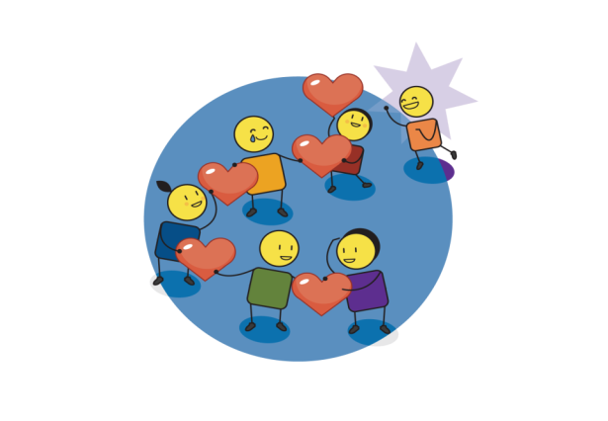
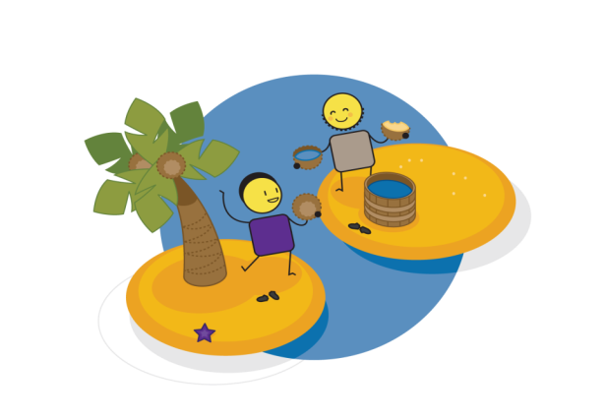

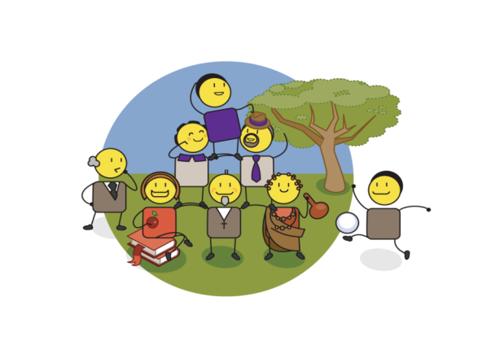
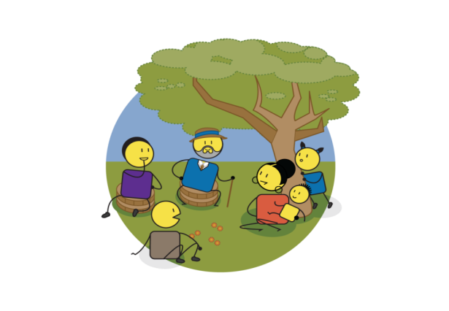


3.
LOVE
5.
PARTNERSHIP
4.
SELF-ESTEEM
WORKSHOP PROCESS
2.
VISION
6.
VALUES
1.
INSIGHT
7.
ACTION
Notes:
As with all Courage programmes, there are 7 steps to ending bullying and realising a courageously kind world.
These steps include :
Gaining insight into what bullying is.
Developing a vision for a courageously kind world.
Building our capacity for love and empathy.
Building our self esteem and self worth so that we can assertively address bullying.
Identifying partners who can help us achieve our vision.
Defining the values that will guide the delivery of our vision.
Creating an action plan.

Slide 3








This workshop will help you to
?
Notes:
This workshop will help you to:
Understand the importance of building a kinder world where bullying is not tolerated at a personal or community level.
Understand what bullying is, who is involved, why, when and where it takes place in our communities
Develop a vision for a courageously kind world where bullying is eliminated.
Exploring the concept of empathy and learning tools to improve empathy at an individual and community level.
Developing assertiveness skills through building self-esteem, self-worth, personal identity and embracing our inner superhero.
Developing win/win partnerships to help address bullying in our communities.
Identify the values that will help us achieve our courageously kind world vision.
Develop an action plan to ensure sustainable behaviour change.

Slide 4





Workshop timing
WELCOME
& BULLY STORIES
30 MINS
COURAGEOUSLY KIND WORLD VISION
20 MINS
SELF ESTEEM
EXERCISE
30 MINS
PARTNERSHIP EXERCISE
30 MINS
ACTION
PLANNING
20 MINS
TAKE
10
TAKE
10
INSIGHT INTO BULLYING
10 MINS
EXPLORING
EMPATHY EXERCISE
30 MINS
ASSERTIVENESS
ROLE PLAY EXERCISE
30 MINS
DEFINING VALUES EXERCISE
20 MINS
Notes:
The workshop can be run in 4 hours or broken up into 4 x 1 hour smaller sessions.
The workshop starts with telling our own personal bullying stories.
Gaining insight into bullying.
Developing a courageously kind world vision.
A short break is recommended at this stage which is followed by an exercise exploring empathy.
A self esteem exercise.
Exploring assertiveness through a range of role play exercises.
Another short break is recommended at this time which is followed by a partnership exercise.
A values exercise.
And we finish off with an action panning exercise.
For details on how to break the workshop up into shorter session, please see the ‘courage community website.

Slide 5

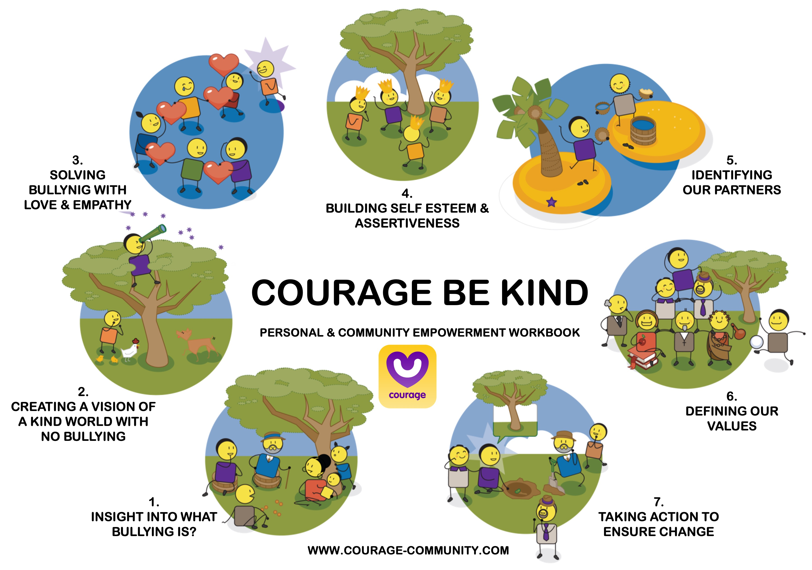
Useful Courage tools
Courage Be Kind
Anti-bullying Workshop Presentation
Courage Be Kind
Anti-bullying Video
Courage Be Kind
Anti-bullying Workbook
Notes:
Useful Courage Tools for this workshop, which you can download from the Courage Community website include:
This facilitators presentation with speaker notes.
The Courage Be Kind Video on our YouTube channel.
And the Courage Be Kind Workbook

Slide 6
Creating empowerment
HIGH
Unconsciously
Empowered
Consciously Empowered
LOVE
PRESENCE
& ACTION
ABUNDANCE
POSSIBILITY
KNOWLEDGE & INSIGHT
Unconsciously Disempowered
Consciously Disempowered
SCARCITY
VISION & PURPOSE
LOW
SELF AWARENESS
HIGH
VALUES & BELIEFS
PARTNERSHIP & COLLABORATION
SELF ESTEEM
& SELF WORTH
Notes:
As with all child protection challenges, bullying is driven by disempowerment, so the way to solve it is through personal and community empowerment. At Courage, we believe that empowerment is driven by 3 things: 1) our belief in possibility, 2) our level of self awareness and 3) our belief in love and abundance.
Diagram explanation:
When we are young, we all believe we can do anything and be anything, we have a high belief in possibility, but low levels of self awareness, we are unconsciously empowered.
But sadly, people arrive in our lives and tell us that we can’t achieve the things we want to…because of our age, or the colour of our skin, or that we are a girl, or a boy, or because of where we live… you get the picture. We lose our belief in possibility, and we become unconsciously disempowered.
The people who make us NOT believe in ourselves, are the consciously disempowered.
These people have a high level of self awareness, they are often very clever, but they believe that there will never be enough for everyone in the world, and so they think that to get more for themselves, they will have to take it away from you. They believe in scarcity rather than abundance.
Where we want to be is consciously empowered, where we have a high belief in possibility, high levels of self awareness and know that there is more than enough for everyone to live their best life.
We build our self awareness through understanding our values and beliefs, testing these through partnering with other people, and ensuring that we maintain our self-esteem and self-worth throughout our lives.
We build our belief in possibility through having a vision or purpose for our lives, building on this daily through gaining knowledge and insight, and finally turning all of this into tangible actions every day.
Finally, we build our belief in abundance by growing our love, care and empathy for others and the world around us, and ensuring that everything we do is about bringing people together, rather than pushing them apart.
This is Courage’s philosophy and process for solving all child protection challenges in a positive, proactive and empowered way.

Slide 7
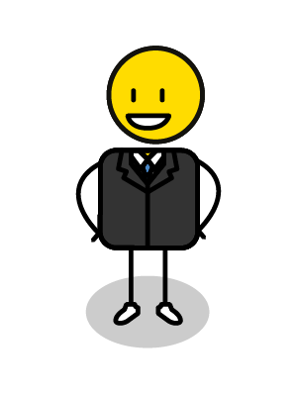
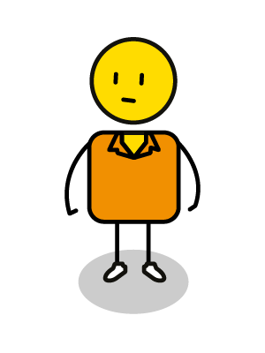
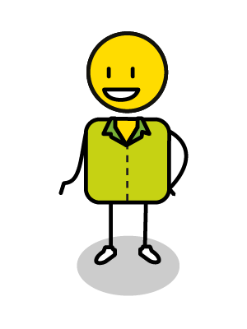
My personal bullying story
BULLY
BULLIED
BYSTANDER
Notes:
Start your workshop with everyone sharing a personal bullying story, bullying is something that has happened to all of us at some stage in our lives.
Exercise:
You will use this template in the workbook to draw your personal bullying story, where you were either bullied, the bully or a bystander? (We won’t ask you to share which, we just want to hear your story)
Tell us exactly what happened. Use speech bubbles to share what was said. Draw how the different people were feeling. Then use your pen or hands to inflict the physical and emotional pain that was experienced in this bullying incident… stab, slash and crumple the page to express the hurt that was felt!
Each participant should share their bullying story and how it impacted on them with the rest of the group.
When everyone has shared their story ask them to cross out the bad words and write good words in their place, like ”I’m sorry I hurt you” and “I think you are amazing”.
Tell your participants to smooth-out the crinkles on the page and whilst doing this, to send kind thoughts to every person involved.
The lesson is, even though we have been through this trauma in the past, it can sometimes leave long lasting emotional scars, as represented by the folds in your picture that can’t be smoothed out. Even when we send love, and say we are sorry, the scars can still remain for a long time afterwards.

Slide 8
1. What is bullying
BUILDING KNOWLEDGE & INSIGHT
Notes:
The first step in any Courage process is to gain knowledge and insight into what we are trying to address, in this case, the issue of bullying.
We need to understand what it is, who is involved and how to stop or avoid it.

Slide 9



Bullying is
1. DELIBERATE
On purpose!
2. REPEATED
More than once!
3. UNEQUAL POWER
Imbalance!
Notes:
It is important that everyone agrees what their definition of bullying is, so that no-one can use the excuse of “we were just playing” or “I was just teasing”.
At Courage we believe that bullying has three main features:
Firstly, it Is deliberate, which means that it is done on purpose,
Secondly, it is usually repeated, which means that it is done more than once,
And finally, it usually happens where there is unequal power, or a power imbalance, where one person is stronger than the other either physically, or due to their age, or their position of authority, and the other person is unable to defend themselves.

Slide 10



There are 4 kinds of bullying
VERBAL
words
PHYSICAL
actions
CYBERBULLYING
social media/gaming
RELATIONAL
friendship
Notes:
There are different kinds of bullying:
Verbal, where the bullying is done with words.
Physical where the bulling is done through actions.
Relational, where the bullying is done through friendships or other relationship drivers.
And Cyberbullying, which is bullying that takes place on the internet through social media or whilst gaming.

Slide 11

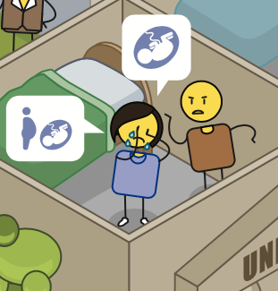

Verbal Bullying
Insulting
taunting
You are so stupid!
laughing
abusive
intimidating
yelling
frightening
name calling
telling lies
threatening
Notes:
Verbal bullying, where the bullying is done with words, includes
insulting someone,
taunting them,
being abusive,
yelling at them,
name calling,
threatening,
telling lies about them that gets them into trouble,
frightening or intimidating them,
or laughing at them in a cruel way.

Slide 12

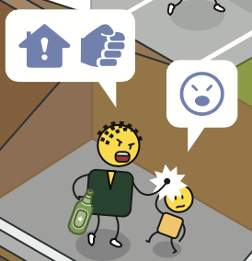
Physical Bullying
hitting
I’ll teach
you not to disrespect me
pushing
forcing
shoving
pushing in line
punching
stealing
biting
destroying
kicking
Notes:
Physical bullying, where the bulling is done through physical action, includes:
hitting,
pushing,
shoving,
punching,
biting,
kicking,
destroying a person’s property,
stealing their things,
pushing in line,
or forcibly taking something from them.

Slide 13

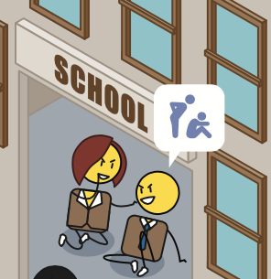
Relational Bullying
excluding someone
spreading rumors
If you want to be my friend you can’t be Bob’s friend ok!
blackmailing
humiliating
cruel teasing
stalking
prolonged staring
eye rolling
turning friends against someone
turning your back on someone
Notes:
Relational bullying, where the bullying is done through friendship or other relationship drivers, includes:
excluding someone,
spreading rumours about them,
humiliating them.
stalking a person,
rolling eyes at them,
turning your back on them,
prolonged staring,
turning a person’s friends against them,
cruel teasing,
or blackmailing them into doing things against their will.

Slide 14


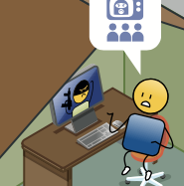
Cyber Bullying
hurtful messages
I can’t believe they said that about me!
hurtful pictures
discrimination
pornography
encouraging self harm
trolling
harassing
ghosting
Notes:
Cyberbullying, which is bullying that takes place on the internet through social media or whilst gaming, includes:
sending hurtful messages
Or hurtful pictures,
posting compromising or even pornographic pictures online,
encouraging them to self harm, saying things like “why don’t you just go and kill yourself”,
Ghosting, which is ignoring someone online,
harassing or trolling someone, which is provoking someone into an argument or for a reaction,
and using discriminatory or abusive language.

Slide 15
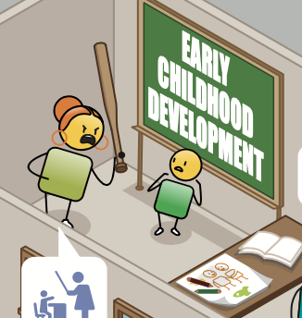

When you are small or vulnerable
Notes:
Bullying is also more prevalent at certain times such as when a person is smaller or more vulnerable.

Slide 16
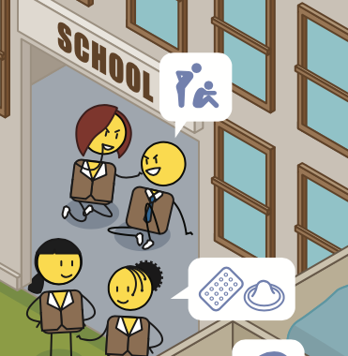
When you are new to a place of stage of life
So this is High School!
Notes:
When a person is new to a place, or a stage of life, such as going from junior to high school, or reaching puberty when their bodies change noticeably.

Slide 17
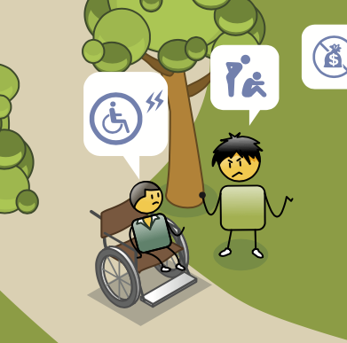
When you have a disability
Notes:
It can be because a person has a disability, which can be seen, as in the case of physical disabilities, or unseen, as in the case of deafness, learning disabilities or neurodevelopmental disorders.

Slide 18
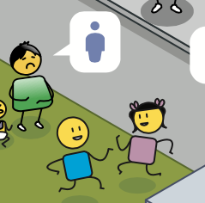
When you
look or behave differently
You can’t play with us you are too fat!
Notes:
Or it can be because a person looks or behaves differently.

Slide 19

Notes:
None of these examples of bullying are acceptable and should be stopped or addressed as soon as they are noticed.
With bullying, the earlier you intervene to stop it, the better!

Slide 20
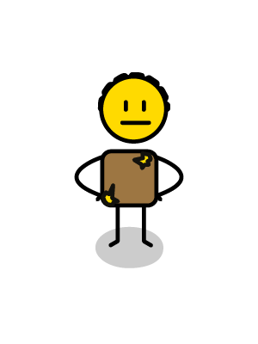
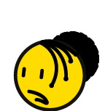
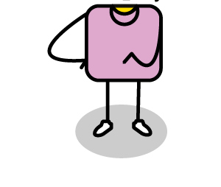
Who is involved?
BULLY
3
BULLIED VICTIM
BYSTANDER
Notes:
It takes three kinds of people for bullying to take place
a bully,
a victim, or person who is being bullied,
and a bystander.
Let’s understand each of these people better and what is happening in their world.

Slide 21
Abuse power
(domination & control)
Uses violence to solve conflict
Don’t follow rules
Bad tempered & aggressive
No empathy
World is dangerous
Enjoys causing pain for others
BULLY
Overly confident
1
BULLIED VICTIM
BYSTANDER
Notes:
The bully abuses power through domination and control,
they don’t follow rules,
they have little to no empathy,
and sometimes enjoy causing pain for others,
they use violence to solve conflict,
they are bad tempered and aggressive,
they see the world as a dangerous place,
and they are often overly confident.

Slide 22








BULLY
1
BULLIED VICTIM
BYSTANDER
Notes:
In the long term, bullies often continue to struggle with:
controlling their emotions and aggression.
They display anti-social behaviour which leads to a number of challenges including drug and alcohol abuse,
the inability to form meaningful connections and relationships,
criminal behaviour,
depression and even suicide.
They are often responsible for creating the next generation of bullies.
Most school shooters note how they were bullied terribly at school.

Slide 23
Scared & afraid
Small, weak & vulnerable
Few friends
Lack confidence
Passive & anxious
BULLY
Submissive
Feel helpless
Blame selves
2
BULLIED VICTIM
BYSTANDER
Notes:
The bullied victims are:
scared and afraid,
they are often smaller, weaker and more vulnerable,
they have few friends,
They lack self confidence,
are passive and anxious,
submissive
and feel helpless,
they often blame themselves for being bullied and end up withdrawing socially.

Slide 24
Watch & observe
BUT do nothing!
Sometimes join in
Passive acceptance
Encourage – audience, comments laughter
BULLY
No such thing
as neutral!
3
BULLIED VICTIM
BYSTANDER
Notes:
The bystander:
watches and observes, but does nothing,
they can sometimes join in,
but often just passively accepts this bullying behaviour.
They sometimes encourage the bully, by laughing, cheering, or making comments, just by being there, they provide the bully with an audience.
But when it comes to bullying, there is no such thing as NEUTRAL, you are either contributing to the problem, by doing nothing, or you are contributing to a solution, by intervening, standing up for the victim, getting help, or gathering evidence to share with someone who can help.

Slide 25

















=
=
Bullying
belief systems
Notes:
Sometimes we are brought up with a belief systems that make us think it’s ok to bully others.
These belief systems include:
Patriarchy, where men are believed to be superior and more important than women or children often causing toxic masculinity.
Fascism, nationalism, Nazism or far right political movements which all support inequality, autocracy and violent oppression of minorities.
Racism which is the prejudice and discrimination against people or groups of people on the basis of perceived racial or ethnic difference.
Sexism or sexual discrimination, which discriminates against people for their sex or sexual identity.
Religious and cultural intolerance which discriminates against different religious or spiritual beliefs.
Ableism, when people with disabilities are discriminated against or denied access and opportunities in favour of able bodied individuals.
Sometimes, bullying behaviour is condoned or even encouraged in different environments or worlds. These different worlds include on the internet or social media, whilst gaming online, or playing a game of sport, or in certain institutional environments such as a student residence.
The most concerning negative belief system is often learnt from the people who are responsible for taking care of children, such as parents, guardians, teachers and coaches. If they model bullying behaviour to a child, the child is likely to think that this behaviour is acceptable and will often repeat it amongst their peer groups socially, in school or on the sports field.
None of these belief systems are acceptable or healthy for individuals, communities or society at large.

Slide 26
CAMERADERIE
EMPATHY
ESTEEM
SUPPORT
SOLIDARITY
GOODWILL
FRIENDSHIP
GOOD INTENTION
GRACIOUSNESS
KINDNESS
PRAISE
CORIDALITY
SYMPATHY
TENDERNESS
AFFABILITY
GENIALITY
CONVIVIALITY
BROTHERHOOD
What is the opposite of bullying?
CHARITY
RESPECT
CORDIAL
AFFECTION
ADMIRATION
NEIGHBOURLINESS
OPENNESS
APPROACHABLE
HONOUR
COMRADESHIP
APPRECIATION
COMMUNITY
GENEROSITY
CARING
SINCERE
GENUINE
OPEN HEARTED
KIND
Notes:
When you search what is the opposite of bullying, there are many attributes that we can focus on such as camaraderie, empathy, esteem, support and solidarity…

Slide 27
CAMERADERIE
EMPATHY
ESTEEM
SUPPORT
SOLIDARITY
GOODWILL
FRIENDSHIP
GOOD INTENTION
GRACIOUSNESS
KINDNESS
PRAISE
CORIDALITY
SYMPATHY
TENDERNESS
AFFABILITY
GENIALITY
CONVIVIALITY
BROTHERHOOD
What is the opposite of bullying?
CHARITY
RESPECT
CORDIAL
AFFECTION
ADMIRATION
NEIGHBOURLINESS
OPENNESS
APPROACHABLE
HONOUR
COMRADESHIP
APPRECIATION
COMMUNITY
GENEROSITY
CARING
SINCERE
GENUINE
OPEN HEARTED
KIND
Notes:
But all of these attributes can be summarised into 4 key themes

Slide 28




What is the opposite of bullying?
Notes:
These themes show us how not to be a bully, or how to stop being a bully if you are one:
The first is to start building a positive community around you that fosters support and togetherness.
The next is to be a good citizen, when you have a choice, choose to do the right thing always.
You need to appreciate differences and diversity in others.
And finally, you need to practice love, empathy, care and kindness – in a world where you can be anything, choose to be kind!

Slide 29
2. What does a courageously
kind world look like?
CREATING A VISION OR PURPOSE
Notes:
Now that we know what bullying is, it is important to create a vision for the kind of world we would like to create without it.
In this exercise we will create a vision statement for a courageously kind world.

Slide 30

What should we ask?
The world would be a kinder place if…
I/we will help make this happen by…
When people see me/us they will think…
Notes:
To create this vision we need to ask ourselves 3 questions:
The world would be a kinder place if?
I or we will help create this world by?
And when people see me or us, they will think?

Slide 31
How should we answer?
My/our world would be a kinder place if…
I/we will help make this happen by…
When people see me/us they will think
Notes:
Capture your answers using this template or simply writing them down on a piece of paper.

Slide 32
3. Building our capacity for empathy, affiliation & care
BUILDING LOVE & COMPASSION
Notes:
Love and compassion are the most powerful tools to solve conflict, and we develop this capacity through understanding empathy, affiliation and care.
Empathy is the ability to understand and share the feelings of others, whether happy or sad, pain or joy, suffering or abundance.

Slide 33

Empathy belief systems
AGAPE
UBUNTU
KYOSEI
ATTACHMENT
KINSHIP
GOLDEN RULE
Notes:
Just as there are different belief systems that condone bullying, there are also belief systems that encourage empathy:
In ancient Greece, Agape fostered a love human kind.
In Africa the belief system of Ubuntu, also called Botho, Unhu, Umunthu, Utu and Kimuntu speaks to a shared humanity.
In Japan, Kyosei, is a philosophy for living and working together for the common good of mankind
In psychology we talk about attachment and in anthropology, kinship, to explain our natural and biological desire to connect meaningfully with others.
And most religions around the world speak of a ‘Golden Rule’, which is a principle of treating others as one wants to be treated, an ethic of reciprocity.

Slide 34

Understand
2
3
Connect
Listen
1
Notes:
The most important thing to remember is that empathy is a skill, that can be taught and learnt, it is not a trait that we are born with.
To be empathetic we need to:
listen,
understand and
connect with other people.
To walk a mile in another person’s shoes… to understand their world from their perspective.

Slide 35




Good & Bad
Notes:
There are, however, good and bad sides to empathy:
On the one hand, it can be a force for good in the world.
Our ability to mirror other people’s feelings is at the core of our ability to help, heal and care for others.
However, sometimes we react very strongly to the emotions of people we identify with, and blame people outside of our group or community for their pain or hurt. This ‘us vs them’ side-taking in a group setting can lead to extreme violence against others, as seen historically with colonialism, genocide and cultural or religious intolerance, and in the present day, movements such as the cancel or call-out culture.
Sometimes, when we are exposed to high levels of suffering, we can experience ‘empathic distress’, where other people’s emotions become ours, and we are unable to identify or regulate our own emotions as a result. ‘Empathy fatigue’ can lead to burn out, stress, and anxiety in some people, whilst others may become desensitized and actively disconnect or step away from the suffering of others.

Slide 36




From Empathy to Compassion
Notes:
When we experience ‘empathy fatigue’ we can lash out at the very people we should be helping because we are exhausted by all the suffering we see around us.
We focus on how we can protect ourselves, as we are feeling
pain,
anger
and stress.
We need to learn how to regulate ourselves by converting our empathy into compassion.
When we feel compassion, we feel a sense of
affiliation,
care and
love, and as we know, the capacity to love is infinite.
By converting our feelings of empathy to compassion, we build resilience for ourselves and other people in our care network.

Slide 37




Empathy is Good for you
Notes:
The good news is, research shows that if you are an empathetic person, you will be:
les stressed,
less depressed,
happier in relationships,
more successful at work,
And more satisfied with your life!

Slide 38

What are they feeling?
Ashamed
Powerful but alone
Angry & scared
No real friends
BULLY
Disempowered
Afraid for self
Embarrassed
Helpless
Humiliated
Guilty
Scared
Sad
BULLIED VICTIM
BYSTANDER
Notes:
This is a useful exercise to think about empathy in the context of bullying:
Ask your participants to think about how the different people in the bullying triangle feel? (Capture these feelings on a flip chart)
The bully may be feeling ashamed,
Angry and scared
They may feel powerful, but alone
And they may feel like they have no real friends
Now think about how the bullied victim feels?
They may feel disempowered and unable to do anything
Embarrassed
Humiliated
And scared.
Finally think about how the bystander feels?
They may be afraid for themselves.
They may feel helpless.
Guilty,
And sad.

Slide 39
Let’s take away the labels
Ashamed
Powerful but alone
Angry & scared
No real friends
Disempowered
Afraid for self
Embarrassed
Helpless
Humiliated
Guilty
Scared
Sad
Notes:
Now lets’ take away the labels? (On the flip chart, cross out or cover each of the bully, bullied and bystander labels)
Can you see how when we take away the labels, each of the people involved can feel all the emotions we have discussed.
Exercise:
You can also do this as a role-playing exercise where everyone sits on a chair that represents the bully, the bullied and the bystander.
They should role play a bullying experience and then talk about how they felt in each of their roles.
Get your participants to switch chairs and roles, and then reenact another bullying experience and again talk about how they felt in their new roles.
Once each person has experienced each role, discuss how each of the feelings that they felt can be experienced by each of the individuals in the bullying triangle.

Slide 40


We are all unique & different
Notes:
Empathy starts with ourselves, not only do we need to be kinder and more compassionate with ourselves, we also need to appreciate our own unique way of being in the world. This is about developing our own personal identity.

Slide 41

We are all unique & different
Notes:
Think about a world where everyone is exactly the same? Everyone would agree with everything you say. Everyone would look the same, and no one would have different opinions. Is this a world that you would like to live in it? The truth is, it would probably be quite boring! Having different people in the world, makes our lives interesting and exciting, and gives us new ideas.
So what makes you unique and different and how do you make the world a more interesting place to live?

Slide 42






Defining our personal identity
Animal/Plant?
Shield?
Colour?
Motto or Tagline?
“Just do it”
Notes:
It is important to spend some time thinking about this, and even developing our own personal brand identity.
A fun way to think about this is to create our own personal crests, just the like the crests we see at our schools.
To create your own personal crest:
Start with selecting an animal that you think represents who you are and/or who you would like to become.

Slide 43
Defining our personal identity
Animal/Plant?
Shield?
Colour?
Motto or Tagline?
“Just do it”
Notes:
Then select a shield shape that speaks to you and your personality.

Slide 44


Defining our personal identity
Animal/Plant?
Shield?
Colour?
Motto or Tagline?
“Just do it”
Notes:
Choose your favourite colours to bring your crest to life

Slide 45
Defining our personal identity
Animal/Plant?
Shield?
Colour?
Motto or Tagline?
“Just do it”
Celebrate Life Together
Notes:
And finally, create a personal motto or tagline that inspires you and and the person you would like to become.
Having a personal crest and motto is a really good way to clearly define who you are and what is important to you.

Slide 46
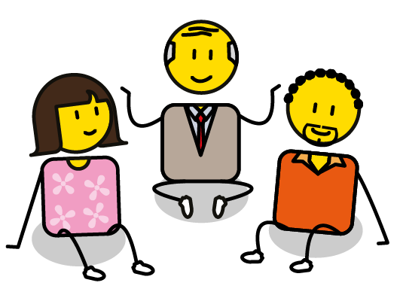
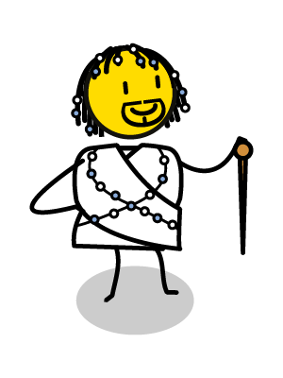
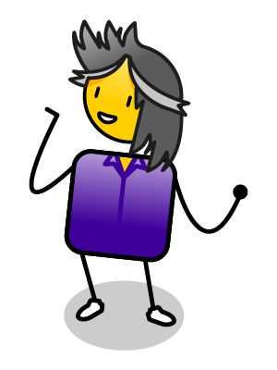

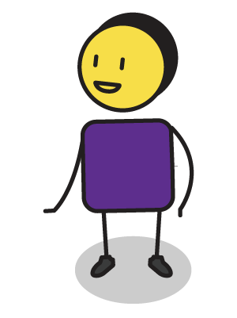

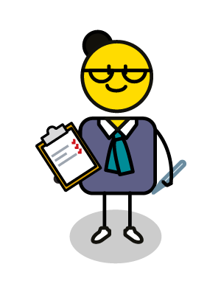
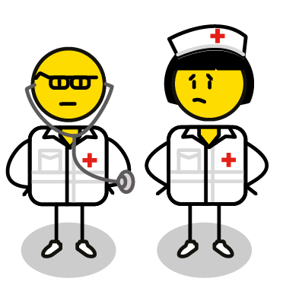
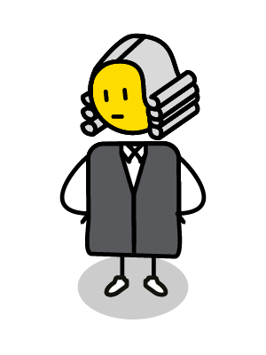




How to Practice
Empathy & Compassion?
Notes:
Understanding the feelings of others and your own personal indemnity are a good place to start, but empathy and compassion should be practiced often, to ensure that we stay resilient in the face of challenges.
Some ways to practice empathy and compassion include:
Be kind to yourself - Think about something you have been struggling with recently and how you have been talking to yourself about it. Now think about how you would talk to a dear friend who was struggling with the same issue and how would you support them? Notice how we are often patient, generous and forgiving with our friends, but harsh, critical and blaming of ourselves. Try to be as compassionate with yourself as you are with those you care about.
Be kind to others – when we are feeling tired, stressed and overwhelmed, it is easy to cut ourselves off from the world, as a self preservation strategy. But the quickest way to reenergise yourself, is to do something kind and compassionate for someone else. It doesn’t need to be a big thing, it is the small acts of kindness, ‘making a cup of tea’, ‘listening to someone’, or ‘sending a supportive message’, that often make the biggest difference in other people’s lives. These acts of kindness get us to focus on other people rather than ourselves.
Try to see the world from someone else's perspective, especially someone you disagree with. You don’t have to agree with them but understanding what is motivating their behaviour will help you have a far better relationship with them.
Use all your technological interactions, especially on social media, as opportunities to foster love and connection, rather than anger and divisiveness. The more intentional you are about this, the more you will create a loving online community who will support you in your world.
Notice the good in other people, creatures and the world around you, and acknowledge it whenever you can. The more you focus on the good, the more this will become your reality and your lived experience of your world.

Slide 47
4. Building our self-esteem
BUILDING SELF-WORTH & PRACTICING ASSERTIVENESS
Notes:
Now that we understand what bullying is, the kind of world we would like to create, and how to practice empathy and compassion, we need to build our self-esteem and self-worth so that we can assertively address bullying in a positive and proactive way.

Slide 48




How to be assertive?
Notes:
To be assertive is to maintain your own self esteem and personal identity, whilst confidently engaging with other people around you.
This is sometimes difficult to do, when you are being harassed by an aggressive or passively aggressive person.
These are some good tips to help you feel more assertive and empowered:
If someone tries to bully or intimidate you, tell them clearly and assertively to STOP
Express your feelings – say if you are feeling unhappy or uncomfortable, if they know this, they can’t pretend they were just teasing or playing.
Be confident about who you are and what you stand for, this is your personal identity and you should never compromise this.
Respect other people and what makes them unique and different.
Build a community of like minded friends around you, who you know will support and stand up for you.
Protect yourself and your information, be smart about where you hang out and who you share your contact details with.
Defend your right to be who you are, this is the most fundamental and universal human right of all.
Finally, embrace your inner-super hero. There is a super hero hiding in each of us, with unique talents and skills. Tap into these, and show the world your super-powers.

Slide 49

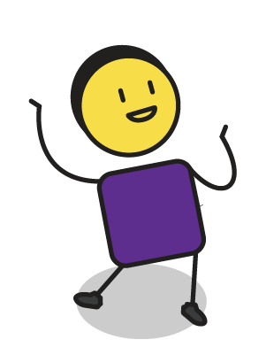
What makes you feel special?
MY SELF ESTEEM BOWL
Notes:
Lets spend some time thinking about what makes you special and unique.
Think about this bowl as representing your own self esteem, or how you feel about yourself.

Slide 50
What makes you feel special?
You look so beautiful in that dress
BEAUTIFUL
CLEVER
CARING
You are so clever and have such great ideas
MY SELF ESTEEM BOWL
You are such a caring friend
Notes:
Now think about all of the things that people say to you, that make you feel special and good about yourself (place items in the bowl).
Perhaps you have been told you are very beautiful.
Or that you are clever,
Or caring.
Your self-esteem bowl feels quite full now, doesn’t it?

Slide 51
What makes you feel sad?
Wow you look huge in those pants!
You failed the test, but it was soooo easy!
BEAUTIFUL
CLEVER
CARING
You are so self interested!
MY SELF ESTEEM BOWL
Notes:
Now think about all of the things that people say to you, that make you feel sad or unhappy about yourself (take the items out of the bowl).
Perhaps they have commented negatively about your appearance,
Or made fun of your intellect,
Or how they feel about you.
All of those lovely things that were put into your self-esteem bowl have now been taken out!
The lesson is, if you allow other people to fill your self-esteem bowl, you also allow them to empty it!

Slide 52
What makes you special?
MY SELF ESTEEM BOWL
Notes:
Spend some time thinking about all the things that you think make you special and unique, the things that no-one can take out of your self-esteem bowl, because you know they are true for you.
Now write these things onto the circles in your workbook and place them in your personal self-esteem bowl.

Slide 53
Embracing your superpowers
SUPER-SKILLS
SUPER-POWERS
SUPERHERO NAME:___________________________
Notes:
In this exercise we are going to move beyond what makes you special and unique, to what you see as your own “superpowers”.
In your workbook, draw yourself as a superhero.
Give yourself a superhero name, that captures who you are.
Describe your superhero skills, these are special talents and things that you have learnt, and that you like to share with the world.
Then describe your super-powers, these are your unique behaviours, or how you do what you do in a way that is uniquely you.
Before we can address bullying in a positive and proactive way, we need to be clear about what makes us special, our personal identity, our skills and talents, and the unique way we bring all of this to the world.

Slide 54
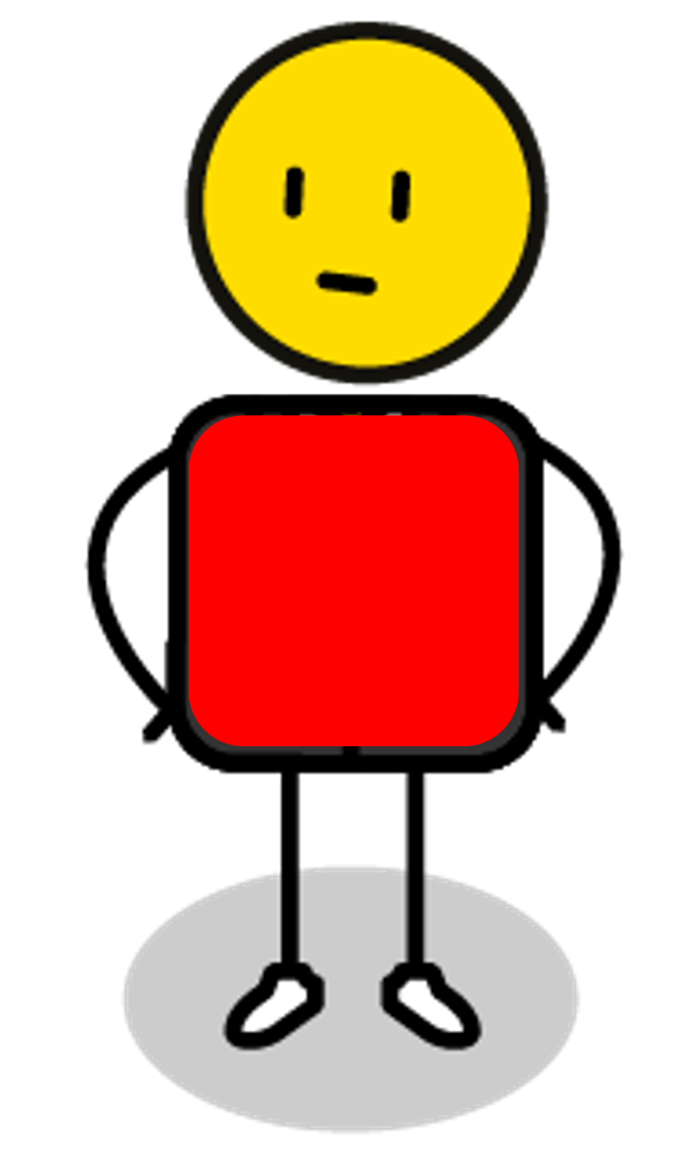
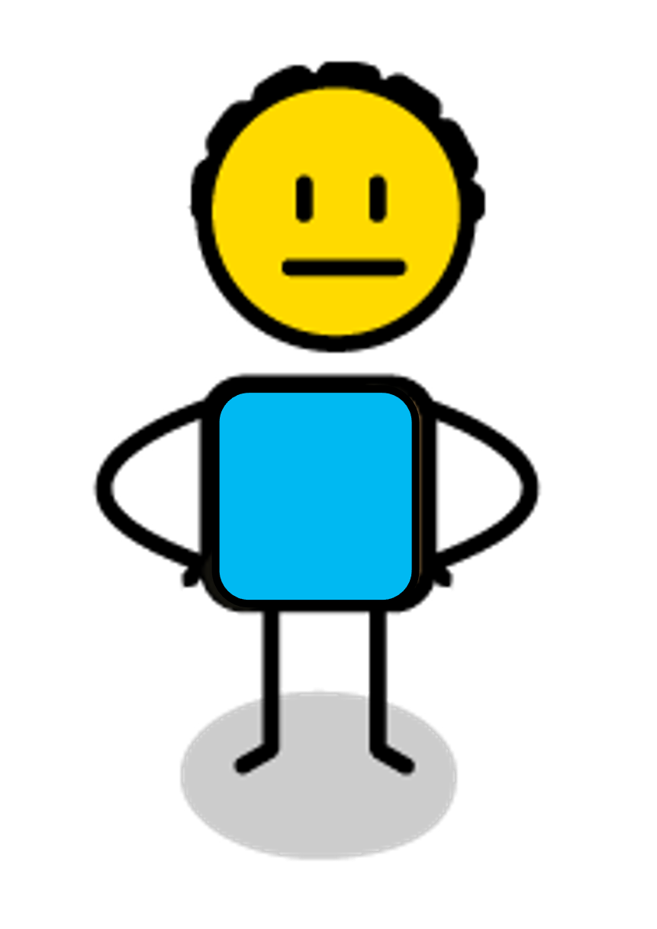
Interaction
AGGRESSIVE
AGGRESSIVE
PROBLEMATIC INTERACTION
PROBLEMATIC INTERACTION
IDEAL INTERACTION
ASSERTIVE
ASSERTIVE
SUBMISSIVE
SUBMISSIVE
Notes:
One way we can look at bullying is through “transactional analysis” which tries to understand how we interact with each other socially.
When we engage with each other, we can choose to do this in one of three different ways:
Aggressively where we try to dominate or hurt the other person.
Submissively, where we give in to the other person, and allow them to dominate us, or,
Assertively, where we stand up for ourselves, but also respect each other’s self esteem.
When we are aggressive we tend to force the other person into a submissive role which is not ideal.
When we are submissive, we tend to endorse, and allow the other person’s aggression and domination.
The ideal way to interact is to be assertive and ensure that both our own and the other person’s self esteem remains intact throughout our interaction.

Slide 55
Role Play 1
You are such an idiot and a loser!
You are the idiot, no one likes you!
AGGRESSIVE
AGGRESSIVE
That’s pretty mean, are you ok?
PROBLEMATIC INTERACTION
PROBLEMATIC INTERACTION
IDEAL INTERACTION
ASSERTIVE
ASSERTIVE
(Crying, says nothing, looks at feet)
NAME-CALLING
SUBMISSIVE
SUBMISSIVE
Notes:
We are now going to try a few role playing exercises where we can explore aggressive, submissive and then assertive approaches to dealing with bullying:
In the first scenario, imagine a bully laughs at you and starts calling you names like “loser” and “idiot”:
The aggressive way to respond is to shout names back at the bully, like ”you are the idiot” and “no one likes you”.
The submissive way to respond is to get upset and start crying or look down at your feet and say nothing.
The assertive way to respond is to calmly reflect their behaviour back to them by saying ”that is pretty mean, is everything ok with you?”

Slide 56
Role Play 2
You are useless, I’m taking over from you!
You are the useless one, get lost!
AGGRESSIVE
AGGRESSIVE
Don’t worry, I’ve got this.
PROBLEMATIC INTERACTION
PROBLEMATIC INTERACTION
IDEAL INTERACTION
ASSERTIVE
ASSERTIVE
(Walks away, says nothing)
INTIMIDATION
SUBMISSIVE
SUBMISSIVE
Notes:
In the second scenario, imagine a bully calls you “useless” on a sports field and tells you to move out of the way so that they can take over:
The aggressive way to respond is to shout back “you are the useless one” and tell them to “get lost”.
The submissive way to respond is to walk away and allow the bully to take over.
The assertive way to respond is to not give way to them, or say “don’t worry, I’ve got this”.

Slide 57
Role Play 3
Ha Ha…This is mine now!
Give that back you creep!
AGGRESSIVE
AGGRESSIVE
No, that is mine, give it back or I will report you.
PROBLEMATIC INTERACTION
PROBLEMATIC INTERACTION
IDEAL INTERACTION
ASSERTIVE
ASSERTIVE
Ok, you can have it.
STEALING
SUBMISSIVE
SUBMISSIVE
Notes:
In the third scenario, imagine a bully steals something from you and laughing says, ”this is mine now”.
The aggressive way to respond is to attack the bully and try to get it back.
The submissive way to respond is to shrug and say “ok”, and let the bully take what they have stolen.
The assertive way to respond is to hold onto the item and firmly and say, ”no, this is mine”, or to tell the bully you are going to report the theft if they don’t return your things.

Slide 58
Role Play 4
Get out of my way, this is my place now!
You are such an idiot, back off!
AGGRESSIVE
AGGRESSIVE
No pushing in, go to the back of the line
PROBLEMATIC INTERACTION
PROBLEMATIC INTERACTION
IDEAL INTERACTION
ASSERTIVE
ASSERTIVE
(Say nothing, let them push in line)
PUSHING IN LINE
SUBMISSIVE
SUBMISSIVE
Notes:
In the fourth scenario, imagine a bully pushes in line and shoves you out of the way:
The aggressive way to respond is to shove them back and tell them “you are an idiot”.
The submissive way to respond is to allow them to push in and say nothing.
The assertive way to respond is to stand your ground and say, “there is no pushing in, go to the back of the line”.

Slide 59
Role Play 5
Do you want to fight!
Sure, you loser! (attack’s bully)
AGGRESSIVE
AGGRESSIVE
I have no interest in fighting you
PROBLEMATIC INTERACTION
PROBLEMATIC INTERACTION
IDEAL INTERACTION
ASSERTIVE
ASSERTIVE
(Freezes, or runs away)
STARTING A FIGHT
SUBMISSIVE
SUBMISSIVE
Notes:
In the fifth scenario, imagine a bully shoves you and says “do you want to fight”:
The aggressive way to respond is to say “sure” and then attack the bully.
The submissive way to respond is to freeze and say nothing or run away.
The assertive way to respond is to say “I have not interest in fighting you” and calmly walk away.

Slide 60
Role Play 6
If you want to play with me, you can’t play with Bob!
Fred told me he thinks you are a loser!
AGGRESSIVE
AGGRESSIVE
I know what you guys are doing and it is not ok.
PROBLEMATIC INTERACTION
PROBLEMATIC INTERACTION
IDEAL INTERACTION
ASSERTIVE
ASSERTIVE
(Goes to sit on their own)
MANIPULATION & LIES
SUBMISSIVE
SUBMISSIVE
Notes:
In the sixth scenario, imagine a bully whispers to your friends, “if you want to be my friend, you can’t play with (you)”.
The aggressive way to respond is to spread a nasty rumour about the bully.
The submissive way to respond is to go and sit on your own and leave your friends alone.
The assertive way to respond is to speak to the the bully and your friends about their behaviour, tell them “I know what you are doing and it is not acceptable behaviour”.

Slide 61
Role Play 7
I posted a pic of your privates online!
I’m going to murder you!
AGGRESSIVE
AGGRESSIVE
That is illegal, I am going to report you.
PROBLEMATIC INTERACTION
PROBLEMATIC INTERACTION
IDEAL INTERACTION
ASSERTIVE
ASSERTIVE
(Ignores post & comments)
CYBER BULLYING
SUBMISSIVE
SUBMISSIVE
Notes:
In the seventh scenario, imagine a bully posts an embarrassing picture that they took of you in the change rooms on a What’s App group.
The aggressive way to respond is to attack the bully and try to smash their phone.
The submissive way to respond is to ignore the post and what everyone is saying about it.
The assertive way to respond is to tell the bully that you know that they shared the picture, to advise them that you have taken a screen shot, and that you will be reporting them to the authorities in your school as this is illegal.

Slide 62
Role Play 8
I wish you would just commit suicide!
I’m going to make you pay for that comment!
AGGRESSIVE
AGGRESSIVE
Why did you post this comment?
PROBLEMATIC INTERACTION
PROBLEMATIC INTERACTION
IDEAL INTERACTION
ASSERTIVE
ASSERTIVE
(Ignores post and blocks bully)
TROLLING
SUBMISSIVE
SUBMISSIVE
Notes:
In the eighth scenario, imagine a bully sees that you are unhappy and posts, ”I wish you would go and commit suicide” on your social media page:
The aggressive way to respond is to troll them on their social media page.
The submissive way to respond is to ignore the post or just to block them.
The assertive way to respond is to ask them in person why they posted such a mean comment online and ask them to remove the post or you will take further action and report them.

Slide 63
Practice
You are such a loser!
AGGRESSIVE
AGGRESSIVE
I am not prepared to talk to you at the moment.
PROBLEMATIC INTERACTION
PROBLEMATIC INTERACTION
IDEAL INTERACTION
ASSERTIVE
ASSERTIVE
You never listen to what I have to say!
DIFFICULT INTERACTIONS
SUBMISSIVE
SUBMISSIVE
Notes:
Each of these scenarios are good ways to practice how to respond to a bully, but sometimes we have a bad interaction with someone and we can’t think of how to respond in the moment.
If this happens to you, take a deep breath, and assertively tell the bully, “I am not prepared to talk to you at the moment”, then calmly walk away.
When you are able to, run through the scenario in your mind, or with the help of a friend.
Think through the aggressive, the submissive and then the assertive way to respond.
Practice the assertive way to respond so that you are prepared if this interaction should happen again.

Slide 64
Engage
You are such a loser!
AGGRESSIVE
AGGRESSIVE
Why did you say this to me, it is not ok with me.
PROBLEMATIC INTERACTION
PROBLEMATIC INTERACTION
IDEAL INTERACTION
ASSERTIVE
ASSERTIVE
You never listen to what I have to say!
DIFFICULT INTERACTIONS
SUBMISSIVE
SUBMISSIVE
Notes:
If you are able, proactively talk to the bully about what they said or did to you at a later stage in a calmer environment.
Tell them how it made you feel and ask them why they thought it was appropriate for them to behave this way.
The best way to have an assertive conversation, is to reflect the aggressive or passively aggressive bully’s behaviour back to them in a calm way, to try and help them reflect on why the interaction was so problematic for you.
Most often a bully behaves in an aggressive way, because they believe that violence is the best way to solve conflict.
We need to teach them that the most affective way to solve conflict is through love.
We may not be able to change their behaviour, but we can change how we respond to them and this will teach them a new perspective.

Slide 65
5. Identifying our partners
BUILDING WIN/WIN PARTNERSHIPS
Notes:
Now that we have defined what our courageously kind world will look like, we need to identifying who we can partner with to help us achieve this vision.

Slide 66
Building win/win partnerships
MY SELF ESTEEM
OTHERS SELF ESTEEM
Notes:
All relationships and partnerships are made up of more than one person.
Which means that there are more than one person’s self-esteem to be aware of, in this case, yours and your partners.

Slide 67
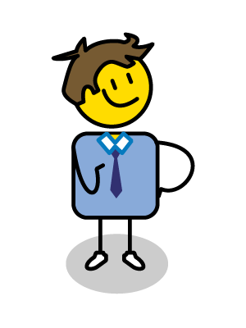
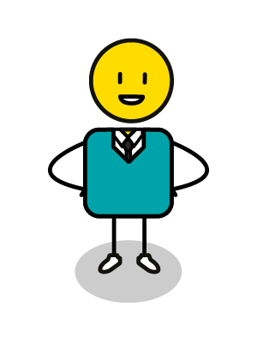
Building win/win partnerships
✗
Confrontation Win/Lose
So, this is how its going to work!
Ok, whatever you say
MY SELF ESTEEM
-
-
-
OTHERS SELF ESTEEM
Notes:
Imagine if you had a partnership with someone that was all about YOU, What would that look like?
The relationship would be all about your self-esteem but not about your partners.
You would decide what is important and what should happen in the relationship, with no regard for your partners feelings or needs.
It would be a very confrontational interaction, but most importantly whilst you would be winning, your partner would be losing in every interaction.
This is a win/lose partnership!

Slide 68
Building win/win partnerships
We need to get this done, so I’ll do whatever you need
Good, I’m going to need you to do most of the work
-
-
-
-
MY SELF ESTEEM
✗
Submission Lose/Win
OTHERS SELF ESTEEM
Notes:
Now imagine if the partnership was all about THEM, What would that look like?
The relationship would be all about their self-esteem but not about yours.
They would decide what was important and what should happen in the relationship, with no regard for your feelings or needs.
It would be a very submissive interaction, and your partner would be winning, whilst you are losing.
This is a lose/win partnership!

Slide 69
Building win/win partnerships
So, I’ll do what I said I would, but if you don’t help, I’m going to stop working
I’m also not prepared to help until you show me what you can do
-
-
✗
MY SELF ESTEEM
Compromise Lose/Lose
OTHERS SELF ESTEEM
Notes:
How about if you both agree to contribute 50/50 towards the partnership, do you think this would work?
The relationship would be about neither of your self-esteems, but rather about who does what, and when, and who is keeping score.
We often think that a 50/50 relationship is a good thing, but it usually just ends up as a compromise.
Neither partner wins, and because you are both compromising both of you are losing out.
This is a lose/lose partnership!

Slide 70
Building win/win partnerships
✗
✗
Win/Win
Confrontation Win/Lose
✗
Compromise Lose/Lose
MY SELF ESTEEM
Submission Lose/Win
✗
OTHERS SELF ESTEEM
Notes:
Ideally when we have a relationship with someone, it needs to be 100% from both sides, where we both give our best to make the relationship work:
Both partners maintain their self-esteem and self-worth.
And most importantly, both partners win.
this is a win/win relationship.

Slide 71
?
?
?
Who can you partner with?
ME
?
?
?
?
?
Notes:
The first step in any partnership plan, is to identify who you would like to partner with:
These are people who you share similar values with, and who believe in the same things you do.
They should be people you trust and respect, and who trust and respect you.
Importantly, you need to know that your partners will stand by you in good times and in bad, such as when a bully is picking on you.
Spend some time thinking about all the people you do, or would like to, partner with moving forward and write their names in your workbook.

Slide 72
How should you partner?
My
Partner
What do I want/need from them?
1. |  | 5.
2. |  | 4.
3. |  | 3.
4. |  | 2.
5. |  | 1.
 |  | What they want/need from me?
Shared Vision & Values?
Me
Notes:
For each of the partnerships you identify, you should think about how to make them win/win for both of you:
Try to define your shared vision and values, such as meaningful friendship and support.
Then think about what you would like or need from the relationship.
Finally think about what your partner would like and need from you.
For a relationship to be win/win, it is important that what you get is balanced by what you give.
The final point to make about good partnerships is that they can only be built on integrity, you cannot have a relationship with a person who lacks integrity or who lies to you.

Slide 73
6. Defining our values
VALUES & BELIEFS
Notes:
We are now at the stage where we need to define the values that will guide the delivery and achievement of our vision of a kinder world.
Values drive all of our day to day actions and choices. Defining a vision is about what we want to achieve, defining our values details how we are going to get there.

Slide 74
How do we define values
Happiness
Respect
Family
Teamwork
Integrity
Creativity
Love
Generosity
Delivery
Commitment
Partnership
Care
Possibility
Community
Reliability
Honesty
Diversity
Notes:
Most people value some things, but not everyone values the same things.
When trying to define what your values are, think about what you have learnt from your family, your teachers, your religious or spiritual leaders, your boss or colleagues, your friends or sporting teammates. Each of these relationships will teach you about what you value and what is important to you.

Slide 75
What do I/we believe in?
To achieve my/our vision of… | I/we will need to believe in…
 | 1.
2. | 2.
3. | 3.
4. | 4.
 | 5.
Notes:
Then return to your vision of a courageously kind world, and ask yourself what will I or we need to believe in to achieve this vision?
Try not to list too many values as you can get lost if you have too many things to focus on, just 3 to 5 beliefs that will help to guide your day to day actions, choices and ultimately the achievement of your vision.

Slide 76
7. Creating an Action Plan
DRIVING PRESENCE & ACTION
Notes:
The final step in any Courage process is to develop an action plan, or to agree what we are going to do differently, especially now that we have a new vision and values to support this.
This is about focussing on the future and understanding how to plan for this today, as this picture illustrates, if you want to grow a tree, your first step is to plant a seed.

Slide 77
What should we ask
Notes:
To understand what actions we need to take, we can ask three simple questions.
To achieve our vision of a courageously kind world:
What do we need to stop doing?
What do we need to start doing?
And what do we need to continue doing, which are things we are already doing that support our vision?

Slide 78
My/our action plan
From today I/we will START | From today I/we will STOP | From today I/we will CONTINUE
1. 2. 3. 4. 5. | 1. 2. 3. 4. 5. | 1. 2. 3. 4. 5.
Signed:_______________________
Date:___________________
Notes:
As an individual or group, think about all the lessons you have learnt about bullying and how to address it in a positive and proactive way, your vision for a courageously kind world, building empathy, what makes you special, who you think you should be partnering with and your values.
Then ask yourself:
To make this happen
What do I or we need to start doing?
What do I or we need to stop doing?
And what do I or we need to continue doing?
Sign your action plan and put a date on it, to make sure that you follow through on building a courageously kind world.

Slide 79

stay strong
take
www.courage-community.com
Notes:
Thanks for watching.
For more information visit Courage dash Community dot com
Be sure to like this video and subscribe to our Courage Channel.
Stay strong and take courage.

