Slide 1

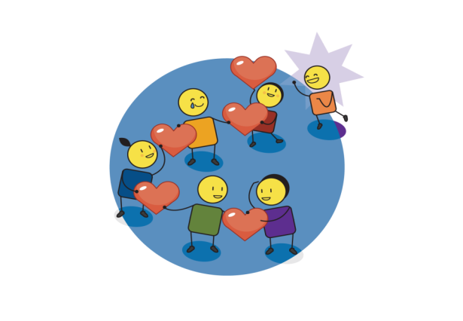
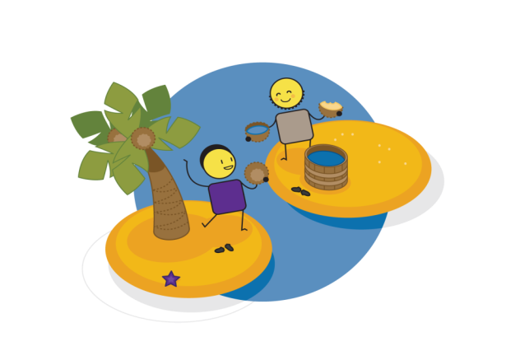

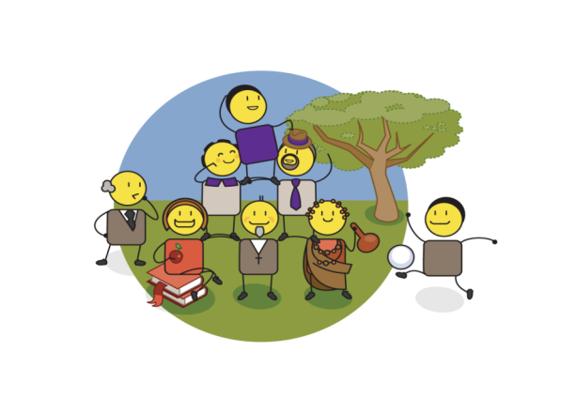

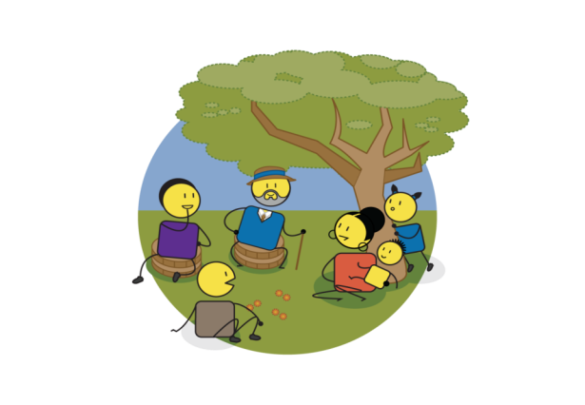

3.
SOLVING BULLYNIG WITH LOVE & EMPATHY
5.
IDENTIFYING OUR PARTNERS
4.
BUILDING SELF ESTEEM & ASSERTIVENESS
COURAGE BE KIND
PERSONAL & COMMUNITY EMPOWERMENT WORKBOOK
2.
CREATING A VISION OF A KIND WORLD WITH NO BULLYING
6.
DEFINING OUR VALUES
1.
INSIGHT INTO WHAT BULLYING IS?
7.
TAKING ACTION TO ENSURE CHANGE
WWW.COURAGE-COMMUNITY.COM
Notes:
This is the Courage ‘Be Kind’ personal and community empowerment workbook. As with all Courage programmes, there are 7 steps to ending bullying and realising a courageously kind world.
These steps include:
Insight into what bullying is.
Creating a vision of what a courageously kind world would look like with no bullying.
Understanding how we can solve bullying using love and empathy.
Building our self esteem and assertiveness to address bullying.
Identifying our partners who will help achieve our vision.
Defining the values that will drive our new courageously kind behaviours.
Taking action to ensure change.

Slide 2





















Courage Be Kind Workshop Timing
4 HOUR ‘COURAGE BE KIND’ ANTI-BULLYING WORKSHOP
1 HOUR BULLYING STORIES, INSIGHT & VISION WORKSHOP
1 HOUR EMAPHTY & PERSONAL IDENTITY WORKSHOP
WELCOME/INTRO
& BULLYING STORIES
30 MINS
WELCOME/INTRO 10 MINS
BULLYING STORIES
20 MINS
WELCOME/RECAP
10 MINS
EXPLORING EMPATHY
20 MINS
INSIGHT INTO BULLYING
10 MINS
BE KIND
WORLD VISION
20 MINS
TAKE
10
BULLYING INSIGHT
10 MINS
KIND WORLD VISON
20 MINS
PERSONAL ID EXERCISE
20 MINS
ACTION PLAN
10 MINS
EXPLORING
EMPATHY EXERCISE
30 MINS
1 HOUR SELF ESTEEM AND ASSERTIVNESS ROLE PLAY WORKSHOP
1 HOUR PARTNERSHIP AND VALUES WORKSHOP
SELF ESTEEM
EXERCISE
30 MINS
WELCOME/RECAP 10 MINS
SELF ESTEEM EXERCISE
20 MINS
WELCOME/RECAP
10 MINS
PARTNERSHIP EXERCISE
20 MINS
TAKE
10
ASSERTIVENESS
ROLE PLAY EXERCISE
30 MINS
PARTNERSHIP EXERCISE
30 MINS
ASSERTIVENESS ROLE PLAY 20 MINS
ACTIONS PLAN
10 MINS
VALUES EXERCISE
20 MINS
ACTION PLAN
10 MINS
DEFINING VALUES EXERCISE
20 MINS
THE COURAGE ‘BE KIND’ MATERIAL CAN BE USED IN A NUMBER OF DIFFERENT WORKSHOP FORMATS DEPENDING ON THE TIME YOU HAVE AVAILABLE AND WHICH MODULES YOU WOULD LIKE TO INCLUDE IN YOUR PROCESS
SEE WWW.COURAGE-COMMUNITY.COM (WORKSHOP THEMES) FOR MORE
ACTION PLAN
20 MINS
Notes:
The process and timing illustrated here shows how you can run:
A 4 hour Courage Be Kind anti-bullying workshop.
A 1 hour bullying stories, insight and vision workshop.
A 1 hour personal identity and empathy workshop.
A 1 hour self esteem and assertive role play workshop.
A 1 hour values and partnership workshop.

Slide 3
Creating Personal Empowerment
LOVE
HIGH
PRESENCE
& ACTION
Unconsciously
Empowered
Consciously Empowered
abundance
POSSIBILITY
KNOWLEDGE & INSIGHT
Unconsciously Disempowered
Consciously Disempowered
scarcity
VISION & PURPOSE
LOW
SELF AWARENESS
HIGH
VALUES & BELIEFS
PARTNERSHIP & COLLABORATION
SELF ESTEEM
& SELF WORTH
Notes:
As with all child protection challenges, bullying is driven by disempowerment, so the way to solve it is through personal and community empowerment. At Courage, we believe that empowerment is driven by 3 things: 1) our belief in possibility, 2) our level of self awareness and 3) our belief in love and abundance.
Diagram explanation:
When we are young, we all believe we can do anything and be anything, we have a high belief in possibility, but low levels of self awareness, we are unconsciously empowered.
But sadly, people arrive in our lives and tell us that we can’t achieve the things we want to…because of our age, or the colour of our skin, or that we are a girl, or a boy, or because of where we live… you get the picture. We lose our belief in possibility, and we become unconsciously disempowered.
The people who make us NOT believe in ourselves, are the consciously disempowered.
These people have a high level of self awareness, they are often very clever, but they believe that there will never be enough for everyone in the world, and so they think that to get more for themselves, they will have to take it away from you. They believe in scarcity rather than abundance.
Where we want to be is consciously empowered, where we have a high belief in possibility, high levels of self awareness and know that there is more than enough for everyone to live their best life.
We build our self awareness through understanding our values and beliefs, testing these through partnering with other people, and ensuring that we maintain our self-esteem and self-worth throughout our lives.
We build our belief in possibility through having a vision or purpose for our lives, building on this daily through gaining knowledge and insight, and finally turning all of this into tangible actions every day.
Finally, we build our belief in abundance by growing our love, care and empathy for others and the world around us and ensuring that everything we do is about bringing people together, rather than pushing them apart.
This is Courage’s philosophy and process for solving all child protection challenges in a positive, proactive and empowered way.

Slide 4
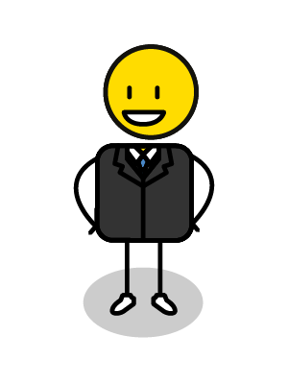
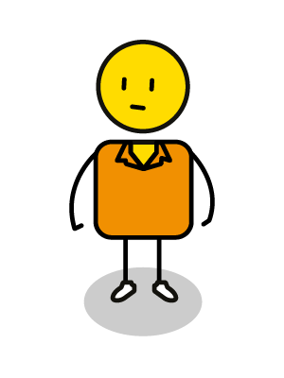
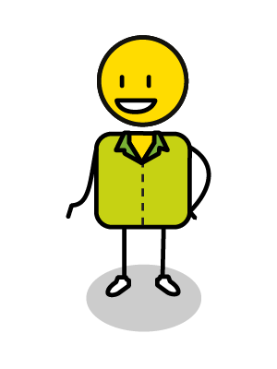
My personal bullying story
BULLY
BULLIED
BYSTANDER
Notes:
Start your workshop with everyone sharing a personal bullying story, bullying is something that has happened to all of us at some stage in our lives.
Exercise:
You will use this template in the workbook to draw your personal bullying story, where you were either bullied, the bully or a bystander? (We won’t ask you to share which, we just want to hear your story)
Tell us exactly what happened. Use speech bubbles to share what was said. Draw how the different people were feeling. Then use your pen or hands to inflict the physical and emotional pain that was experienced in this bullying incident… stab, slash and crumple the page to express the hurt that was felt!
Each participant should share their bullying story and how it impacted on them with the rest of the group.
When everyone has shared their story ask them to cross out the bad words and write good words in their place, like ”I’m sorry I hurt you” and “I think you are amazing”.
Tell your participants to smooth-out the crinkles on the page and whilst doing this, to send kind thoughts to every person involved.
The lesson is that even though we have been through this trauma in the past, it can sometimes leave long lasting emotional scars, as represented by the folds in your picture that can’t be smoothed out. Even when we send love, and say we are sorry, the scars can still remain for a long time afterwards.

Slide 5






What is bullying?
When you are small or more vulnerable
When you are new to a place or stage of life
VERBAL (words)
PHYSICAL
(actions)
hitting
abusive
insulting
pushing
biting
taunting
yelling
punching
shoving
name calling
threatening
kicking
destroying property
1. DELIBERATE
On purpose!
telling lies
stealing
pushing in
frightening or
intimidating
laughing
forcibly taking
2. REPEATED
More than once!
sending hurtful messages or pictures
excluding
spreading rumours
posting compromising/ pornographic pictures
3. UNEQUAL POWER
Imbalance!
stalking
eyerolling
back turning
ghosting
encouraging self harm
prolonged staring
turning friends against you
cruel teasing
harassing
discriminatory or abusive language
humiliating
trolling
CYBERBULLYING
(social media/gaming)
blackmail
RELATIONAL
(friendship)
When you look or behave differently
When you have a disability
Notes:
Lets discuss bullying, what it is and when it takes place. Bullying is 1) deliberate, or done on purpose, 2) it is often repeated and done more than once and 3) usually happens where there is unequal power, or a power imbalance, where one person is stronger than the other either physically, or due to their age, or their position or authority, and the other person is unable to defend themselves.
There are different kinds of bullying:
Verbal, where the bullying is done with words such as insulting someone, taunting them, being abusive, yelling at them, name calling, threatening, telling lies about them that gets them into trouble, frightening or intimidating them, or laughing at them in a cruel way.
Physical, where the bulling is done through actions such as hitting, pushing, shoving, punching, biting, kicking, destroying a person’s property, stealing their things, pushing in line, or forcibly taking something from them.
Relational, where the bullying is done through friendships or other relationship drivers such as excluding someone, spreading rumours about them, stalking a person, rolling eyes at them, turning your back on them, prolonged staring, turning a person’s friends against them, cruel teasing, humiliating or blackmailing them into doing things against their will.
Cyberbullying, which is bullying that takes place on the internet through social media or whilst gaming and can include sending hurtful messages or pictures, posting compromising or even pornographic pictures online, encouraging them to self harm (“why don’t you just go and kill yourself”), ghosting (which is ignoring online), harassing or trolling someone (provoking someone into an argument or for a reaction) and using discriminatory or abusive language.
Bullying is also more prevalent at certain times such as when a person is smaller or more vulnerable, when a person is new to a place, or a stage of life, such as going from junior to high school, or reaching puberty when their bodies change noticeably. It can be because a person looks or behaves differently, or if a person has a disability. None of these examples of bullying are acceptable and should be stopped as soon as they are noticed. With bullying, the earlier you intervene to stop it, the better!

Slide 6
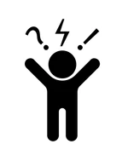





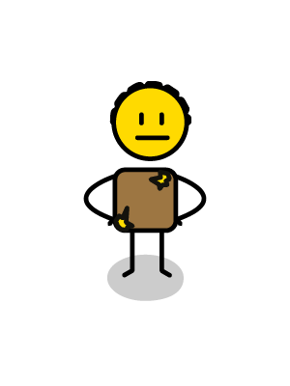
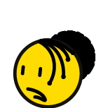
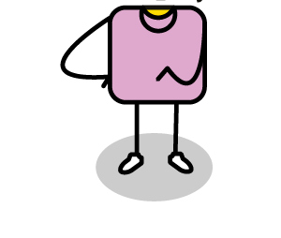
Who is involved?
Abuse power
(domination & control)
Uses violence to solve conflict
Don’t follow rules
Bad tempered & aggressive
No empathy
World is dangerous
Enjoys causing pain for others
BULLY
Overly confident
Scared & afraid
Watch & observe BUT do nothing!
Small, weak & vulnerable
It takes 3
kinds of people!
Can join in
Few friends
Passive acceptance
Lack confidence
Encourage – audience, comments laughter
Passive
BULLIED
BYSTANDER
Anxious
Submissive
Blame selves
No such thing as neutral
Feel helpless
Notes:
It takes three kinds of people for bullying to take place, a bully, a victim, or person who is being bullied, and a bystander. Let’s understand each of these people better and what is happening in their world:
The bully abuses power through domination and control, they don’t follow rules, the have little to no empathy, and sometimes enjoy causing pain for others, they use violence to solve conflict, they are bad tempered and aggressive, they see the world as a dangerous place, and they are often overly confident. In the long term, bullies often continue to struggle with controlling their emotions and aggression. They display anti-social behaviour which leads to a number of challenges including drug and alcohol abuse, the inability to form meaningful connections and relationships, criminal behaviour, depression and even suicide. Most school shooters note how they were bullied terribly at school.
The bullied victims are scared and afraid, they are often smaller, weaker and more vulnerable, they have few friends, lack self confidence, are passive and anxious, submissive and feel helpless, they often blame themselves for being bullied and end up withdrawing socially.
The bystander watches and observes, but does nothing, they can join in, but often just passively accepts the bullying behaviour. They sometimes encourage the bully, by laughing, cheering, or making comments, just by being there, they provide the bully with an audience. But when it comes to bullying, there is no such thing as neutral, you are either contributing to the problem, by not doing anything, or you are contributing to a solution, by intervening, standing up for the victim, getting help, or gathering evidence to share with someone who can help.

Slide 7



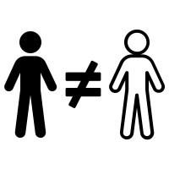






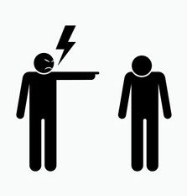





Sometimes our belief system or values
makes us think it is ok to bully others
Fascism/Nationalism/Nazism/Far-Right
Patriarchy/Toxic Masculinity
Racism
Negative Parenting/Teaching
Sexism & Sexual Discrimination
BULLY
Religious or Cultural Intolerance
Ableism
Traditional
Institutions
Whilst gaming
On social media & WWW
In sport
Notes:
Sometimes we are brought up with a belief systems that make us think it’s ok to bully others.
These belief systems include:
Patriarchy, where men are believed to be superior and more important than women or children often causing toxic masculinity.
Fascism, nationalism, Nazism or far right political movements which all support inequality, autocracy and violent oppression of minorities.
Racism which is the prejudice and discrimination against people or groups of people on the basis of perceived racial or ethnic difference.
Sexism or sexual discrimination, which discriminates against people for their sex or sexual identity.
Religious and cultural intolerance which discriminates against different religious or spiritual beliefs.
Sometimes, bullying behaviour is condoned or even encouraged in different environments or worlds. These different worlds include on the internet or social media, whilst gaming online, or playing a game of sport, or in certain institutional environments such as a student residence.
Ableism, when people with disabilities are discriminated against or denied access and opportunities in favour of able bodied individuals.
The most concerning negative belief system is often learnt from the people who are responsible for taking care of children, such as parents, guardians, teachers and coaches. If they model bullying behaviour to a child, the child is likely to think that this behaviour is acceptable and will often repeat it amongst their peer groups socially, in school or on the sports field.
None of these belief systems are acceptable or healthy for individuals, communities or society at large.

Slide 8



How can you stop being a bully?
Build community & togetherness
Be a good citizen
HOW TO BE COURAGEOUSLY KIND
Appreciate difference & diversity in others
Practice love, empathy, care & kindness
Notes:
How can a person stop being a bully?
There are 4 simple steps:
Start to build a positive community around you that fosters support and togetherness.
Be a good citizen, when you have a choice, choose to do the right thing always.
Appreciate differences and diversity in others.
Practice love, empathy, care and kindness – in a world where you can be anything, choose to be kind!

Slide 9
Defining our ‘Courageously Kind’ world
My/our world would be a kinder place if…
I am/we are going to help make this happen by…
When people see me/us they will think…
Notes:
We are now going to do an individual or team exercise to define our vision for a courageously kind world. The first step in creating a bully free world is to picture what this world would look like.
As an individual or team, try to finish each of these sentences to create your courageously kind world vision:
Our world would be a kinder place if…
I am/We are going to help make this happen by…
When people see me/us they will think…
Get each individual/team to share their courageously kind world vision.

Slide 10
Exploring empathy
Angry & scared
Powerful but alone
Ashamed
No real friends
BULLY
Scared
How do you think they feel?
Helpless
Afraid for self
Embarrassed
Guilty
Humiliated
BULLIED
BYSTANDER
Sad
Disempowered
Notes:
We are now going to explore the concept of empathy.
Exercise:
Get participants to discuss what empathy means to them.
Explain that empathy is the ability to understand and share the feelings of another. To be able to walk a mile in another person’s shoes and understand their world from their perspective.
It is important to remember that empathy is a skill, that can be taught and learnt, it is not a trait that we are born with. To be empathetic we need to listen, understand and connect with other people.
The good news is, research shows that if you are an empathetic person, you will be les stressed, less depressed, happier in relationships, more successful at work and more satisfied with your life!
Discuss how bullying impacts negatively on everyone involved, the bully, the person being bullied and the bystander.
Get your participants to call out the emotions that each of these people may feel when they are part of the bullying triangle.
Write these emotions up on a flip chart, without the labels.
Discuss how all these emotions can and are felt by all three participants in any bullying scenario.
Exercise:
You can also do this as a role-playing exercise where everyone sits on a chair that represents the bully, the bullied and the bystander.
They should role play a bullying experience and then talk about how they felt in each of their roles.
Get your participants to switch chairs and roles, and then reenact another bullying experience and again talk about how they felt in their new roles.
Once each person has experienced each role, discuss how each of the feelings that they felt can be experienced by each of the individuals in the bullying triangle.

Slide 11




My personal crest
Animal/Plant?
Shield?
Colour?
Motto or Tagline?
“Just do it”
Notes:
Think about a world where everyone is exactly the same? Everyone would agree with everything you say. Everyone would look the same, and no one would have different opinions. Is this a world that you would like to live in it? The truth is, it would probably be quite boring! Having different people in the world, makes our lives interesting and exciting, and gives us new ideas. So what makes you unique and different and how do you make the world a more interesting place to live?
Exercise:
Once you have discussed the value of difference and uniqueness, get everyone to design their own personal crest, like your school crest (explore this if there is confusion).
You will need to choose:
An animal that you think represents who you are and/or who you would like to become.
A shield shape
Your favourite colour (you can choose more than one), and
A personal motto or tagline that inspires you and and the person you would like to become.
Get everyone to share their personal crests.

Slide 12




Some good tips to feel assertive & empowered
Try to avoid bullies where possible
Be assertive &
tell them to STOP
Express you’re your feelings
Be confident in your personal identity
Embrace your inner superhero
Respect others and their differences
Build a community around you
Protect yourself & your information
Defend your rights to be you
Notes:
Now that we understand what bullying is, the kind of world we would like to create, and how to practice empathy and compassion, we need to build our self-esteem and self-worth so that we can assertively address bullying in a positive and proactive way. To be assertive is to maintain your own self esteem and personal identity, whilst confidently engaging with other people around you.
This is sometimes difficult to do, when you are being harassed by an aggressive or passively aggressive person.
These are some good tips to help you feel more assertive and empowered:
If someone tries to bully or intimidate you, tell them clearly and assertively to STOP
Express your feelings – say if you are feeling unhappy or uncomfortable, if they know this, they can’t pretend they were just teasing or playing.
Be confident about who you are and what you stand for, this is your personal identity and you should never compromise this.
Respect other people and what makes them unique and different.
Build a community of like minded friends around you, who you know will support and stand up for you.
Protect yourself and your information, be smart about where you hang out and who you share your contact details with.
Defend your right to be who you are, this is the most fundamental and universal human right of all.
Finally, embrace your inner-super hero. There is a super hero hiding in each of us, with unique talents and skills. Tap into these, and show the world your super-powers.

Slide 13

What makes me special
MY SELF ESTEEM
BOWL
Notes:
We are now going to focus on getting strong enough to stop bullies, this is about building our own self-esteem and self-worth. The first lesson in empathy, is to start with yourself. If you are not kind to yourself, it is very difficult to be kind to others.
Think about something you have been struggling with recently and how you have been talking to yourself about it. Now think about how you would talk to a dear friend who was struggling with the same issue, how would you support them? Notice how we are often patient, generous and forgiving with our friends, but harsh, critical and blaming of ourselves. This has to do with our self esteem, just like empathy, this is a skill that you need to consciously need to build in yourself.
Exercise:
Think about this bowl as representing your own self esteem, or how you feel about yourself.
Think about all of the things that people say to you, that makes you feel special and good about yourself (place items in the bowl).
Now think about all of the things that people say to you, that make you feel sad or unhappy about yourself (take the items out of the bowl).
Remember, if you allow other people to fill your self esteem bowl, you also allow them to empty the bowl!
Try to think about all of the things that you think make you special and unique. The things that no-one can take out of your self esteem bowl.
Now write these things into the circles above the bowl.

Slide 14
Me as a self-assured superhero
SUPER-SKILLS
SUPER-POWERS
Superhero Name:____________________________
Notes:
In this exercise we are going to move beyond what makes you special and unique, to what you see as your own “superpowers”.
In your workbook, draw yourself as a superhero.
Give yourself a superhero name, that captures who you are.
Describe your superhero skills, these are special talents and things that you have learnt, and that you like to share with the world.
Then describe your super-powers, these are your unique behaviours, or how you do what you do in a way that is uniquely you.
Before we can address bullying in a positive and proactive way, we need to be clear about what makes us special, our personal identity, our skills and talents, and the unique way we bring all of this to the world.

Slide 15
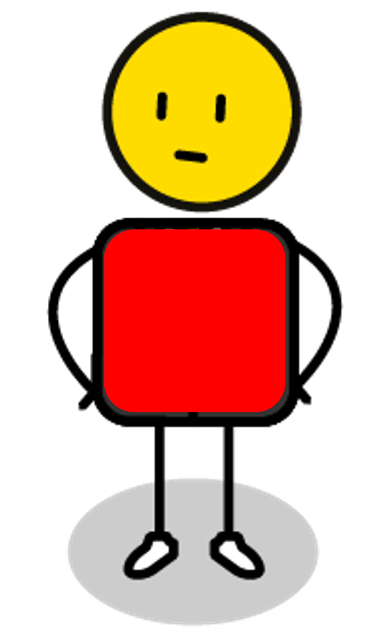
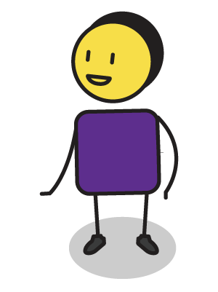
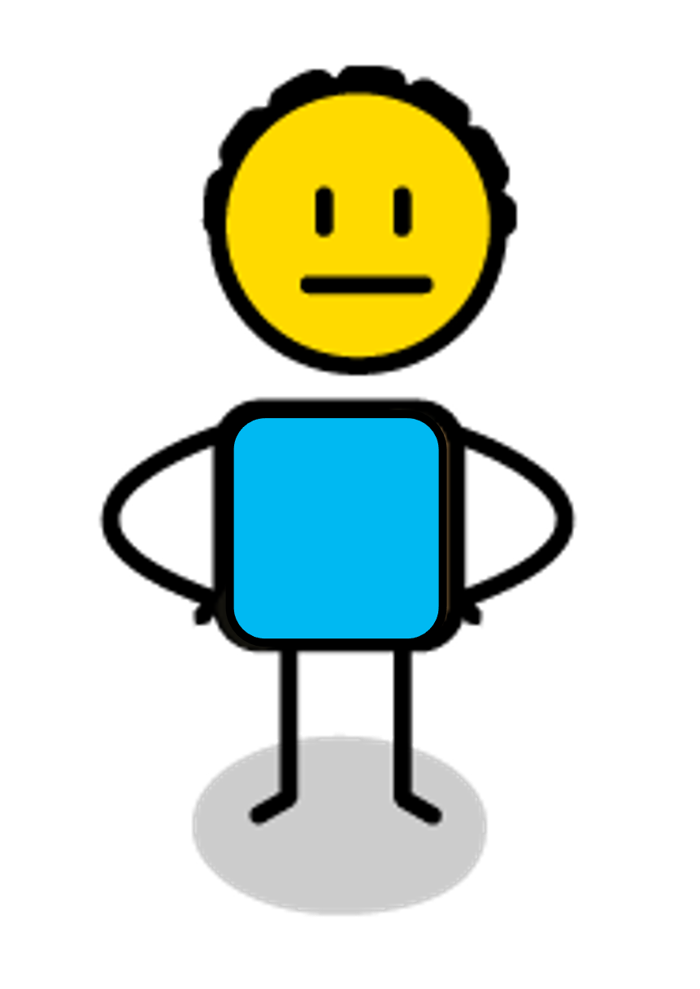
The bully transaction
AGGRESSIVE
AGGRESSIVE
PROBLEMATIC INTERACTION
PROBLEMATIC INTERACTION
IDEAL INTERACTION
ASSERTIVE
ASSERTIVE
SUBMISSIVE
SUBMISSIVE
Notes:
One way we can look at bullying is through “transactional analysis” which tries to understand how we engage with each other socially.
When we engage with each other, we can choose to do this in one of three different ways:
Aggressively where you try to dominate or hurt the other person.
Assertively, where you stand up for yourself, but also respect each other’s self esteem, or,
Submissively, where you give in to the other person, and allow them to dominate you.
When we are aggressive we tend the force the other person into a submissive role which is not ideal.
When we are submissive, we tend to endorse and allow the other person’s aggression and domination.
The ideal way to interact is to be assertive and ensure that both our own and the other person’s self esteem remains intact.
We are now going to try a few role playing exercises where participants can explore aggressive, submissive and then assertive approaches to dealing with bullying:
A bully laughs at you and starts calling you names like “loser” and “idiot”:
The aggressive way to respond is to shout names back at the bully, like ”you are the idiot” and “no one likes you”.
The submissive way to respond is to get upset and start crying or look down at your feet and say nothing.
The assertive way to respond is to calmly reflect their behaviour back to them by saying ”that is pretty mean, is everything ok with you?”
A bully calls you “useless” on a sports field and tells you to move out of the way so that they can take over.
The aggressive way to respond is to shout back “you are the useless one” and “get lost”.
The submissive way to respond is to walk away and allow the bully to take over.
The assertive way to respond is to not give way to them, or say “don’t worry, I’ve got this”.
A bully steals something from you and laughing says, ”this is mine now”.
The aggressive way to respond is to attack the bully and try to get it back.
The submissive way to respond is to shrug and say “ok”, and let the bully take what they have stolen.
The assertive way to respond is to hold onto the item and firmly say, ”no, this is mine”, or to tell the bully you are going to report the theft if they don’t return your things.
A bully pushes in line and shoves you out of the way.
The aggressive way to respond is to shove them back and tell them “you are an idiot”.
The submissive way to respond is to allow them to push in and say nothing.
The assertive way to respond is to stand your ground and say, “there is no pushing in, go to the back of the line”.
A bully shoves you and says “do you want to fight”.
The aggressive way to respond is to say “sure” and then attack the bully.
The submissive way to respond is to freeze and say nothing or run away.
The assertive way to respond is to say “I have not interest in fighting you” and calmly walk away.
A bully whispers to your friends, “if you want to be my friend, you can’t play with (you)”.
The aggressive way to respond is to spread a nasty rumour about the bully.
The submissive way to respond is to go and sit on your own and leave your friends alone.
The assertive way to respond is to speak to the the bully and your friends about their behaviour, tell them “I know what you are doing and it is not acceptable behaviour”.
A bully posts an embarrassing picture that they took of you in the change rooms at on a What’s App group.
The aggressive way to respond is to attack the bully and try to smash their phone.
The submissive way to respond is to ignore the post and what everyone is saying about it.
The assertive way to respond is to tell the bully that you know that they shared the picture, to advise them that you have taken a screen shot, and that you will be reporting them to the authorities in your school as this is illegal.
A bully sees that you are unhappy and posts, ”I wish you would go and commit suicide” on your social media page.
The aggressive way to respond is to troll them on their social media page.
The submissive way to respond is to ignore the post or just to block them.
The assertive way to respond is to ask them in person why they posted such a mean comment online and ask them to remove the post or you will take further action and report them.
Each of these scenarios are good ways to practice how to respond to a bully, but sometimes we have a bad interaction with someone and we can’t think of how to respond in the moment.
If this happens to you, take a deep breath, and assertively tell the bully, “I am not prepared to talk to you at the moment”, then calmly walk away.
When you are able to, run through the scenario in your mind, or with the help of a friend.
Think through the aggressive, the submissive and then the assertive way to respond.
Practice the assertive way to respond so that you are prepared if this interaction should happen again.
If you are able, proactively talk to the bully about what they said or did to you at a later stage in a calmer environment.
Tell them how it made you feel and ask them why they thought it was appropriate for them to behave this way.
The best way to have an assertive conversation, is to reflect the aggressive or passively aggressive bully’s behaviour back to them in a calm way, to try and help them reflect on why the interaction was so problematic for you.
Most often a bully behaves in an aggressive way, because they believe that violence is the best way to solve conflict.
We need to teach them that the most affective way to solve conflict is through love.
We may not be able to change their behaviour, but we can change how we respond to them and this will teach them a new perspective.

Slide 16
Building win/win partnerships
✗
✗
Win/Win
Confrontation (Win/Lose)
✗
MY SELF ESTEEM
Compromise (Lose/Lose)
✗
Subservience (Lose/Win)
OTHERS SELF ESTEEM
Notes:
An important skill in learning to create a courageously kind community, with no bullying, is how to build strong win/win relationships or partnerships.
Explain or role play:
All relationships and partnerships are made up of more than one person, which means that there are more than one person’s self-esteem to be aware of, in this case, yours and mine.
Pick a participant to role play these different partnership scenarios with:
If the relationship is all about me, what would that look like? (Role play a confrontational and domineering relationship which is win/lose).
If the relationship is all about you, what would that look like? (Role play a subservient and submissive relationship which is lose/win).
What if each person agrees to meet the other half-way or 50%/50%? (Role play a bargaining relationship that is all about compromise which is lose/lose)
So ideally when we have a relationship with someone, it needs to be 100%/100%, where we both give our best to making the relationship work, this is a win/win relationship.

Slide 17
Who I can partner with
Me
Notes:
The first step in any partnership plan is identifying who the different people are that you partner with in your life, school or work?
Exercise:
Get participants to identify each of the people they do or would like to partner with and write them in the circles on the page.

Slide 18
My win/win partnership
What do I want/need from them?
1. | Our Shared Vision & Values | 8.
2. |  | 7.
3. |  | 6.
4. |  | 5.
5. |  | 4.
6. |  | 3.
7. |  | 2.
8. |  | 1.
 |  | What they want/need from me?
Me
Notes:
Now get them to choose one relationship that they are struggling with at the moment. Explain that good relationships are based on having a shared vision & values, and mutual trust & respect. Mutual trust and respect is built through understanding what each person brings to the relationships.
Exercise:
Tell your participants to write the name of their partner in the top circle.
They should then write what they think their partnership’s shared vision and values are e.g. friendship and support.
They should then write what they would like to get from the relationship on the left, and what they think they should give on the right.
Explain that good win/win relationships are usually balanced where what you give is matches up with what you get.
Finally, ensure that everyone understands that a relationship can only be built on integrity, you cannot have a relationship with a person who lacks integrity or who lies to you.

Slide 19
My/our values
Respect
Happiness
Family
Teamwork
Creativity
Integrity
Generosity
Love
TO ACHIEVE MY/OUR VISION OF… | I/WE WILL NEED TO BELIEVE IN…
 | 1.
2. | 2.
3. | 3.
4. | 4.
 | 5.
Delivery
Partnership
Community
Care
Commitment
Possibility
Reliability
Notes:
In this exercise you are going to define the values that will help you to achieve your vision of a courageously kind world. Start by writing a summary of your vision in the left hand square (from the exercise where you defined how you will create a kinder world). Then think about the 3 to 5 values that will help you to achieve this vision in the column on the right. Values are the things that are most important to us and often guide how we act or behave on a day to day basis. There are a few examples on the page, but it is best that you write your values in your own language. Ask yourself the question, to achieve my/our vision of a courageously kind world, we will need to be believe in… (write your answers in the space provided).

Slide 20
My/our personal action plan & pledge
From today I/we will START | From today I/we will STOP | From today I/we will CONTINUE
Signed:____________________________
Date:____________________________
Notes:
It’s time to turn all of this good thinking into an action plan.
Exercise:
As an individual or team, think about all the lessons you have learnt today, your vision for a courageously kind world, empathy, what makes you special, who you think you should be partnering with and how.
To make this happen, think about all of the things that you need to start doing to achieve your new vision.
Now think about all of the things that you are doing at the moment that don’t support your vision, these are the things that you need to stop doing.
Finally, think about the things that you are already doing that support your vision of a courageously kind world, these are the things that you need to continue doing.
Sign this action plan and put a date on it, to make sure that you follow through on building a courageously kind world.
Thanks and close the workshop.

