Slide 1

Creating a community vision that puts your children first
www.couragechildprotection.com
Notes:
This Courage presentation explains how to develop a vision for your community that focuses on the needs and rights of your children.

Slide 2

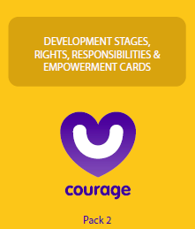









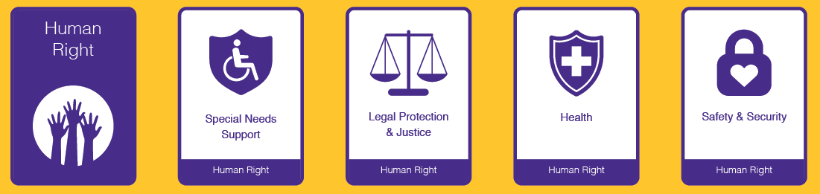
Useful Courage Tools
child needs & rights cards
or
child needs & rights poster
or
child needs & rights movie/presentation
Notes:
Before we begin, these are some useful tools that will help you to create your vision, which you can download from the Courage Child Protection Website or order a printed version online.
As stimulus for your vision workshop you can either use a pack of Courage Empowerment cards, which include cards describing children’s rights and developmental needs.
Or you can use the Courage Child Development Needs and Rights A1 Poster.
Or you can play this video or download the original presentation from our website, complete with speaker notes, and present it yourself.

Slide 3
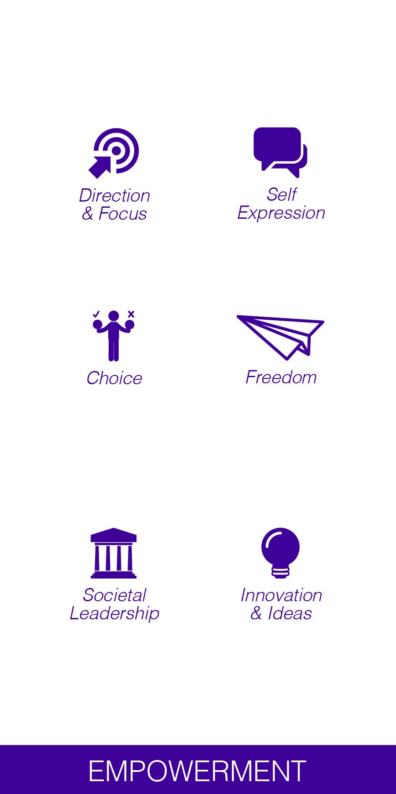

What is a vision?
Notes:
So what is a vision? To have a vision or purpose is to have direction and focus.
It is about making choices and leadership at every level, from individuals to society at large.
A vision allows you to express who you are and what is important to you at a personal and community level.
Once you have defined your vision or purpose, you will feel a great sense of freedom that comes with turning your dreams and ideas for the future into reality.
The best visions are those based on new ideas and innovation, thinking differently about the world, and how you can make it better.

Slide 4
Great visions?
leader initiated
positive & inspiring
shared & supported
comprehensive & detailed
Notes:
A great vision is leader initiated, meaning that you are the master of your destiny.
It should be shared and supported by your family, friends and community.
It should be comprehensive and detailed, so that you know exactly what you need to do to achieve it.
And it should be positive and inspiring, to make sure that you push yourself to new heights.

Slide 5
What should we ask?
Notes:
When thinking about creating a vision for the children in our communities, it is useful to ask ourselves two questions.
Firstly, why do we have children and what is their role in our lives?
And secondly, what kind of world should we be creating for them?

Slide 6
How should we answer?
The role of children is…
We should create a world that…
1.
2.
3.
4.
5.
1.
2.
3.
4.
5.
Notes:
This is a useful template to help you and your team or community to capture your answers.
On the one side list the role of children in your family and community, and on the other, the kind of world you would like to create for them.

Slide 7
Why is a vision important?
Notes:
So why is a vision important?

Slide 8
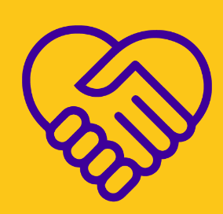
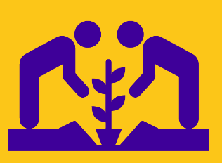


Positive Role = Empowered Child
The role of children is…
care, love & empathy
To be an expression of our love as a couple/family.
To build and grow our families and communities.
To build our future generations.
To create new ideas and possibilities.
family & community
learning & education
innovation & growth
Notes:
If children have a positive role in their family and community, they will be empowered and have a high degree of stability in their lives.
This role could be as an expression of a family's love, to grow that family and community, to build future generations and to create future possibilities.
A positive role creates empowered children who are empathetic and value love,
Family, community,
Education,
Innovation and growth.

Slide 9
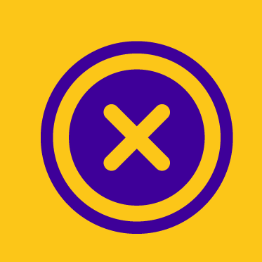
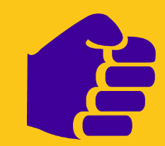
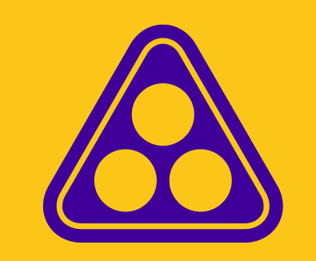
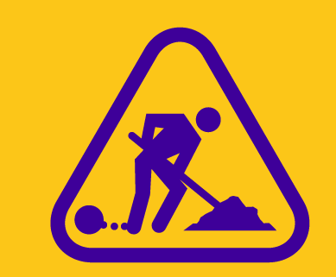
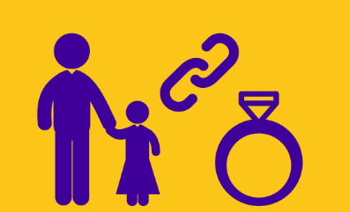
Negative Role = Disempowered Child
The role of children is…
abuse & neglect
They were a mistake we did not plan for them.
I had them because my culture expects it of me.
They are a good source of labour.
They are a good retirement plan.
harmful cultural practices
child labour & exploitation
child marriage
Notes:
However, many people do not think about the role of children in their world.
Parents often talk about unplanned children as a mistake.
They note how their culture expects them to have children rather than wanting a child themselves.
In many workshops I have heard of children being referred to as ‘a good source of labour’ or ‘a good retirement plan.’
It is not surprising that some of the biggest child protection challenges in the world include abuse and neglect,
Harmful cultural practices.
Child labour and exploitation
And child marriage.
Just as children with positive roles are empowered and have stability in their lives, children with negative or no defined role are often disempowered and have an enormous amount of instability in their world.

Slide 10
How should children grow up?
Notes:
To think about the kind of world we would like our children to grow up in, its useful to understand how our children should grow up.

Slide 11
They have rights…
Notes:
Firstly, all children are entitled to a number of rights.

Slide 12






vs
Notes:
These rights were first identified at the United Nations Convention on the Rights of the Child in 1990.
Children’s Rights have been defined at a global level by UNICEF,
At a continental level, such as by the African or European Unions,
And by individual countries in their own Bill of Rights and Children’s Acts.
These ‘Rights Documents’ detail what should, or should not be happening to children in families, communities or societies at large..

Slide 13



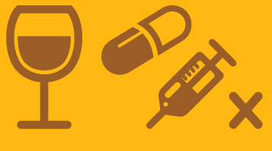
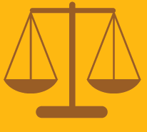



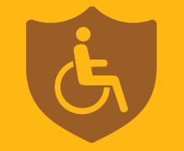
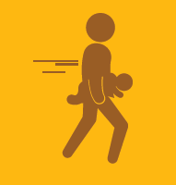



They have rights to live
vs
Notes:
All children have a right to live…
These rights include a right to life,
Safety and security.
To be registered and have a name, an identity and a nationality.
A right to health care.
A right to legal protection and justice.
And a right to support if they have any special needs.
This is in contrast to a world of no rights…
Where children are rejected or neglected.
Subjected to abuse, whether physical, emotional or sexual.
To substance abuse, sometimes even in utero.
Have no access to justice
Or are trafficked as a commodity to be bought or sold.

Slide 14




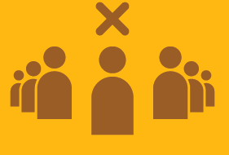
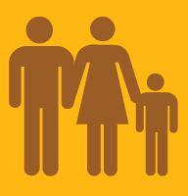
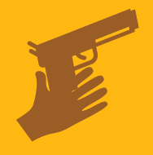


They have rights to love
vs
Notes:
They have rights to love…
Which include a right to a family.
And parental love and care.
To honour, respect and dignity.
And to privacy.
Versus a world where they are subjected to.
Harmful cultural practices
Armed conflict.
Race, gender, age or sexual discrimination.
Where they are refugees..
And have no care or protection.

Slide 15


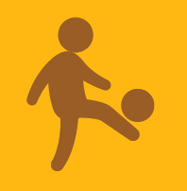


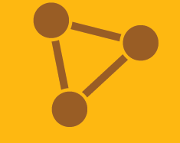

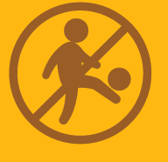
They have rights to learn
vs
Notes:
They have rights to learn…
Through community participation and belonging
Through education.
Leisure and recreation.
Where they have freedom of thought, expression, association and religion.
And knowledge of their cultural roots.
Versus a world where they have no access…
To play.
To education.
To personal development.
And are subjected to harmful cultural practices

Slide 16


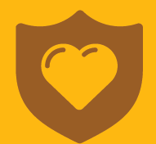
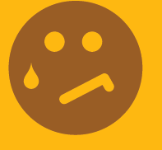







They have rights to leave a legacy
vs
Notes:
And finally they have a right to leave a legacy…
To have a unique identity.
To have physical, mental and emotional development.
To have moral development.
To live a full and happy life.
On a healthy planet
Versus a world where they …
Have no belonging or identity.
They are not developed or nurtured
They are Isolated and ignored.
And live an unhappy life
On an unhealthy planet.

Slide 17
They have needs…
Notes:
In addition to their rights, children also have different needs as they grow up and develop…

Slide 18
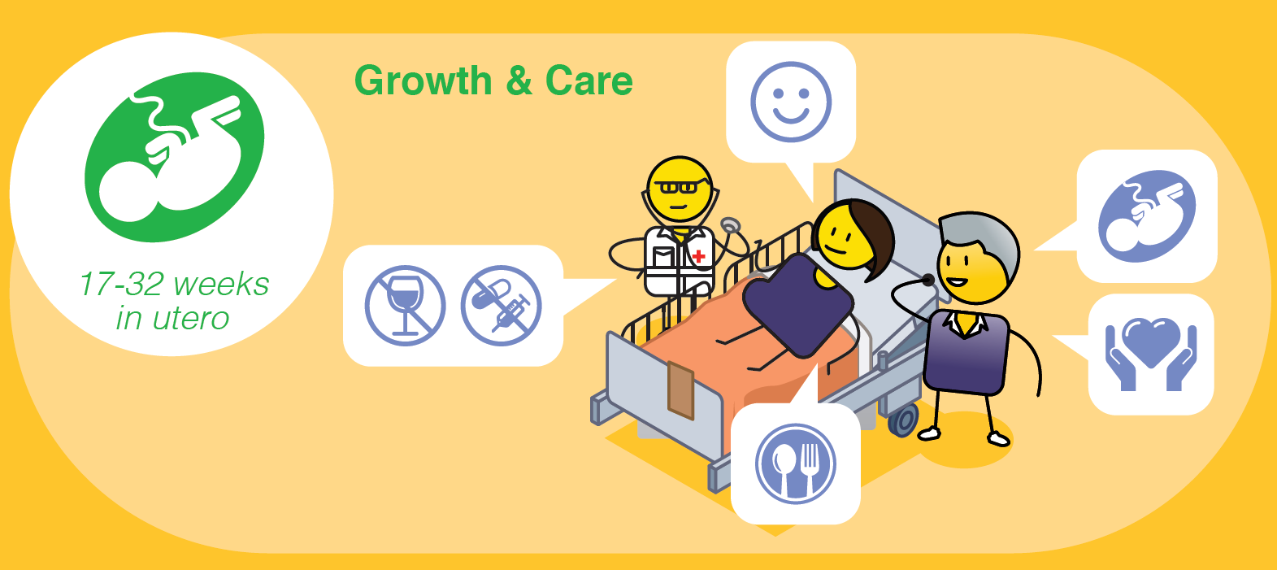
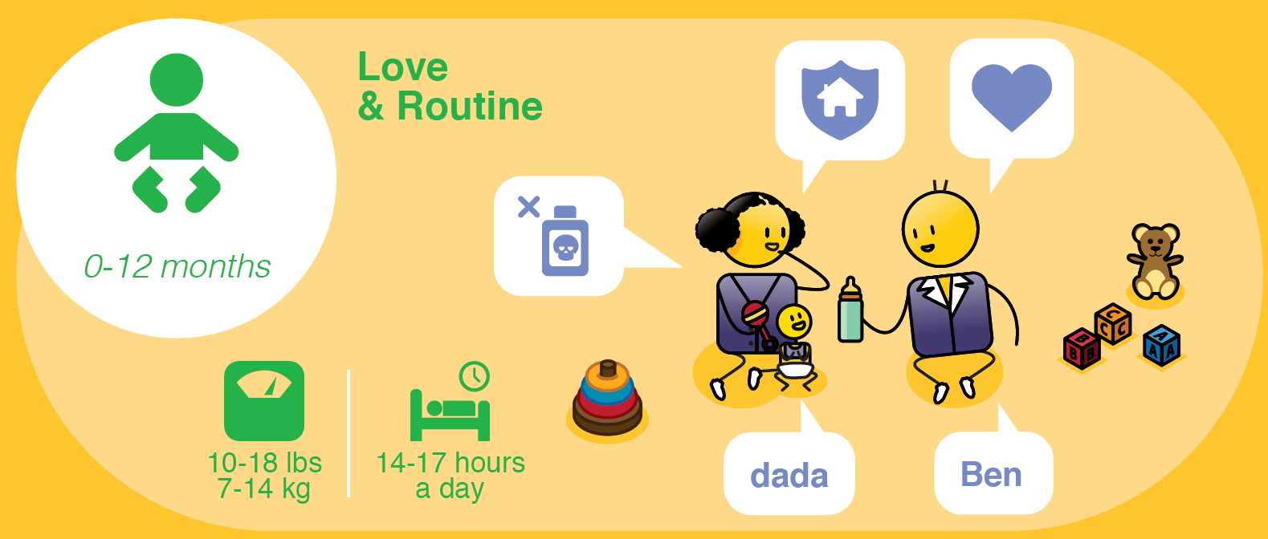
0 – 40 weeks
Healthy weight for Mother
8 Hours Sleep at Night
Notes:
Even in-utero, a foetus has rights from around 24 weeks, to when they are born between 38 and 40 weeks.
This is a time of growth for the baby and care of the mother.
Pregnant mothers must get lots of rest, visit their doctor or clinic regularly and eat healthy food.
They must avoid all drugs and alcohol and try to stay calm and happy during this exciting time.
Ideally they should be supported by their family and partner.

Slide 19
17-27 lbs
7-14 kg
(Day/Night)
Notes:
From zero to 12 months is a time of love and creating routine in your babies life.
In this first year they will learn their name, start to play with basic toys and build strong attachments to their parents or caregivers.
Parents should make sure they have ‘baby proofed’ their home by locking away any dangerous substances, covering electrical outlets or open sources of water.

Slide 20
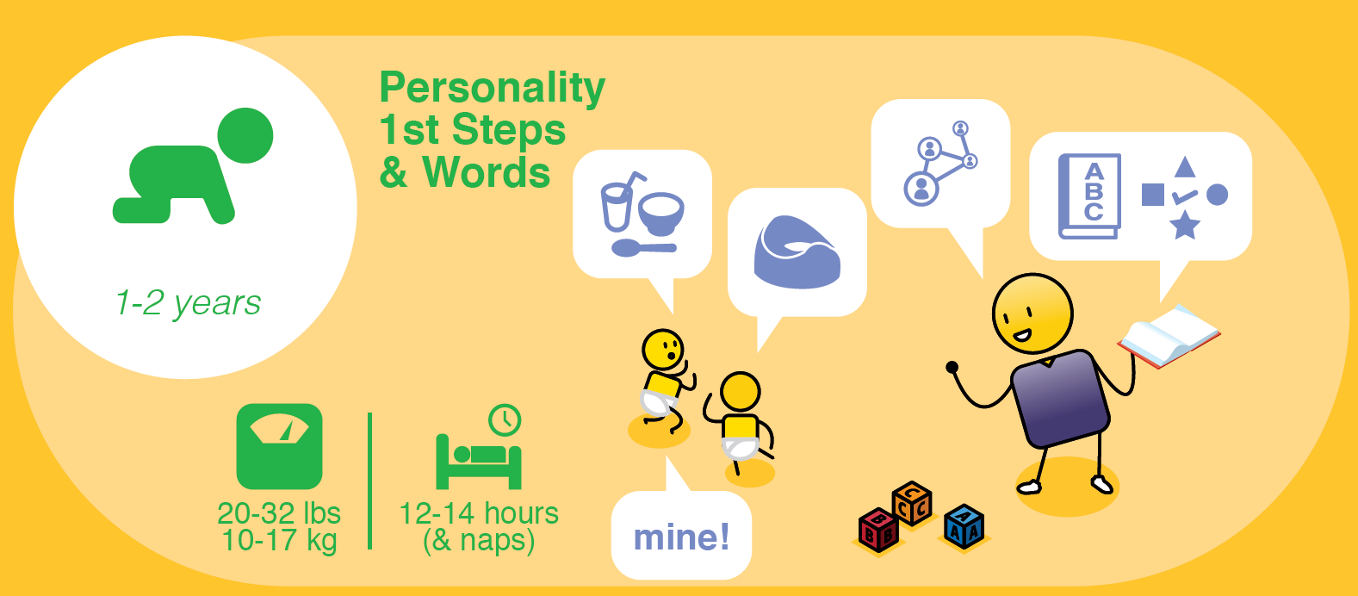
Notes:
From their first to second birthday, a baby will develop their personality, take their first steps and say their fist words.
They will start to be possessive of their toys, understand that they belong to a family and be interested in early learning concepts such as letters, colours, shapes and texture.
They should start potty training at this stage and learn to drink from a cup and feed themselves.

Slide 21
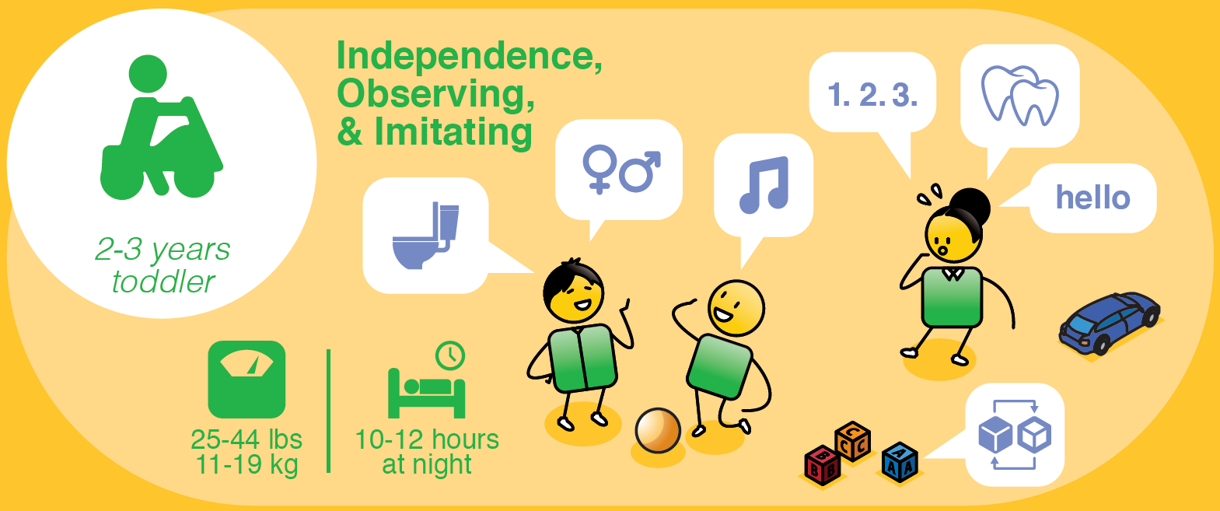
Notes:
From two to three years, a baby becomes a toddler, it is a time of learning independence from their primary care givers and observing and imitating the people around them.
They will start to notice biological differences between boys and girls, and engage in singing, simple counting and playing with more complex toys such as stacking items and kicking a ball.
They should move from a potty onto a toilet and as their teeth start to grow they will need to be taught about good dental care.
At this stage they will also need to engage in an early childhood development programme or play school.
This is also the stage when parents may notice some developmental delays in a child with neurodevelopmental challenges, and should seek help if this is the case.

Slide 22
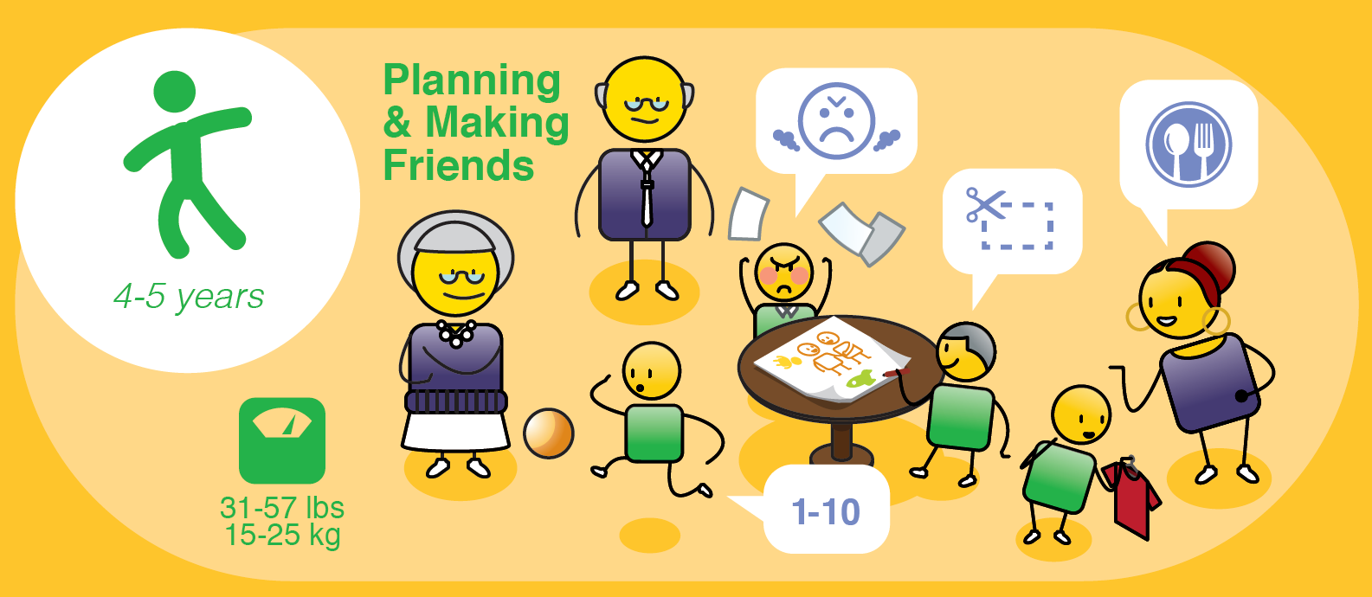
Notes:
From four to five years children will start to make friends and learn simple planning.
They may become frustrated and express anger through tantrums, so positive discipline is encouraged.
They become more active in sport, developing their gross and fine motor coordination, which is important for writing and cutting.
They should be able to count to 10, remember basic letters and words, and dress themselves.
As they are growing fast, good nutrition is very important, as is giving them opportunities to connect with extended family and friends to build their sense of belonging to a community.

Slide 23
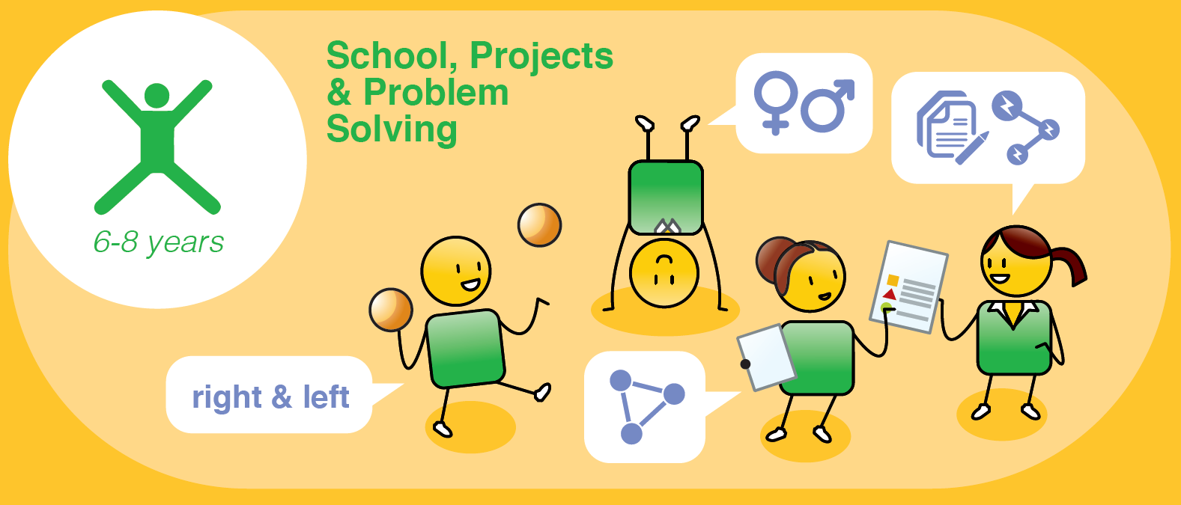
Notes:
From 6 to 8 years, children start school, and learn about projects and problem solving.
Their right or left hand and foot dominance becomes evident and their confidence in their physical body grows.
Gender awareness becomes more pronounced, and their need to belong to broader communities such as friendship circles.

Slide 24
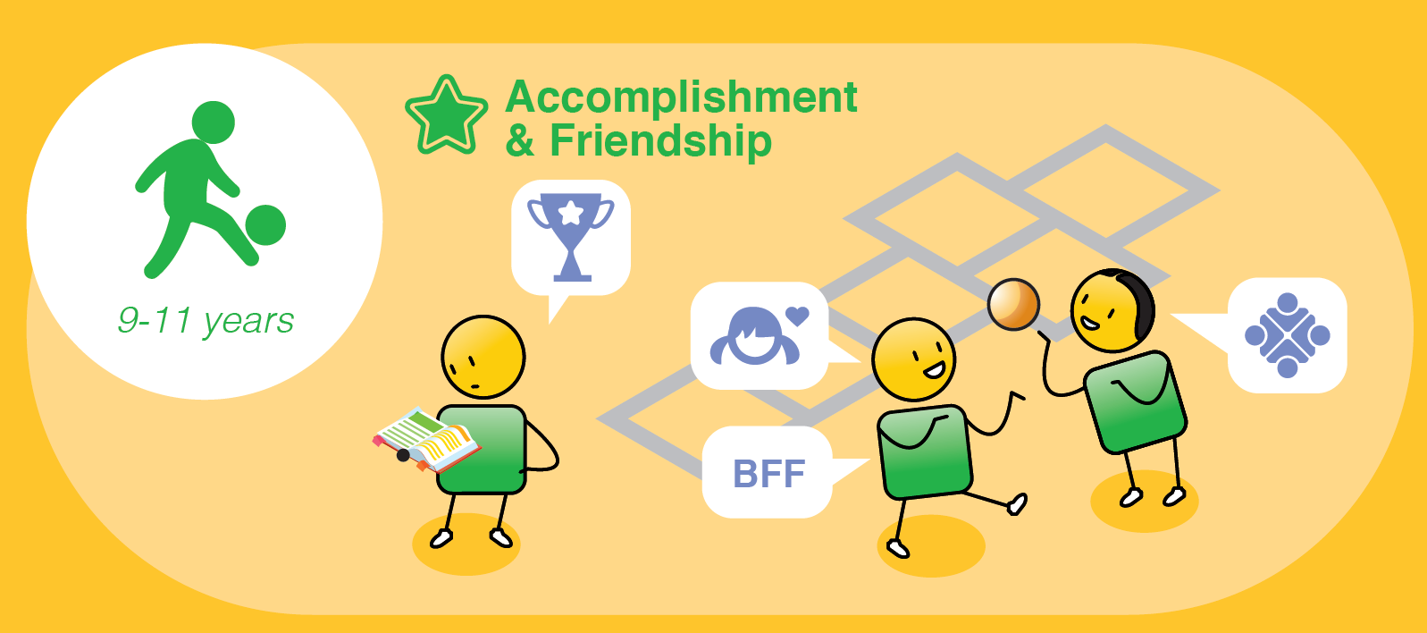
Notes:
From 9 to 11 years, children become more focussed on achievement and building their personal friendships.
They will start to identify ‘best friends’ and even enemies and will want to belong to clubs and social groups.
They will also become sexually aware at this stage and it is important to start to engage with them openly about their bodies and sexuality.

Slide 25
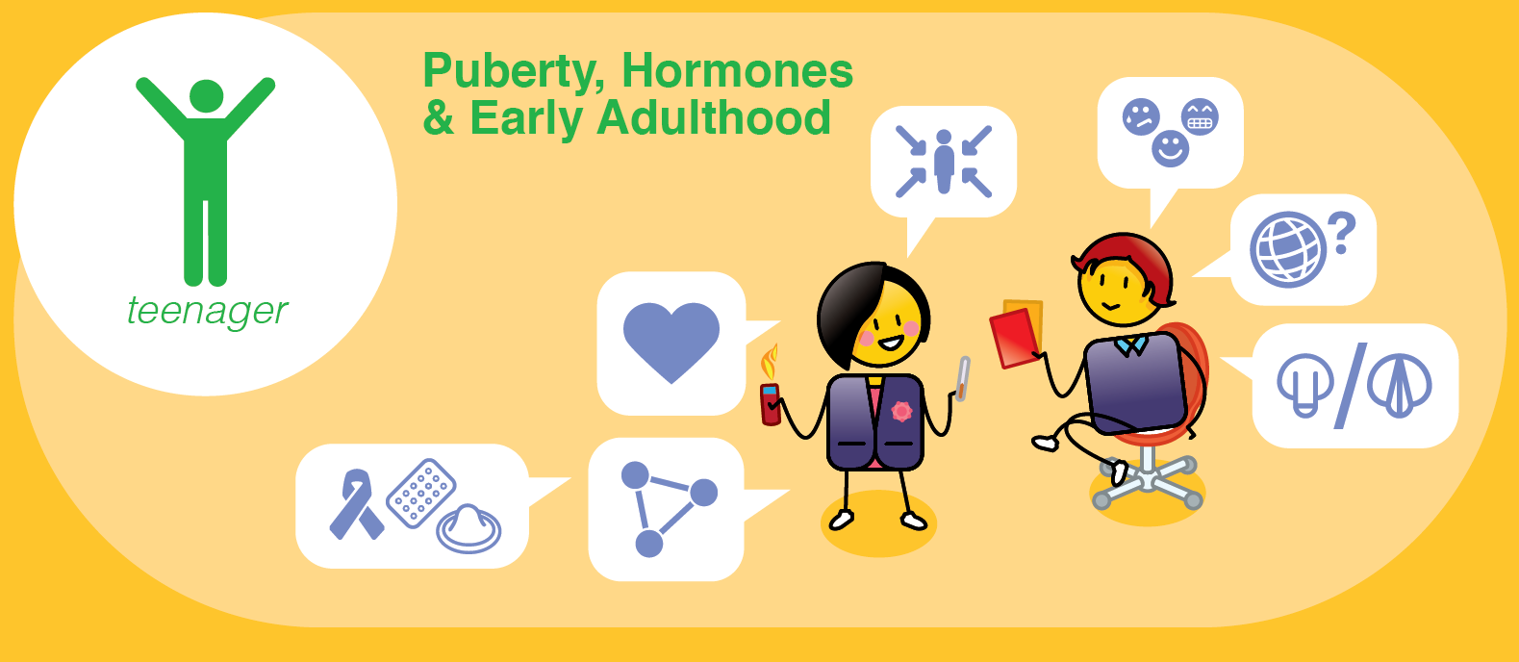
Notes:
From 12 to 18 years, children enter their teenage years, which is typified by puberty, hormones and development into young adults.
They may become sexually active, so it is important to talk to them about sex education, birth control and how to protect themselves from sexually transmitted diseases.
They will start to fall in love, become quite self centred, questions norms and values (especially of their parents or caregivers), and sometimes have dramatic mood swings, this is all completely normal.
They will start to test boundaries and sometimes engage in risky behaviour such as smoking, drinking or taking drugs, often due to peer pressure.
It is important that they know that they can confide in their parents or another family member should they need to throughout their teenage years.

Slide 26
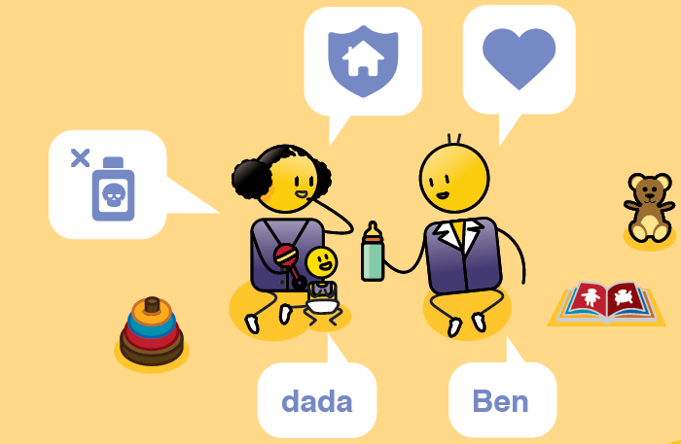

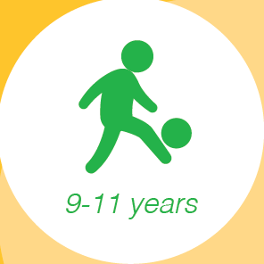

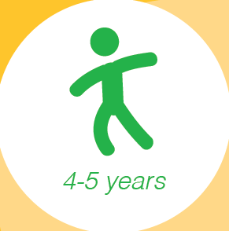
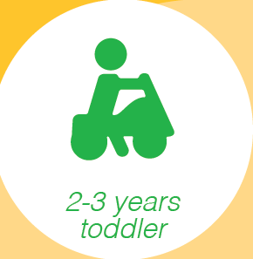
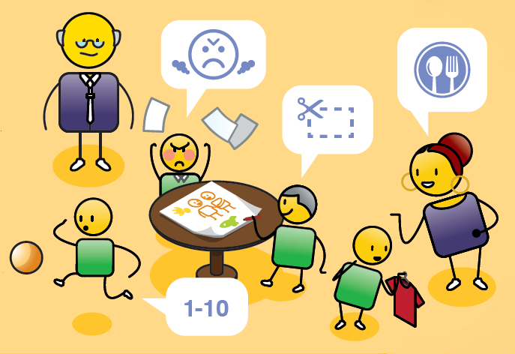

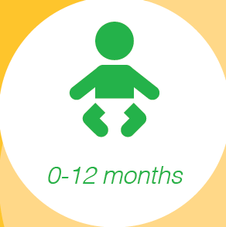
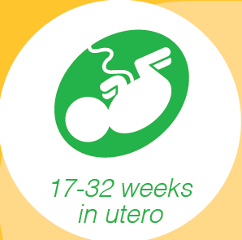
Courageous Parenting
Notes:
For more detailed information about how a child develops physically, mentally, emotionally and socially, see our ‘Courageous Parenting’ presentation which details this and tips for parenting at each stage.

Slide 27
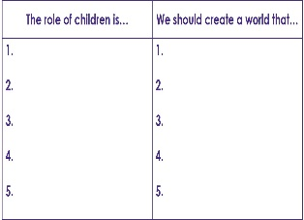
Agree your vision
Let’s agree on what kind of world we would like our children to live in so that we can build this for them?
Notes:
Now that we understand the rights and needs of children, spend some time discussing and agree a positive role for children in your community and the kind of world that you would like to create for them. Then summarise this into a simple vision statement that you can share with your family, community, school or child protection organisation.

Slide 28
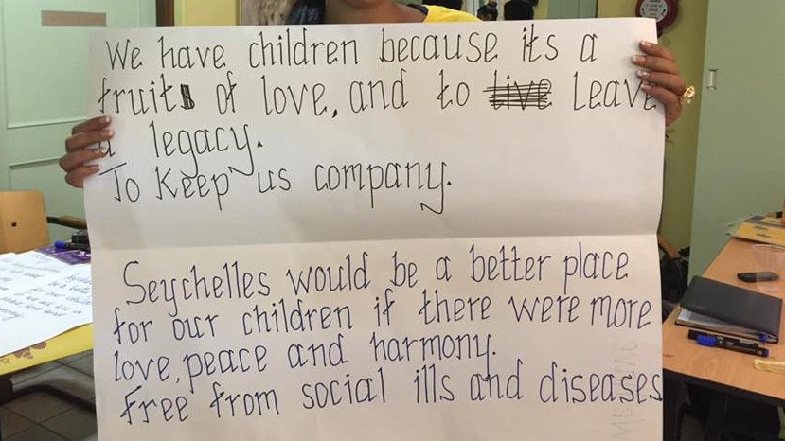
Notes:
This is an example of a community vision that a team developed in one of our workshops.

Slide 29
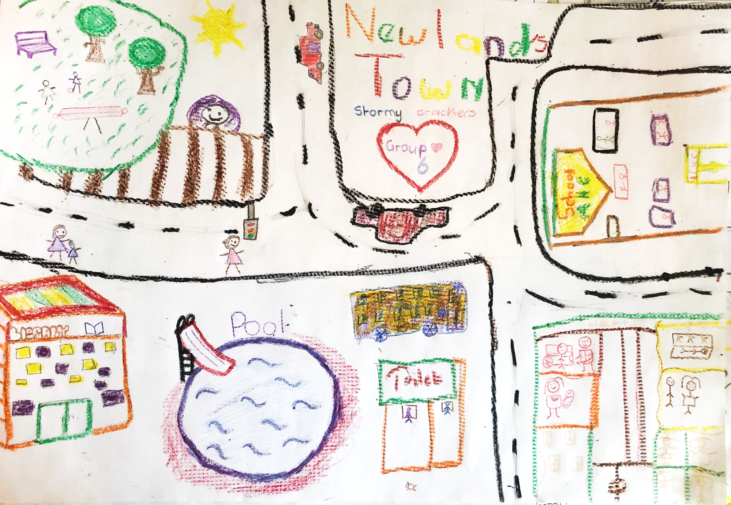
Notes:
In this vision, developed by a group of children, they have drawn and named their ideal community, which is another approach to creating a vision.

Slide 30
No right or wrong visions
leader initiated
positive & inspiring
shared & supported
comprehensive & detailed
Notes:
There are no right or wrong vision statements, but remember…
If you are part of creating the vision, you are also responsible for leading it.
You will need to share it with your community and make sure that they support you.
It needs to be comprehensive and detailed enough that everyone can help in delivering it.
And it must be positive and inspiring to be worth the effort of creating it in the first place..

Slide 31

stay strong
take
www.couragechildprotection.com
Notes:
Thanks for watching.
For more information visit Courage Child Protection dot com
Be sure to like this video and subscribe to our Courage Channel.
Stay strong and take courage.

