Slide 1

Understanding sex, gender and identity terms and icons
www.couragechildprotection.com
Notes:
This Courage video will help you to understand the concepts, terms and icons associated with sex and gender identity. It is important to note that these may change over time and across cultures, but this is a good point of departure.

Slide 2
MERCURY
VENUS
EARTH
MARS
Notes:
Rather strangely, we start with the planets in our very own the solar system, moving out from the sun we have Mercury, Venus, Earth and then Mars.

Slide 3
MERCURY
VENUS
EARTH
MARS
HERMAFRODITE
FEMALE
HOME
MALE
Notes:
In the Ancient Greek Byzantine codex’s written over 1500 years ago, each planet was associated with a Roman or Greek god and an alchemical element. Iron for Mars, the god of war, copper for Venus, the goddess of love, and quicksilver for Mercury, the messenger of the gods, also known as Hermes. Each planet was also assigned a gender, Mars on the right of earth symbolized masculinity, Venus on the left represented the ultimate in femininity and Mercury, was said to have produced a child of both male and female sexes with Venus, who was known as Hermafroditus. The name Hermafrodite came to represent a person or animal who has both male and female sex organs or characteristics, now referred to as intersex.

Slide 4
FEMALE
HYBRID
MALE
Notes:
In the 1700’s Carl Linnaeus developed a botanical encyclopaedia where he used the planetary symbols for Mars, Venus and Mercury, to represent male, female and Hermafrodite or hybrid plants. These symbols have become the icons we use to represent sex and gender in biology, medicine, geneology, sociology and anthropology. They are also icons for LGBTQ culture, gender and identity politics.

Slide 5
FEMALE
INTERSEX
MALE
Notes:
A person's 'sex' refers to their biological status and is usuallly assigned at birth, based on a child’s external anatomy. Sex is typically categorized as male, female or intersex.

Slide 6
INTERSEX
Notes:
Intersex is an umbrella term used to describe people with differences in reproductive anatomy, chromosomes or hormones that don't fit typical definitions of male and female.
Intersex can refer to a spectrum of natural variations that fall outside of the strict male/female binary.
However, being ‘intersex’ is not the same as being nonbinary or transgender as these refer to gender identities rather than biological differences.

Slide 7



FEMALE
NON-BINARY
MALE
Notes:
Gender is a social construct of norms, behaviors and roles that can vary between societies and cultures, over time. Gender is often categorized as male, female or nonbinary.

Slide 8

FEMALE
NON-BINARY
MALE
Notes:
Gender identity refers to a person’s internal sense of self and what they believe their gender to be. People can relate to being a man, a woman, neither or both. Gender identity is not outwardly visible to others, as with gender expression. Some people’s gender identity aligns with the sex they were assigned at birth, however, for other people, their gender identity differs in varying degrees from what they were assigned.

Slide 9
FEMALE
NON-BINARY
MALE
Notes:
Cisgender, or cis, is an adjective that describes a person whose gender identity aligns with the sex they were assigned at birth, and comes from the Latin prefix ‘cis’, meaning "on this side of"

Slide 10
TRANSGENDER
Notes:
Transgender, or trans, is an adjective used to describe someone whose gender identity differs from the sex they were assigned at birth. Trans is the Latin prefix, meaning "across from”. By way of example, a transgender woman, may be listed as male at birth but her gender identity is now female.

Slide 11
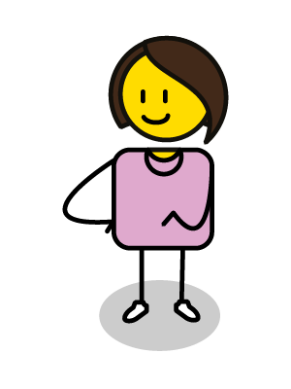
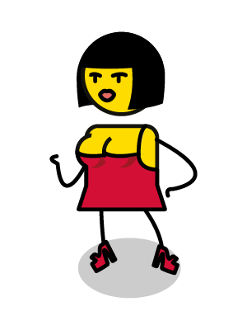
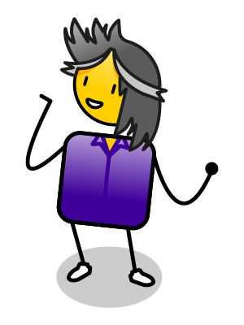
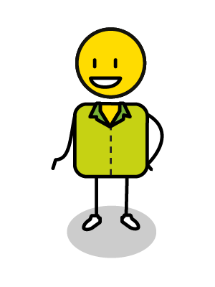
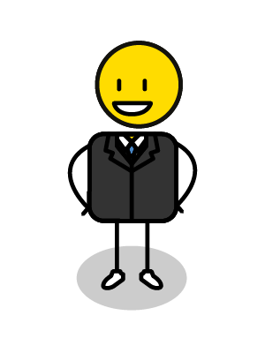
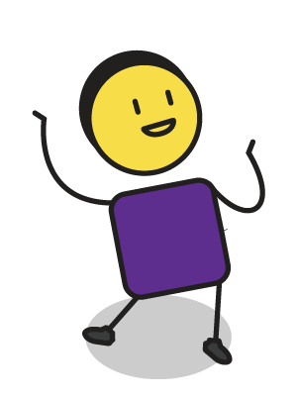
FEMININE
ANDROGYNE
MASCULINE
Notes:
Gender expression is how a person presents their gender outwardly, through their behaviour, clothing, voice or other social characteristics, which can be viewed as feminine, masculine or androgynous, where a person’s gender is unclear. These definitions and perceptions can change over time and across cultures and societies.

Slide 12
NONBINARY OR
GENDER QUEER
Notes:
Some people identify as ‘non-binary’ or ‘genderqueer’ which can be represented by each of these icons and refers to people who do not describe themselves or their genders as fitting into the categories of man or woman.

Slide 13
DEMI
GIRL
DEMI
BOY
Notes:
Gender identities can be fluid as in the case of demi-girls and demi-boys, who are individuals who identify as partially man or women, regardless of their assigned gender at birth, but also fall partly outside the binary of male or female. There are over 70 different gender identity terms used in the world today.

Slide 14
AGENDER
GENDERLESS
NEUTROIS
Notes:
Agender, genderless and neutrois are all terms used to describe a person who does not identify as any gender, they may view themselves as gender neural, or describe themselves as being indifferent towards genders. Some people use the term gender-expansive, which describes a person who is more flexible towards gender identity.

Slide 15
?
?
?
FEMALE
TRANSGENDER
MALE
Notes:
Gender dysphoria refers to the psychological distress that a person feels when their gender identity differs from the sex they were assigned at birth. This is not experienced by all transgender people, and the level of dysphoria and distress can vary from person to person.

Slide 16
TRANSITIONING TO MALE
TRANSITIONING TO FEMALE
Notes:
Gender transitioning is a process a person can take to bring themselves and/or their bodies into alignment with their gender identity. Transitioning can include simply telling one’s family, friends or community, changing your name or pronouns or medical intervention such as hormone therapy or gender confirmation surgery.

Slide 17
TRANSVESTI
Notes:
Transvestism is when any person, who can be asexual, bisexual, heterosexual, or gay, engages in cross-dressing. It is different to transexuals who cross-dress as part of their transitioning process, as Transvestites can be comfortable with their assigned biological sex and associated gender identity and social roles.

Slide 18
LESBIAN
LGBTQ
STRAIGHT
(HETEROSEXUAL)
GAY
LGBTQ
Notes:
Sexual orientation, refers to the physical, romantic and/or emotional attraction to members of the same and/or other genders, including lesbian, gay, bisexual and straight orientations. The term sexual preference is deemed derogatory as it suggest that being gay, lesbian, or bisexual is voluntary and can therefore be changed. It is also important to note that the term “homosexual” is considered offensive by the LGBTQ community, due to its clinical history and use in defining gay men or women as having a disorder in need of remediation.

Slide 19
BISEXUAL
LGBTQ
BISEXUAL
LGBTQ
BISEXUAL
LGBTQ
Notes:
People do not need to have had specific sexual experiences, or relationships, to know their own sexual orientation, or for this to be validated. In fact, they do not need to have had any sexual experience at all.
Sexual orientation is separate from gender identity. Transgender people can be straight, lesbian, gay, bisexual or queer. A person who transitions from male to female and is attracted solely to men would typically identify as a straight woman. A person who transitions from female to male and is attracted solely to men would typically identify as a gay man.

Slide 20
PAN SEXUAL
Notes:
Pansexuality is sexual, romantic, or emotional attraction towards people regardless of their sex or gender identity. Pansexual people may refer to themselves as gender-blind and believe that gender and sex are not determining factors in their romantic or sexual attraction to others.

Slide 21
Hi, my name is Sue, and my pronouns are she and her
I’m Jo and my pronouns are they and them
Hi I’m Tom and my pronouns are he and him
FEMALE
NONBINARY
MALE
Notes:
Everyone has pronouns that are used when referring to them, such as she, her, he, him or they and them. Pronouns are how we identify ourselves apart from our name in sentences and stories. For many people, their pronouns are as important as their name, as they affirm their identity and how they see themselves. As with names, people can choose which pronouns they would prefer to be used when other people are talking about them. The easiest way to ensure that you are not offending anyone, or may be offended by anyone, is to introduce yourself with your name and your preferred pronouns, or to gently inform people who have assumed the incorrect pronouns for your gender identity.

Slide 22
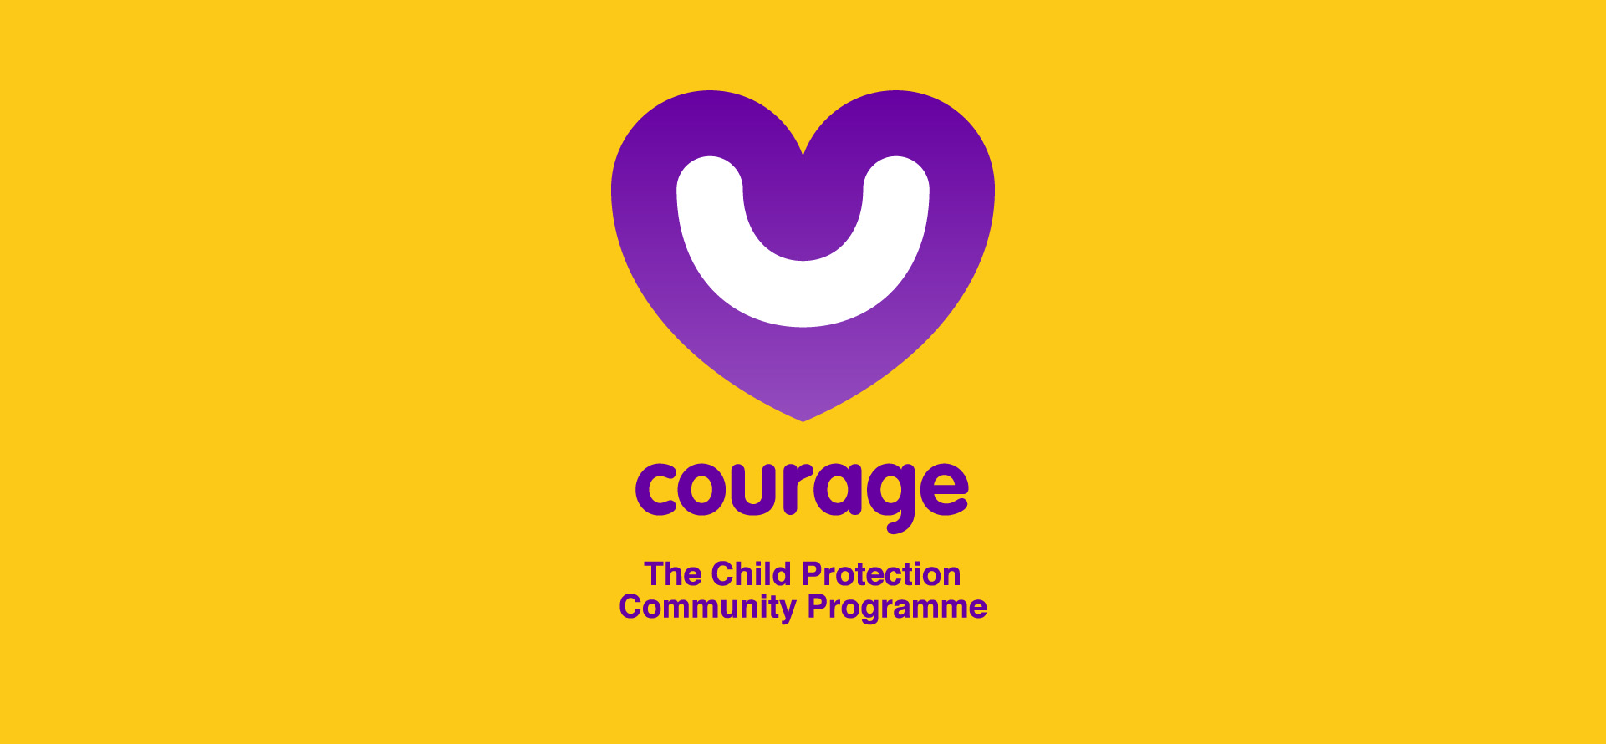
stay strong
take
www.couragechildprotection.com
Notes:
Thanks for watching.
For more information visit Courage Child Protection dot com
Be sure to like this video and subscribe to our Courage Channel.
Stay strong and take courage.

