Slide 1
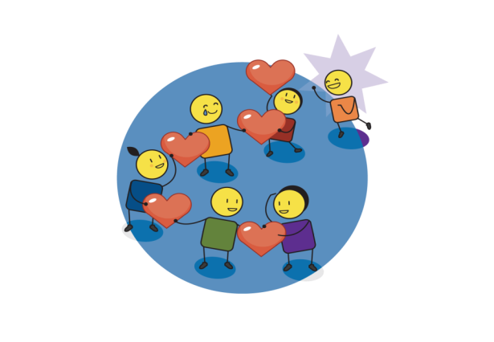


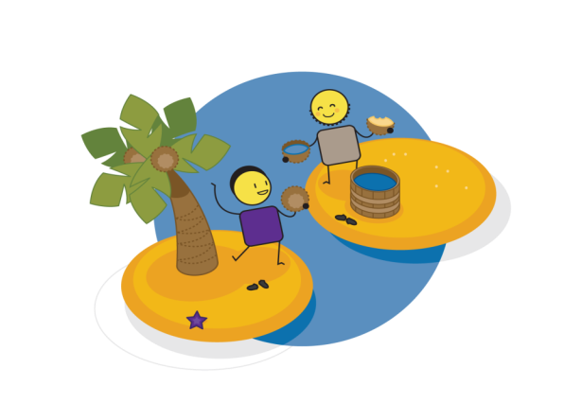
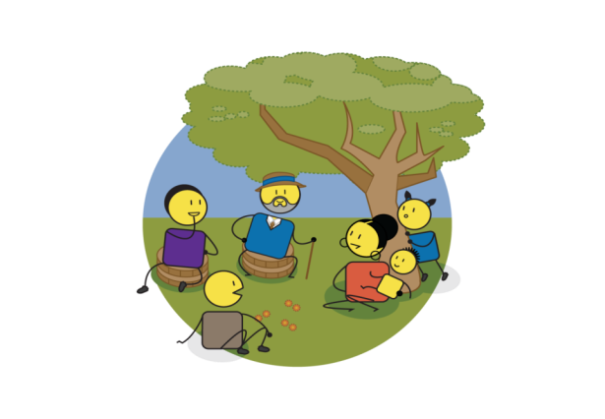

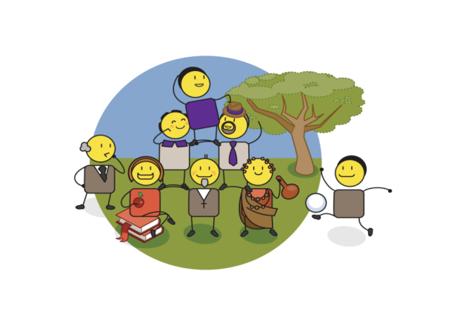

LOVE & HARMONY
SELF ESTEEM
& SELF WORTH
VISION & PURPOSE
MY PERSONAL EMPOWERMENT BOOK
PARTNERSHIP & COLLABORATION
KNOWLEDGE & INSIGHT
VALUES & BELIEFS
PRESENCE
& ACTION
Notes:
This book has been created as a personal workbook for children considered to have a-typical minds.
Its purpose is to explore their world from their perspective.

Slide 2
Creating Personal Empowerment
LOVE &
HARMONY
PRESENCE
& ACTION
HIGH
Unconsciously
Empowered
Consciously Empowered
abundance
KNOWLEDGE & INSIGHT
POSSIBILITY
Unconsciously Disempowered
Consciously Disempowered
scarcity
VISION & PURPOSE
LOW
SELF AWARENESS
HIGH
VALUES & BELIEFS
PARTNERSHIP & COLLABORATION
SELF ESTEEM
& SELF WORTH

Slide 3
Personal ‘IP’ Assessment
Complete the template below, referring specifically to your perceptions of yourself:
7. I strive to live my life in the present moment, ensuring action and personal accountability in all that I do?
0% | 10% | 20% | 30% | 40% | 50% | 60% | 70% | 80% | 90% | 100%
6. I am constantly seeking answers to the questions I encounter every day?
0% | 10% | 20% | 30% | 40% | 50% | 60% | 70% | 80% | 90% | 100%
5. I have defined my personal vision (life purpose) and live this daily with passion and commitment?
0% | 10% | 20% | 30% | 40% | 50% | 60% | 70% | 80% | 90% | 100%
4. I actively manage conflict resolution in my personal and business life to ensure harmony and understanding?
0% | 10% | 20% | 30% | 40% | 50% | 60% | 70% | 80% | 90% | 100%
3. I am confident that I am adding value to the world around me in a unique and meaningful way?
0% | 10% | 20% | 30% | 40% | 50% | 60% | 70% | 80% | 90% | 100%
2. I actively build win/win partnerships/relationships in my personal and business life?
0% | 10% | 20% | 30% | 40% | 50% | 60% | 70% | 80% | 90% | 100%
1. I have defined my own personal value set and live these daily with passion and commitment?
0% | 10% | 20% | 30% | 40% | 50% | 60% | 70% | 80% | 90% | 100%
Start at the bottom and work your way up from 1 to 7.
Circle the % number that you think you have achieved, at this stage in your life, in response to the question asked.

Slide 4
Work ‘IP’ Assessment
Complete the template below, referring specifically to your perceptions of the business:
7. We actively turn our strategies into action, and take personal responsibility for this action across our organisation?
0% | 10% | 20% | 30% | 40% | 50% | 60% | 70% | 80% | 90% | 100%
6. We have a learning organisation that prioritises and supports insight and innovation for future growth?
0% | 10% | 20% | 30% | 40% | 50% | 60% | 70% | 80% | 90% | 100%
5. Everyone in our organisation knows, understands, and lives our vision with passion and commitment?
0% | 10% | 20% | 30% | 40% | 50% | 60% | 70% | 80% | 90% | 100%
4. We are actively managing conflict resolution in our organisation to ensure harmony and understanding?
0% | 10% | 20% | 30% | 40% | 50% | 60% | 70% | 80% | 90% | 100%
3. As a company, we are confidently adding value to the world around us in a unique and meaningful way?
0% | 10% | 20% | 30% | 40% | 50% | 60% | 70% | 80% | 90% | 100%
2. We are building strong win/win partnerships/relationships, both inside and outside of our organisation?
0% | 10% | 20% | 30% | 40% | 50% | 60% | 70% | 80% | 90% | 100%
1. Everyone in our organisation knows, understands and lives our values with passion and commitment?
0% | 10% | 20% | 30% | 40% | 50% | 60% | 70% | 80% | 90% | 100%
Start at the bottom and work your way up from 1 to 7.
Circle the % number that you think your organisation has achieved, at this stage, in response to the question asked.

Slide 5

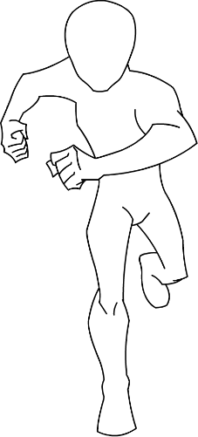
Me as a Superhero
My talents:
My tools:
Superhero Name:____________________________
Notes:
Use the template to draw yourself as a superhero.
Give yourself a superhero name.
Use the blocks provided to describe your superhero talents and tools (you can draw or write these).

Slide 6
Personal Insight
What are the things I am good at? | What are the things I need help with?
What are the things I like to do most? | What are the things I don’t like to do?
Notes:
Fill in this template as honestly as possible. If the child cannot write, this can be a discussion with the facilitator or a creative drawing exercise.

Slide 7

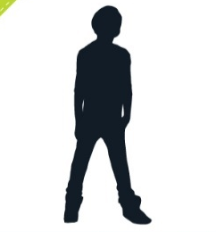


My journey so far?
Notes:
Draw or write the highlights and lowlights in your life so far. You don’t have to remember everything just that things that were important or had an impact on you.

Slide 8
My best vs worst day?
My best day? | My worst day?
Notes:
Describe your best vs your worst day. This can be an actual day or a made up day.

Slide 9





Exploring my emotions? (mind-map)
HAPPY
SAD
ANGRY/CROSS
SCARED/AFRAID
CURIOUS/INTERESTED
EXCITED
Notes:
Explore each of your emotions as a mind map. Ask: What makes you happy? When you feel happy? Who makes you happy? Where do you feel happy in your body? Etc. (for each emotion)

Slide 10





Exploring my emotions? (mind-map)
CALM/CONTENT
EMBARRASSED
ANXIOUS/WORRIED
STRESSED
LOVE/TENDERNESS
?

Slide 11





Exploring my language of love
PHYSICAL TOUCH | LOVE? | GIFT GIVING/RECEIVING
ACTS OF SERVICE | QUALITY TIME | WORDS OF AFFIRMATION

Slide 12
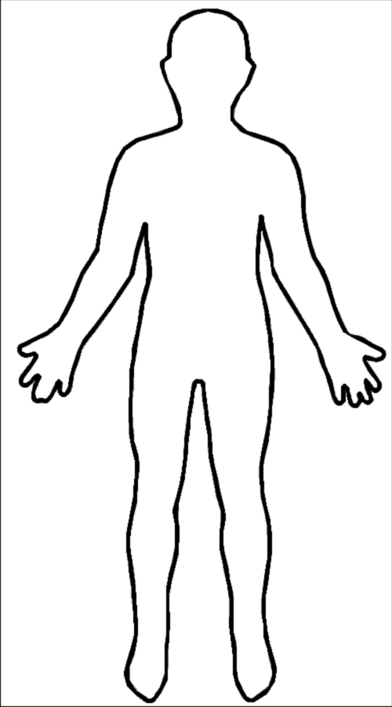
Exploring my body?
Notes:
Draw what you think is happening inside your body when it feels happy and when it feels sad. You don’t have to keep inside the lines if this is not how your body feels. Remember to use colours, shapes and colouring techniques to bring this exercise to life.

Slide 13
How does my brain work?
Notes:
Draw how you think your brain works. You don’t have to draw an actual brain, but rather a picture that describes how you think your brain works.

Slide 14
Important people in my life & how close I am to them?
5.
4.
3.
2.
1.
ME
Notes:
Who are the most important people in your life and how close are you to them? (1 = very close, 5 = not that close)

Slide 15
What is our relationship like?
What do I get from them? |  |  | What do I Get from them?
1. |  | 3. | 1. |  | 3.
2. |  | 2. | 2. |  | 2.
3. |  | 1. | 3. |  | 1.
 |  | What do I give them? |  |  | What do I Give to them?
Me
Me
What do I get from them? |  |  | What do I get from them?
1. |  | 3. | 1. |  | 3.
2. |  | 2. | 2. |  | 2.
3. |  | 1. | 3. |  | 1.
 |  | What do I give to them? |  |  | What do I give to them?
Me
Me
Notes:
Explore your relationship with all of the important people in your life. Think about what you get from them (physically, emotionally, socially) and what you give them (physically, emotionally, socially).

Slide 16
What is our relationship like?
What do I get from them? |  |  | What do I Get from them?
1. |  | 3. | 1. |  | 3.
2. |  | 2. | 2. |  | 2.
3. |  | 1. | 3. |  | 1.
 |  | What do I give them? |  |  | What do I Give to them?
Me
Me
What do I get from them? |  |  | What do I get from them?
1. |  | 3. | 1. |  | 3.
2. |  | 2. | 2. |  | 2.
3. |  | 1. | 3. |  | 1.
 |  | What do I give to them? |  |  | What do I give to them?
Me
Me
Notes:
Explore your relationship with all of the important people in your life. Think about what you get from them (physically, emotionally, socially) and what you give them (physically, emotionally, socially).

Slide 17
My perfect learning environment/school?
Notes:
Design and draw your perfect learning environment. This does not have to be your existing school, but rather a space that you think you learn best in. Try to be as creative as possible.

Slide 18

The tools I need to help me learn/work at school?
Notes:
What are the tools that you use, or think you should use to help you learn and work better at school? These can be strategies, certain kinds of people, medication, diet, really anything that you think helps you learn/work better?

Slide 19
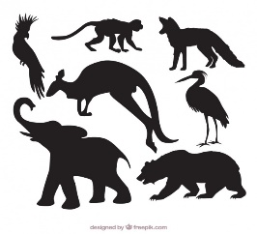


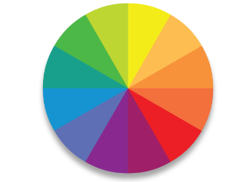

My personal crest?
Animal/Plant?
Shield?
Colour?
Motto or Tagline?
Notes:
Design your own personal crest, like your school crest (explore this if there is confusion). You will need to choose an animal that you think represents who you are and/or who you would like to become. A shield shape, your favourite colour (you can choose more than one) and a motto or tagline that inspires you and who you want to become.

Slide 20
My Future Dream World?
Notes:
Draw a picture or create a collage of your future dream world. This is the world that you would like to create for yourself to live in when you grow up.

Slide 21
My personal vision?
The world would be a better place if…
I am going to help make this happen by…
When people see me they will think…
Notes:
Finish each of these sentences to create your own personal vision.

Slide 22
My personal values?
Teamwork
Happiness
Creativity
Cleanliness
Integrity
Respect
Family
Community
Reliability
Honesty
Love
Commitment
Punctuality
Delivery
Partnership
Possibility
Caring
Notes:
Think about what is most important to you in your life, your values. Values are the things that are most important to you and often guide how you act or behave on a day to day basis. There are a few examples on the page that you can circle, or you can write your own in your own language. Try to pick the 4 or 5 most important values that represent what is most important to you.

Slide 23
My partners who will help me get there?
ME
Notes:
Who are the people that you think will help you achieve your dream world. These may not be the same people that you are close to, but rather the people who can help you achieve your vision for yourself.

Slide 24
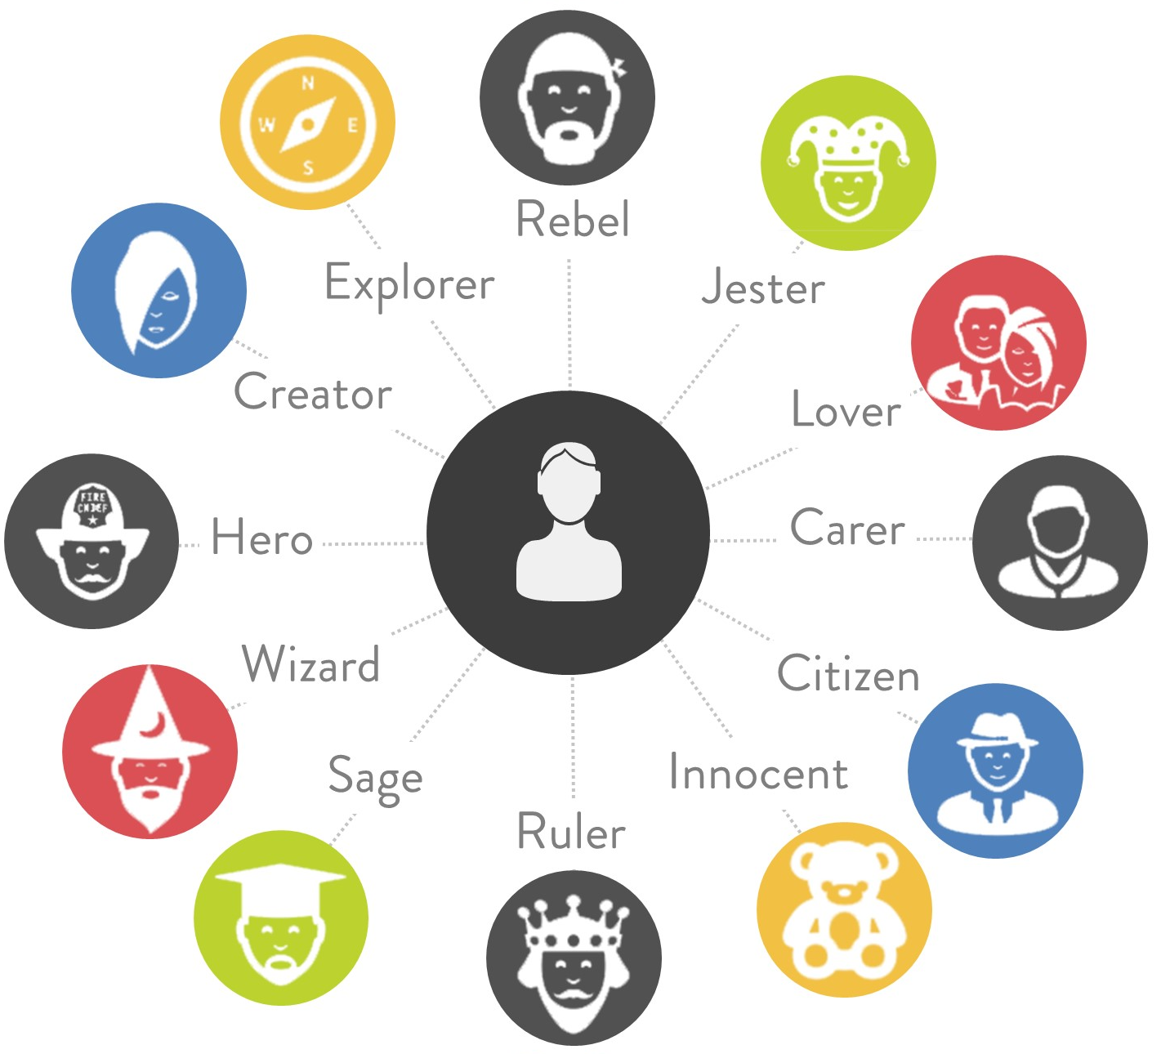
How I see myself?
Notes:
Choose a first, second and possibly a third personality type that you think describes who you are. The first choice is the most important character trait, followed by the second and possibly a third.

Slide 25

What makes me special?
MY SELF ESTEEM
Notes:
Think about this bowl as representing your own self esteem, or how you feel about yourself. Think about all of the things that people say to you that makes you feel special about yourself. Now think about all of the things that people say you that make you feel sad or unhappy about yourself. Remember, if you allow other people to fill your self esteem bowl, you also allow them to empty the bowl! Try to think about all of the things that you think make you special and unique. The things that no-one can take out of your self esteem bowl. Now write these things into the circles above the bowl.

Slide 26
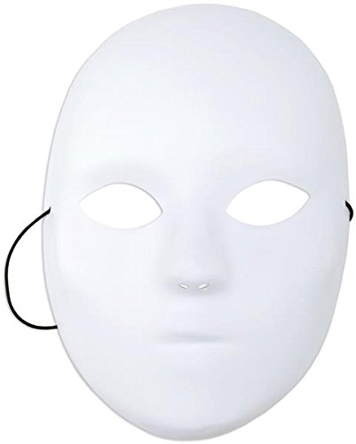
My Tribal Mask?
Notes:
Pretend that you have a tribe that you below to. Create a mask that represents this tribe. Think about the icons, patterns and colours that you would put on this mask to represent yourself and your tribe.

Slide 27
My personal action plan & pledge?
From today I will START | From today I will STOP | From today I will CONTINUE
Signed:____________________________
Date:____________________________
Notes:
Its time to make an action plan. Thinking about all of the things that you have written in this book, what will your action plan be from today. Think about all of the things that you need to start doing to achieve your vision. Now think about all of the things that you are doing at the moment that don’t support your vision or dream for yourself, these are the things that you need to stop doing. Finally, think about the things that you are already doing that support your vision or dream for yourself, these are the things that you need to continue doing. Sign this action plan and put a date on it, to make sure that you follow through on building your own personal vision.

