Slide 1

What is the process of adoption?
www.couragechildprotection.com
Notes:
This Courage Presentation helps you to understand the process of adoption.

Slide 2
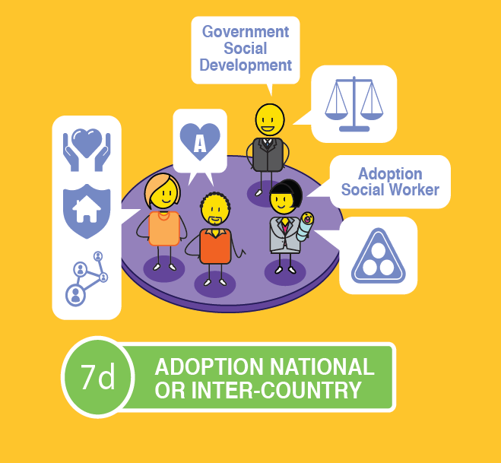

Notes:
The best long-term solution for a child, outside of their own family, is to be placed in a loving, permanent home through the process of adoption.
Courage has outlined the process of adoption in this video, or you can download the relevant poster from our website, Courage Child Protection dot come.
The process may vary slightly from country to country, but this is believed to represent a good standard approach.

Slide 3





Notes:
In the process of adoption there are three important groups of people. The adoptive parents who are wanting to adopt a child, the birth parents who are unable to take care of their child and the child themselves.
A child can be adopted by a couple or by a person on their own as long as they are deemed to be fit and proper parents, will respect the rights of the child, and will take care of the child in totality, from a physical, financial, intellectual emotional, social and moral perspective, until they turn 18 years of age.

Slide 4
Notes:
A child is considered available for adoption if their biological parent or parents sign consent for them to be adopted, if they are orphaned and have no guardian or caregiver willing to take care of them, if the whereabouts of their parent or guardian cannot be established, if they have been abandoned, if they have been deliberately abused, neglected or exploited, or if they are in need of a permanent alternative placement.
The assessment for both the child and parents must be conducted by an accredited adoption social worker and in line with your country's legal system and Children’s Act.

Slide 5
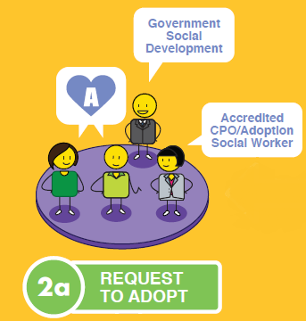

Notes:
The adoptive parent or family need to contact an accredited adoption social worker and complete a formal request to adopt. They will then be subjected to a number of assessments to ensure that they fit the requirements of an adoptive parent, this includes medical, psychological, relationship, financial and home assessments, as well as a police clearance.
During this 'screening' , the parents will also be counselled about the process of adoption to ensure that they are prepared for this life changing decision.

Slide 6
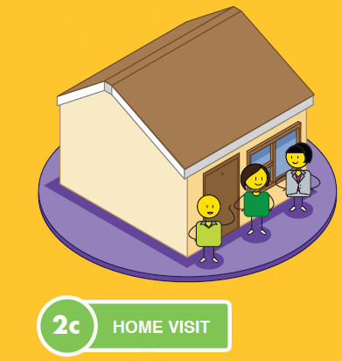


Notes:
Once they and their home environment have been assessed and deemed fit and proper, the adoptive parents will make a formal application to adopt and be placed on your country's registry of adoptable children and parents.

Slide 7





Notes:
For the child, they will need to be assessed for adaptability by an accredited adoption social worker, or legally pronounced abandoned.
If the adoption relates to a mother experiencing a crisis pregnancy, who wishes to place her child up for adoption, the mother should be counselled extensively to ensure that she understands the permanency of the arrangement and what consent will mean.

Slide 8
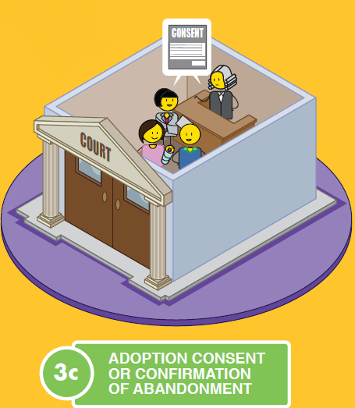
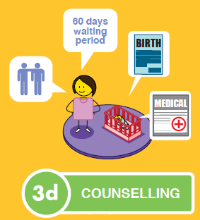
Notes:
The birth mother (and preferably the father as well) will then have to formally rescind their parental rights in a court and consent to the adoption of their child, counselling should continue throughout this process.

Slide 9

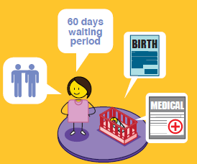
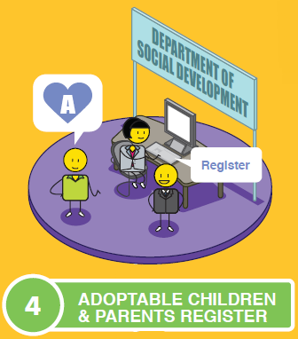

Notes:
Once the child is deemed adoptable, they are also placed on your country's register of adoptable children and parents. There is often a 30 to 60 day waiting period after a parent has signed away their rights to their child, to ensure that they are 100% sure that they want to do this.

Slide 10
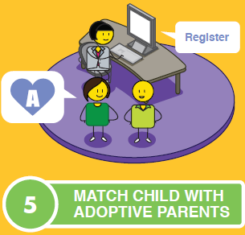




OR
Notes:
The adoptable child is then matched with the ideal parents for them either in their own country, or if no suitable match if found nationally, the social worker may consider international adoption.
All international adoptions are overseen by inter-country agreements as set out by the Hague Convention on International Adoption.

Slide 11
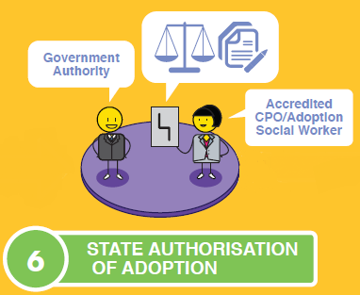

Notes:
Once the child has been appropriately matched with parents, the state or governing body needs to authorise the adoption, and the child is then placed in the care of their adoptive parents.

Slide 12
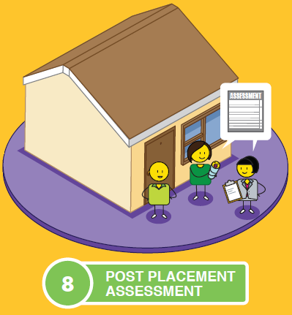
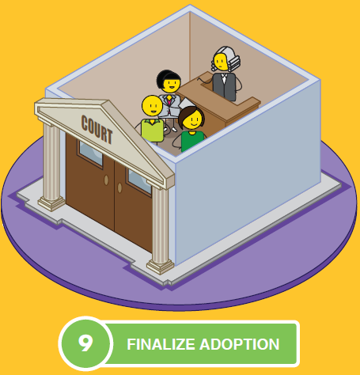
Notes:
There is usually a post placement assessment before the adoption is finalised in court.

Slide 13
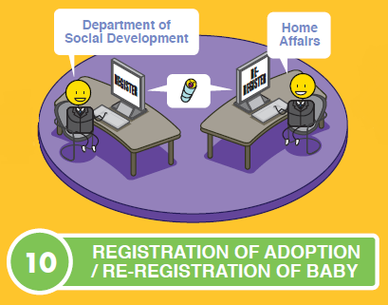





Notes:
The adoption should then be registered by the relevant authority and the child's identity documentation amended to reflect their new adoptive family status.
If the child was adopted by international parents, it is only at this point that they can return to their home country.
Adoption is a wonderful way of creating new permanent families, but it is not all smooth sailing, so it is recommended that adoptive parents seek post adoption support through social workers, counsellors and other adoptive parents or families.

Slide 14
X
Notes:
An adoption may only be rescinded (or cancelled) if it is in the best interests of the child, the biological mother's consent was required but not obtained for the adoption, or the adoptive parent did not qualify to adopt the child in terms of the act that governs the adoption process.
This may only be applied for in a High Court and must be lodged within a reasonable time e.g. in South Africa, this time cannot exceed two years from the date of the adoption.
For more detailed information, please refer to your country's specific Children’s Act that guides your adoption process.

Slide 15

stay strong
take
www.couragechildprotection.com
Notes:
Thanks for watching.
For more information visit Courage Child Protection dot com
Be sure to like this video and subscribe to our Courage Channel.
Stay strong and take courage.

