Slide 1

What should you
do if you find an abandoned child
in your community?
www.couragechildprotection.com
Notes:
This Courage Presentation helps you to understand what you should do if you find an abandoned child in your community.

Slide 2
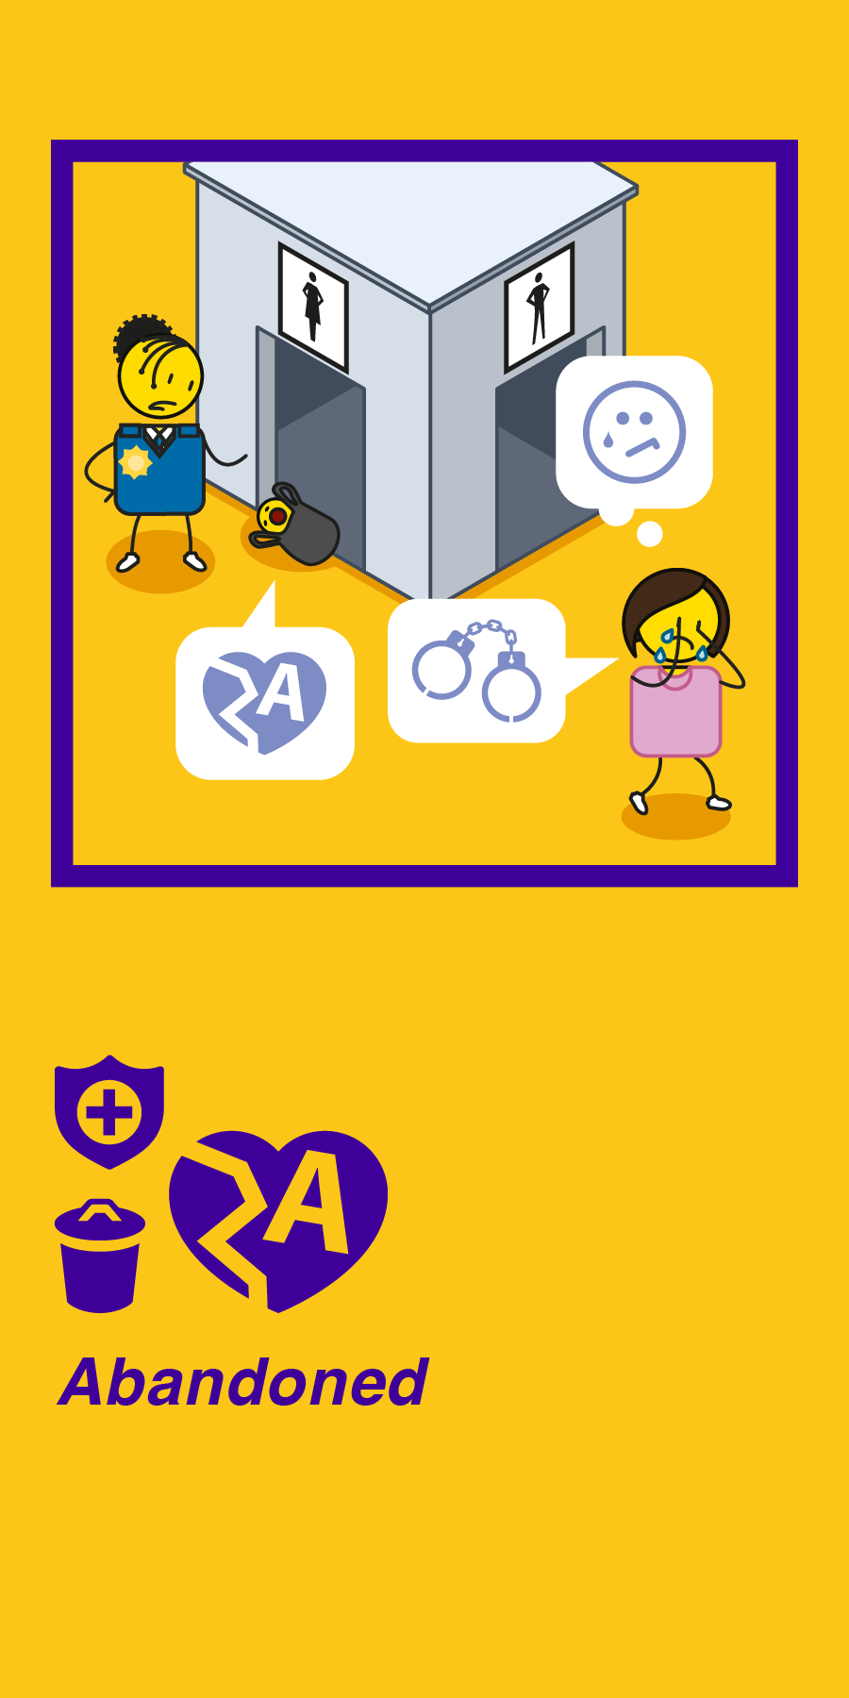
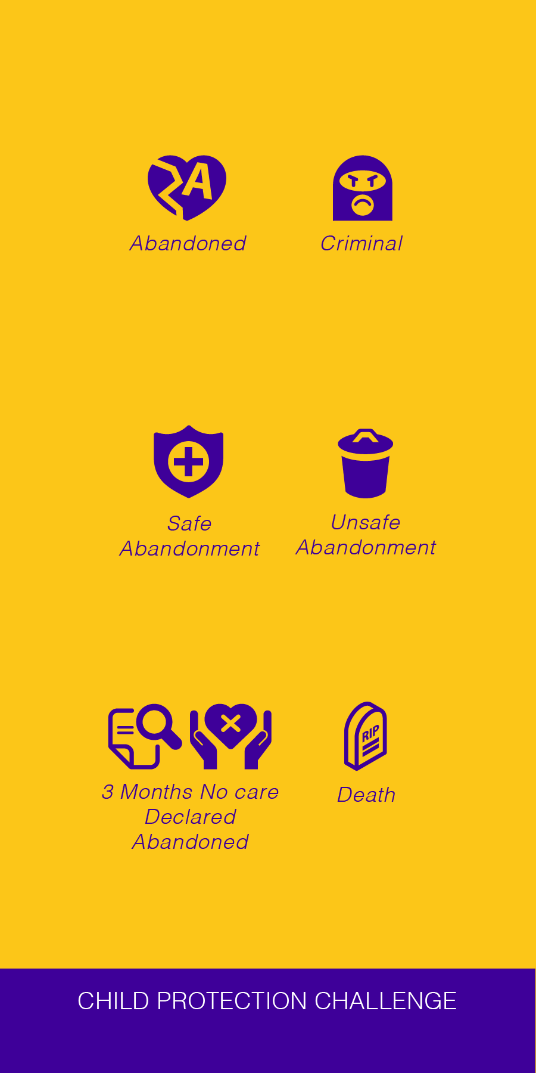
Notes:
Abandonment is when a child has been left by their biological parents or caregivers in a safe or unsafe space for a period of more than three months without any care.
In some countries, child abandonment is a criminal act. Unsafe abandonment can often lead to the death of the child.
There are a number of reasons for child abandonment, these include rapid urbanisation, restrictive legislation specifying who can and who can’t enter a child protection system, poverty, high levels of violence, extreme gender inequality, the HIV/AIDS pandemic and diminishing family support for young women who find themselves experiencing an unplanned or crisis pregnancy.
The process that follows explains what you should do if you find an abandoned child in your community, and how to get them into the child protection system as quickly as possible.

Slide 3
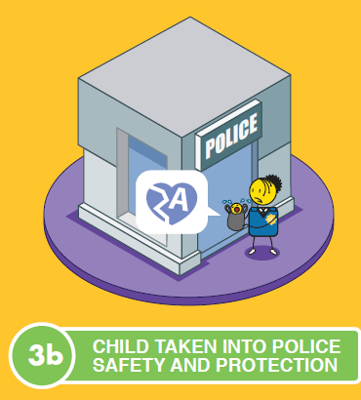

Notes:
If a child is found abandoned, the first step is to contact a recognised child protection officer such as the police, a social worker, a registered child protection organisation or a representative of the Department of Social Development.
They will take custody of the child and place them in the care of a social worker who can manage their case.

Slide 4

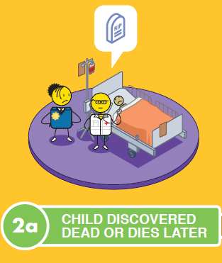


Notes:
Sadly, abandoned children who die, or are found dead, are buried in a municipal grave, with no acknowledgement of their individual personhood.

Slide 5
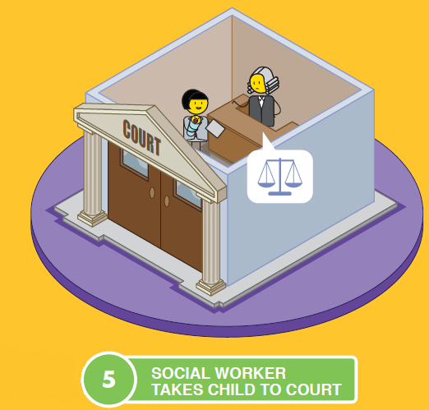
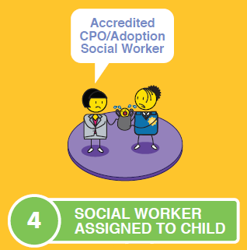
Notes:
The social worker will gain all the legal documentation required to manage the abandoned child from the children’s court.

Slide 6
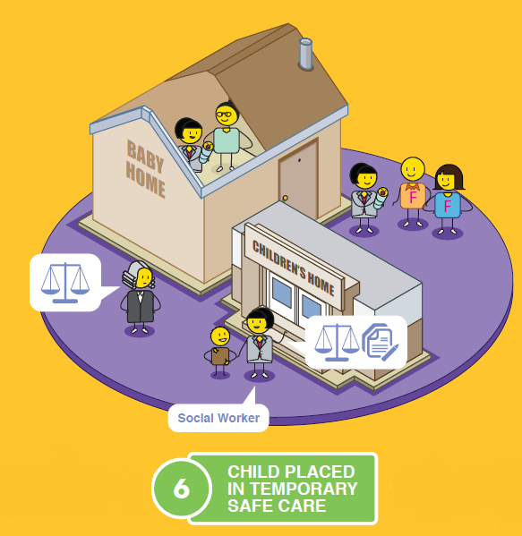
Notes:
This includes putting the child into a place of safety which includes a baby or children’s home or foster care.

Slide 7
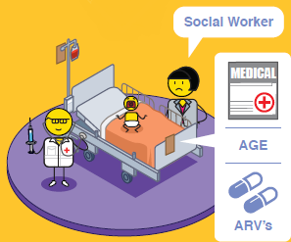


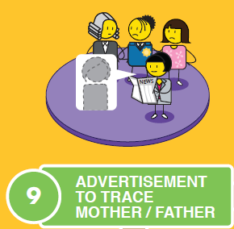

Notes:
Once the child is safe, they will need a medical and age assessment and the administering ARV medication if it is believed that the child may be at risk from exposure to HIV and AIDS at their birth.
The police and social worker then work together to conduct a detailed investigation to try and find the birth parents or extended biological family, this includes advertising for the parents in a local newspaper.

Slide 8
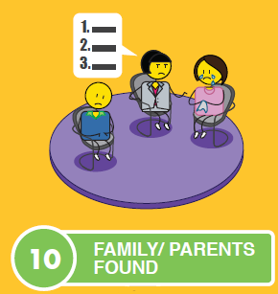
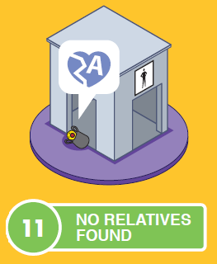
OR
Notes:
If the parents are found, the social worker will need to decide how to proceed. If the child was left in a safe place, such as the hospital or a baby home or safe, and the mother was under extreme stress at the time of the abandonment, they may consider counselling and family reunification over time.
If, however, the child was abandoned in an unsafe place and placed at risk, the police and social worker may consider charging the mother with concealment of birth and even attempted murder, if the mother intended for the child to die.

Slide 9





OR
Notes:
Other options considered include kinship care, foster care and residential care, until a permanent solution can be found for the child such as through the process of adoption.

Slide 10


Notes:
Should the family of an abandoned child be located then reunification will always be considered first. If, however the family or parents do not cooperate with reunification efforts, then adoption can still be considered.

Slide 11

Notes:
Kinship care refers to placing a child into the care of another family member, such as the child’s grandparents or a close relative.
The courts and child protection officers must ensure that these family members are fit to care for the child in question.
This can be done through a formal foster care placement or adoption, or through an informal arrangement between family members.
It is important to note that Kinship care can have a negative impact on older family members as they are expected to take care of young children, well into old age, which can lead to high levels of stress and anxiety.
Financial considerations also need to be taken into account and whether the family member is in a financial position to take on another dependent.
This option does ensure that the child is still connected to their biological family which can support the cultural needs of the child.

Slide 12
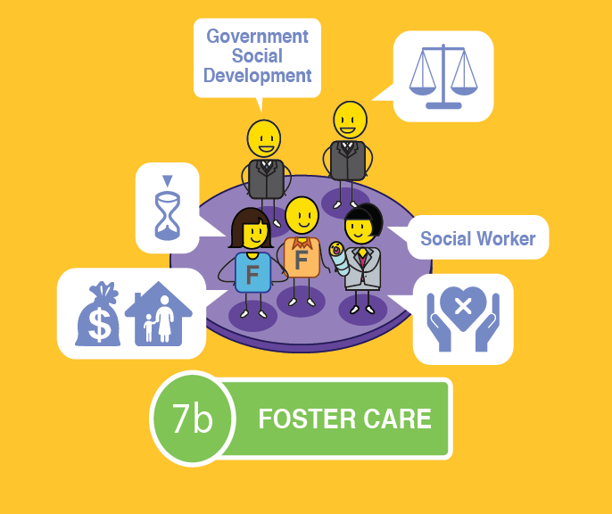
Notes:
Foster care is a temporary child protection solution to give parents or guardians an opportunity to remediate the challenges that led to their child’s abandonment
Foster care is legal, when conducted in accordance with the Children’s Act, and is a good temporary solution for keeping a child safe and secure.
The child can remain in contact with their parents, if they desire this, usually under supervision.
Foster parents are entitled to a foster care grant which they can apply for at their local Department of Social Development.
As it is a temporary solution, however, there are some concerns that need to be raised.
Foster care can never replace a family environment where a child has a sense of permanence and feels like they belong.
The child may struggle with the issue of having an inconsistent carer, they may not be able to bond with a primary care giver and as a result they could feel insecure and struggle with their sense of identity as they grow up.

Slide 13
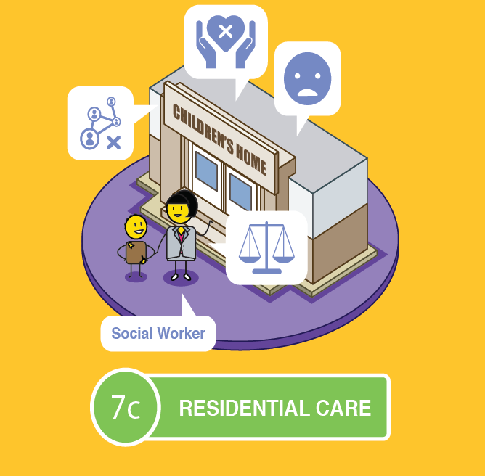
Notes:
Institutional or residential care is when a child is placed in a children’s home, or a group foster care home after going through the necessary process in court.
As with foster care, this option is a temporary child protection solution to give parents or guardians an opportunity to remediate the challenges that led to their child’s abandonment.
The child can remain in contact with their parents if they desire this, usually under supervision.
The home will take full responsibility for the care and education of the child whilst he or she is in their care.
As it is a temporary solution, however, there are some concerns that need to be raised.
As with Foster Care, a children’s home can never replace a family environment where a child has a sense of permanence and feels like they belong.
The child may struggle with the issue of having an inconsistent carer as children’s homes rely on shift workers.
They may not be able to bond with a primary care giver and as a result they could feel insecure and once again struggle with their sense of identity as they grow up.

Slide 14

Notes:
Adoption is believed to be the best long-term solution for a child outside of being cared for by their own family.
It is a legal process that is conducted in accordance with the Children’s Act.
The child would get a new family that has been carefully selected to meet their needs in a stable, permanent and loving home.
Some adoptees struggle with their identity formation due to living with an adopted family, rather than their biological family.
The child may choose to meet their biological parents when they become an adult, but this is at their discretion.

Slide 15

Notes:
If no relatives are found for the child, the social worker will need to obtain identification and registration documentation for the child, including a birth certificate.

Slide 16


Notes:
The child will then be placed on the register of adoptable children and parents. The social worker or child protection organisation will then attempt to match the child with parents through the process of adoption.
For more information on the process of adoption, watch the relevant Courage video or download the process poster at Courage Child Protection dot com

Slide 17

stay strong
take
www.couragechildprotection.com
Notes:
Thanks for watching.
For more information visit Courage Child Protection dot com
Be sure to like this video and subscribe to our Courage Channel.
Stay strong and take courage.

